Slide 1
WELCOME

Slide 2
Meet
THE TEAM
Saad Muhammod Bijoy
ID: 20-41880-1
Khondoker Hozaifa Ibne Shafiq
ID: 20-42883-1
Md. Jidan Rahman
ID: 20-41860-1
Md. Alinur Hossain
ID: 20-41855-1

Slide 3
Table Of Content
Introduction
Ideation process
Use case
User story card
User interface
Activity diagram
Class diagram
Project timeline
Cost estimation
Jira & GIT

Slide 4
Introduction
Every great software starts with a plan and a clear process.
Software development works into different phases containing activities with the intent of better planning and management. It may include some pre-definition of specific deliverables that are created and completed by a project team.
Software product development is a highly organized process with precise procedures and strictly defined steps.
To make a perfect software, there are some rules to practice to connection between tech and non-tech members, project stakeholders to transform the exceptional idea into a unique software product or solution.

Slide 5
IDEATION
PROCESS

Slide 6
Ideation is a collaborative process with the client that requires us to
create a relationship between the following:
Idea Generation (human intuition and creativity),
Technology (technology selection and implementation),
Market Potential (research and analytics).
“Big ideas come from forward thinking people who challenge the norm,
think outside the box, and invent the world they see inside rather than submitting to the limitations of current dilemmas.”
- T. D. Jakes

Slide 7
To imagine how the product will look and feel, and how the people will relate with it now and in the future, first we have to
understand how the product works. For understanding the product we try to look at the following fundamentals within the
ideation process:
What is it that we are creating?
What informed observations, business intelligence and/or customer knowledge serve as motivation to development ?
What primary set of tasks should be performed?
What set of problems need to be solved?
How the people will interact with the solution?
What new casualties are created after the product is launched?
Outcomes of ideation process:
View of the entire project.
Development Methodology(Agile/Scrum).
Technology Selection

Slide 8
USE
CASE

Slide 9
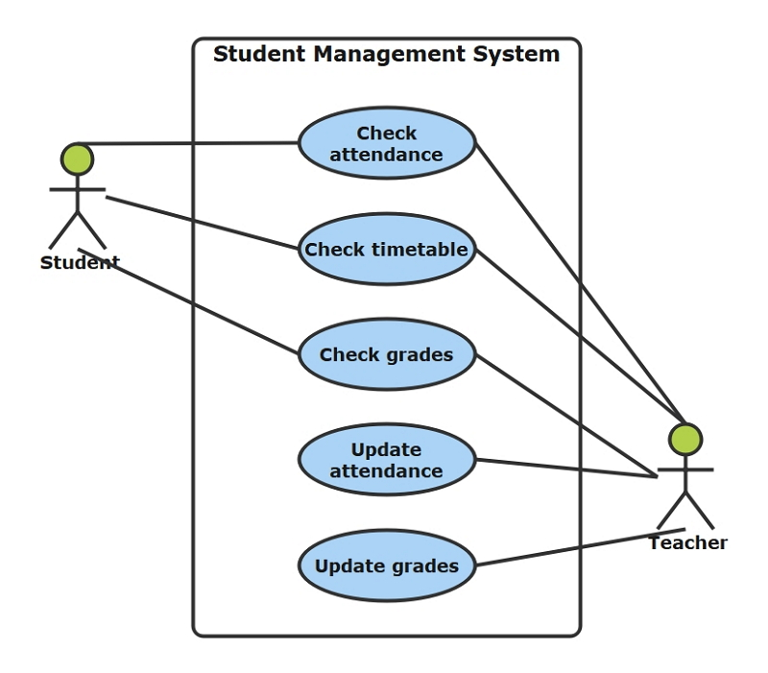
What is a Use Case diagram??
A use case diagram is a graphical depiction of a user's possible interactions with a system. A use case diagram shows various use cases and different types of users the system has and will often be accompanied by other types of diagrams as well.
Usage Of Use Case diagram:
To visualize, specify, construct, and document the (intended) behavior of the system.
Provide a way to communicate.
Reflects the relationships between the use cases and the actors.
Outside view of a system.

Slide 10
USER STORY
CARD

Slide 11
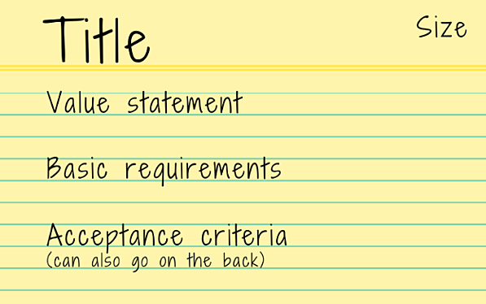
What is a User Story Card??
Story Card describes a desired feature of the software project in story form—a sentence or two from the customer’s perspective.
Why use user story Card??
Reflects the requirements of the customer.
Save time for the developers.
Provides essence for the developers to prioritize.

Slide 12
USER
INTERFACE

Slide 13
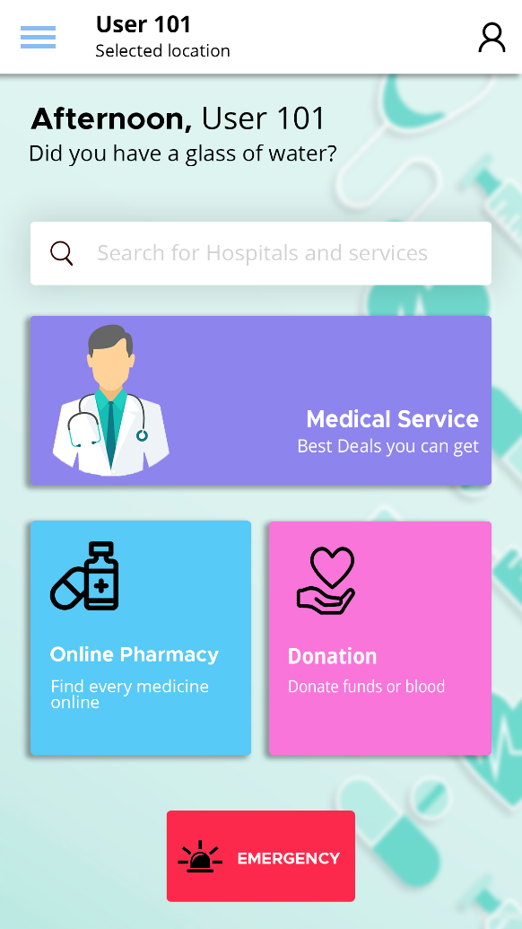
What is a User Interface Designing??
User interface (UI) design is the process designers use to build interfaces in software or computerized devices, focusing on looks or style.
Designers aim to create interfaces which users find easy to use and pleasurable.
Formats of Designing UI:
Graphical User Interface(GUI): Computer’s Desktop.
Voice-controlled Interface(VUI): Siri on iPhone.
Gesture based Interface : VR (Virtual Reality) games.

Slide 14
ACTIVITY
DIAGRAM

Slide 15
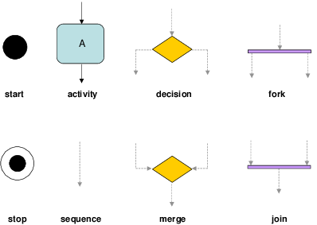
What is a Activity Diagram??
Activity diagram describes the dynamic aspects of the system. Activity diagram is basically a flowchart to represent the flow from one activity to another activity. The activity can be described as an operation of the system.
Usage Of Activity diagram:
Dynamic modelling of the system or a process.
Illustrate the various steps involved in a UML use case.
Model software elements like methods ,operations and functions.
We can use Activity diagrams to depict concurrent activities easily.
Show the constraints, conditions and logic behind algorithms.

Slide 16
CLASS
DIAGRAM

Slide 17
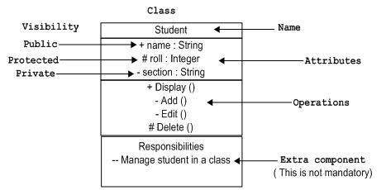
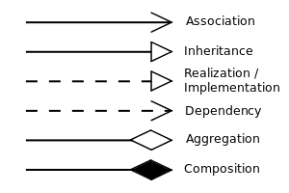
What is a Class Diagram??
A class diagram is a diagram used in designing and modeling software to describe classes and their relationships. Class diagrams enable us to model software in a high level of abstraction and without having to look at the source code.
Relation Between Classes
Usage Of Class diagram:
To describe the static view of a system.
To show the collaboration among every instance in the static view.
To describe the functionalities performed by the system.
To construct the software application using object-oriented languages.

Slide 18
Project
Timeline

Slide 19
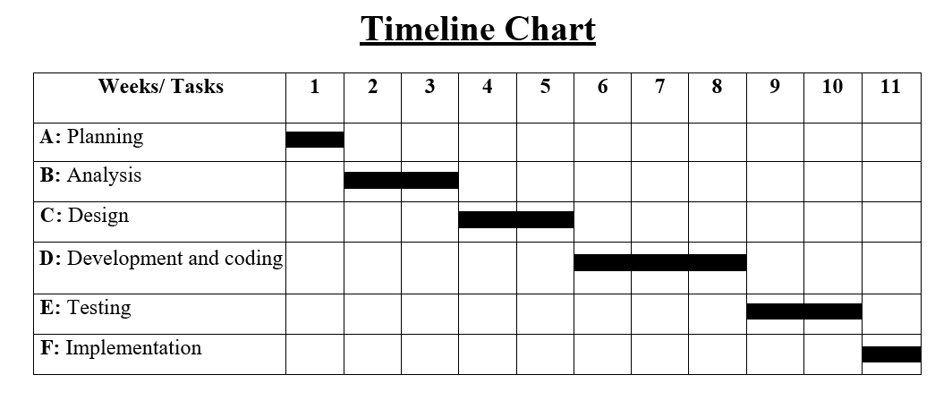
What is a Project Timeline??
A project timeline is a visual list of tasks or activities placed in chronological order, which lets project managers view the entirety of the project in one place.
Usage Of Project Timeline:
Organize the tasks
Show when in the project the tasks start
View task deadlines
Link dependent tasks
Break the project into phases
Identify team members assigned to a task

Slide 20
COST
ESTIMATION

Slide 21
What is Cost Estimation??
Cost estimation is the approach which considers different sectors and calculates a budget that meets the financial commitment for the project.
Need of Cost estimation:
Define the scope of work to be done and the time and human effort needed.
Allows understanding what in a project creates the costs and prioritizing tasks more effectively.
Gives clarity to both the development team and the client, helping to define and agree on milestones.

Slide 22
JIRA
& GIT

Slide 23
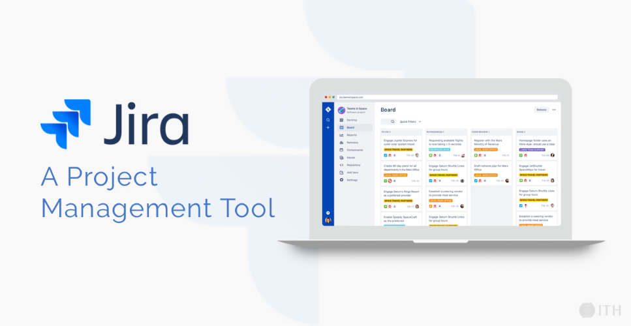
What is JIRA??
Using JIRA on demand as our incident management tool. It provides bug tracking, issue tracking and project management functions.
JIRA has 3 concepts:
Issue : Depending on how an organization is using JIRA, an issue
could represent a software bug, a project task, a helpdesk etc.
Project : A JIRA project is a collection of issues, and is defined
according to your organization's requirements. For example, a
JIRA project could be:
a software development project
a marketing campaign
a helpdesk system
a leave request management system
a website enhancement request system
Workflow : Workflow is the movement of an issue through various Statuses
during its lifecycle.

Slide 24
What is Git??
Mostly commonly used version control system which is developed by Linus Torvalds in 2005.
Tracks every changes of file and have records of it.
Option for rolling back to any previous version or state of a project.
Makes collaboration easier.
Concepts
Snapshots
Commit
Repositories
Braces
Merging
GitHub
www.github.com is a site for online storage of Git repositories
We can create a “remote repo” there and push code to it
It allows for code collaboration with anyone online

Slide 25
Conclusion
Ideation process is one of the most important phases. Here developers have to collaborate with the client to improve the development system.
Use case, user interface, activity diagram, class diagram should be made because it guides the developer to make the project easily.
User story card is mostly needed because it reflects the requirements of the customer and it also saves the time for the developers.
Via project timeline, developers can easily divide their works between them and cost estimation calculates the required budget that meets the financial commitment for the project.
Using JIRA, every work can be managed easily. Also, GIT is used to track the changes made into the file or project.

Slide 26



