Slide 1


Final Year Project
Ez-Transit
Supervised By: Mr. Sadaqat Ali (Lecturer)

Slide 2
Project Team
Ali Rayyan (25858)
Abdur Rahman Farooqi (25435)

Slide 3
Table of Content
Opportunity & Stakeholders
Solution
Progress Report Summary
Requirements
Software System (Design + Implementation + Testing)
Endeavour (Team + Work + Way of Working)
Next Steps
Prototype / Report

Slide 4
Opportunity & Stakeholders

Slide 5
Opportunity
Large number of people use Metro bus on daily bases which makes platforms crowded. Metro Islamabad transports an estimated 135,000 passengers.
Being one of those commuter gave us opportunity to develop a solution to skip long queues to buy tickets which will save time for commuters.

Slide 6
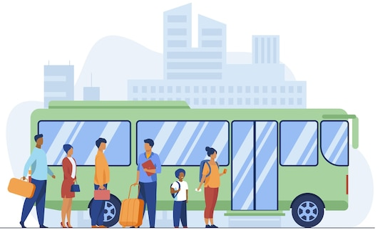
Stakeholders
Commuters:
The primary users who rely on Metro bus for travelling on daily or occasional bases.

Slide 7

Stakeholders
Administrator:
The team responsible for overseeing the entire system, including Metro routes, stations and user feedback/complaints.

Slide 8
Solution
Ez-Transit is a comprehensive solution designed to address the challenges faced by Metro Bus commuters in Islamabad and Rawalpindi.
This innovative platform aims to enhance the overall commuting experience by providing quick and efficient access to route planning, digital ticketing, and wallet management.
By minimizing delays and streamlining the ticketing process, Ez-Transit ensures a more convenient and hassle-free journey for daily commuters.

Slide 9
PROGRESS REPORT Summary

Slide 10
Requirements
Elicitation Techniques
Interview
Interviews with stakeholders such as daily commuters and Metro Bus management to gather detailed insights into their needs and challenges.
Surveys and Questionnaires
Distribute surveys to a wide audience of commuters to collect quantitative data on their experiences, preferences, and pain points.

Slide 11
Requirements
Elicitation Techniques
Observation
Observe commuter behavior at Metro Bus stations during peak and off-peak hours to identify common issues and bottlenecks.

Slide 12
Requirements
Elicitation Tools
Google Forms
Figma
Canva
Whatsapp

Slide 13
Requirements
List of Different Users
Metro Bus Commuter
Admin

Slide 14
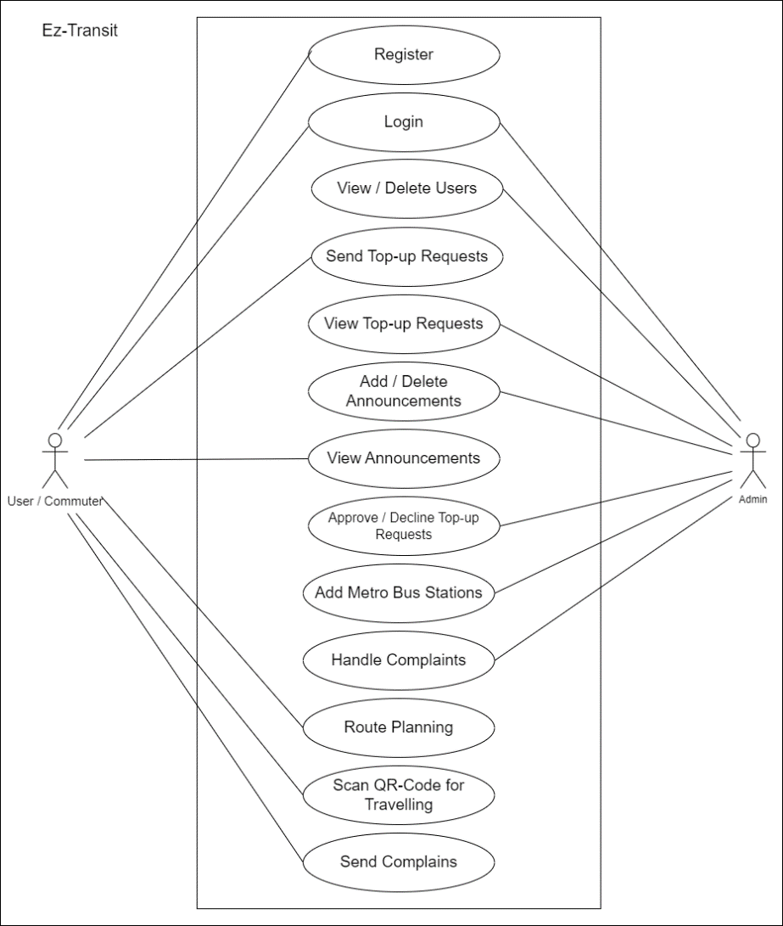
Requirements
Use Case Diagram

Slide 15
Requirements
Functional Requirements
Module | S. No | Functional Requirement | Status
ADMIN | 1 | Admin can login into the system. | Done
 | 2 | Admin can view and delete registered users. | Done
 | 3 | Admin can add and delete announcements. | Done
 | 4 | Admin can view top-up requests. | Done
 | 5 | Admin can approve or decline top-up requests.
 | 6 | Admin can add Metro Bus stations.
 | 7 | Admin can handle Metro Bus cards requests.
 | 8 | Admin can handle complains.

Slide 16
Requirements
Functional Requirements
Module | S. No | Functional Requirement | Status
USER / COMMUTER | 9 | User can register into mobile application. | Done
 | 10 | User can login to the mobile application. | Done
 | 11 | User can send top-up request. | Done
 | 12 | User can view announcements. | Done
 | 13 | User can plan route for travelling.
 | 14 | User can scan QR-Code for travelling.
 | 15 | User can view travel history.
 | 16 | User can send complains.
 | 17 | User can order Metro Bus card.

Slide 17
IMPLEMENTATION

Slide 18
Implementation
Development Tools :
Visual Studio Code
Git
Github
Canva
Figma

Slide 19
Implementation
Development Technologies :
React Native
React.js
Node.js
Express.js
Mongo DB

Slide 20
Implementation
Best Practices / Coding Standards :
Code Readability
Modular Code
Consistent Coding Style
Version Control
Security
Scalability

Slide 21
Implementation
Libraries / Components / Web Services
React Native
React.js
Node.js
UI Components
Axios

Slide 22
Endeavour

Slide 23
Endeavour
Roles of team members
Member | Roles
Ali Rayyan, Abdur Rahman | Documentation
Ali Rayyan, Abdur Rahman | Requirement Analysis
Ali Rayyan, Abdur Rahman | System Design
Ali Rayyan | Frontend
Ali Rayyan | Backend
Abdur Rahman | Testing

Slide 24
Endeavour
Software development process
Requirements Gathering
Planning
Design
Implementation
Testing

Slide 25
Endeavour
Way of working as a team
Whatsapp
Physical Meetings in University
Meeting with supervisor
Zoom Meeting

Slide 26
Prototype & Report

Slide 27
Report
Chapter 1: Introduction
Chapter 2: Literature / Market Survey
Chapter 3: Requirement Analysis
Chapter 4: System Design
Chapter 5: Implementation
Chapter 6: Testing & Evaluations
Chapter 7: Conclusion & Outlook

