Slide 1
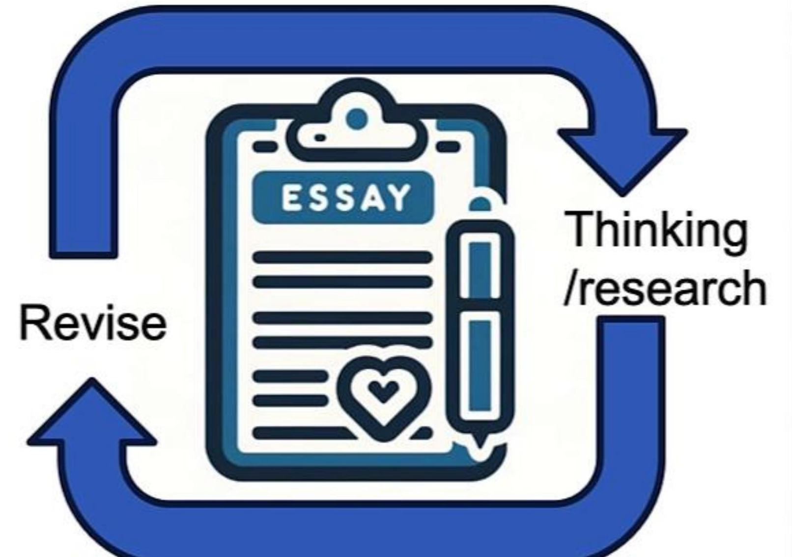
Agentic AI
Non- agentic workflow (zero- shot):
Agentic workflow:
Please type out an essay on topic X from start to finish in one go, without using backspace.
Write an essay outline on topic X
Do you need any web research?
Write a first draft.
Consider what parts need revision or more research.
Revise your draft.
...

Slide 2
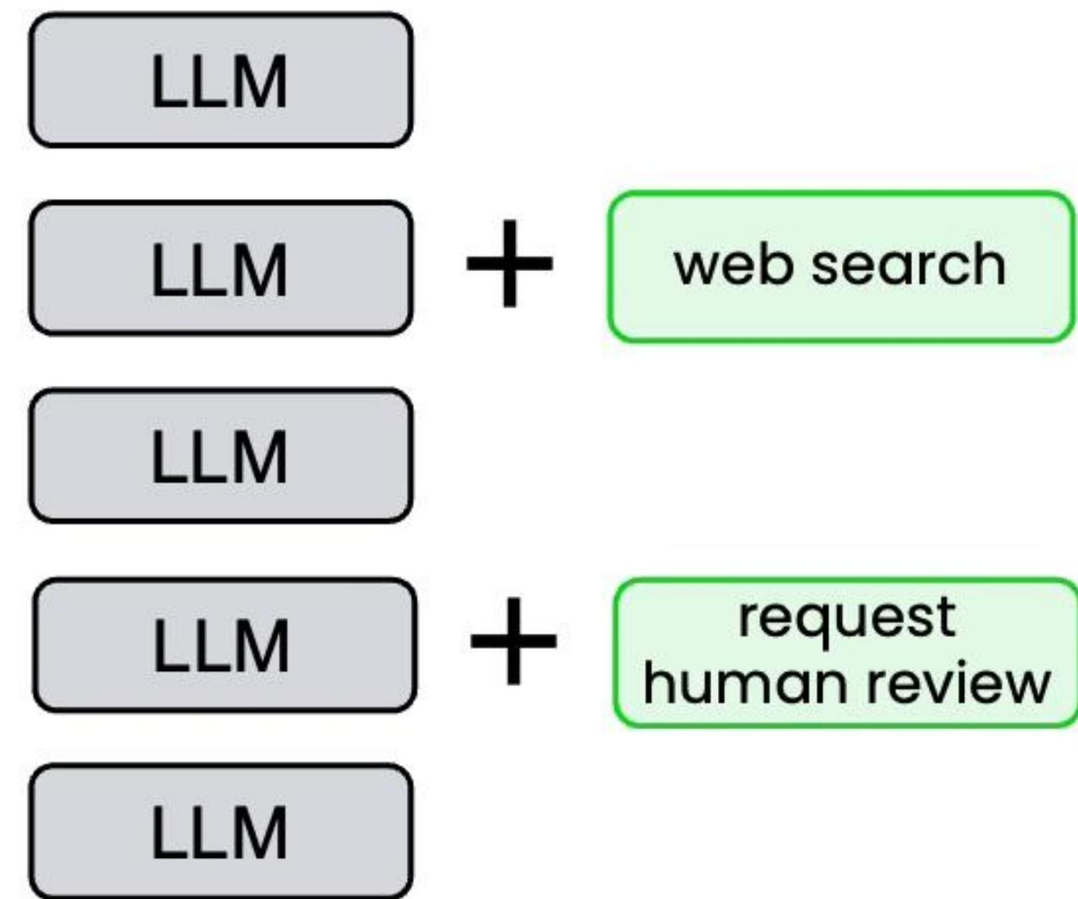
Agentic AI workflows
An agentic AI workflow is a process where an LLM- based app executes multiple steps to complete a task.
Essay- writing example:
Write an essay outline on topic X
Do you need any web research?
Write a first draft.
Consider what parts need revision or more research.
Revise your draft.

