Slide 1
Lectures 2: Introduction to SQL

Slide 2
SQL introduction & schema definitions
Lecture 2
Today’s Lecture
Basic single-table queries
ACTIVITY: Single-table queries!
Multi-table queries
ACTIVITY: Multi-table queries!

Slide 3
2. Single-table queries
Lecture 2 > Section 2

Slide 4
What you will learn about in this section
Lecture 2 > Section 2
The SFW query
Other useful operators: LIKE, DISTINCT, ORDER BY
ACTIVITY: Single-table queries

Slide 5
SQL Query
Lecture 2 > Section 2 > SFW
Basic form (there are many many more bells and whistles)
SELECT <attributes> FROM <one or more relations> WHERE <conditions>
Call this a SFW query.
Notes:
SWF: Select/From/Where

Slide 6
Simple SQL Query: Selection
Lecture 2 > Section 2 > SFW
PName | Price | Category | Manufacturer
Gizmo | $19.99 | Gadgets | GizmoWorks
Powergizmo | $29.99 | Gadgets | GizmoWorks
SingleTouch | $149.99 | Photography | Canon
MultiTouch | $203.99 | Household | Hitachi
Selection is the operation of filtering a relation’s tuples on some condition
SELECT * FROM Product WHERE Category = ‘Gadgets’
PName | Price | Category | Manufacturer
Gizmo | $19.99 | Gadgets | GizmoWorks
Powergizmo | $29.99 | Gadgets | GizmoWorks

Slide 7
Simple SQL Query: Projection
Lecture 2 > Section 2 > SFW
Product
PName | Price | Category | Manufacturer
Gizmo | $19.99 | Gadgets | GizmoWorks
Powergizmo | $29.99 | Gadgets | GizmoWorks
SingleTouch | $149.99 | Photography | Canon
MultiTouch | $203.99 | Household | Hitachi
Projection is the operation of producing an output table with tuples that have a subset of their prior attributes
SELECT Pname, Price, Manufacturer FROM Product WHERE Category = ‘Gadgets’
PName | Price | Manufacturer
Gizmo | $19.99 | GizmoWorks
Powergizmo | $29.99 | GizmoWorks
Notes:
operation :عمل

Slide 8
Notation
Lecture 2 > Section 2 > SFW
Input schema
Product(PName, Price, Category, Manfacturer)
SELECT Pname, Price, Manufacturer FROM Product WHERE Category = ‘Gadgets’
Output schema
Answer(PName, Price, Manfacturer)

Slide 9
A Few Details
Lecture 2 > Section 2 > SFW
SQL commands are case insensitive:
Same: SELECT, Select, select
Same: Product, product
Values are not:
Different: ‘Seattle’, ‘seattle’
Use single quotes for constants:
‘abc’ - yes
“abc” - no

Slide 10
DISTINCT: Eliminating Duplicates
Lecture 2 > Section 2 > Other operators
Product
PName | Price | Category | Manufacturer
Gizmo | $19.99 | Gadgets | GizmoWorks
Powergizmo | $29.99 | Gadgets | GizmoWorks
SingleTouch | $149.99 | Photography | Canon
MultiTouch | $203.99 | Household | Hitachi
Category
Gadgets
Photography
Household
SELECT DISTINCT Category
FROM Product
Versus
Category
Gadgets
Gadgets
Photography
Household
SELECT Category
FROM Product

Slide 11
LIKE: Simple String Pattern Matching
Lecture 2 > Section 2 > Other operators
SELECT * FROM Products WHERE PName LIKE ‘%gizmo%’
s LIKE p: pattern matching on strings
p may contain two special symbols:
% = any sequence of characters
_ = any single character

Slide 12
ORDER BY: Sorting the Results
Lecture 2 > Section 2 > Other operators
SELECT PName, Price, Manufacturer
FROM Product
WHERE Category=‘Gadgets’ AND Price < 50
ORDER BY Price, PName
Ties are broken by the second attribute on the ORDER BY list, etc.
Ordering is ascending, unless you specify the DESC keyword.
PName | Price | Category | Manufacturer
Gizmo | $19.99 | Gadgets | GizmoWorks
Powergizmo | $29.99 | Gadgets | GizmoWorks
SingleTouch | $149.99 | Photography | Canon
gizmo2 | $29.99 | Gadgets | GizmoW
MultiTouch | $203.99 | Household | Hitachi
PName | Price | Manufacturer
Gizmo | $19.99 | GizmoWorks
gizmo2 | $29.99 | GizmoW
Powergizmo | $29.99 | GizmoWorks

Slide 13
3. Multi-table queries
Lecture 2 > Section 3

Slide 14
What you will learn about in this section
Lecture 2 > Section 3
Foreign key constraints
Joins: basics
Joins: SQL semantics
ACTIVITY: Multi-table queries

Slide 15
Foreign Key constraints
Lecture 2 > Section 3 > Foreign Keys
Suppose we have the following schema:
And we want to impose the following constraint:
‘Only bona fide students may enroll in courses’ i.e. a student must appear in the Students table to enroll in a class
Students(sid: string, name: string, gpa: float)
Enrolled(student_id: string, cid: string, grade: string)
Students
Enrolled
student_id alone is not a key- what is?
sid | name | gpa
101 | Bob | 3.2
123 | Mary | 3.8
student_id | cid | grade
123 | 564 | A
123 | 537 | A+
We say that student_id is a foreign key that refers to Students

Slide 16
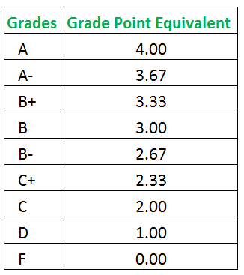
GPA

Slide 17
Declaring Foreign Keys
Lecture 2 > Section 3 > Foreign Keys
Students(sid: string, name: string, gpa: float)
Enrolled(student_id: string, cid: string, grade: string)
CREATE TABLE Enrolled(
student_id CHAR(20),
cid CHAR(20),
grade CHAR(10),
PRIMARY KEY (student_id, cid),
FOREIGN KEY (student_id) REFERENCES Students(sid)
)
Students
Enrolled
sid | name | gpa
101 | Bob | 3.2
123 | Mary | 3.8
student_id | cid | grade
123 | 564 | A
123 | 537 | A+

Slide 18
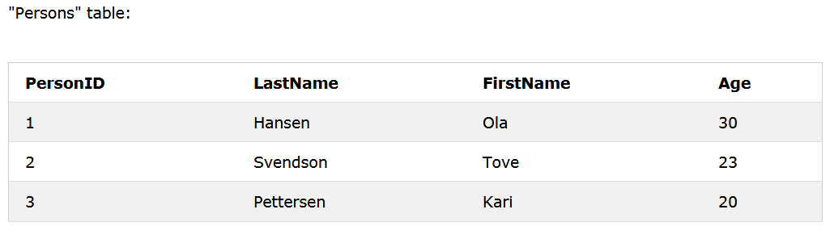
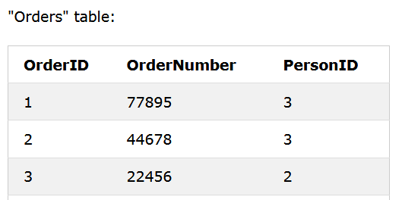
Declaring Foreign Keys
Lecture 2 > Section 3 > Foreign Keys
ALTER TABLE Orders DROP FOREIGN KEY FK_PersonOrder;
ALTER TABLE Orders ADD FOREIGN KEY (PersonID) REFERENCES Persons(PersonID);
CREATE TABLE Orders ( OrderID int NOT NULL, OrderNumber int NOT NULL, PersonID int, PRIMARY KEY (OrderID), FOREIGN KEY (PersonID) REFERENCES Persons(PersonID) );
CREATE TABLE Orders ( OrderID int NOT NULL, OrderNumber int NOT NULL, PersonID int, PRIMARY KEY (OrderID), CONSTRAINT FK_PersonOrder FOREIGN KEY (PersonID) REFERENCES Persons(PersonID) );
ALTER TABLE Orders ADD CONSTRAINT FK_PersonOrder FOREIGN KEY (PersonID) REFERENCES Persons(PersonID);

Slide 19
Foreign Keys and update operations
Lecture 2 > Section 3 > Foreign Keys
Students(sid: string, name: string, gpa: float)
Enrolled(student_id: string, cid: string, grade: string)
What if we insert a tuple into Enrolled, but no corresponding student?
INSERT is rejected (foreign keys are constraints)!
What if we delete a student?
Disallow the delete
Remove all of the courses for that student
SQL allows a third via NULL
DBA chooses (syntax in the book)

Slide 20
Keys and Foreign Keys
Lecture 2 > Section 3 > Foreign Keys
Company
What is a foreign key vs. a key here?
CName | StockPrice | Country
GizmoWorks | 25 | USA
Canon | 65 | Japan
Hitachi | 15 | Japan
Product
PName | Price | Category | Manufacturer
Gizmo | $19.99 | Gadgets | GizmoWorks
Powergizmo | $29.99 | Gadgets | GizmoWorks
SingleTouch | $149.99 | Photography | Canon
MultiTouch | $203.99 | Household | Hitachi

Slide 21
Joins
Lecture 2 > Section 3 > Joins: Basics
Product(PName, Price, Category, Manufacturer)
Company(CName, StockPrice, Country)
Note: we will often omit attribute types in schema definitions for brevity, but assume attributes are always atomic types
Ex: Find all products under $200 manufactured in Japan; return their names and prices.
SELECT PName, Price FROM Product, Company WHERE Manufacturer = CName
AND Country=‘Japan’ AND Price <= 200

Slide 22
Joins
Lecture 2 > Section 3 > Joins: Basics
Product(PName, Price, Category, Manufacturer)
Company(CName, StockPrice, Country)
Ex: Find all products under $200 manufactured in Japan; return their names and prices.
SELECT PName, Price FROM Product, Company WHERE Manufacturer = CName
AND Country=‘Japan’ AND Price <= 200
A join between tables returns all unique combinations of their tuples which meet some specified join condition

Slide 23
Joins
Lecture 2 > Section 3 > Joins: Basics
SELECT column-names
FROM table-name1
JOIN table-name2 ON column-name1 = column-name2
WHERE condition;
Table1
Table2

Slide 24
Joins
Lecture 2 > Section 3 > Joins: Basics
SELECT column-names
FROM table-name1
JOIN table-name2 ON column-name1 = column-name2
WHERE condition;
Product(PName, Price, Category, Manufacturer)
Company(CName, StockPrice, Country)
Several equivalent ways to write a basic join in SQL:
SELECT PName, Price FROM Product, Company WHERE Manufacturer = CName
AND Country=‘Japan’ AND Price <= 200
SELECT PName, Price FROM Product
JOIN Company ON Manufacturer = Cname
AND Country=‘Japan’ WHERE Price <= 200
A few more later on…

Slide 25
Joins
Lecture 2 > Section 3 > Joins: Basics
Product
Company
PName | Price | Category | Manuf
Gizmo | $19 | Gadgets | GWorks
Powergizmo | $29 | Gadgets | GWorks
SingleTouch | $149 | Photography | Canon
MultiTouch | $203 | Household | Hitachi
Cname | Stock | Country
GWorks | 25 | USA
Canon | 65 | Japan
Hitachi | 15 | Japan
SELECT PName, Price FROM Product, Company WHERE Manufacturer = CName
AND Country=‘Japan’ AND Price <= 200
PName | Price
SingleTouch | $149.99

Slide 26
Tuple Variable Ambiguity in Multi-Table
Lecture 2 > Section 3 > Joins: Semantics
Person(name, address, worksfor) Company(name, address)
Which “address” does this refer to?
Which “name”s??
SELECT name, address FROM Person, Company WHERE worksfor = name

Slide 27
Tuple Variable Ambiguity in Multi-Table
Lecture 2 > Section 3 > Joins: Semantics
Person(name, address, worksfor) Company(name, address)
SELECT Person.name, Person.address FROM Person, Company WHERE Person.worksfor = Company.name
Both equivalent ways to resolve variable ambiguity
SELECT p.name, p.address FROM Person p, Company c WHERE p.worksfor = c.name
SELECT name, address FROM Person, Company WHERE worksfor = name

Slide 28
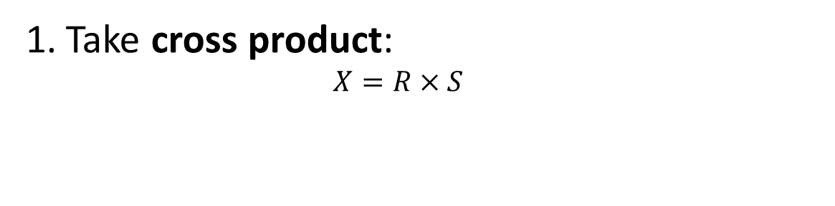
Note the semantics of a join
Lecture 2 > Section 3 > Joins: semantics
Take cross product:
$$X=R×S$$
Recall: Cross product (A X B) is the set of all unique tuples in A,B
Ex: {a,b,c} X {1,2}
= {(a,1), (a,2), (b,1), (b,2), (c,1), (c,2)}

Slide 29
An example of SQL semantics
Lecture 2 > Section 3 > Joins: semantics
SELECT R.A
FROM R, S
WHERE R.A = S.B
Output
A
3
3
R
A
1
3
A | B | C
1 | 2 | 3
1 | 3 | 4
1 | 3 | 5
3 | 2 | 3
3 | 3 | 4
3 | 3 | 5
Cross Product
Apply Projection
Apply Selections / Conditions
S
B | C
2 | 3
3 | 4
3 | 5
A | B | C
3 | 3 | 4
3 | 3 | 5

Slide 30
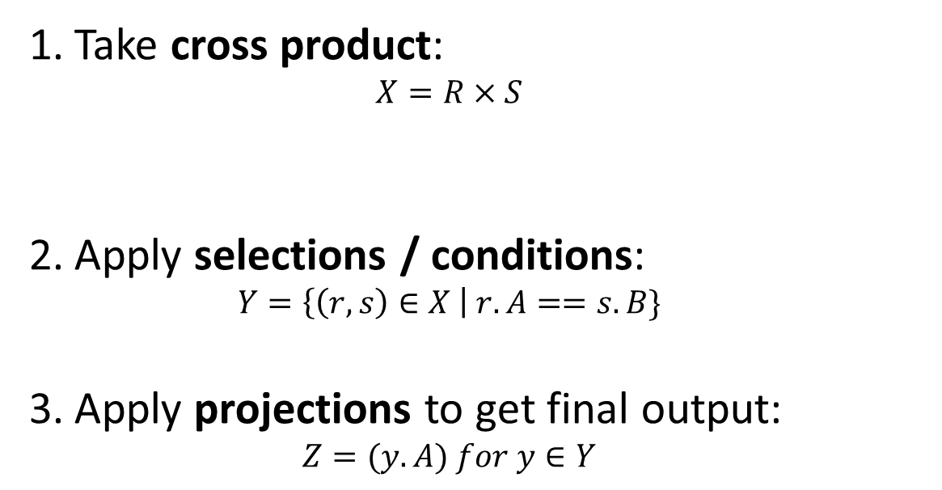
Note the semantics of a join
Lecture 2 > Section 3 > Joins: semantics
SELECT R.A
FROM R, S
WHERE R.A = S.B
Take cross product:
$$X=R×S$$
Apply selections / conditions:
$$Y=\left\{\left(r,s\right)∈X \right| r.A==s.B\}$$
Apply projections to get final output:
$$Z=(y.A) for y∈Y$$
Recall: Cross product (A X B) is the set of all unique tuples in A,B
Ex: {a,b,c} X {1,2}
= {(a,1), (a,2), (b,1), (b,2), (c,1), (c,2)}
= Filtering!
= Returning only some attributes
Remembering this order is critical to understanding the output of certain queries (see later on…)

Slide 31
Note: we say “semantics” not “execution order”
Lecture 2 > Section 3 > Joins: semantics
The preceding slides show what a join means
Not actually how the DBMS executes it under the covers

Slide 32
A Subtlety about Joins
Lecture 2 > Section 3 > ACTIVITY
Lecture 2 > Section 3 > Joins: semantics
Product(PName, Price, Category, Manufacturer)
Company(CName, StockPrice, Country)
Find all countries that manufacture some product in the ‘Gadgets’ category.
SELECT Country FROM Product, Company WHERE Manufacturer=CName AND Category=‘Gadgets’
Product
PName | Price | Category | Manuf
Gizmo | $19 | Gadgets | GWorks
Powergizmo | $29 | Gadgets | GWorks
SingleTouch | $149 | Photography | Canon
MultiTouch | $203 | Household | Hitachi
Company
Cname | Stock | Country
GWorks | 25 | USA
Canon | 65 | Japan
Hitachi | 15 | Japan

Slide 33
A subtlety about Joins
Lecture 2 > Section 3 > Joins: semantics
Lecture 2 > Section 3 > ACTIVITY
Product
Company
PName | Price | Category | Manuf
Gizmo | $19 | Gadgets | GWorks
Powergizmo | $29 | Gadgets | GWorks
SingleTouch | $149 | Photography | Canon
MultiTouch | $203 | Household | Hitachi
Cname | Stock | Country
GWorks | 25 | USA
Canon | 65 | Japan
Hitachi | 15 | Japan
SELECT Country FROM Product, Company WHERE Manufacturer=Cname
AND Category=‘Gadgets’
Country
?
?
What is the problem ?
What’s the solution ?

Slide 34
An Unintuitive Query
Lecture 2 > Section 3 > ACTIVITY
SELECT DISTINCT R.A
FROM R, S, T
WHERE R.A=S.A OR R.A=T.A
What does it compute?

Slide 35
An Unintuitive Query
Lecture 2 > Section 3 > ACTIVITY
SELECT DISTINCT R.A
FROM R, S, T
WHERE R.A=S.A OR R.A=T.A
S
T
R
But what if S = φ?
Computes R ∩ (S ∪ T)
Go back to the semantics!

Slide 36
An Unintuitive Query
Lecture 2 > Section 3 > ACTIVITY
SELECT DISTINCT R.A
FROM R, S, T
WHERE R.A=S.A OR R.A=T.A
Recall the semantics!
Take cross-product
Apply selections / conditions
Apply projection
If S = {}, then the cross product of R, S, T = {}, and the query result = {}!
Must consider semantics here.
Are there more explicit way to do set operations like this?

