Slide 1
Multiplexer
MUX

Slide 2
Multiplexer
Multiplexer (Selector)
  2^{n} data inputs
  n control inputs
  1 output
  Described as 2^{n}:1
  Is used to connect only one of 2^{n} inputs to a single output at a given time
  The control signal pattern forms the binary index of the input connected to the output
  Called “MUX” for brevity
A
Z
0
I
I
1
I
0
0
2:1
Z
1
I
1
MUX
A
I
0
I
1
4:1
Z
I
2
MUX
I
3
A
B
I
0
I
1
I
2
I
3
8:1
I
4
MUX
Z
I
5
I
6
I
7
A
B
C

Slide 3
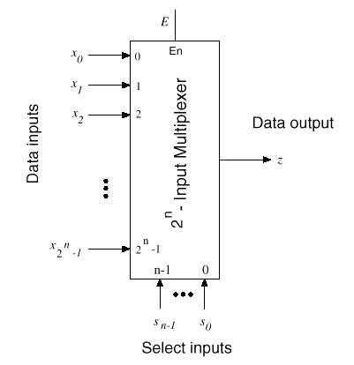
Multiplexer
…
…

Slide 4
MUX Boolean Functions
I
0
2:1
A
I₀
A
I
MUX
Z
00
01
11
10
1
Z = A' I₀ + A I₁
I₁
0
0
1
0
0
A
A
1
0
1
1
1
I
0
0
1
I
B
I
1
4:1
Z
2
MUX
0
I₀
I₂
I₀
I
3
1
I₁
I₃
A
B
Z = A' B' I₀ + A' B I₁ + A B' I₂ + A B I₃
I
0
I
1
I
2
Z = A' B' C' I₀ + A' B' C I₁ + A' B C' I₂ + A' B C I₃ +
A B' C' I₄ + A B' C I₅ + A B C' I₆ + A B C I₇
I
3
8:1
I
4
MUX
Z
I
5
2^{n} -1
I
6
In general: Z = Σ m_{k} I_{k} , in minterm form
I
7
k=0
A
B
C

Slide 5
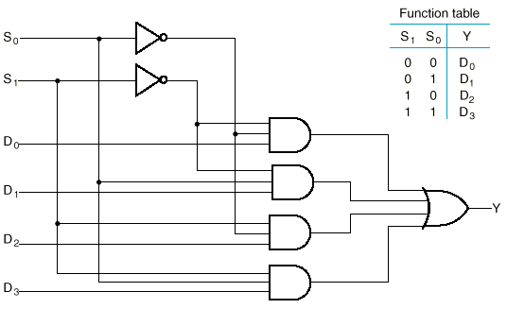
Circuit Diagram
4:1 MUX
Y = A' B' I₀ + A' B I₁ + A B' I₂ + A B I₃
A | B | Y
0 | 0 | I₀
0 | 1 | I₁
1 | 0 | I₂
1 | 1 | I₃
A
B
I₀
I₁
I₂
I₃

Slide 6
Cascading MUXes
  Design an 8:1 MUX by using smaller MUXes
I
0
0
I
4:1
1
1
MUX
I
2
2
I
3
S
S
0
2:1
Z
3
1
0
MUX
I
4
0
1
S
I
4:1
5
1
MUX
I
6
2
I
7
3
S
S
1
0
B
C
A

Slide 7
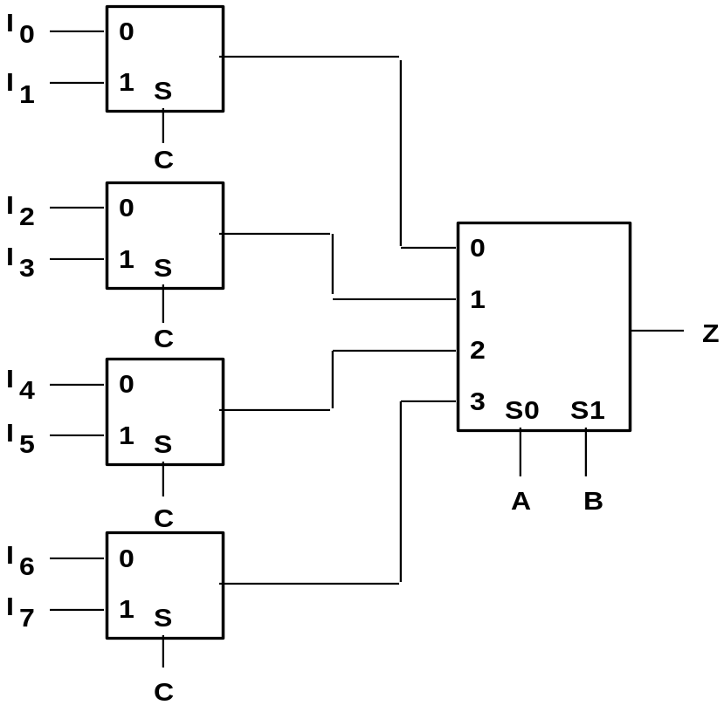
Another Implementation
2:1
MUX
2:1
MUX
4:1
MUX
2:1
MUX
2:1
MUX

Slide 8
Larger Data Lines
  What if we want to select m-bit datawords?
  Combine MUX blocks in parallel with common select and enable signals

Slide 9
4-bit data
Example:
  Selection between 2 sets of 4-bit inputs (x[3:0] or y[3:0])
  Use four 2:1 MUXes in parallel
  Tie all four control lines together
I
0
2:1
I
MUX
Z
1
x₀
A
x₁
I
0
2:1
x₂
I
MUX
Z
1
z₀
?
x₃
z₁
A
I
z₂
y₀
0
2:1
I
MUX
Z
z₃
y₁
1
y₂
A
I
0
2:1
y₃
Z
I
1
MUX
A

Slide 10
Application
A
B
C
D
Adder with multiple input
sources:
A+C or
A+D or
B+C or
B+D
Sa
MUX
MUX
Sb
X
Y
Sum

Slide 11
MUX by 3-State Buffers
  Three-state logic in place of AND-OR
S
0
I
0
I
1
S
1
Y
I
2
I
3
(b)
  Output of gates can be connected

Slide 12
General Logic by MUX
  Any Boolean function of n variables can be implemented using a 2^{n-1}:1 multiplexer
  n-1 inputs go to the control lines directly
  One input is used to appropriately determine the output
  The choice of the singled-out input doesn’t change the functionality but it affects the complexity
  MUXes can only implement single-output functions

Slide 13
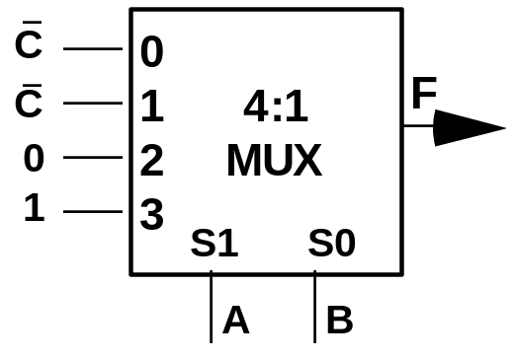
General Logic by MUX
Example:
  F = A' B' C' + A' B C' + A B C' + A B C
  = A' B' (C') + A' B (C') + A B' (0) + A B (1)
1
0
A
B
C
F
A
B
F
0
1
0
0
0
1
C’
0
0
C’
1
2
F
0
0
1
0
0
1
C’
0
3
8:1
0
1
0
1
1
0
0
0
4
MUX
0
1
1
0
C’
0
5
1
1
1
1
6
1
0
0
0
0
1
7
S2 S1 S0
1
0
1
0
1
1
0
1
1
A
B
C
1
1
1
1
  What if A or B had been chosen as the singled-out input?

Slide 14
Using Smaller MUX
  How about implementing a 4-variable function by a 4:1 MUX
    Can still be done
    2 input variables go to the 2 control lines directly
    The other 2 input variables will go to the MUX inputs using some necessary gates
    Choose the 2 that go to control inputs and the 2 that go to the MUX inputs carefully!
    The choice affects the number of necessary gates

Slide 15
General Logic
By decoder:
  Multiple outputs:
    A single decoder
    One OR gate for each output
By MUX:
  Multiple outputs:
    One MUX needed for each output
    No need for OR gates
Use MUX for single-output functions
Use decoder for multiple-output functions

Slide 16
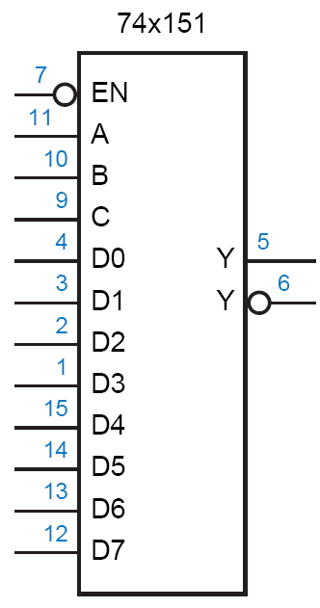
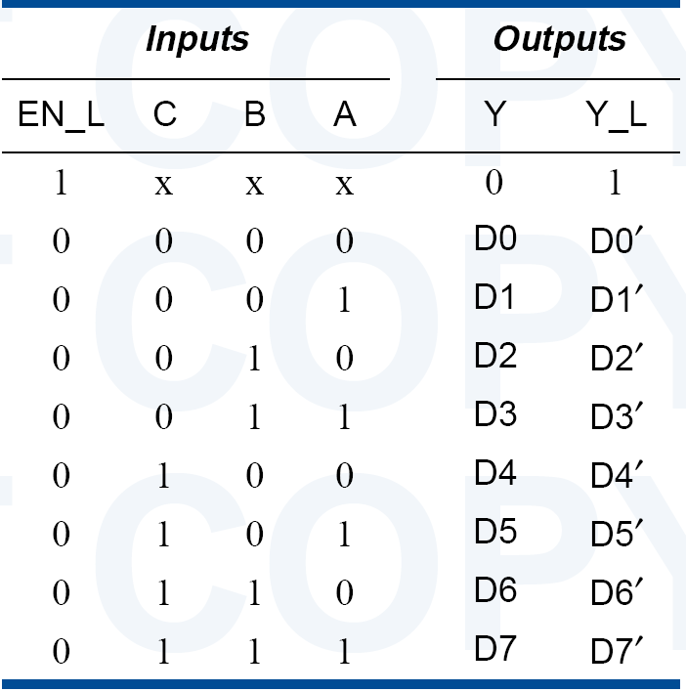
Standard MSI MUXes
74x151
  8:1 MUX

Slide 17
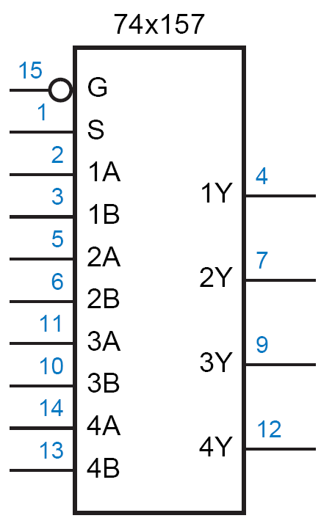
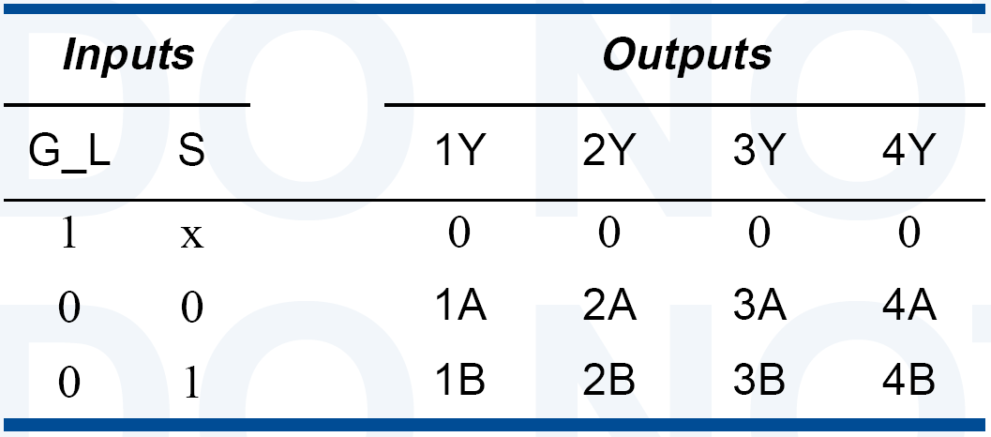
Standard MSI MUXes
74x157
  4-bit wide, 2:1 MUX

Slide 18
Demultiplexer
DEMUX

Slide 19
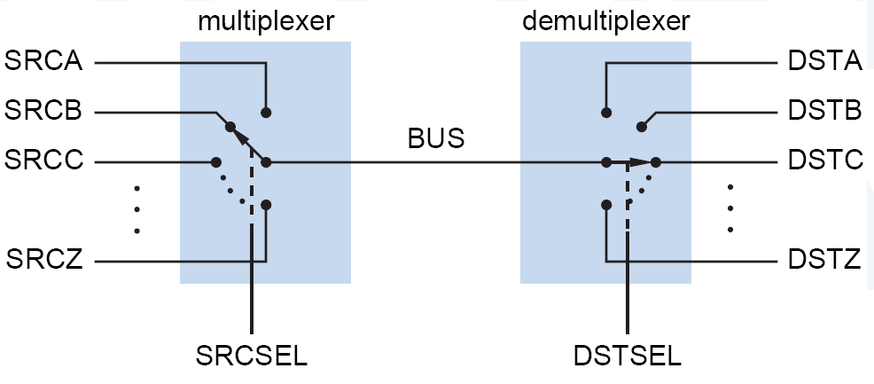
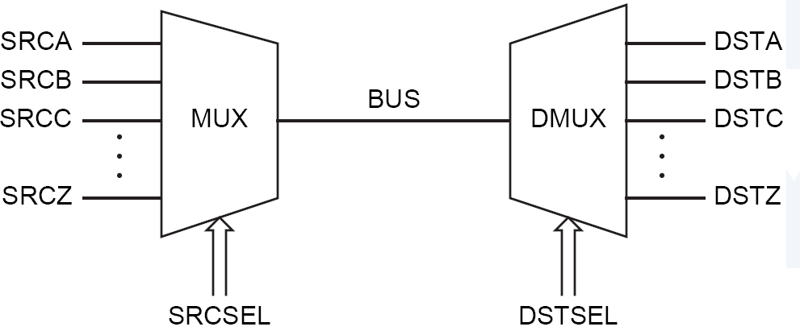
DEMUX

Slide 20
Decoder vs. DEMUX
E | A | B | C | O₀ | O₁ | O₂ | O₃ | O₄ | O₅ | O₆ | O₇
0 | X | X | X | 0 | 0 | 0 | 0 | 0 | 0 | 0 | 0
1 | 0 | 0 | 0 | 1 | 0 | 0 | 0 | 0 | 0 | 0 | 0
1 | 0 | 0 | 1 | 0 | 1 | 0 | 0 | 0 | 0 | 0 | 0
1 | 0 | 1 | 0 | 0 | 0 | 1 | 0 | 0 | 0 | 0 | 0
1 | 0 | 1 | 1 | 0 | 0 | 0 | 1 | 0 | 0 | 0 | 0
1 | 1 | 0 | 0 | 0 | 0 | 0 | 0 | 1 | 0 | 0 | 0
1 | 1 | 0 | 1 | 0 | 0 | 0 | 0 | 0 | 1 | 0 | 0
1 | 1 | 1 | 0 | 0 | 0 | 0 | 0 | 0 | 0 | 1 | 0
1 | 1 | 1 | 1 | 0 | 0 | 0 | 0 | 0 | 0 | 0 | 1
O₀
ABC
A
S₂
O₁
ABC
O₂
ABC
B
S₁
3:8
O₃
ABC
C
dec
O₄
ABC
S₀
O₅
ABC
O₆
ABC
O₇
ABC
E
  By switching the view between (A, B, C) and E, can a decoder be considered a DEMUX?

Slide 21
Decoder vs. DEMUX
O₀
ABC
0
Y0
O₁
ABC
1
Y1
A
S₂
O₂
ABC
E
1:8 DEMUX
2
Y2
B
S₁
3:8
O₃
ABC
(3:8 dec)
3
Y3
C
dec
O₄
ABC
4
Y4
S₀
5
Y5
O₅
ABC
O₆
ABC
6
Y6
O₇
ABC
S
S
S
7
Y7
2
1
0
A
B
C
E

