Slide 1
Read-Only Memory
ROM

Slide 2

ROM
Decoder
  Produces minterms
ORs
  Produce SOP’s
0
A
‘B’C’D’
1
A
‘B’C’D
F
2
A
‘B’CD’
1
3
A
‘B’CD
A
S₃
4
A
‘BC’D’
S₂
5
A
‘BC’D
B
6
A
‘BCD’
4:16
7
A
‘ BCD
C
S₁
dec
8
A
B’C’D’
F
9
A
B’C’D
2
D
S₀
10
A
B’CD’
1
1
A
B’CD
12
A
B C’D’
13
A
B C’D
14
A
B C D’
F
15
A
B C D
3
Enb

Slide 3
ROM
ROM
  A decoder
  A set of programmable OR’s
D7
X
X
X
D6
D5
X
X
D4
X
A
A2
D3
X
D2
X
X
B
A1
D1
A0
D0
X
C
F3
F2
F1
F0

Slide 4
ROM vs. PLA/PAL
Fixed
Programmable
Programmable
Inputs
AND array
Connections
OR array
Outputs
(decoder)
(a) Programmable read-only memory (PROM)
Inputs
Programmable
Programmable
Fixed
Connections
AND array
OR array
Outputs
(b) Programmable array logic (PAL) device
Programmable
Programmable
Programmable
Programmable
Inputs
Connections
AND array
Connections
OR array
Outputs
(c) Programmable logic array (PLA) device

Slide 5
General Logic Implementation
  Given a 2^{k}xn ROM, we can implement ANY combinational circuit with at most k inputs and at most n outputs.
Why?
  k-to-2^{k} decoder will generate all 2^{k} possible minterms
  Each of the OR gates can implement a ∑m()
  Each ∑m() can be programmed to represent one function

Slide 6
Example
Find a ROM-based circuit implementation for:
  f(a,b,c) = a’b’ + abc
  g(a,b,c) = a’b’c’ + ab + bc
  h(a,b,c) = a’b’ + c
Solution:
  Determine the required ROM size
  Express f(), g(), and h() in ∑m() format (use truth tables)
  Program the ROM based on the 3 ∑m()’s

Slide 7
Example (Continued)
  There are 3 inputs and 3 outputs, thus we need an 8x3 ROM block.
  Prepare the minterm lists:
    f = ∑m(0, 1, 7)
    g = ∑m(0, 3, 6, 7)
    h = ∑m(0, 1, 3, 5, 7)
  Program the ROM
a
0
1
2
3
4
5
6
7
b
3-to-8
decoder
c
f
g
h

Slide 8
ROM as a Memory
ROM’s can be viewed as memory with the inputs as address lines, and outputs as the stored data
Usually have:
  N input lines,
  M output lines,
  Provide 2^{N} x M bits of memory
History:
  ROM: the first generation, used as a memory but preprogrammed at the time of manufacturing
  PROM: Programmable ROM, the second generation, able to be programmed at the time of usage
  EPROM: Erasable PROM, able to be erased by UV, and reprogrammed
  EEPROM: Electronically EPROM, able to be erased electronically and reprogrammed

Slide 9
(Memories)
Volatile:
  Random Access Memory (RAM):
    SRAM: "static"
    DRAM: "dynamic"
Non-Volatile:
  ROM
  PROM
  EPROM
  EEPROM
  FLASH memory: similar to EEPROM with programmer integrated on chip

Slide 10
ROM as Memory
Read Example: For input (A₂,A₁,A₀) = 011, output is (F₀,F₁,F₂,F₃ ) = 0010.
What are functions F₃, F₂ , F₁ and F₀ in terms of (A₂, A₁, A₀)?
Address
8x4 ROM
D0
X
X
X
0 | 1 | 1 | 0 | 1
1 | 0 | 0 | 0 | 0
2 | 1 | 0 | 0 | 1
3 | 0 | 0 | 1 | 0
4 | 0 | 0 | 0 | 0
5 | 1 | 0 | 0 | 0
6 | 0 | 0 | 1 | 1
7 | 0 | 1 | 0 | 0
D1
D2
X
X
D3
X
A
A2
D4
X
A[2:0]
F[3:0]
D5
X
X
B
A1
D6
3
4
A0
D7
X
C
F0
F1
F2
F3

Slide 11
Design by ROM: Example
BCD to 7-Segment Display Controller
A B C D
C0 C1 C2 C3 C4 C5 C6
0 0 0 0
0 0 0 1
0 0 1 0
0 0 1 1
0 1 0 0
0 1 0 1
0 1 1 0
0 1 1 1
1 1 1 1 1 1 0
0 1 1 0 0 0 0
1 1 0 1 1 0 1
1 1 1 1 0 0 1
0 1 1 0 0 1 1
1 0 1 1 0 1 1
1 0 1 1 1 1 1
1 1 1 0 0 0 0
1 1 1 1 1 1 1
1 1 1 0 0 1 1
Reminder:
C
0
C
C
5
C
6
1
1 0 0 0
1 0 0 1
1 0 1 0
1 0 1 1
1 1 0 0
1 1 0 1
1 1 1 0
0 1 1 1
C
C
4
2
C
X X X X X X X
X X X X X X X
X X X X X X X
X X X X X X X
X X X X X X X
X X X X X X X
3
Need a ROM with at least 4 address lines and 7 bits of output

Slide 12
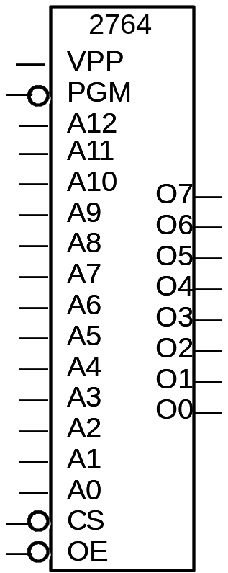
Design by ROM: Example Continued
  There are some standard devices
  Vpp and PGM are used when programming
  Chip Select (CS) and Output Enable (OE) inputs are used to control the chip
  13 address lines provide 2¹³ (=8192=8K) memory bytes of 8 bits
  Extra address lines grounded
  Extra output line not connected
2764 EPROM
8K x 8
?
?
0
0
0
0
C
0
0
0
C
1
0
C
2
0
C
3
0
C
4
A
C
5
B
C
6
C
D
?
?

Slide 13
ROM vs. PLA/PAL
ROM approach advantageous when
  (1) design time is short (no need to minimize output functions)
  (2) little sharing of product terms among output functions
ROM problem:
  (1) size doubles for each additional input,
  (2) can't use don't cares
PLA approach advantageous when
  (1) many minterms are shared among the output functions
PAL problem:
  constrained fan-ins on OR planes

Slide 14
ROM vs. PLA
ROM
  Cheap (high-volume component)
  Medium speed
PLA
  Expensive
    Complex design; need more sophisticated tools
  Slow
    Two programmable planes

