Slide 1


CONTENT STUDIO
AI-Powered Content Production
Presented by [Your Name Here]

Slide 2
The Content Creation Challenge
Slow and Fragmented Processes
Social teams struggle with disconnected tools, leading to hours spent crafting AI prompts that align with brand voice, ultimately causing delays and inconsistencies in the content production pipeline.

Slide 3
The Unified Workspace
Streamline Your Content Creation
Content Studio consolidates branding elements, enabling teams to produce consistent and on-brand content efficiently. By integrating everything into one platform, businesses can focus on strategy, not logistics.

Slide 4
Product Overview
Brand Profile
Create a comprehensive brand profile, detailing identity, tone of voice, and visual style to guide all content generation.
A streamlined process for effective content creation
Content Calendar
Utilize AI-assisted planning to build a content calendar that organizes posts and schedules them efficiently for optimal engagement.
AI Prompts
Generate on-brand prompts for images, videos, and captions, ensuring consistency and quality across all social media platforms.

Slide 5
Target Users
Built for social media professionals
Social Media Managers
Small Business Owners
Marketing Agencies
Social media managers need efficient tools to plan and produce content across multiple brands, enhancing collaboration and streamlining workflows while ensuring on-brand messaging in every post.
Small business owners require accessible solutions to maintain a professional online presence, allowing them to manage content creation independently without the overhead of hiring an agency or expert.
Marketing agencies seek consistent branding across various client accounts, enabling them to deliver high-quality, on-brand content quickly while managing multiple projects and deadlines efficiently.

Slide 6
Key Features
Brand Identity Engine
AI Image Generation
Extracts tone, style, and visual identity from brand info and reference images for consistent content creation.
Generates on-brand image, video, and caption prompts to streamline content production and maintain brand integrity.
Content Calendar
Prompt Library
Plans, generates, and manages scheduled posts with AI assistance, simplifying the social media workflow for users.
Offers a searchable, reusable history of on-brand prompts, allowing easy access to previously generated content for future use.
Reference Image Analysis
Analyzes inspiration images to turn them into usable style directions, enhancing creative options while maintaining brand consistency.

Slide 7
Market Opportunity
Growing Demand
Demand for AI-driven tools in content creation is surging, especially among small businesses and marketing agencies seeking efficiency and effectiveness.
A rapidly expanding sector for AI content solutions
Unique Positioning
Many existing tools focus on scheduling or content generation, but Content Studio uniquely integrates both features for seamless workflow management.
Untapped Potential
The market for brand-consistent AI content production remains underserved, providing a significant opportunity for growth and innovation in the sector.

Slide 8
Business Model
Simple Subscription Pricing
Starter Plan
Pro Plan
Agency Plan
Our Starter Plan offers core features for a single brand, ideal for solo creators and small businesses looking to harness the power of AI in their content production.
The Pro Plan supports multiple brands and includes a comprehensive content calendar, making it suitable for growing teams that require more advanced features and collaboration tools.
Designed for marketing agencies, the Agency Plan allows for unlimited brands and team seats, providing essential tools for managing several client accounts efficiently and effectively.

Slide 9
Roadmap Overview
Current Features
Today, we offer a core workflow including brand profiles, content calendars, AI prompt generation, and a prompt library for users.
From local tool to multi-tenant platform expansion
Next Steps
Our immediate focus is on implementing multi-tenant accounts, finalizing the visual design system, and completing Google Drive export capabilities.
Mid to Long-Term
In the mid-term, we’ll enable direct publishing, team collaboration features, and an analytics dashboard for enhanced user insights.

Slide 10
The Ask
Building our AI content engine
Funding Opportunities
Strategic Partnerships
We are raising a seed round to support the development of our multi-tenant platform, focusing on creating a robust infrastructure for content generation and publishing integrations.
We are seeking design partners and pilot customers, particularly agencies and small business teams, to collaborate on refining our offerings and ensuring market fit.

Slide 11
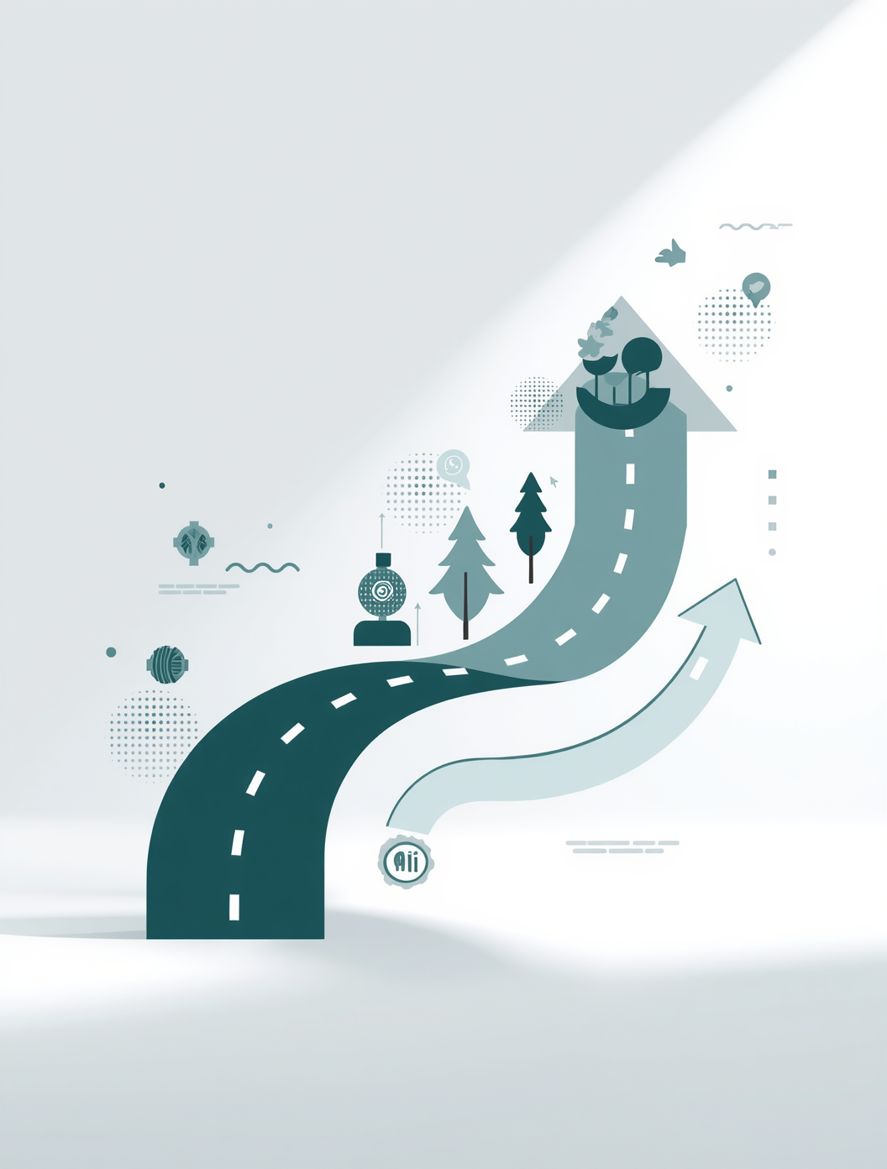
Ready to take action?
Let's discuss partnership and investment opportunities today

