Slide 1
Applied Data Science
Capstone Report
By:
Alireza Abdihamzehkolaei
December, 2020

Slide 2
Project description
Several investors are planning to open a Mexican buffet in Oklahoma City.
Their main concern is the location.
Obviously, in order to achieve high revenue, they are trying to attract more customers by choosing the best location.
There are many restaurants and buffets in Oklahoma City while it is not a very large city, so choosing the right spot is very challenging.
Their priorities are:
The location should be close to a shopping center.
The location should be as far as possible from other restaurants especially other buffets.
The location should not be in the downtown due to the high price and traffic.
4. Other venues in the vicinity of the location would be a plus.

Slide 3
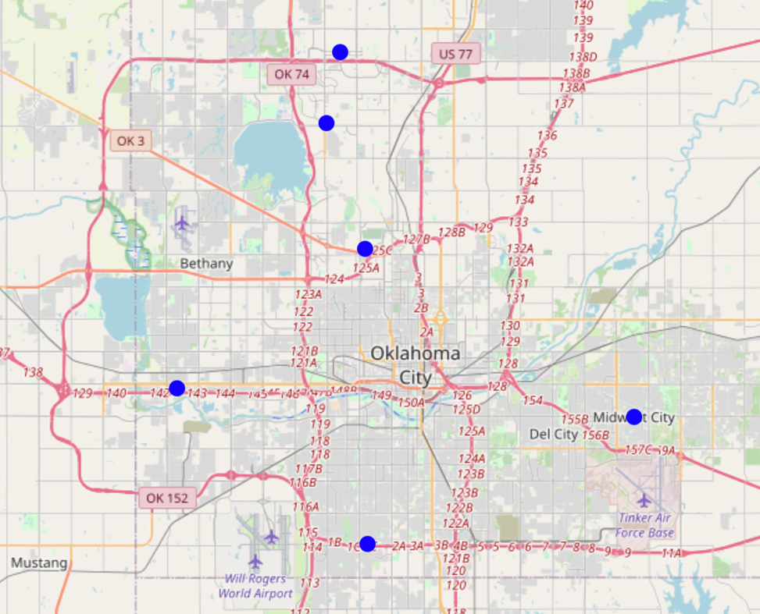
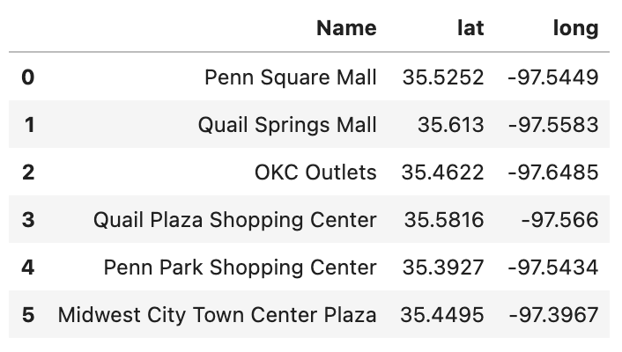
Results
The major shopping centers along with their coordinates were extracted by “geopy” and shown on the map.

Slide 4
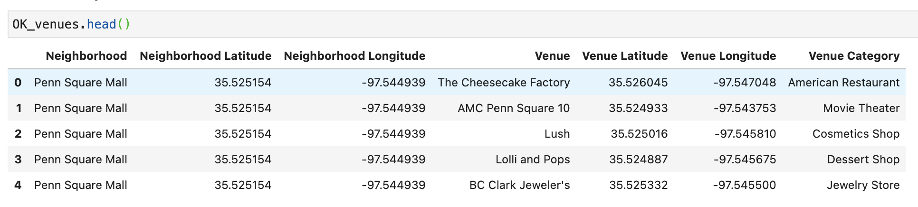
Results
Maximum of 100 venues were extracted near (up to 750 meters) every shopping center.

Slide 5
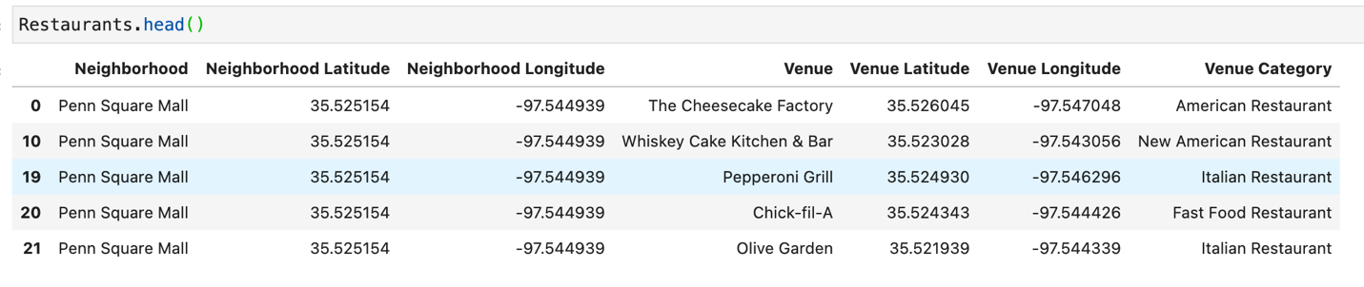
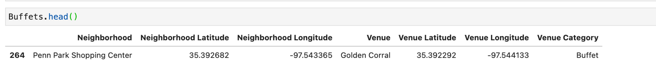
Results
Restaurants and buffets were separated from the rest.

Slide 6
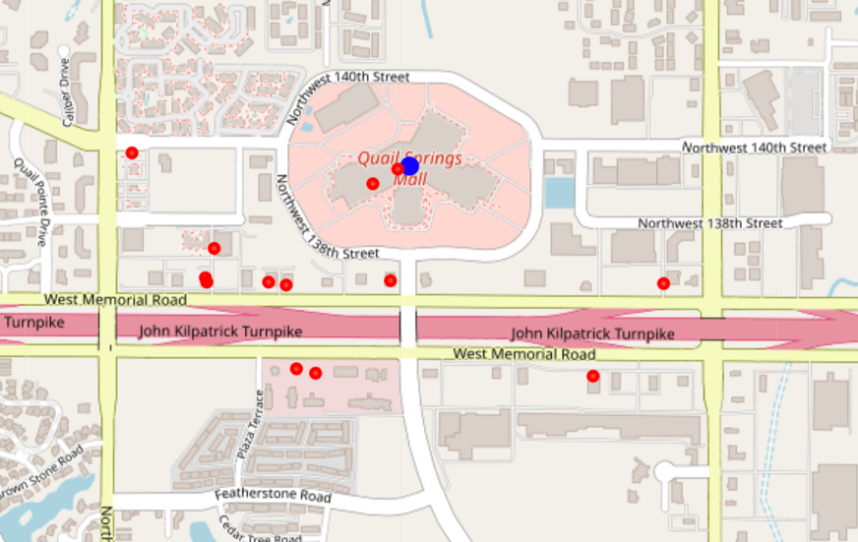
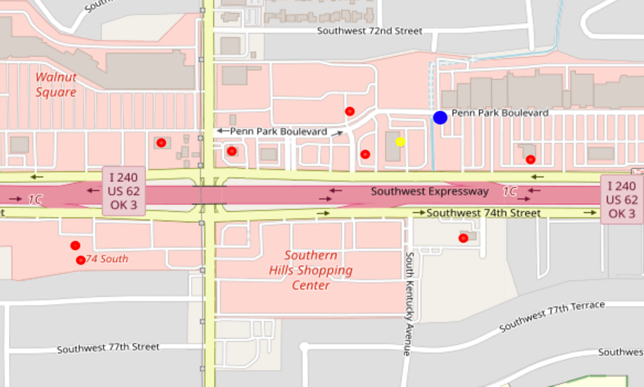
Results
On the map, restaurants are shown by red dots and buffets are shown by yellow dots.
Two examples out of six

Slide 7
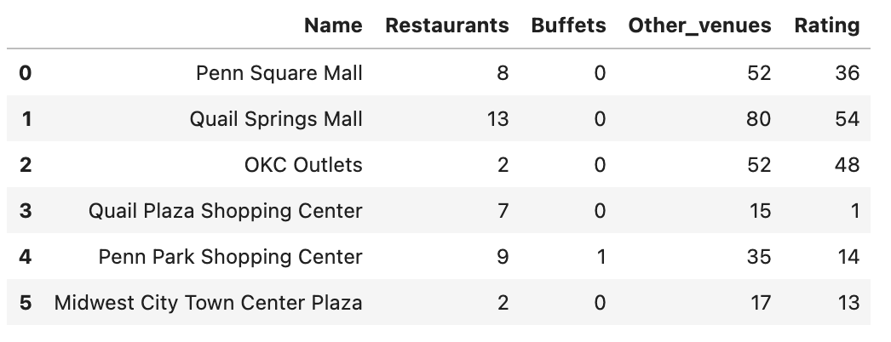
Conclusion
Rating system:
Each restaurant nearby= -2 points
each buffet nearby= -3 points
any other type of venues= +1 point
Based on the rating system, Quail Springs Mall is the right spot.

