Slide 1
Text pre-processing
Stopwords and punctuation removal
Convert to lowercase
Stemming: is the process of reducing words to their root or base form.
Lemmatization: is a process that involves reducing words to their canonical form (lemma) based on their dictionary definition.

Slide 2
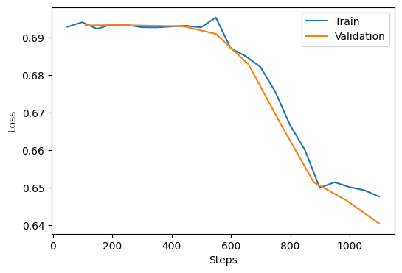
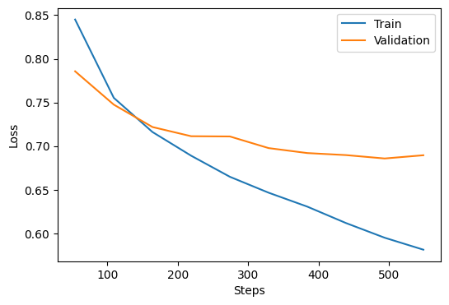
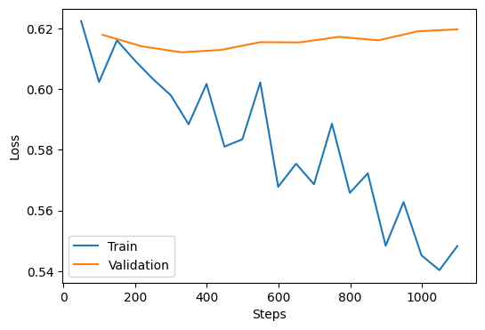
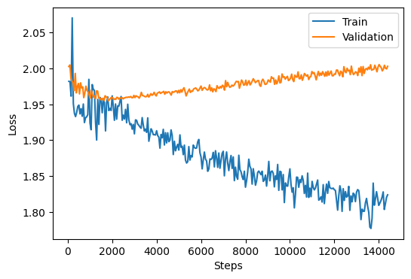
Losses
Siamese network
Siamese-attention network
Siamese-contrastive network
Sequence-to-sequence learning

Slide 3
Conclusion and future work
DSI can make the training process and need less computational cost for an IR task
Using sequence-to-sequence learning models can outperform classical self-supervised approaches
If computational recourses available, evaluating the models trained using higher number of epochs
A comprehensive compassion in terms of time, computational costs, scalability and efficiency between the developed models and other index-then-retrieve pipelines

