Slide 1
Text pre-processing
Stopwords and punctuation removal
Convert to lowercase
Stemming: is the process of reducing words to their root or base form.
Lemmatization: is a process that involves reducing words to their canonical form (lemma) based on their dictionary definition.

Slide 2
DSI
Sequence-to-sequence learning (transformer-based model)
Model’s architecture: A transformer-based encoder-decoder that involves three transformer layers for each component. Encoder plays the role of indexing, in which the model has to acquire the documents knowledge to map every document to its related docid. Meanwhile, the decoder is tasked with retrieval, generating the complete target sequence from a given query. Ranking is conducted according to semantic similarity.
Steps:
• Initializing the sequence-to-sequence model (Parameters):
nlayers: set number of transformer layers for the encoder-decoder model
nhead: the number of heads in the multihead attention models.
nhid: the dimension of the feedforward network model.
droupout: the dropout rate for each layer.
Training the Model (Parameters): tokenized_dataset, Transformer_module, max_epochs, batch_size, split_ratio, etc.
This model can be a more generalizable one but needs more powerful computational racecourse for training.

Slide 3
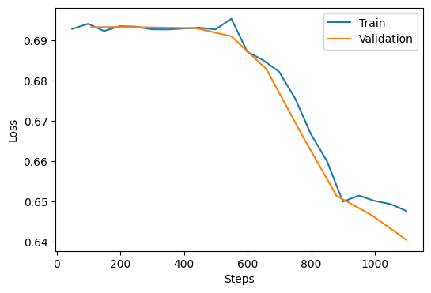
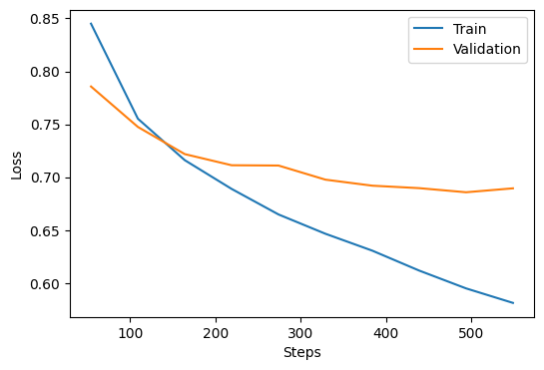
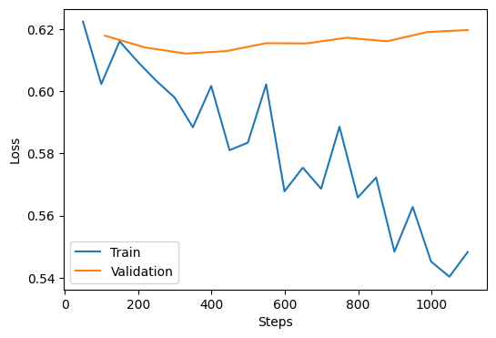
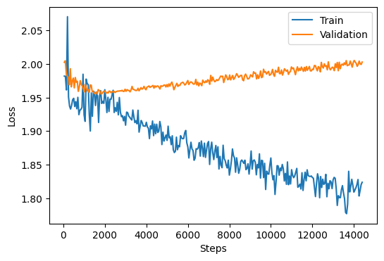
Losses
Siamese network
Siamese-attention network
Siamese-contrastive network
Sequence-to-sequence learning

Slide 4
Conclusion and future work
DSI can make the training process faster and needs less computational cost for IR tasks but might not show better efficiency compared to index-then-retrieve approaches.
Using sequence-to-sequence learning models can outperform classical self-supervised approaches (is that correct?!)
If computational recourses available, evaluate the trained models using higher number of epochs
A comprehensive compassion in terms of time, computational costs, scalability and efficiency between the developed models and other index-then-retrieve pipelines

