Slide 1


Layout and Simulation of Inverter Layout Post in 45 nm Technology by Cadence Virtuoso Software(With DRC & LVS) Student name : Alireza Alivand Faculty of Electrical and Computer Engineering, Urmia University

Slide 2
Contents :
1. Introduction
2. Description of the simulation
3. Description of the Layout
4. Reference

Slide 3

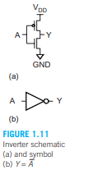
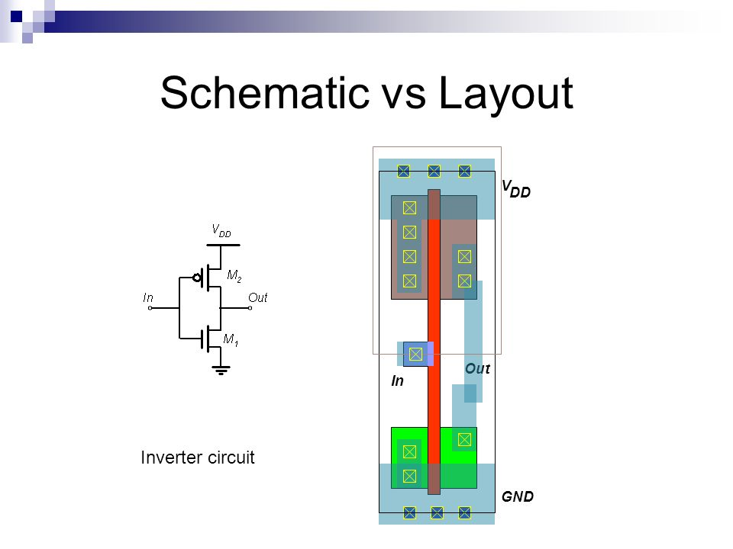
Figure 1.11 shows the schematic and symbol for a CMOS inverter or NOT gate using one nMOS transistor and one pMOS transistor. The bar at the top indicates VDD and the triangle at the bottom indicates GND. When the input A is 0, the nMOS transistor is OFF and the pMOS transistor is ON. Thus, the output Y is pulled up to 1 because it is connected to VDD but not to GND. Conversely, when A is 1, the nMOS is ON, the pMOS is OFF, and Y is pulled down to ‘0.’This is summarized in Table 1.1. Transistor dimensions specified as width/length: -Minimum size is 4 λ2/ λ, sometimes called 1 unit. -In the f=0.6 μm process, this is 1.2 μm wide, 0.6 μm long.

Slide 4
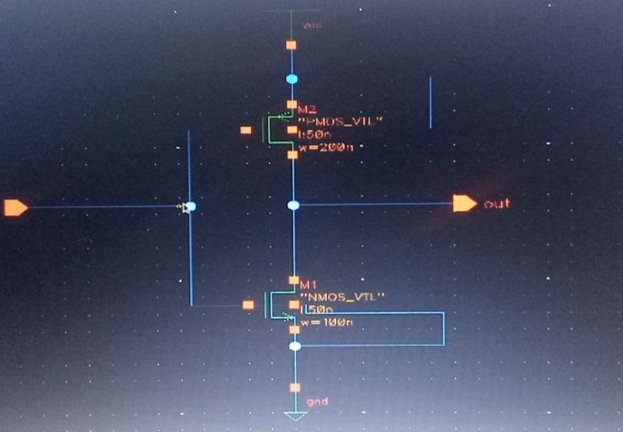

Slide 5
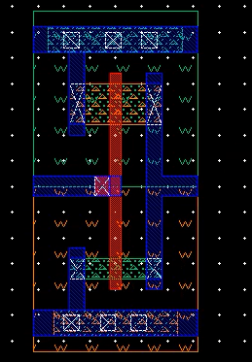
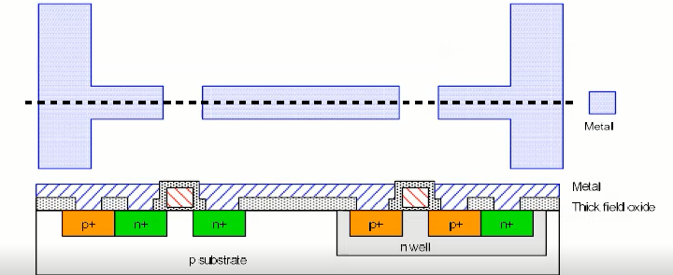

Slide 6
1.CMOS VLSI Design Book (Weste & Harris)

Slide 7


