Slide 1
Cloud Based Big Data Processing and Predictive Analytics for 5G O RAN Networks
Using the NetsLab 5G O RAN IDD Dataset and Amazon Web Services
Final Project Presentation
Alireza Eslamikhah
Student Number: 200550614
Course: Big Data Analytics and Cloud Computing
Platform: Amazon S3, EC2, and EMR Serverless
Models: Random Forest for network flow and radio telemetry
Goal: distinguish attack traffic from benign traffic
1

Slide 2
Presentation Outline
1. Problem motivation and 5G O RAN security context
2. Dataset source, scale, and Big Data characteristics
3. End to end cloud pipeline and AWS implementation
4. Spark based packet processing and Parquet conversion
5. Network flow Random Forest model
6. Radio telemetry Random Forest model
7. Final results, cost, and future work
2

Slide 3
Why Anomaly Detection Matters in 5G O RAN
5G networks serve many devices, applications, and software defined functions.
O RAN opens the radio access network through disaggregated components such as O CU, O DU, O RU, and the RIC.
Open interfaces improve flexibility, but they also increase the attack surface.
Binary attack versus benign detection is a practical first step for operational monitoring.
The dataset includes DDoS, DoS, brute force, probe, and web attacks.
Random Forest is suitable because it handles mixed network features well, trains quickly, and is easy to interpret.
User
Equipment
O RU
O DU
O CU
5G Core
Near Real Time RIC
Simplified 5G O RAN view used to explain the monitored environment.
3

Slide 4
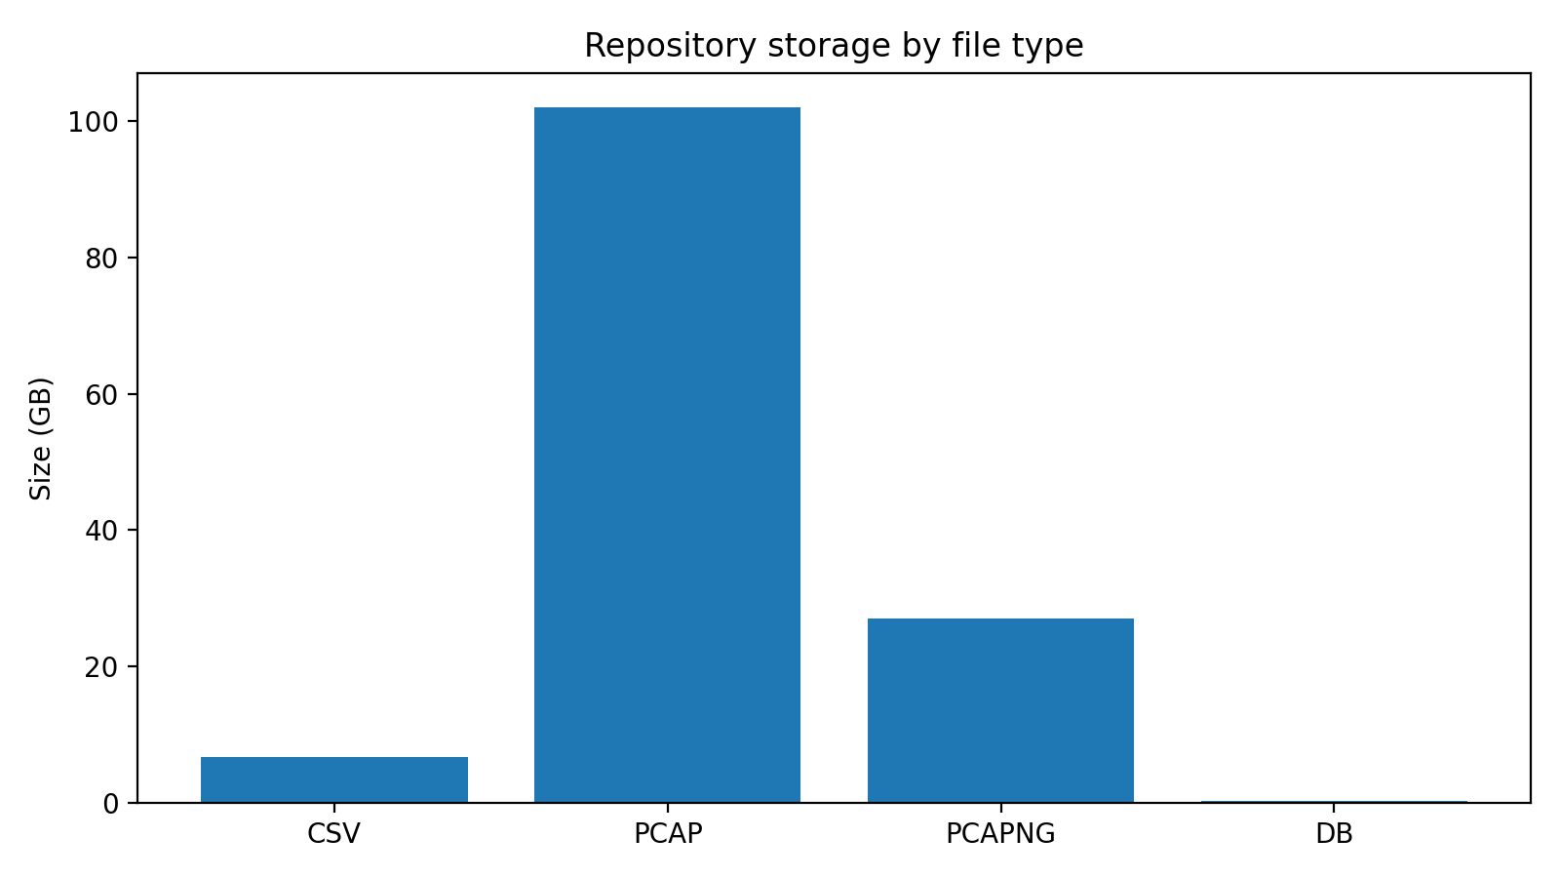
Dataset Source and Repository Overview
Source: NetsLab 5G O RAN intrusion detection dataset collected from a live testbed.
Repository includes raw packet captures, packet CSV exports, network flow records, and lower layer radio measurements.
The total repository size measured locally was 135.93 GB.
Component | Count / Size
Total files | 320
PCAP + PCAPNG | 129.08 GB
CSV files | 110 files, 6.62 GB
Prepared databases | 4 files, 221.32 MB
Network flow records | 1,723,817
Radio telemetry records | 45,244
Most of the repository volume comes from raw PCAP and PCAPNG files.
4

Slide 5
Why This Dataset Qualifies as Big Data
Volume
135.93 GB repository size, including 129.08 GB of raw packet captures and 28.8 million packet rows processed in Spark.
Variety
Multiple data forms: PCAP, PCAPNG, packet CSV, network flow CSV, SQLite databases, text logs, and radio telemetry.
Velocity
Traffic and radio data are generated continuously in operational networks. The study used offline snapshots, but the design targets scalable processing.
Veracity
Label imbalance, schema differences, and cross layer alignment issues required careful cleaning and scope control.
5

Slide 6
Dataset Structures Used in the Final Study
Network flow dataset | Details
Rows | 1,723,817
Columns | 26
Target | traffic_type
Dropped identifiers | uid, src_ip, dst_ip
Dropped leakage fields | attack_category, attack_type, history
Examples of retained fields | src_port, dst_port, proto, service, duration, bytes, packets
Radio dataset | Details
Rows | 45,244
Selected numeric features | 16
Target | traffic_type
Excluded identifiers | timestamp, ue_id, cellid, rnti
Examples of retained fields | dlBytes, ulBytes, dlMcs, rsrp, rsrq, sinr, cqi, puschSnr
The project used one structured network table and one structured radio table for the final ML experiments.
6

Slide 7
End to End Pipeline
Local profiling
Inventory
Schema grouping
Data inspection
Cloud ingestion
Temporary EC2
Download from source
Upload to S3
Spark processing
EMR Serverless
Read raw packet CSV
Clean and enrich
Curated storage
Parquet partitions
S3 processed zone
Machine learning
Network RF
Radio RF
Validation and test
Results
Metrics
Confusion matrix
Cost evidence
The design separated raw data handling, distributed transformation, and machine learning evaluation.
This structure improved reproducibility and made it easier to show which steps required Big Data tools and which steps required cloud resources.
7

Slide 8
AWS Implementation
Amazon S3 bucket organized into raw, processed, results, and scripts prefixes.
Temporary EC2 instance used only for controlled cloud side ingestion from the dataset source.
EMR Serverless application used for Spark batch jobs without long running clusters.
IAM roles controlled access to S3 and EMR execution.
This design kept costs low while still demonstrating cloud based Big Data processing.
8

Slide 9
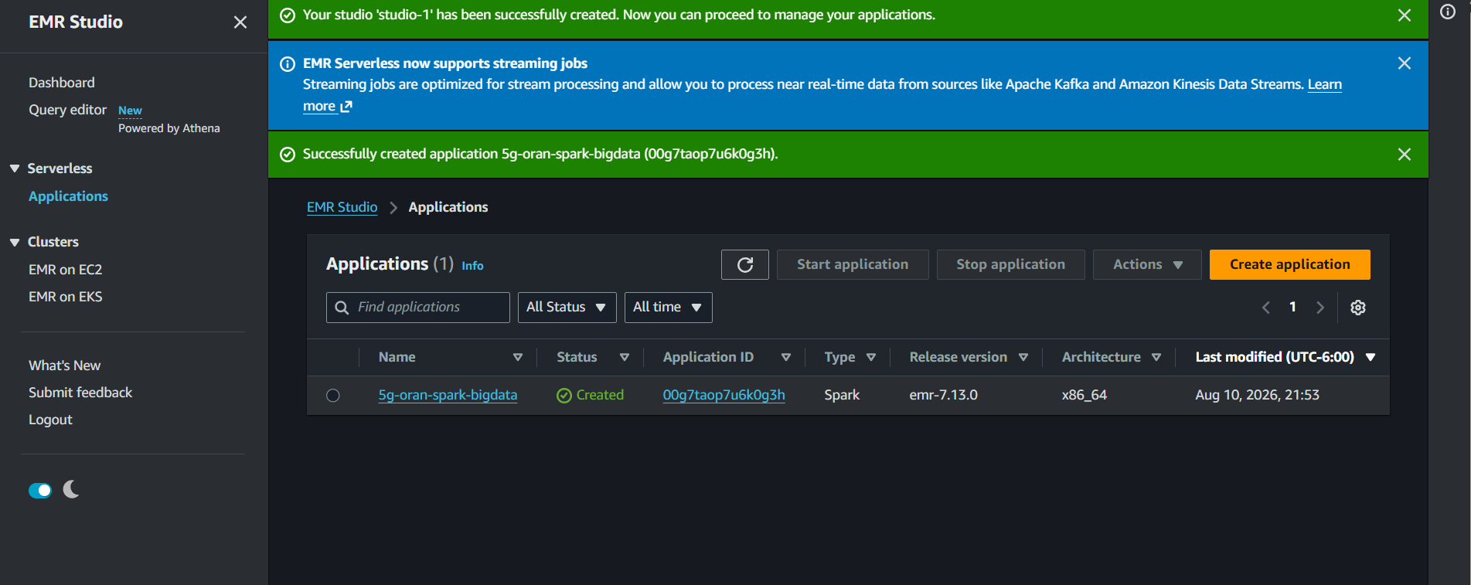

Slide 10
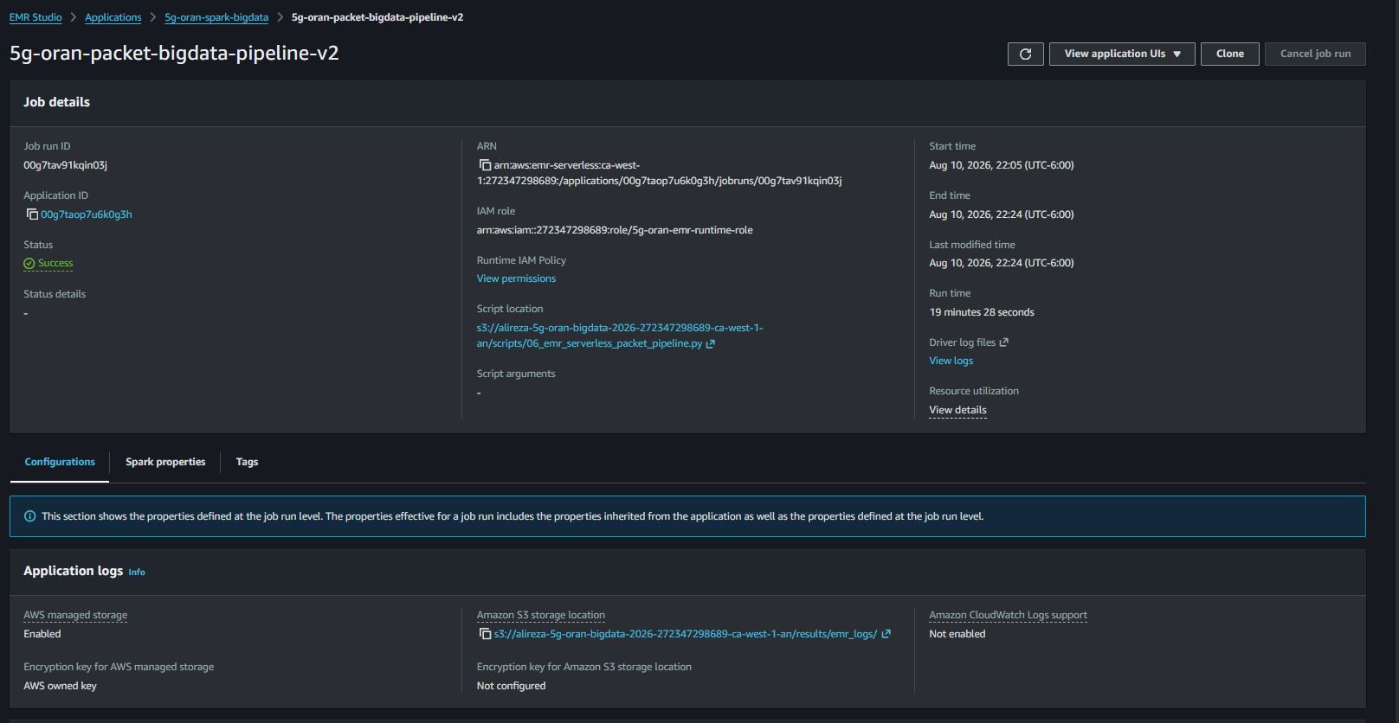

Slide 12
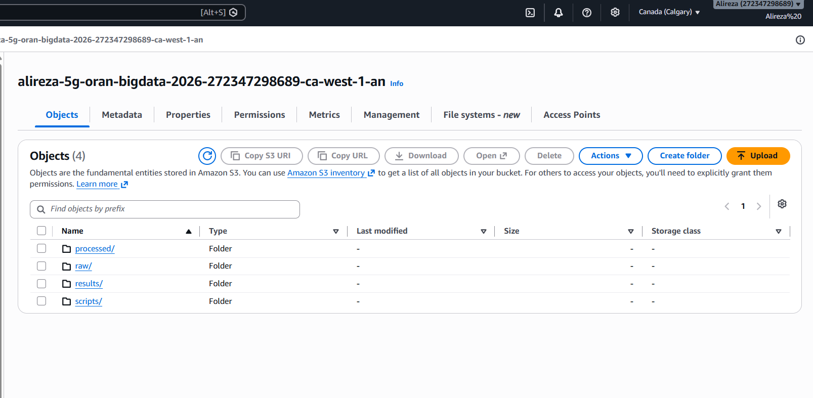

Slide 13
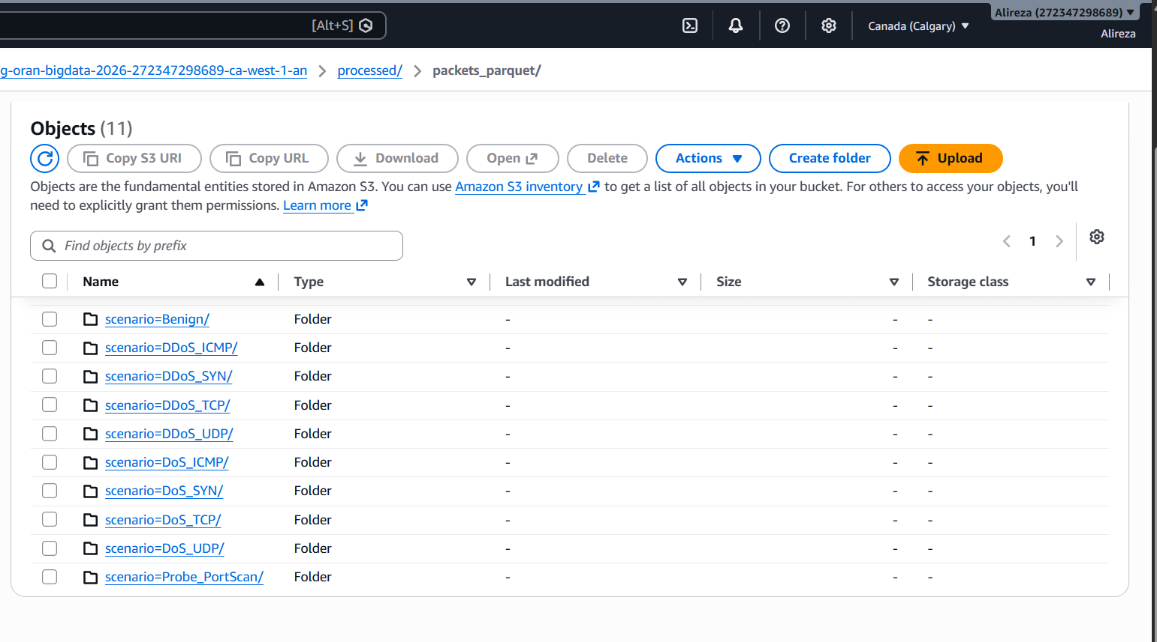
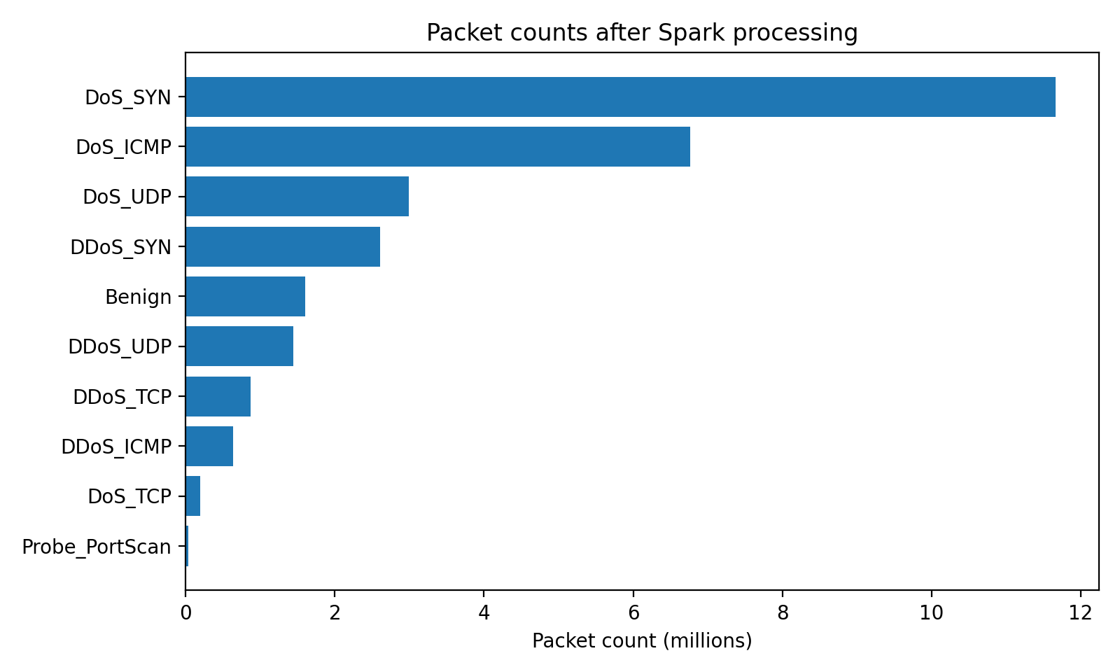
Spark Based Packet Processing Results
Metric | Value
Input packet CSV files | 35
Input rows | 28,803,972
Most packet count | DoS_SYN
Clean rows | 28,803,972
Parquet write status | Success
Output format | Partitioned Parquet by scenario
Packet counts by scenario after Spark processing and the final Parquet partitions in S3.
Processing this stage in Spark demonstrated the Big Data component of the project. The job read all 35 packet CSV files and wrote curated Parquet outputs by scenario.
9

Slide 14
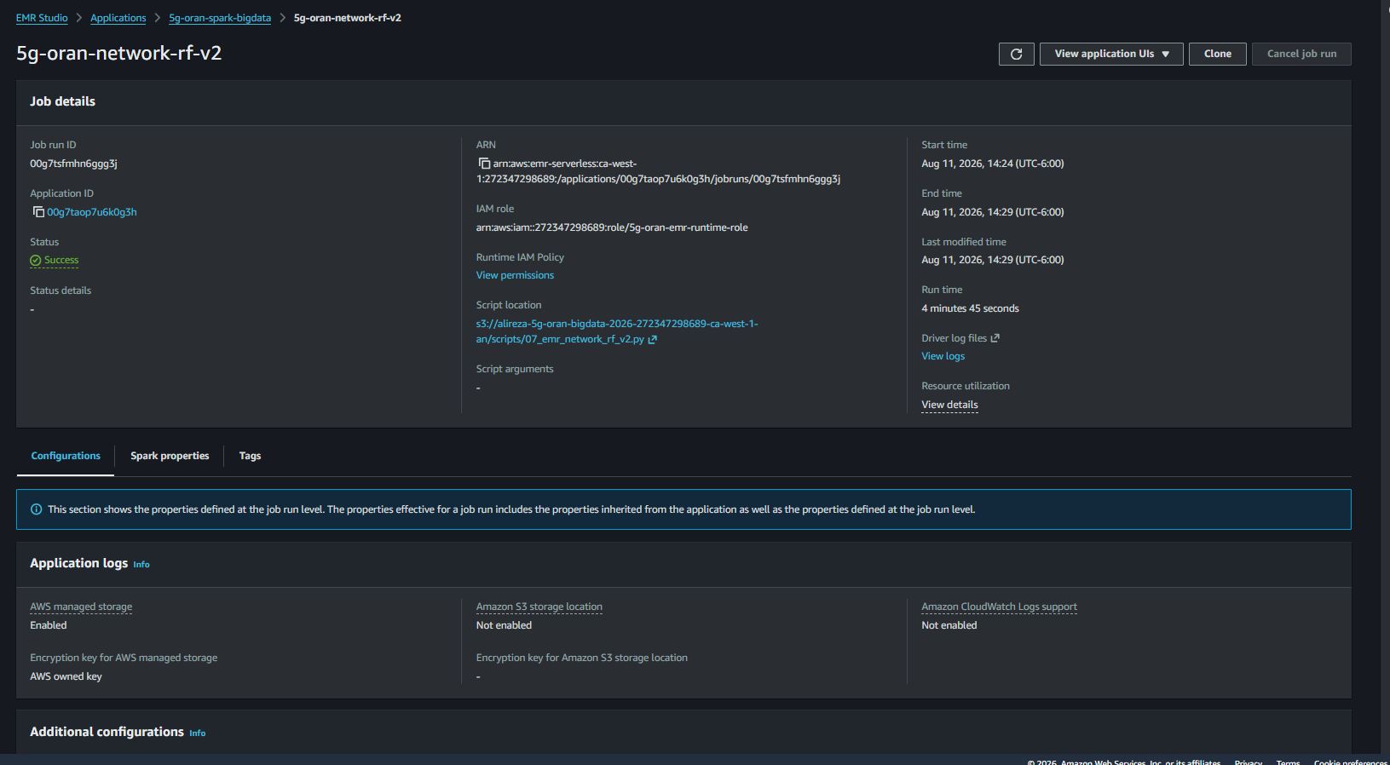
Network Flow Random Forest Method
Input table: Network_Dataset.csv with 1,723,817 flow records.
Target label: traffic_type (0 = benign, 1 = attack).
Feature preparation: excluded identifiers and label leakage fields; categorical fields were encoded and numeric fields were assembled into vectors.
Split: 70% training, 15% validation, 15% test, with deterministic random splitting.
Two Random Forest candidates were evaluated on the validation split.
Best candidate: 100 trees and maximum depth 12.
Candidate | Trees | Depth | Val F1 | Val ROC AUC
1 | 60 | 10 | 0.9869 | 0.9950
2 | 100 | 12 | 0.9872 | 0.9956
Successful EMR Serverless job for the network Random Forest experiment.
10

Slide 15
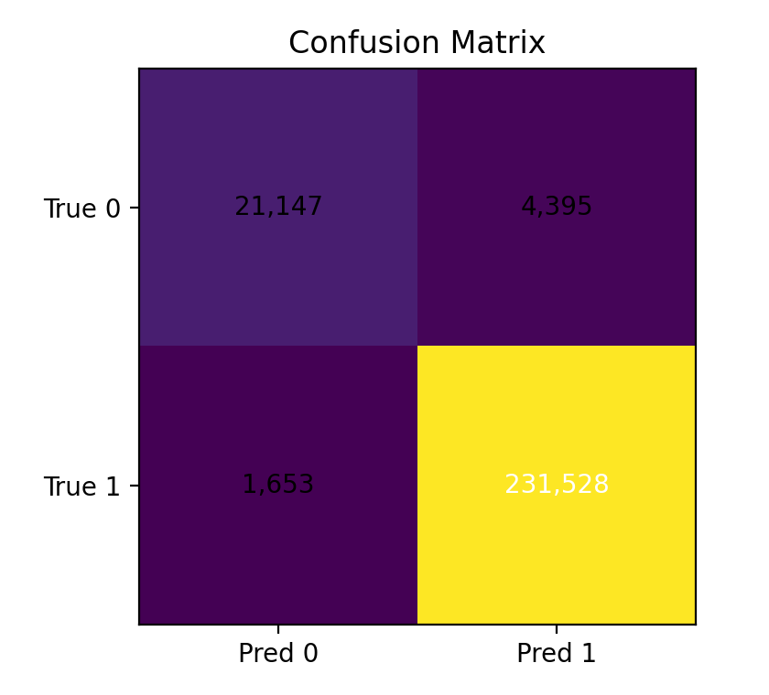
Network Flow Model Results
Metric | Value
Train / validation / test | 1,206,950 / 258,144 / 258,723
Accuracy | 97.66%
Attack precision | 98.14%
Attack recall | 99.29%
Attack F1 | 98.71%
ROC AUC | 0.9956
TN = 21,147
FP = 4,395
FN = 1,653
TP = 231,528
The model strongly recognized attack traffic, with high recall and strong overall separation.
Final test results for the network flow classifier.
11

Slide 16
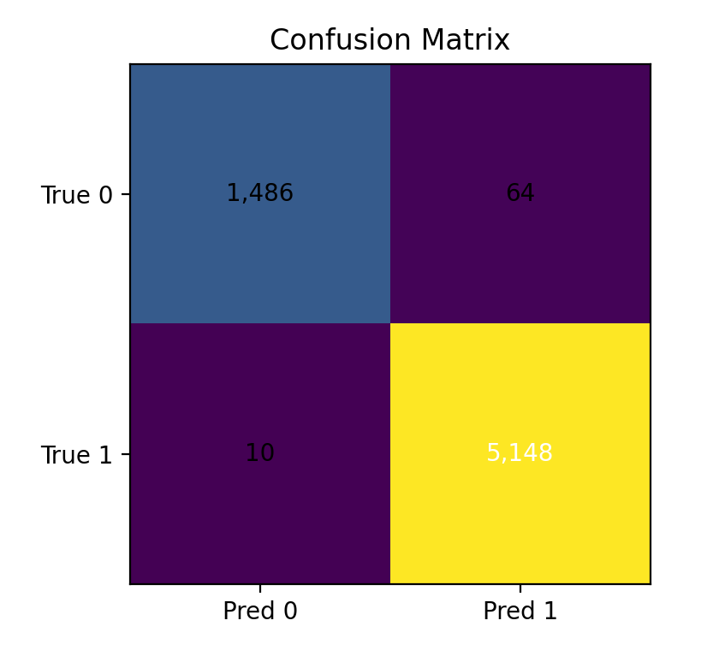
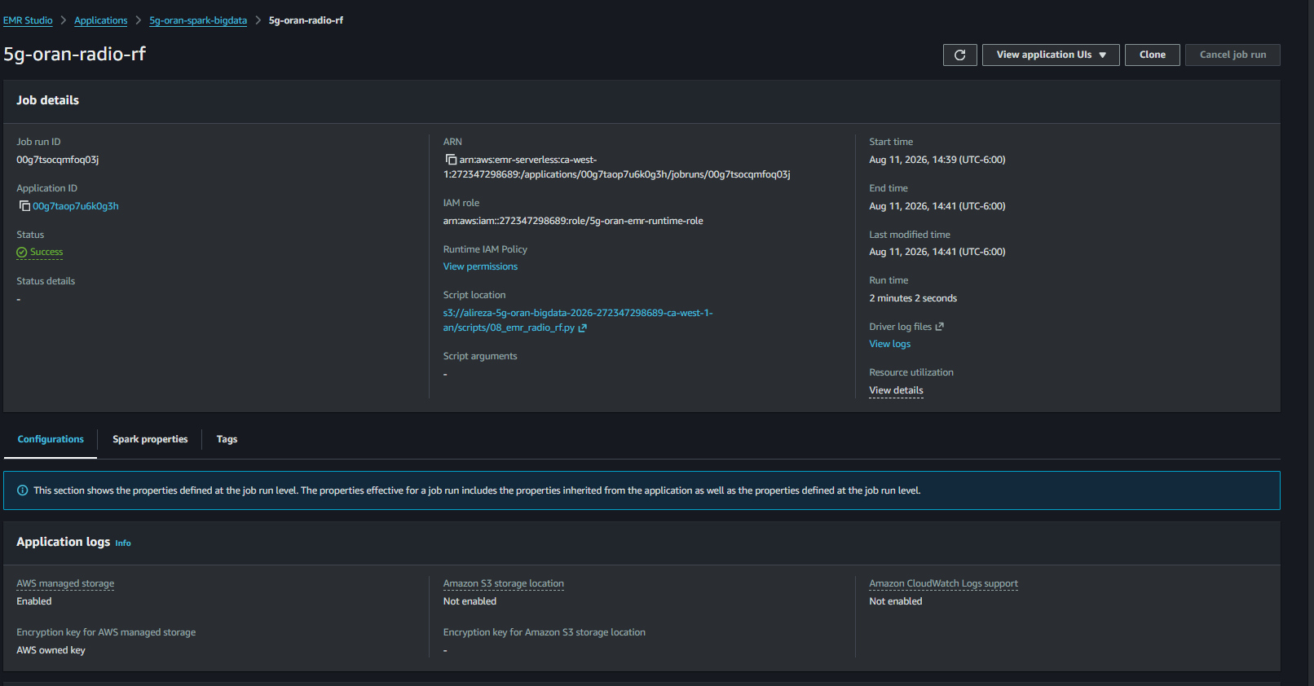
Radio Telemetry Random Forest Results
Metric | Value
Train / validation / test | 31,829 / 6,707 / 6,708
Accuracy | 98.90%
Attack precision | 98.77%
Attack recall | 99.81%
Attack F1 | 99.29%
ROC AUC | 0.9990
Best validation candidate: 100 trees, depth 12.
TN = 1,486
FP = 64
FN = 10
TP = 5,148
Radio features achieved excellent discrimination.
12

Slide 17
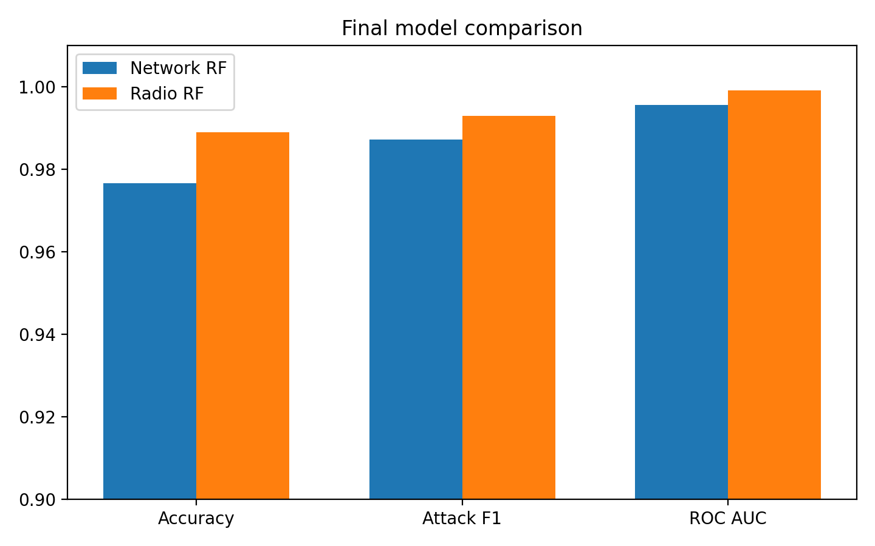
Comparison and Discussion
Aspect | Network RF | Radio RF
Input size | 1,723,817 rows | 45,244 rows
Best settings | 100 trees, depth 12 | 100 trees, depth 12
Accuracy | 97.66% | 98.90%
Attack F1 | 98.71% | 99.29%
Job logic time | 197.4 s | 37.4 s
Both modalities worked well, but the radio features achieved slightly stronger final scores in this binary setting.
The packet processing stage was the main Big Data stage, while the final ML stages used the structured network and radio tables.
13

Slide 18
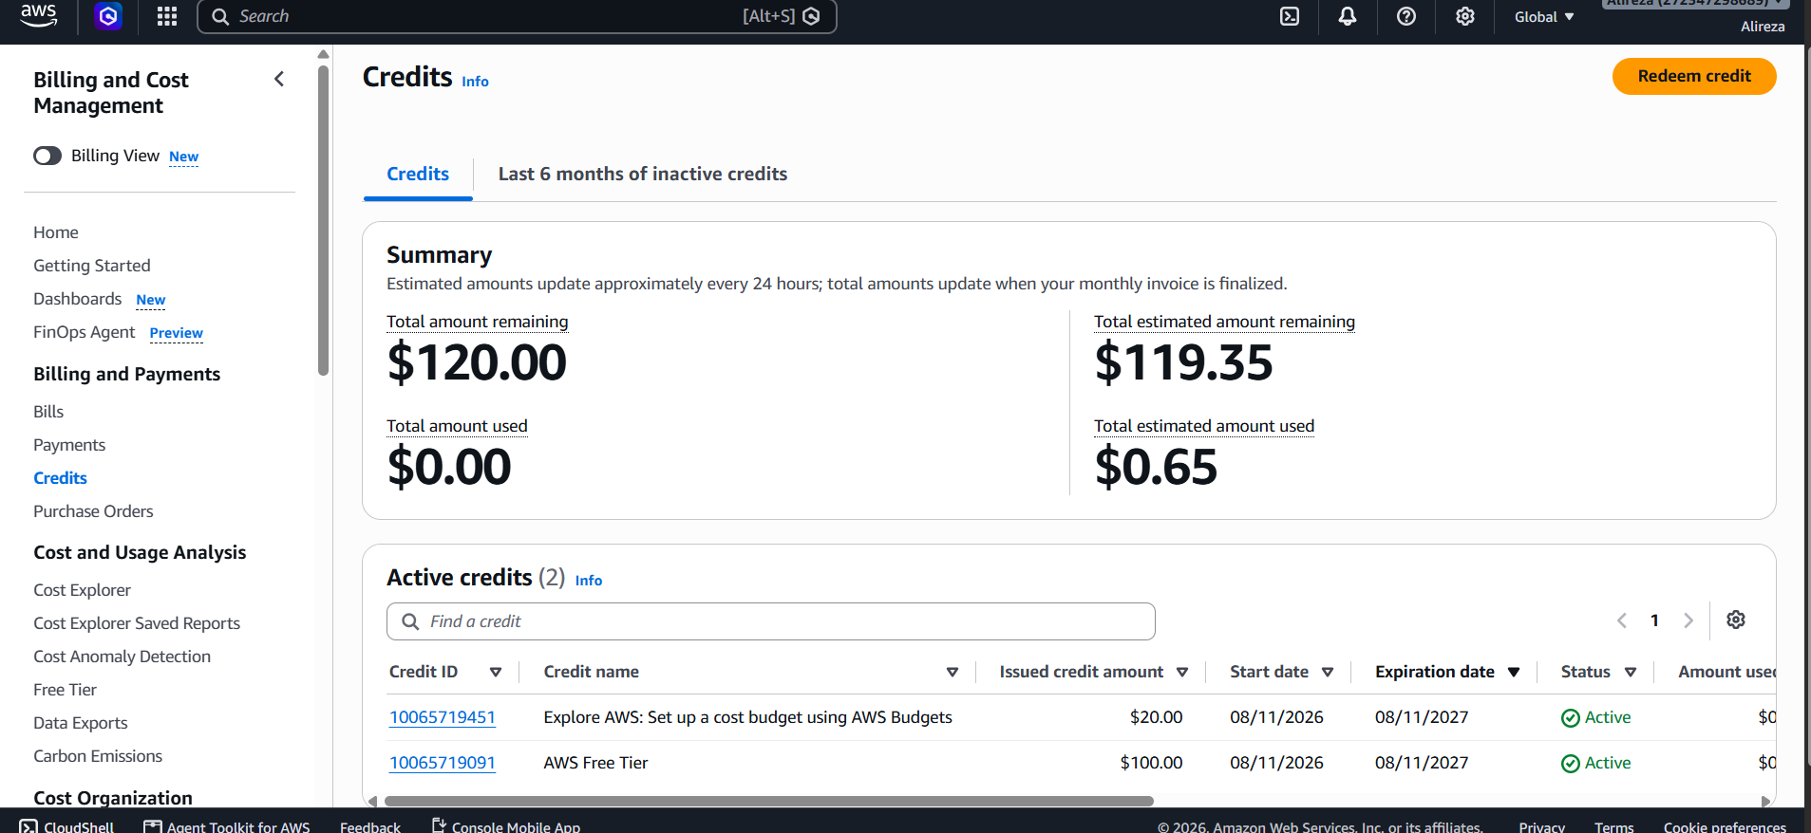
Cost and Practical Lessons
The cloud portion was completed with very low spending.
Final billing screenshot showed about $0.65 estimated usage and $119.35 estimated credit remaining.
EMR Serverless reduced management overhead because no long running Spark cluster had to be maintained.
Using a temporary EC2 instance only for ingestion helped control costs.
S3 provided persistent storage for raw data, Parquet outputs, scripts, and final metrics.
Billing and credit usage at the end of the experiments.
14

Slide 19
Conclusion and Future Work
The project successfully demonstrated a complete cloud based Big Data pipeline for a real 5G O RAN security dataset.
Spark was used to process the largest structured packet collection and to convert it into Parquet for scalable analytics.
The network flow Random Forest reached 97.66% accuracy and 98.71% attack F1 on the full test split.
The radio Random Forest reached 98.90% accuracy and 99.29% attack F1 on the full test split.
The AWS workflow remained inexpensive and reproducible.
Future work: cross layer aligned modeling, more detailed multiclass detection, time aware evaluation, and comparison with deep learning models.
Thank you
Full references and detailed discussion are available in the final report.
15

