Slide 1
Data Professionals Survey
Author: Alireza Hadipoor
Email: alirzahadipur@gmail.com
Goal: Survey of professionals who work in the field of data
Date: 10th May 2024

Slide 2
Introduction: In this part, I will show you some investigation about the dataset related to the data professionals survey. In this survey, 624 professionals have participated. I cleaned the data, wrote some queries, and then visualized them.
You can see all the materials in my GitHub repository: Link
Note: These results were derived using this data set and may not be generally correct. However, they can give you a good intuition about careers in data.

Slide 3
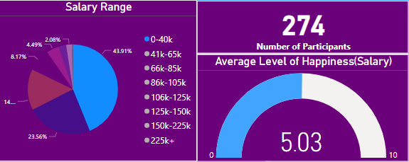
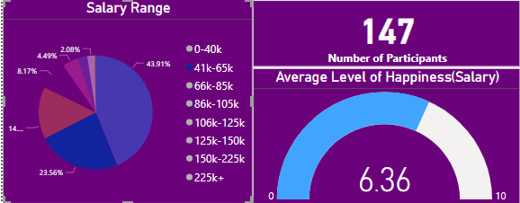
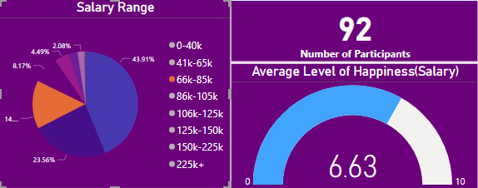
Insight (1/4)
Increasing the average salary has almost a direct relation to happiness.
Salary: 0-40k
Happiness: 5.03
Salary: 41K-65K
Happiness: 6.36
Salary: 66K-85K
Happiness: 6.63

Slide 4
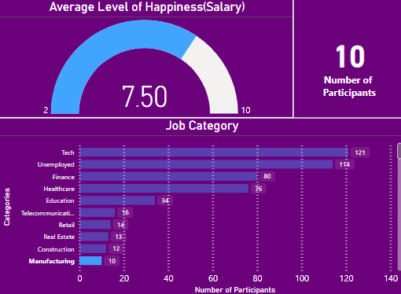
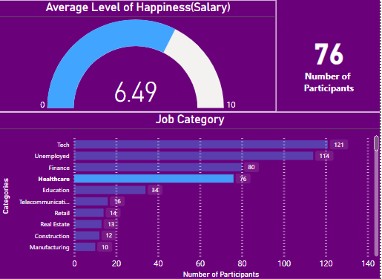
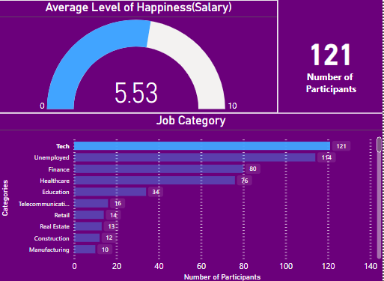
Insight (2/4)
Professionals who work in jobs related to health and manufacturing have significantly higher levels of happiness to their jobs.
Category: Manufacturing
Happiness: 7.50
Category: Healthcare
Happiness: 6.49
Category: Tech
Happiness: 5.53

Slide 5
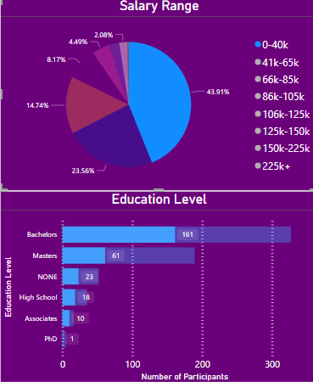
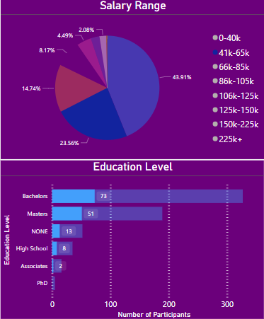
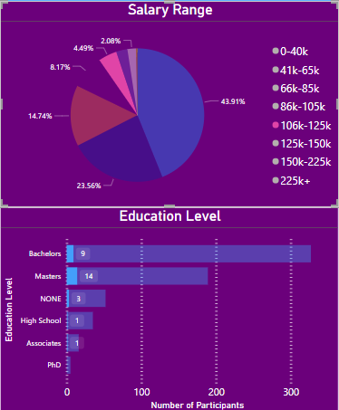
Insight (3/4)
The number of Bachelors is the highest among all levels of education but as the salary increases, the percentage of bachelors decreases.
Salary:0-40K
Percentage of bachelors(almost): 59%
Salary:41K-65K
Percentage of bachelors(almost): 50%
Salary:106K-125K
Percentage of bachelors(almost): 32%

Slide 6
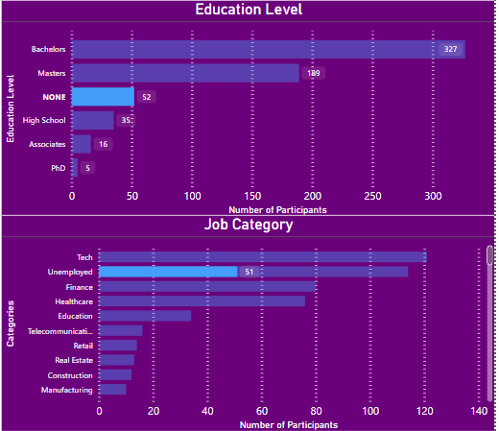
Insight (4/4)
Almost everyone who selected The ‘None’ option in the ‘education’ part selected ‘unemployment’ in the ‘job category’ part.
It can be inferred that it’s almost impossible to get a job as a data professional with none of the degrees.

