Slide 1
Part 2 Excel Project Report
Author: Alireza Hadipoor
Email: alirzahadipur@gmail.com
Part 2: Pivot Table

Slide 2
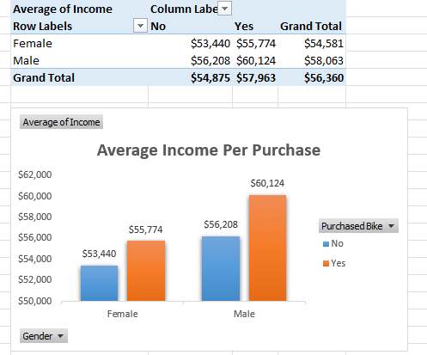
1
This pivot table shows the average income per purchased bikes for two categories male and female.

Slide 3
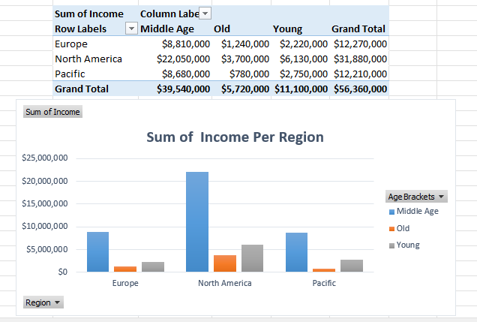
2
The next pivot table shows the sum of income per region for 3 categories: Europe, North America, Pacific

Slide 4
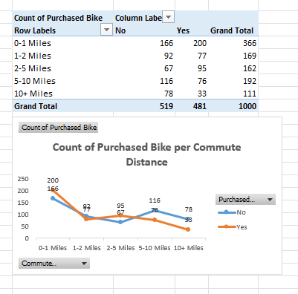
3
The third one shows the number of purchased bikes per commute distance.

Slide 5
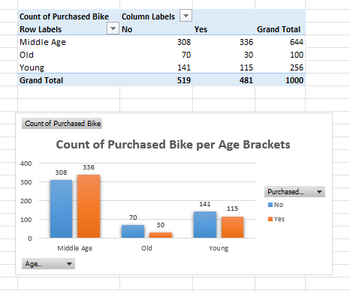
4
The last pivot table is the count of purchased bikes per age bracket

