Slide 1
Part 1 Excel Project Report
Topics:
1. Removing Duplicates
2. Making columns more readable
3. Making age brackets
Author: Alireza Hadipoor
Email: alirzahadipur@gmail.com
Part 1: Cleaning Data

Slide 2
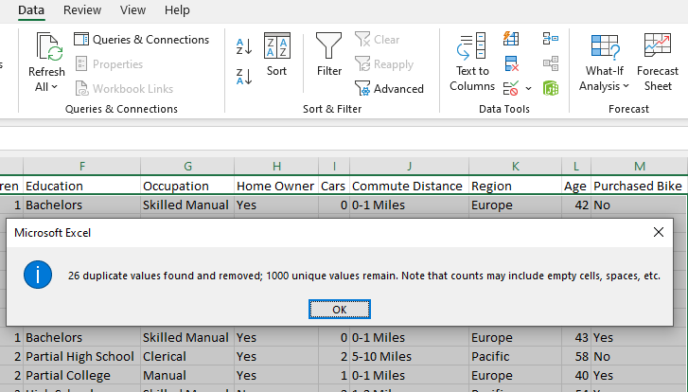
1. Removing Duplicates
First, we use this button to remove duplicates

Slide 3
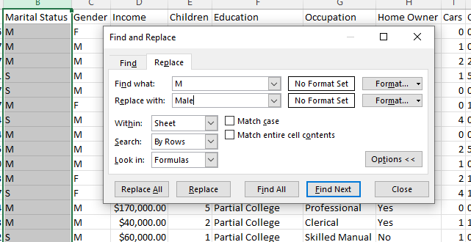
2. Making columns more readable
We have 2 rows that can be ambiguous for those who will see our dashboard so that we can clarify these columns.
For this purpose, we should select the rows and like this image use the find and replace option to convert M to Male, and F to Female

Slide 4
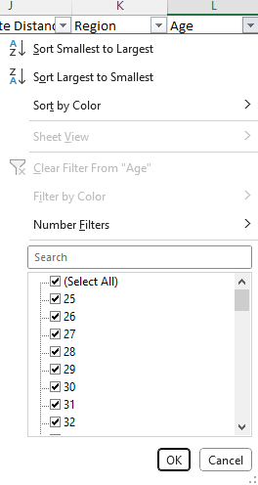
3. Making age brackets
The column that shows customers' age, ranges from 25 to 89, it’s not useful for us.
We use a formula to make a column that classifies ages.

Slide 5

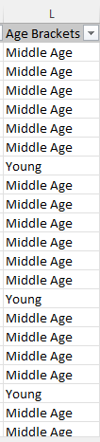
3. Making age brackets
This is the formula, we used a nested IF statement.
And this is the result
You can see all the data before and after cleaning in the Excel file in this folder.

