Slide 1

LangChain Framework
Student: Alireza Dastmalchi Saei
Course: Natural Language Processing (NLP)
Professor: Dr. Baradaran

Slide 2
Context
LangChain Framework
Retrieval-Augmented Generation (RAG)
Using LangChain for RAG
Chatting with Data
1 of 22

Slide 3
LangChain: Models, Prompts and Output Parsers
Direct API calls to OpenAI
API calls through LangChain:
Prompts
Models
Output parsers
2 of 22

Slide 4
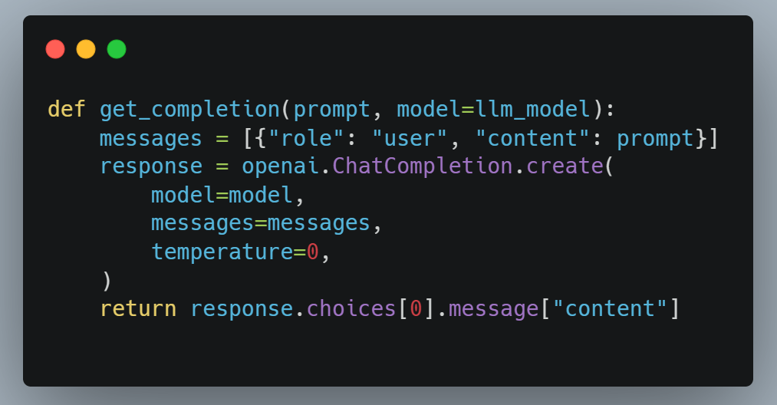
Direct API calls to OpenAI
3 of 22

Slide 5
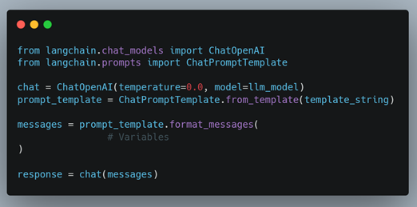
API calls with LangChain (Prompt & Model)
4 of 22

Slide 6
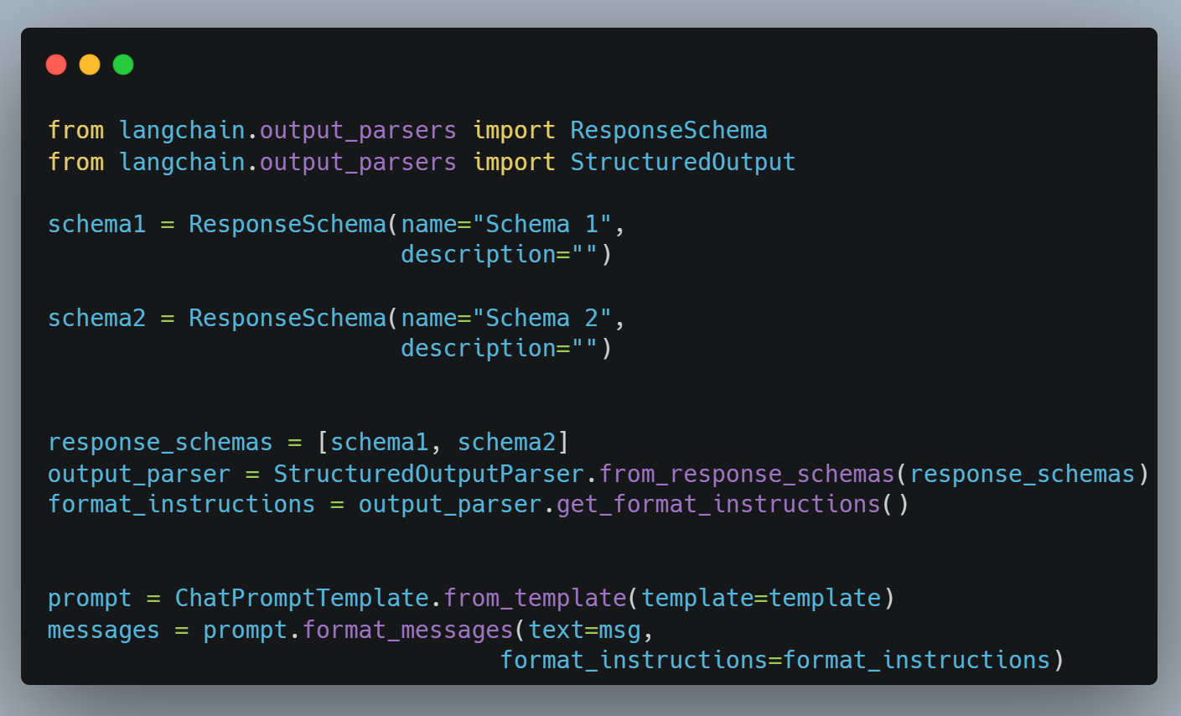
API calls with LangChain (Output Parser)
5 of 22

Slide 7
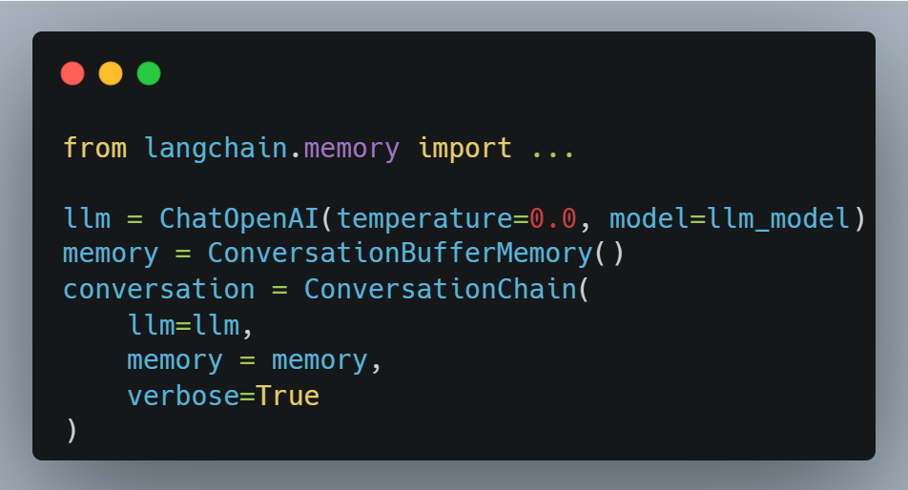
LangChain: Memory
LLMs are `stateless`, that means each transaction is independent.
Chatbots appear to have memory by providing the full conversation as `context`
LangChain provides different types of memories and accumulate the conversation:
ConversationBufferMemory
ConversationBufferWindowMemory (k)
ConversationTokenBufferMemory
ConversationSummaryMemory
llm
max_token_limit
6 of 22

Slide 8
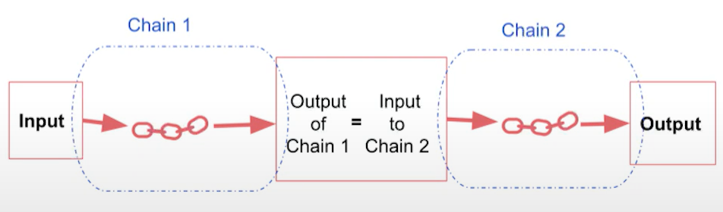
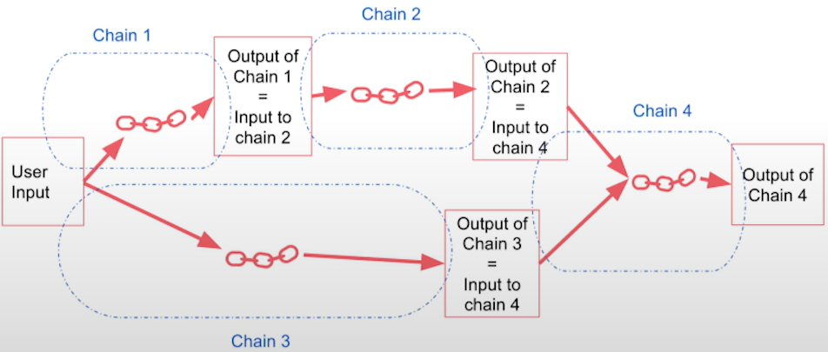
LangChain: Chains
LLMChain
Sequential Chains
SimpleSequentialChain
SequentialChain
Router Chain
7 of 22

Slide 9
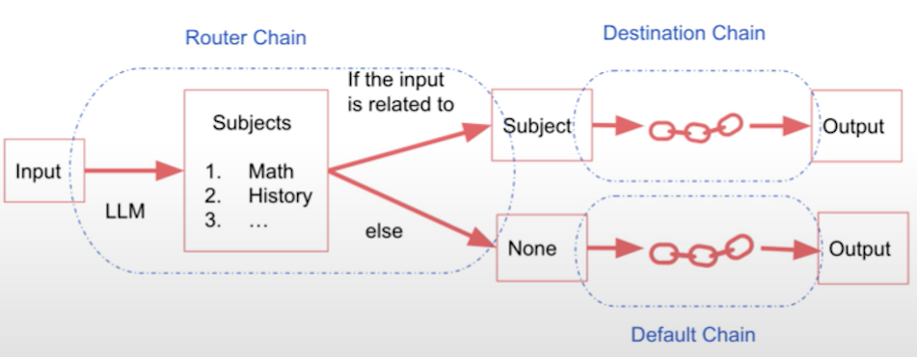
LangChain: Chains
LLMChain
Sequential Chains
SimpleSequentialChain
SequentialChain
Router Chain
8 of 22

Slide 10
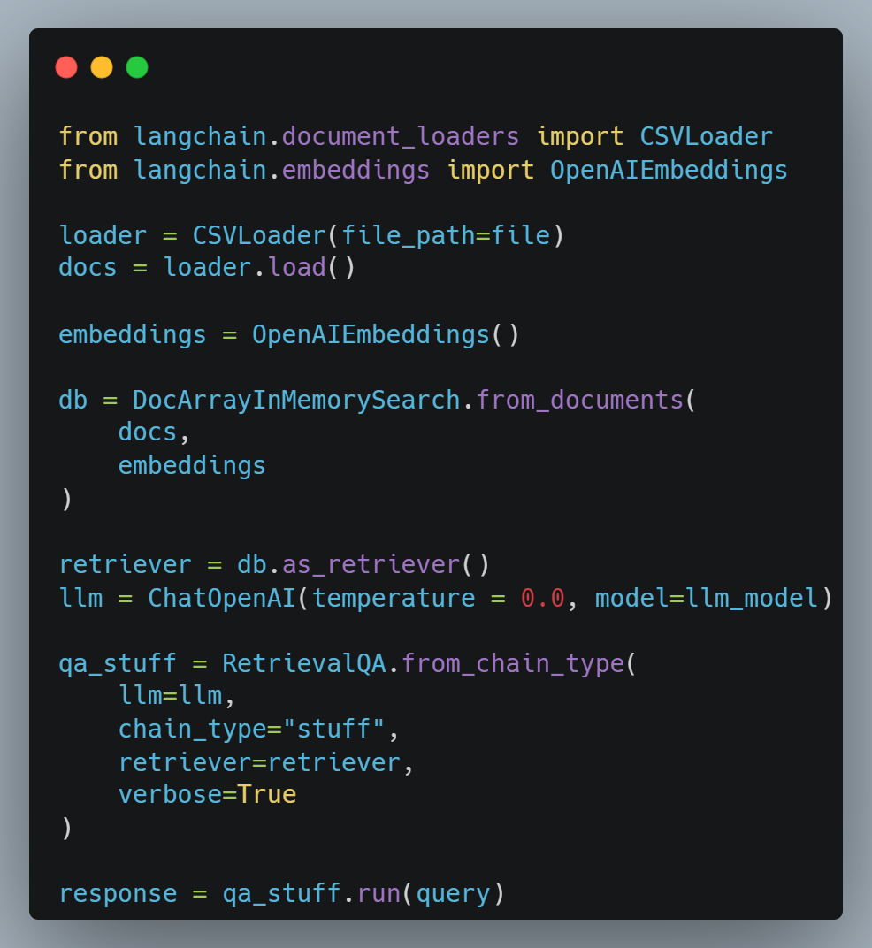
LangChain: Q&A over Documents
9 of 22

Slide 11
LangChain: Evaluation
Example generation
Hard-Coding Examples
LLM Generated Examples
Manual evaluation (+ debugging)
LLM-assisted evaluation
LangChain evaluation platform
10 of 22

Slide 12
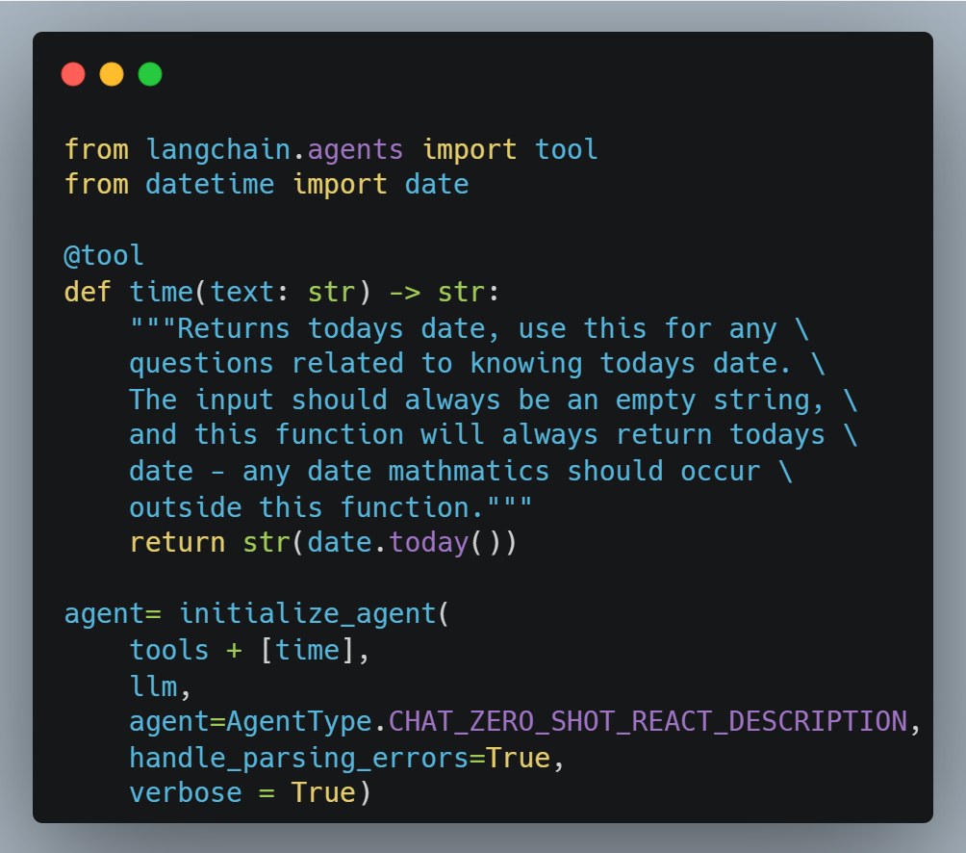
LangChain: Agents
Using built in LangChain tools
DuckDuckGo search
Wikipedia
Python (PythonREPLTool)
Etc.
Defining your own tools
11 of 22

Slide 13
Retrieval Augmented Generation (RAG)
RAG: an AI framework that combines the strengths of traditional information retrieval systems (such as databases) with the capabilities of generative large language models (LLMs).
In RAG, an LLM retrieves contextual documents from an external dataset as part of its execution.
Use-case: Useful if we want to ask question about specific documents (e.g., our PDFs, a set of videos, etc.)
12 of 22

Slide 14
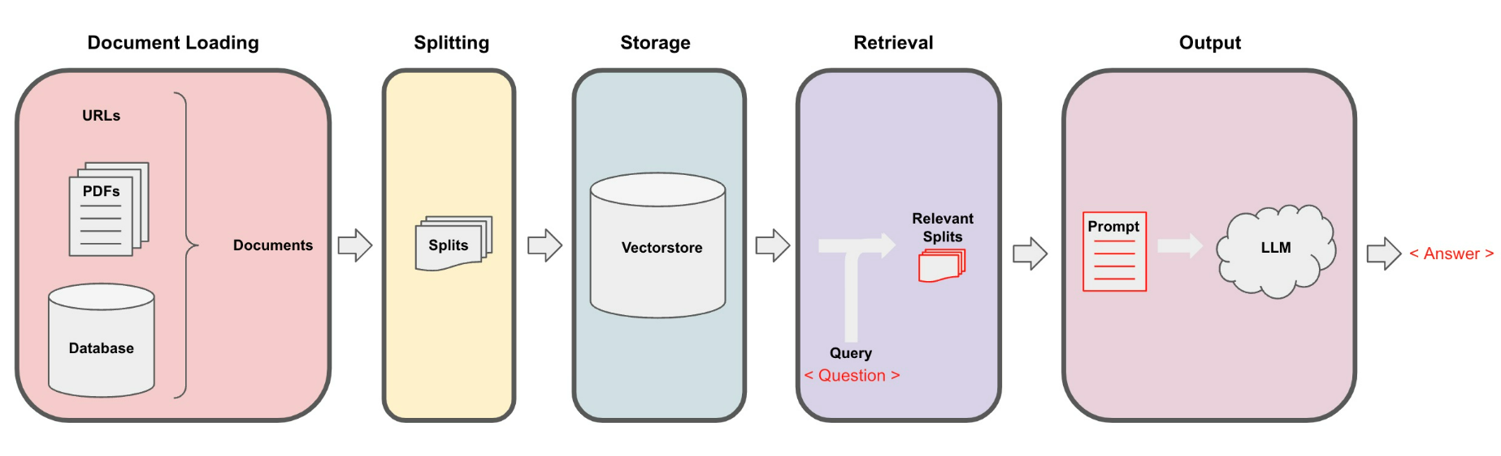
RAG: Overview
13 of 22

Slide 15
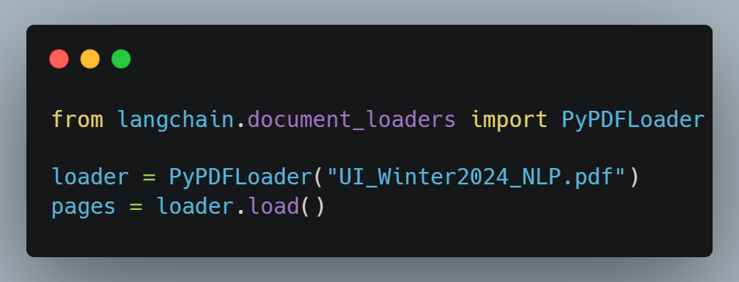
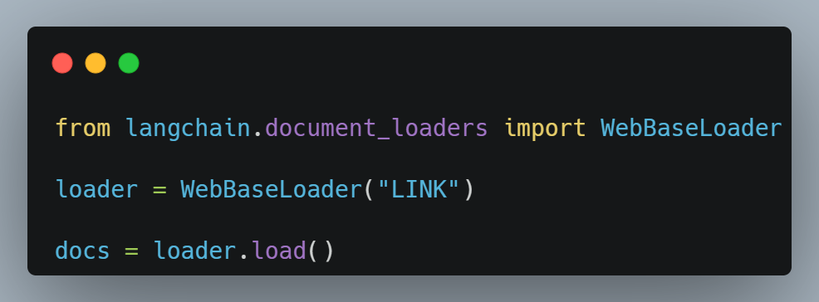
RAG: Document Loading (Part 1)
PDF
Each page in PDF is a `Document`
page_content
metadata
URLs
14 of 22

Slide 16
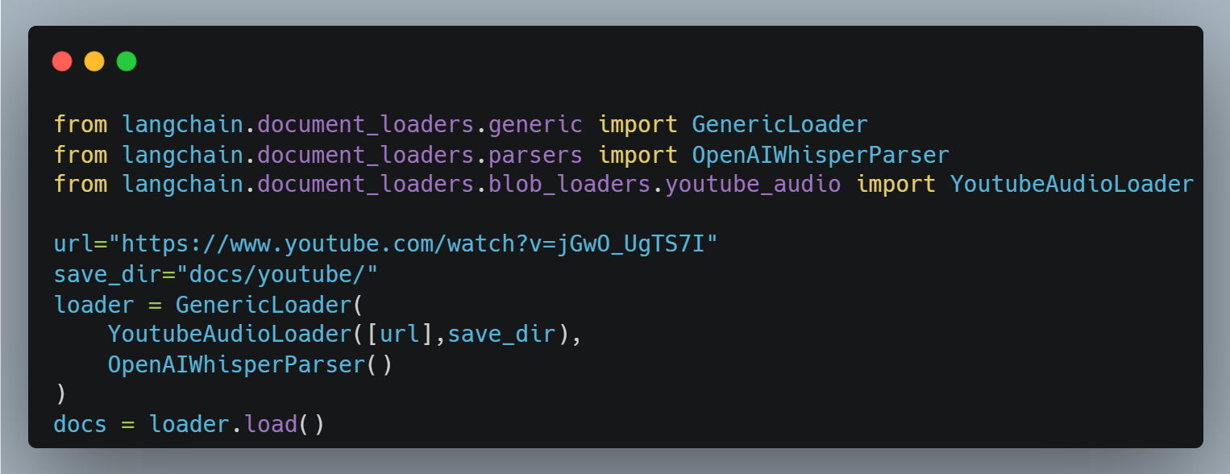
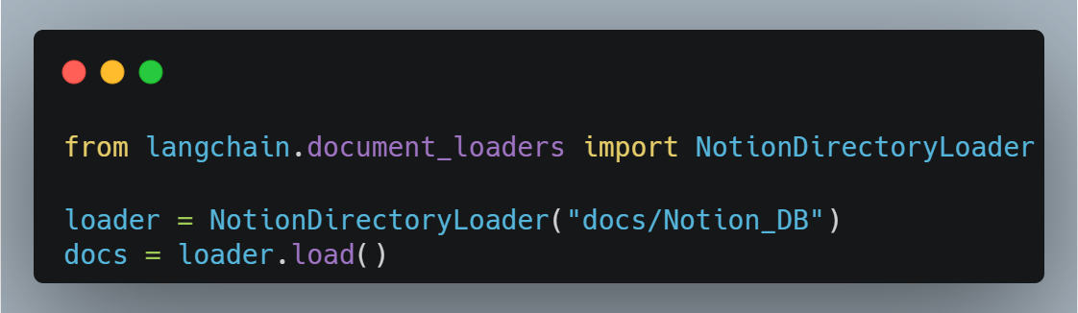
RAG: Document Loading (Part 2)
YouTube
Notion
15 of 22

Slide 17
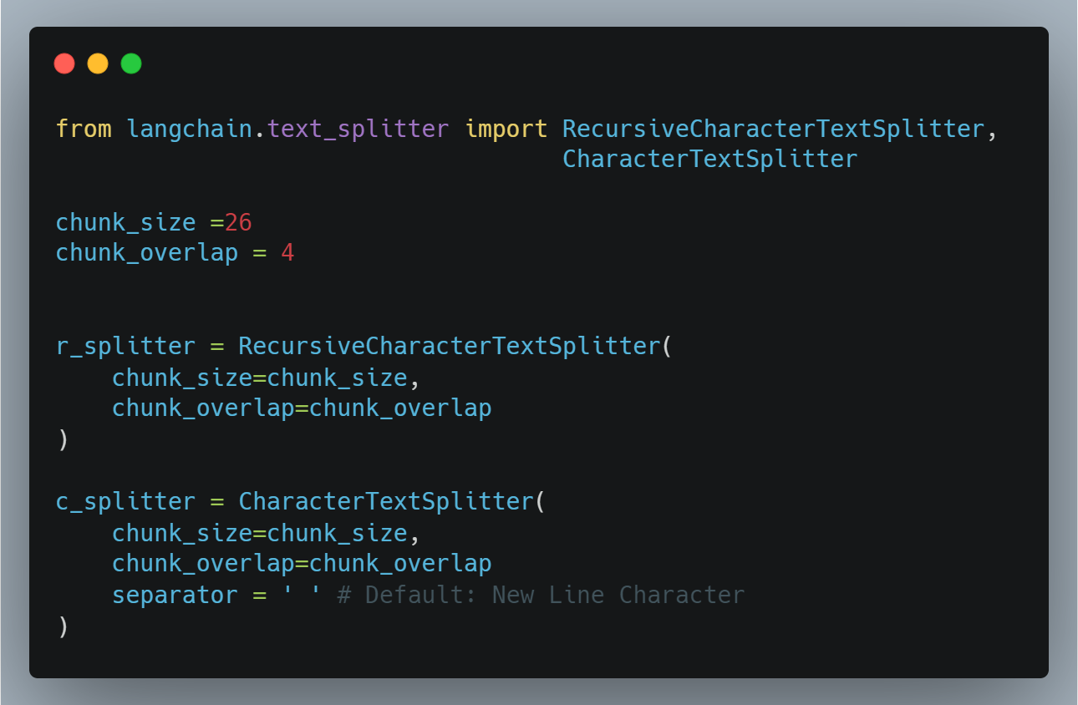
RAG: Document Splitting
Splitting document into smaller chunks, but retaining meaningful relationships
16 of 22

Slide 18
RAG: Document Splitting
Types of text splitters in LangChain:
CharacterTextSplitter()
MarkdownHeaderTextSplitter()
Context Aware Splitter
TokenTextSplitter()
Tokens are often ~4 characters
Useful because LLMs often have context windows designated in tokens
SentencesTransformersTokenTextSplitter()
RecursiveCharacterTextSplitter()
Recommended for generic text
Language()
NLTKTextSplitter()
SpacyTextSplitter()
17 of 22

Slide 19
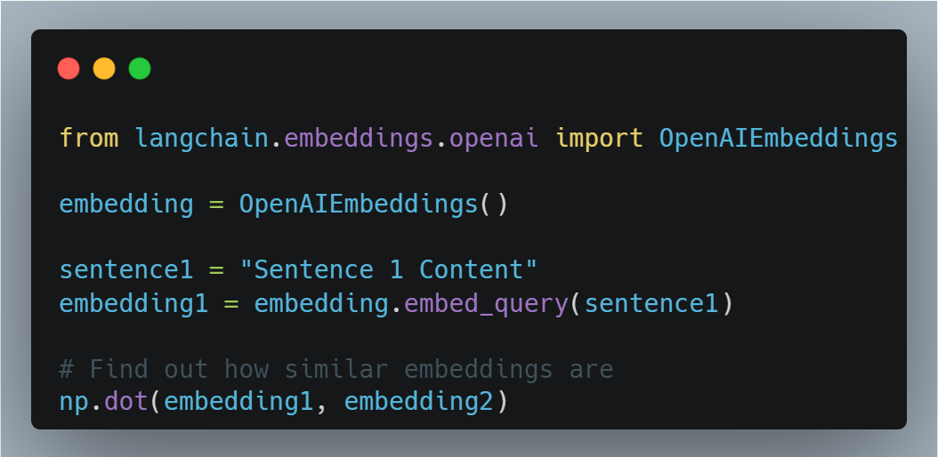
RAG: Storage
Embeddings
Embedding vector captures context/meaning
Text with similar contexts will have similar vectors
18 of 22

Slide 20
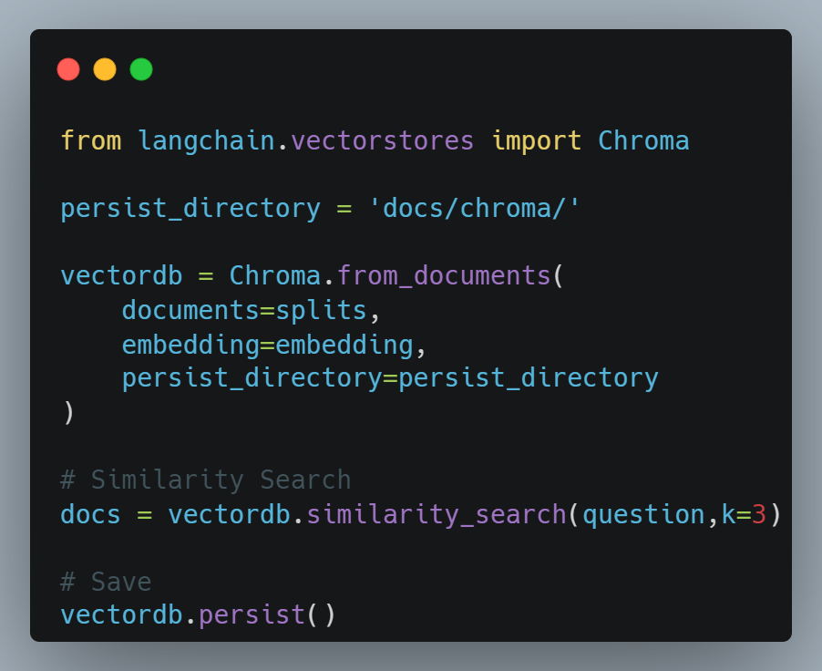
RAG: Storage
Vector Store
A storage where all splits are converted
into embedding vectors
Can find and return top `n` similar
embeddings to the entry
Failure Modes
Duplicate data will cause the vector store return
duplicate answer
19 of 22

Slide 21
RAG: Retrieval
Retrieval is the centerpiece of our retrieval augmented generation (RAG) flow
Addressing Diversity: Maximum marginal relevance (k, fetch_k)
Addressing Specificity: Working with metadata (Filter)
Addressing Specificity: Working with metadata using self-query retriever (SelfQueryRetriever)
Additional tricks: Compression (ContextualCompressionRetriever)
20 of 22

Slide 22
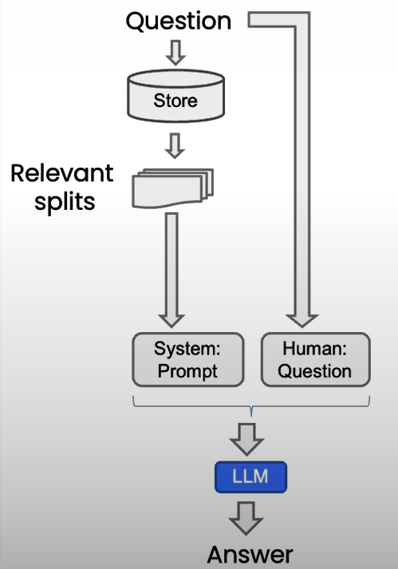
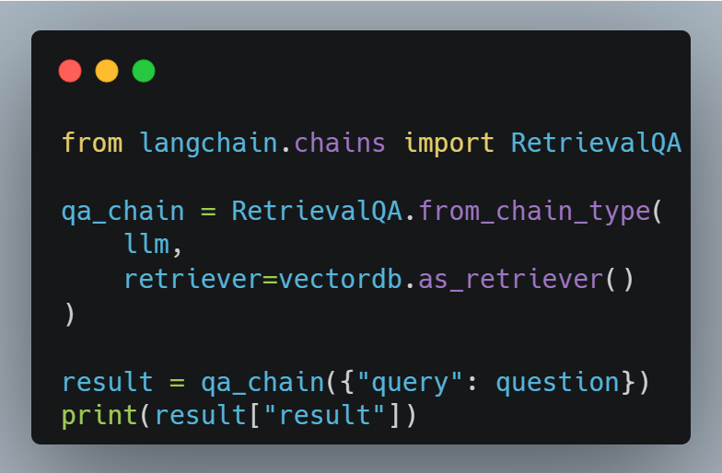
RAG: Chat with Data
RetrievalQA chain
Can use PromptTemplate from langchain.prompts
It must be passed to RetreivalQA
21 of 22

Slide 23
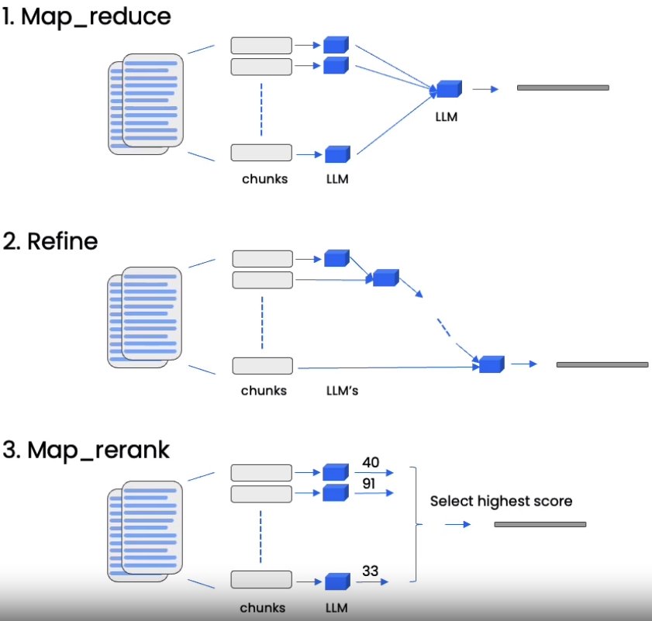
RAG: Chat with Data
Methods to resolve short context issues:
Map Reduce
Refine
Map Re-rank
22 of 22

Slide 24
The End

