Slide 1

Introduction to LangChain Framework
Student: Alireza Dastmalchi Saei
Course: Natural Language Processing (NLP)
Professor: Dr. Baradaran

Slide 2
Context
LangChain Framework
Retrieval-Augmented Generation (RAG)
Using LangChain for RAG
Chatting with Data
1 of n

Slide 3
LangChain: Models, Prompts and Output Parsers
Direct API calls to OpenAI
API calls through LangChain:
Prompts
Models
Output parsers
2 of n

Slide 4
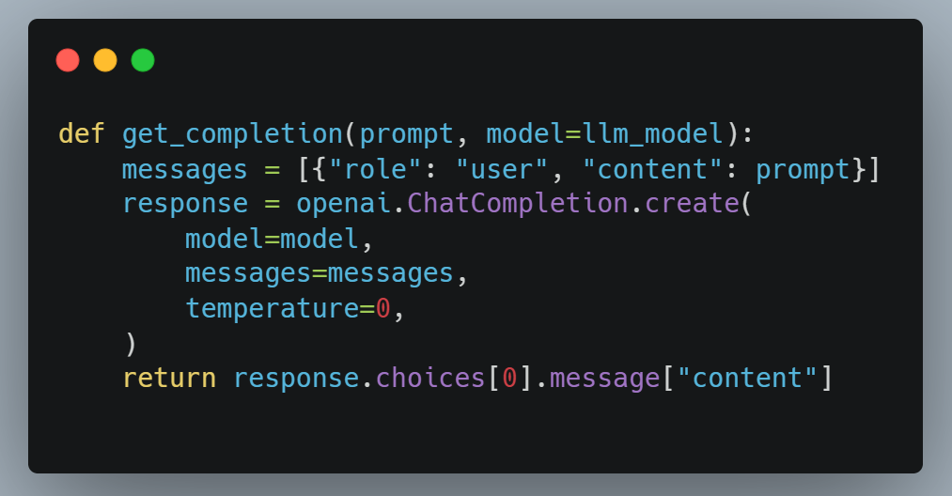
Direct API calls to OpenAI

Slide 5
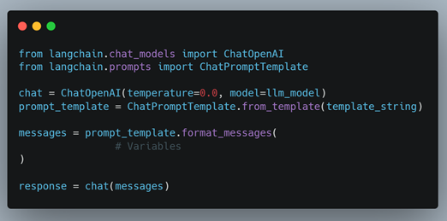
API calls with LangChain (Prompt & Model)

Slide 6
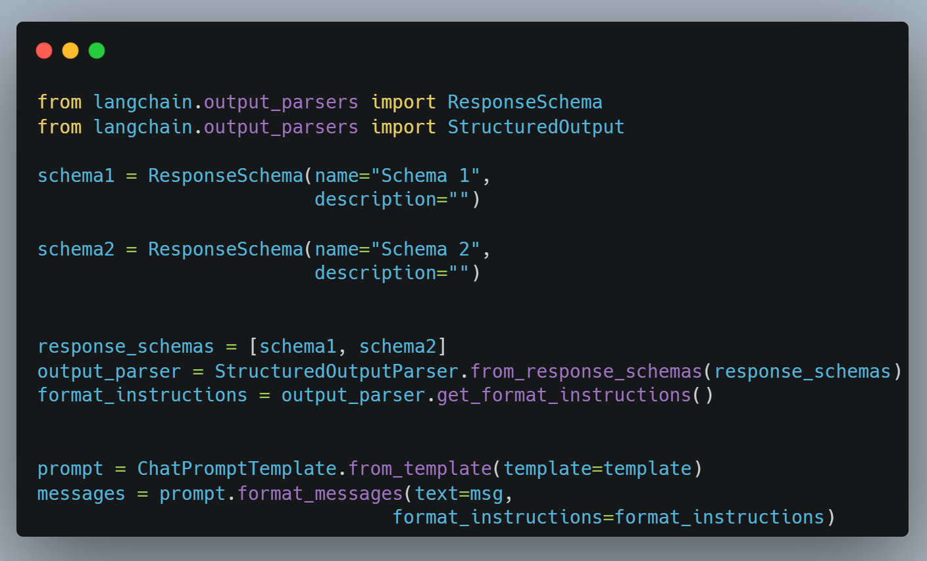
API calls with LangChain (Output Parser)

Slide 7
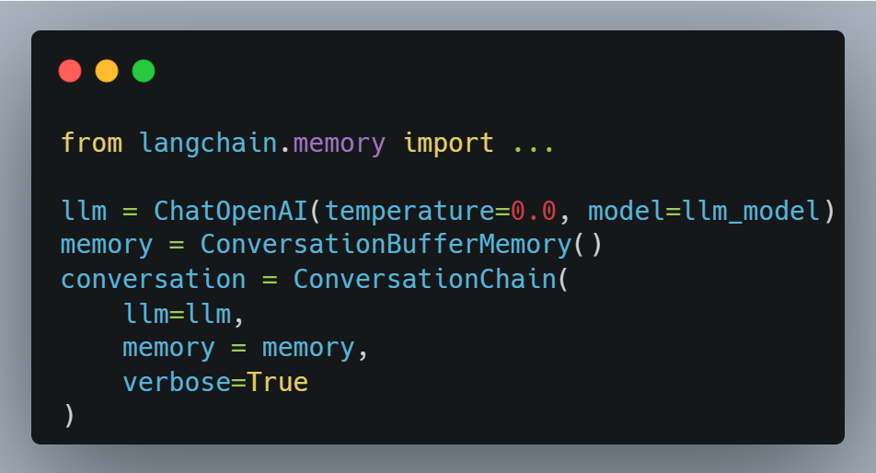
LangChain: Memory
LLMs are `stateless`, that means each transaction is independent.
Chatbots appear to have memory by providing the full conversation as `context`
LangChain provides different types of memories and accumulate the conversation:
ConversationBufferMemory
ConversationBufferWindowMemory
ConversationTokenBufferMemory
ConversationSummaryMemory
3 of n

Slide 8
LangChain: Chains
LLMChain
Sequential Chains
SimpleSequentialChain
SequentialChain
Router Chain
4 of n

Slide 9
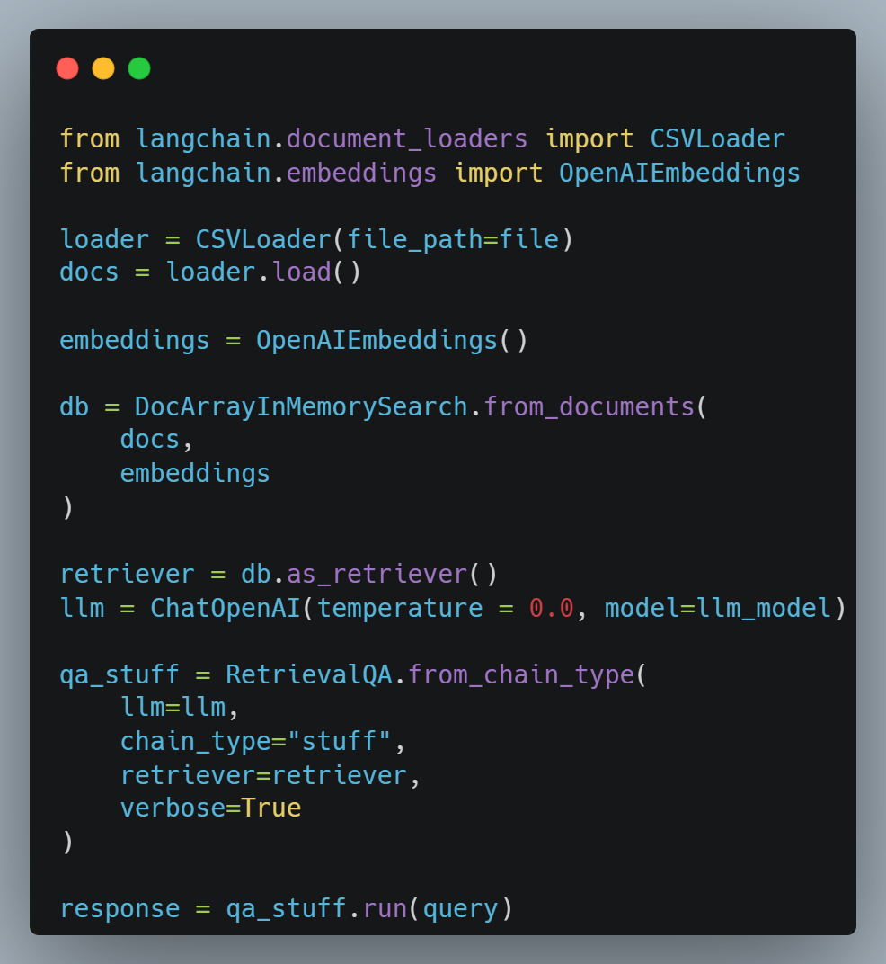
LangChain: Q&A over Documents
5 of n

Slide 10
LangChain: Evaluation
Example generation
Hard-Coding Examples
LLM Generated Examples
Manual evaluation (+ debugging)
LLM-assisted evaluation
LangChain evaluation platform
6 of n

Slide 11
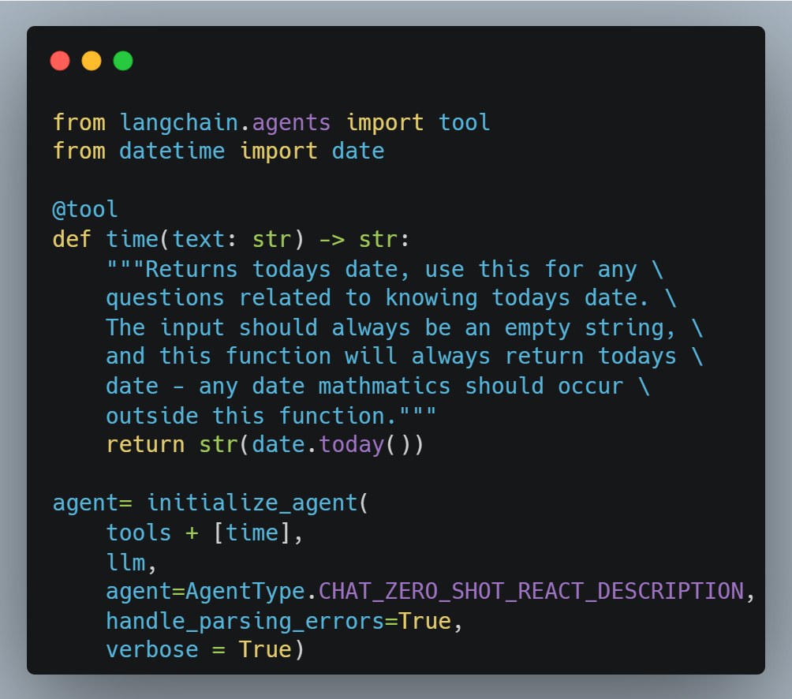
LangChain: Agents
Using built in LangChain tools
DuckDuckGo search
Wikipedia
Python (PythonREPLTool)
Etc.
Defining your own tools
6 of n

Slide 12
Retrieval Augmented Generation (RAG)
RAG: an AI framework that combines the strengths of traditional information retrieval systems (such as databases) with the capabilities of generative large language models (LLMs).
In RAG, an LLM retrieves contextual documents from an external dataset as part of its execution.
Use-case: Useful if we want to ask question about specific documents (e.g., our PDFs, a set of videos, etc.)
7 of n

Slide 13
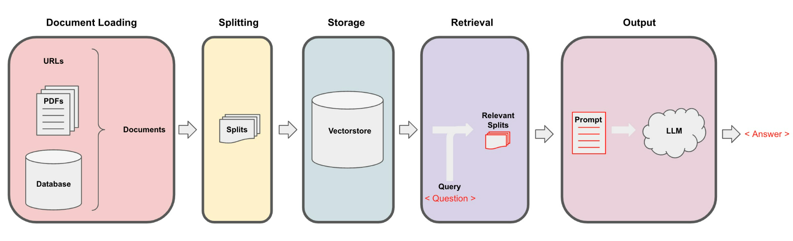
RAG: Overview

Slide 14
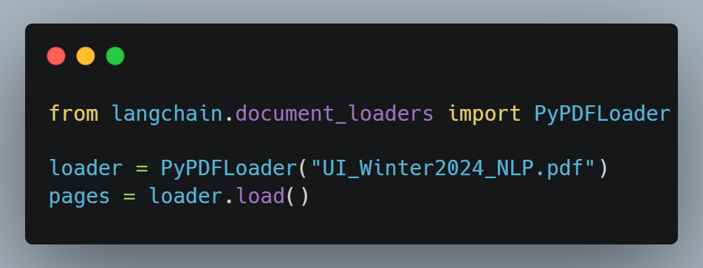
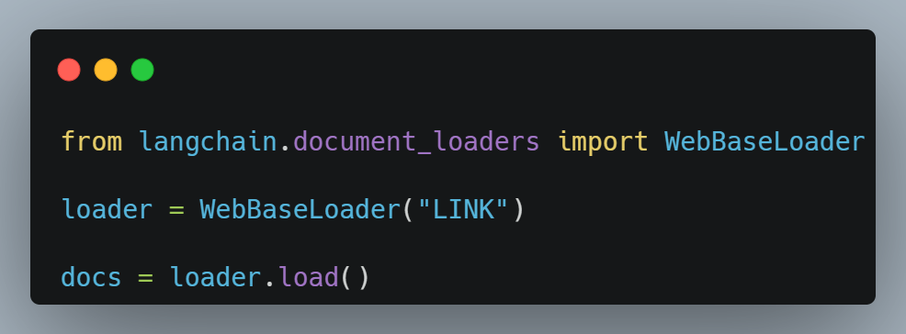
RAG: Document Loading (Part 1)
PDF
Each page in PDF is a `Document`
page_content
metadata
URLs
8 of n

Slide 15
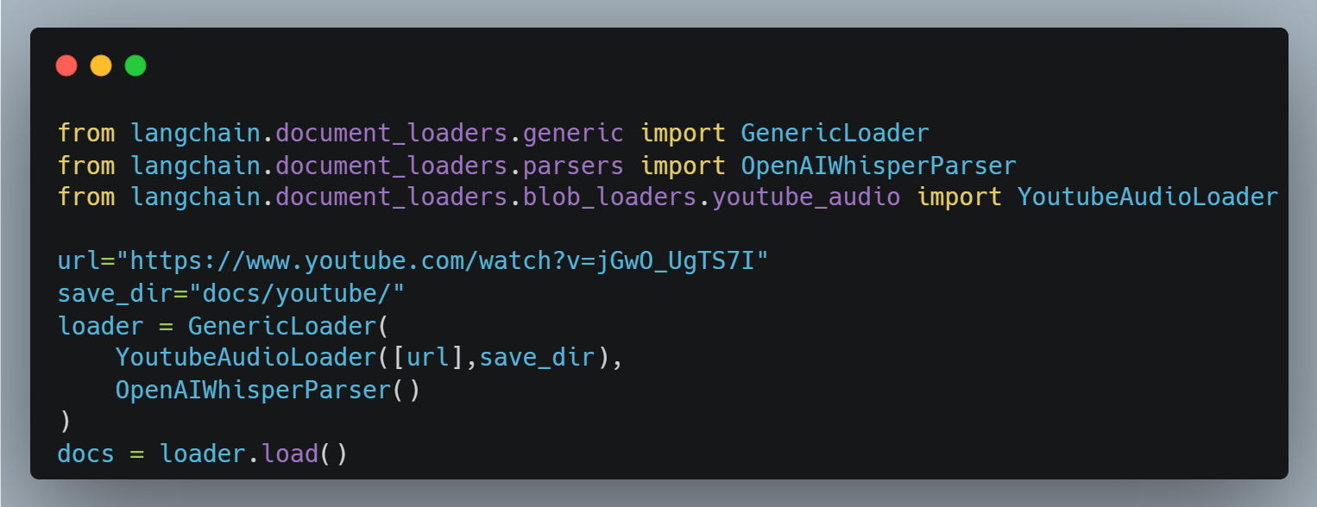
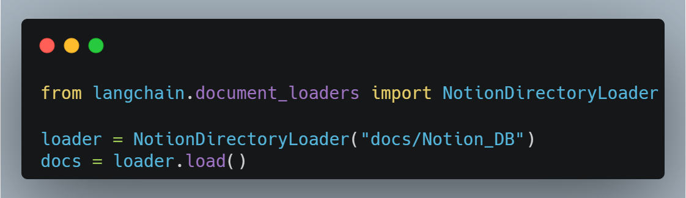
RAG: Document Loading (Part 2)
YouTube
Notion
8 of n

Slide 16
RAG: Document Splitting
Splitting document into smaller chunks, but retaining meaningful relationships
9 of n

Slide 17
RAG: Storage
10 of n

Slide 18
RAG: Retrieval
11 of n

Slide 19
RAG: Chat with Data
12 of n

Slide 20
The End

