Slide 1

Introduction to LangChain Framework
Student: Alireza Dastmalchi Saei
Course: Natural Language Processing (NLP)
Professor: Dr. Baradaran

Slide 2
Context
LangChain Framework
Retrieval-Augmented Generation (RAG)
Using LangChain for RAG
Chatting with Data
1 of n

Slide 3
LangChain: Models, Prompts and Output Parsers
Direct API calls to OpenAI
API calls through LangChain:
Prompts
Models
Output parsers
2 of n

Slide 4
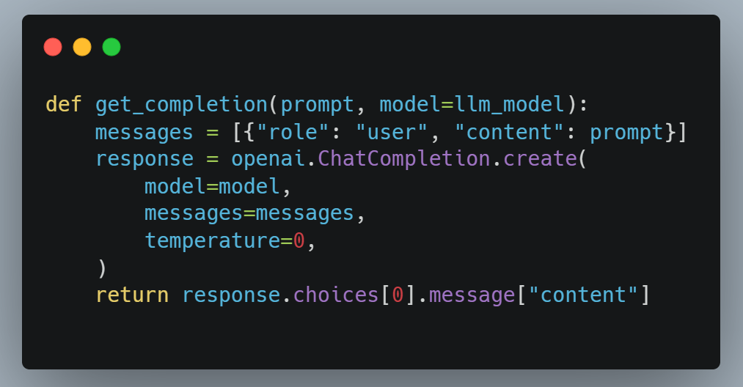
Direct API calls to OpenAI

Slide 5
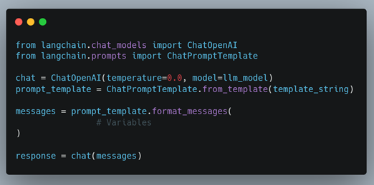
API calls with LangChain (Prompt & Model)

Slide 6
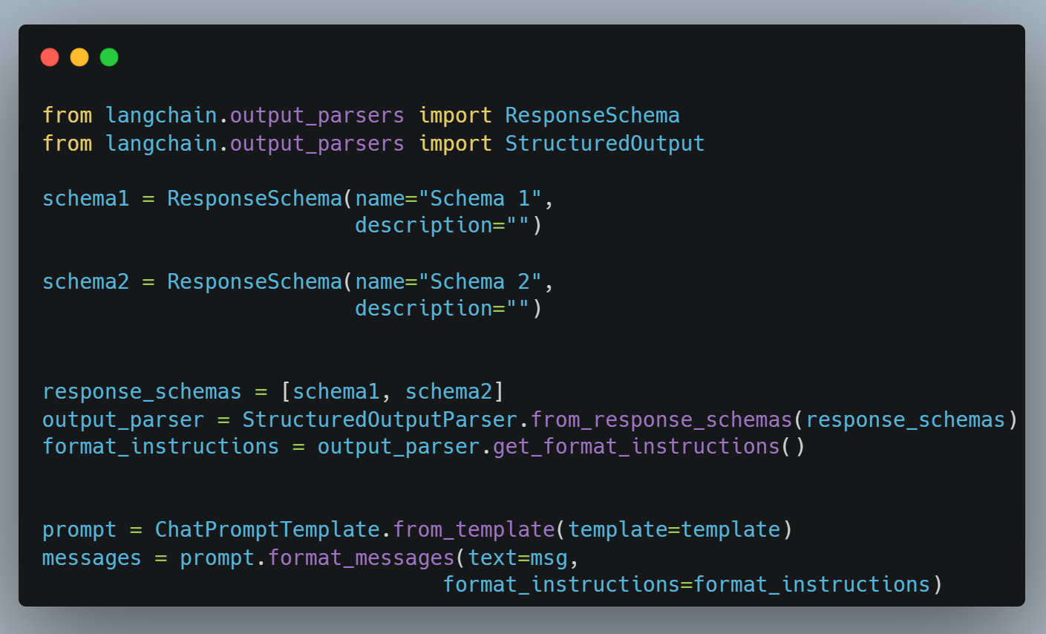
API calls with LangChain (Output Parser)

Slide 7
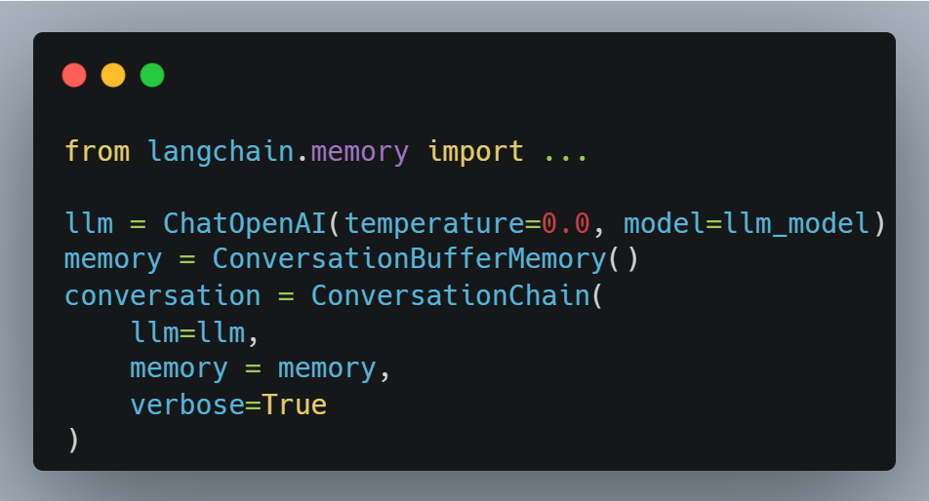
LangChain: Memory
LLMs are `stateless`, that means each transaction is independent.
Chatbots appear to have memory by providing the full conversation as `context`
LangChain provides different types of memories and accumulate the conversation:
ConversationBufferMemory
ConversationBufferWindowMemory
ConversationTokenBufferMemory
ConversationSummaryMemory
3 of n

Slide 8
LangChain: Chains
LLMChain
Sequential Chains
SimpleSequentialChain
SequentialChain
Router Chain
4 of n

Slide 9
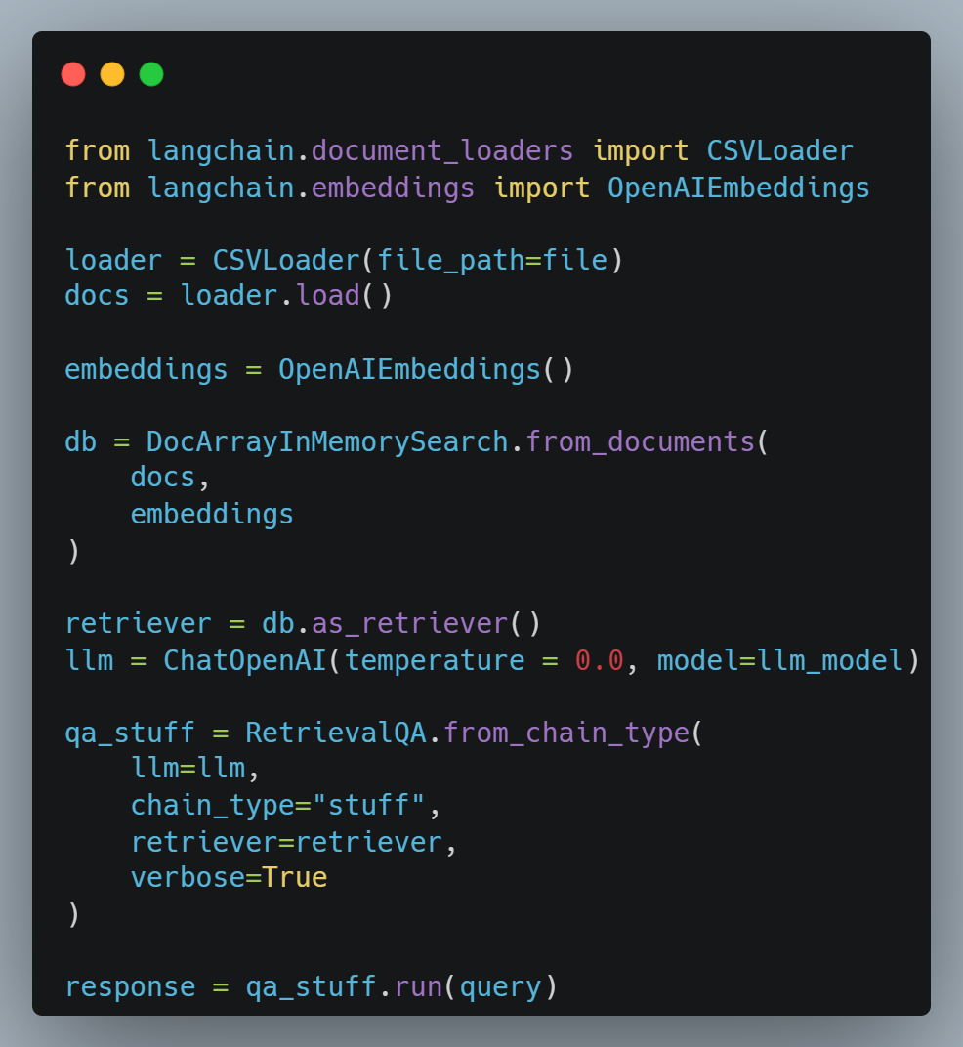
LangChain: Q&A over Documents
5 of n

Slide 10
LangChain: Evaluation
6 of n

Slide 11
Retrieval Augmented Generation (RAG)
7 of n

Slide 12
RAG: Document Loading
8 of n

Slide 13
RAG: Document Splitting
9 of n

Slide 14
RAG: Storage
10 of n

Slide 15
RAG: Retrieval
11 of n

Slide 16
RAG: Chat with Data
12 of n

Slide 17
The End

