Slide 1
Evaluation and tuning
Mohammad ghoddosi

Slide 2
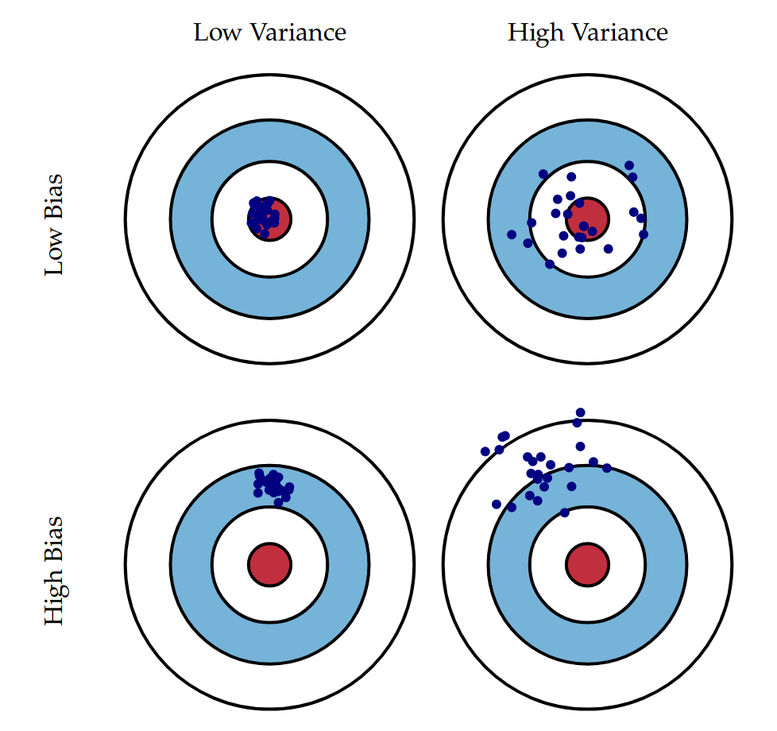
Bias and variance

Slide 3
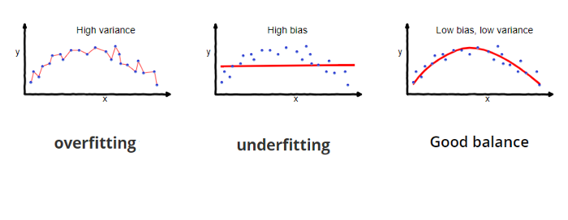
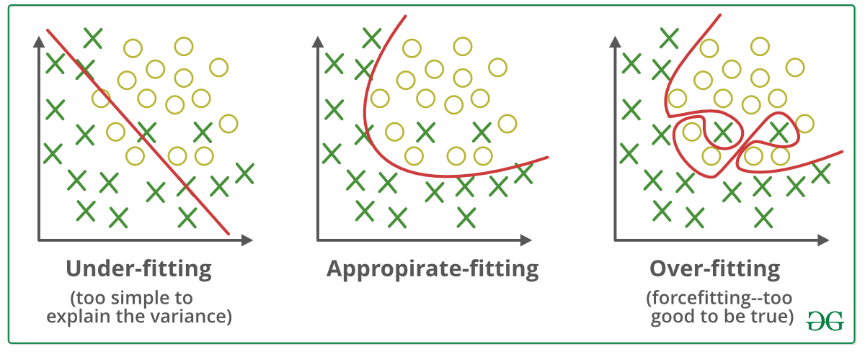
Overfitting and underfitting

Slide 4
Train-test split
Dataset
Train
Test

Slide 5
Train-test - validation split
Dataset
Test
Train
validation

Slide 6
K-fold cross validation
Dataset
Fold 1
Fold 2
Fold 3
Fold 4
Fold 5
Test

Slide 7
K-fold cross validation
Dataset
Fold 1
Fold 2
Fold 3
Fold 4
Fold 5
Test

Slide 8
K-fold cross validation
Dataset
Fold 1
Fold 2
Fold 3
Fold 4
Fold 5
Test

Slide 9
K-fold cross validation
Dataset
Fold 1
Fold 2
Fold 3
Fold 4
Fold 5
Test

Slide 10
K-fold cross validation
Dataset
Fold 1
Fold 2
Fold 3
Fold 4
Fold 5
Test

Slide 11
K-fold cross validation
Dataset
Fold 1
Fold 2
Fold 3
Fold 4
Fold 5
Test

Slide 12
Hyper parameter tuning
Grid search
Random search
Evolutionary optimization
…

Slide 13
Learning curve (old)
validation set
Loss
Training set
Training set size

Slide 14
Learning curve (new)
validation set
Loss
Training set
Iterations

Slide 15
Handling underfitting
Increase model capacity
Add polynomial features
Increase features
Get more features
Use feature extraction
Reduce regularization
Use more powerful models
…

Slide 16
Handling overfitting
Reduce model capacity
Reduce parameters
Reduce polynomial degree
Remove some features
Apply regularization
Increase data size
Early stopping
…

Slide 17
Classification Performance metric
Accuracy
Confusion matrix
Precision
Recall
F1-score
ROC-AUC

Slide 18
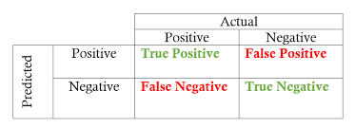

Performance metric (acc)
$$Accuracy\left(ACC\right)=\frac{\#TP+\#TN}{\#Positive+\#Negative}$$

Slide 19

Performance metric (precision)
$$Precision=\frac{\#TP}{\#TP+\#FP}$$

Slide 20

Performance metric (recall)
$$recall(TPR)=\frac{\#TP}{\#TP+\#FN}$$

Slide 21

Performance metric (F1-score)
$$F_{1} score=2∗\frac{Precision ∗Recall}{Precision+Recall}$$

Slide 22
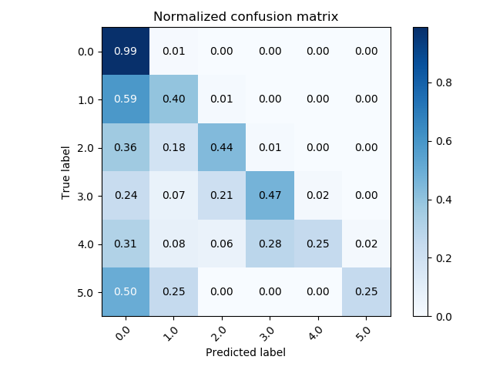
Confusion matrix

Slide 23



Regression Performance metric
$$MAE=\frac{1}{n} \sum_{i=1}^{n}{\left|h_{i}−y_{i}\right|}$$
Mean Absolute Error (MAE)
Mean Squared Error (MSE)
Root Mean Absolute Error (RMAE)
R-Squared
Adjusted R-Squared
$$MSE=\frac{1}{n} \sum_{i=1}^{n}{{\left(h_{i}−y_{i}\right)}^{2}}$$
$$RMSE=\sqrt{MSE}$$

Slide 24
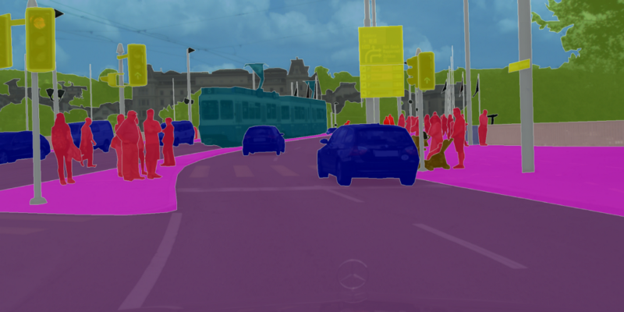


Segmentation Performance metric
Pixel Accuracy
Intersection-over-Union (IoU)
Dice coefficient
DICE and IoU are correlated
$$Dice=2\frac{|X∩Y|}{\left|X\right|+|Y|}$$
$$IoU=\frac{|X∩Y|}{|X∪Y|}$$

