Slide 1
Convolutional neural networks
Mohammad ghoddosi

Slide 2

MLP for images
MLP downsides for images
Local features
Position invariant
Big weight matrix ($n_{in}∗n_{out}$)
Overfitting

Slide 3
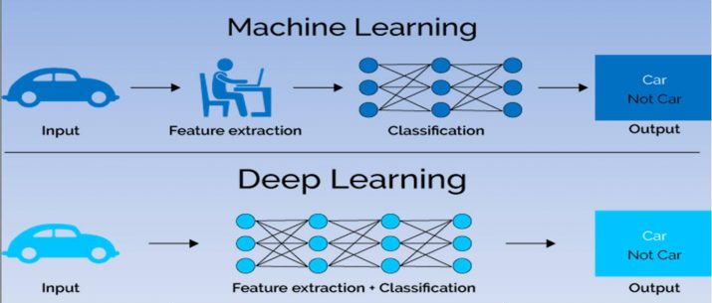
Deep learning

Slide 4
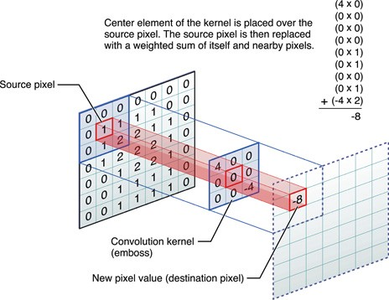

Convolution (2d)
Cross-Correlation
Output size
Padding
Stride
$n_{out}= \left\lfloor \frac{n_{in}+2p −k}{s}\right\rfloor +1$

Slide 5
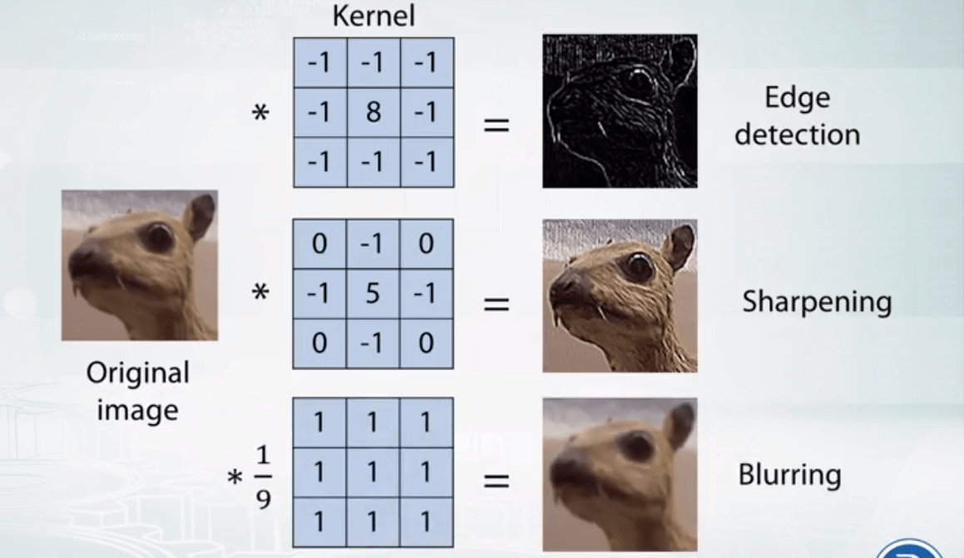
Example (edge detection)

Slide 6
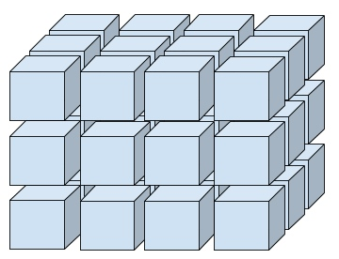

Convolution layer
Convolves a filter
Learns filters weight tensor
Local processing
Position invariant
Small weight ($f ∗k ∗c_{in}$)
Rank 3+ tensor
Time consuming $O(WHk^{2})$

Slide 7
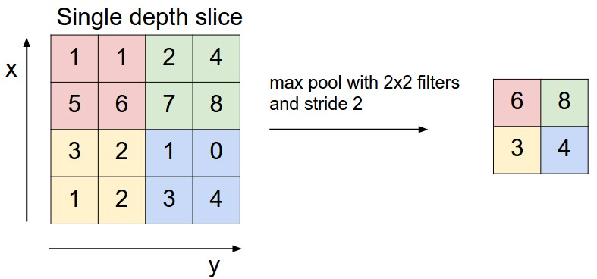
Pooling layer
Max / Average
Not trainable
Stride = kernel size
Decrease image size
Increase speed

Slide 8
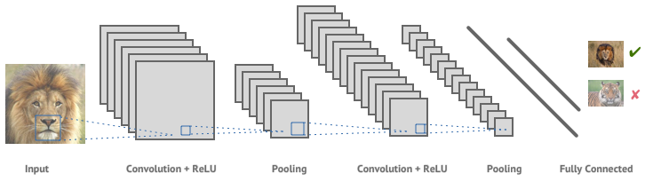
CNN architecture

Slide 9
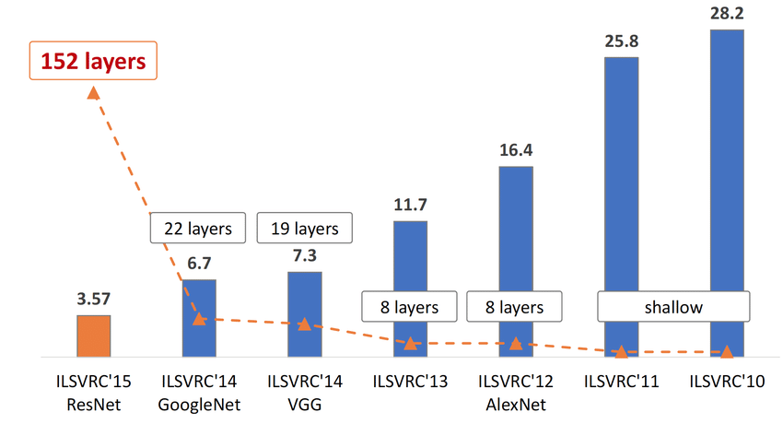
CNN vs shallow

Slide 10
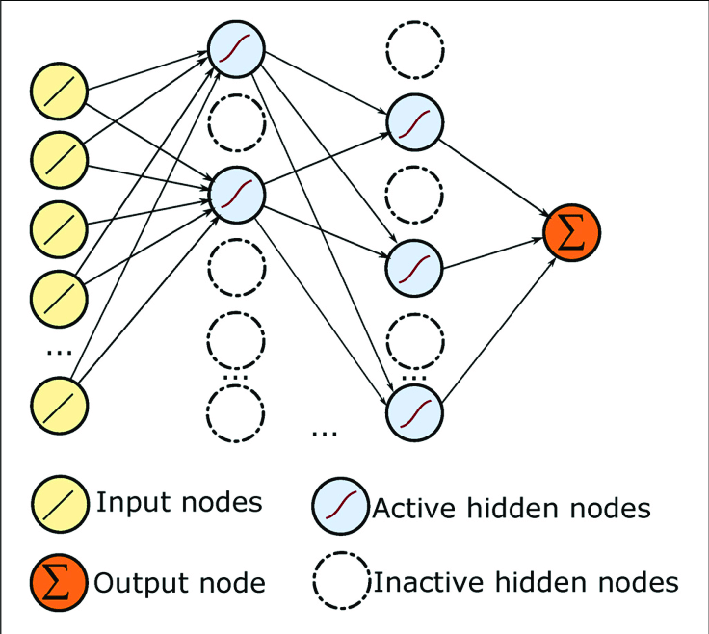
Dropout
Prevent overfitting
Weak model in train phase
Powerful model in inference phase
Randomness

Slide 11
Other CNN base layers
Conv1D
Batch normalization
Global max pooling
Global average pooling

Slide 12
CNN
Whole model is not totally position invariant
There is MLP layer
Usually we use 3*3 conv with stride 1
Usually number of features increase over layers
Usually we use 2*2 pooling with stride 2

