Slide 1
Transfer learning
Mohammad ghoddosi

Slide 2
What is transfer learning
We train a model on one task
Use trained model on another task
Increase final accuracy
Decrease train time
Decrease needed data size

Slide 3
Transfer learning
We use a pre-trained model (like VGG) on our task
We use both weights and structure
We have to train classifier
We may or may not train CNN layers

Slide 4
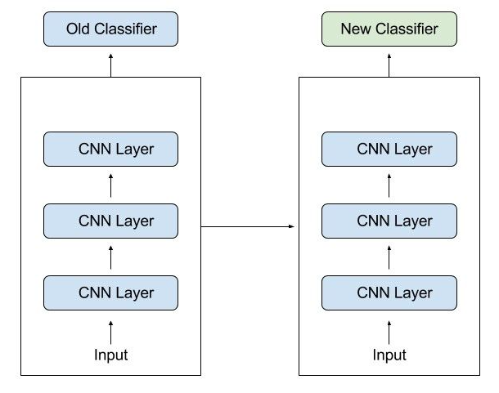
Transfer learning

Slide 5
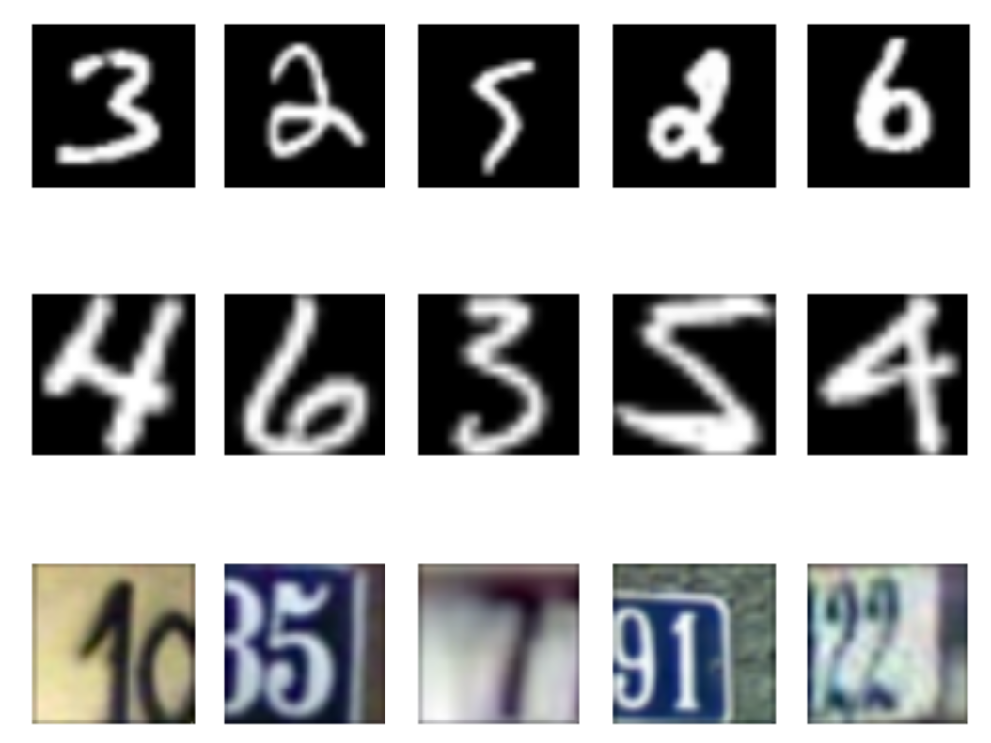
Example - OCR

Slide 6
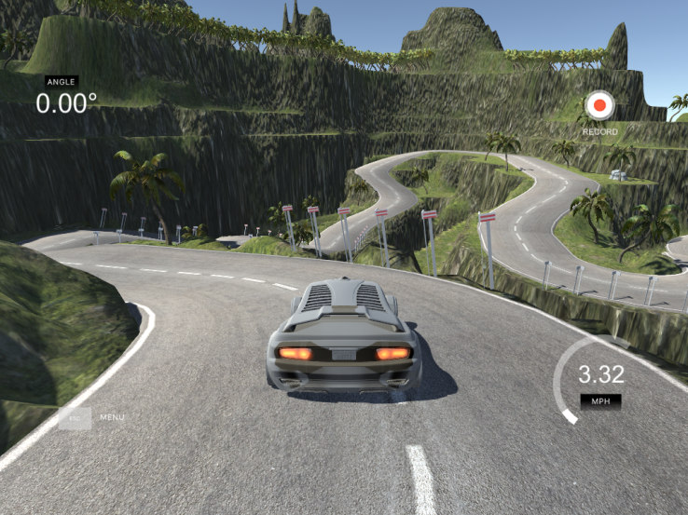
Example – self-driving cars

Slide 7
Benefits of transfer learning
Saving training time
Better performance
Dose not need a lot of data
Artificial General Intelligence

Slide 8
When we use transfer learning
Not enough data
pre-trained model on similar task (trained with massive data) exists
Tasks have same input
Note: features have to be general

Slide 9
Approaches to transfer learning
Training model and then reuse it
Using a pre-trained model

Slide 10
Approaches to transfer learning
Use pre-trained model to extract features then train classifier
representation learning
Build a new model by combining pre-trained model and classifier
train classifier
Build a new model by combining pre-trained model and classifier and
train classifier first
Train classifier and pre-trained model together
Just use first CNN layers as starting point of model

