Slide 1
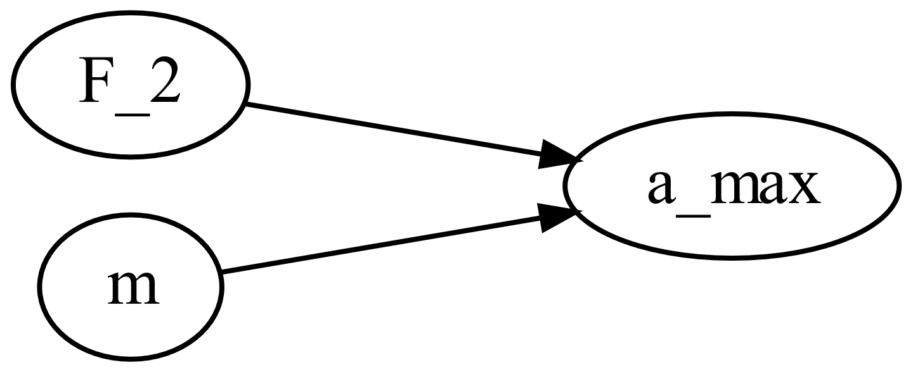
M0001_acceleration
This function calculates the maximal negative acceleration of a frontal car crash depending on the mass of the car and the force the passive safety structure provides to stop the car.
M0001_f_acceleration.m

Slide 2

M0001_acceleration
Mass of the car
Maximal force during the crash
$$a_{max}=\frac{F_{2}}{m}$$

