Slide 1
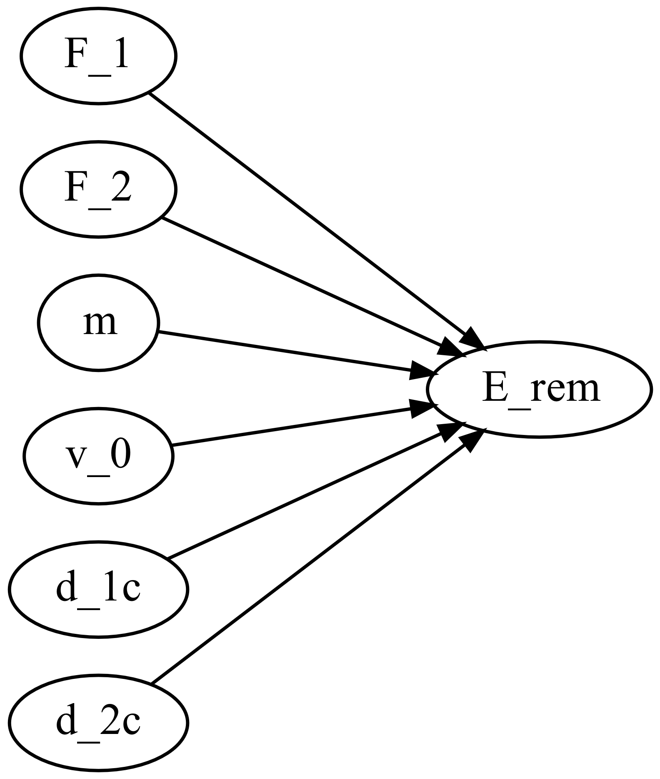
M0002_remaining_energy
This function calculates the remaining energy of a car after a frontal crash.
M0002_f_remaining_energy.m

Slide 2

M0002_remaining_energy
Mass of the car
Initial Speed
Forces and deformations during the crash
$$E_{rem}=\frac{m}{2}v_{0}^{2}−\left(F_{1}d_{1c}+F_{2}d_{2c}\right)$$

