Slide 1
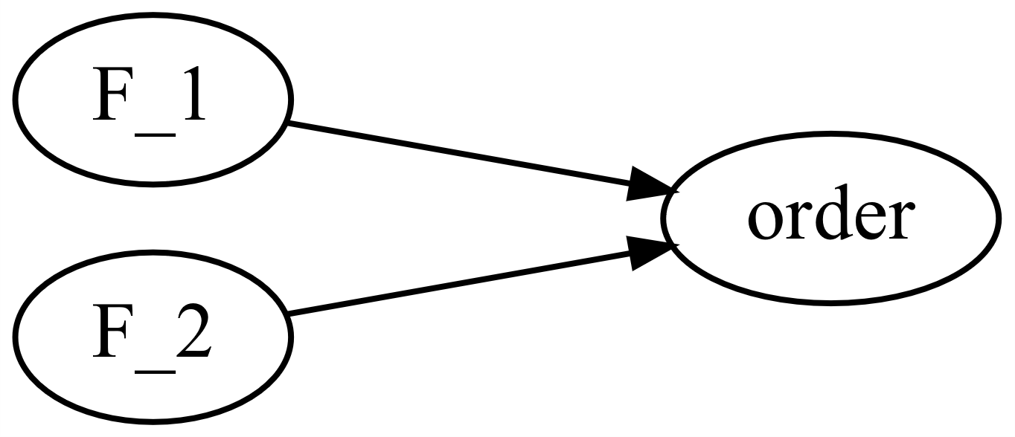
M0003_order
This function calculates the deformation order of the two sectors of a car during a frontal crash.
M0003_f_order.m

Slide 2

M0003_order
Forces during the crash
$$order=F_{1}−F_{2}$$

