Slide 1



Panda Points!
Goals:
Reward system to promote CTA Usage
Help reduce commute costs for groups in need: Children & Students Ω
Notes:
Our project is called Panda Points, a reward system app integratable within preexisting CTA systems. Our project goals are to find ways to increase usage of the CTA to increase revenue for the city, and to reduce commute costs for groups in need. The application will track user usage and reward for consecutive, regular use of Chicago’s L. The reward system also will be tied to assisting groups in need, as users can redeem points for free rides, and when they receive a free ride, they also donate one to a pool usable by children and students that need them. This will be the first target group that we benefit, as it is the easiest to implement, but can be expanded to match other demographics situationally.

Slide 2
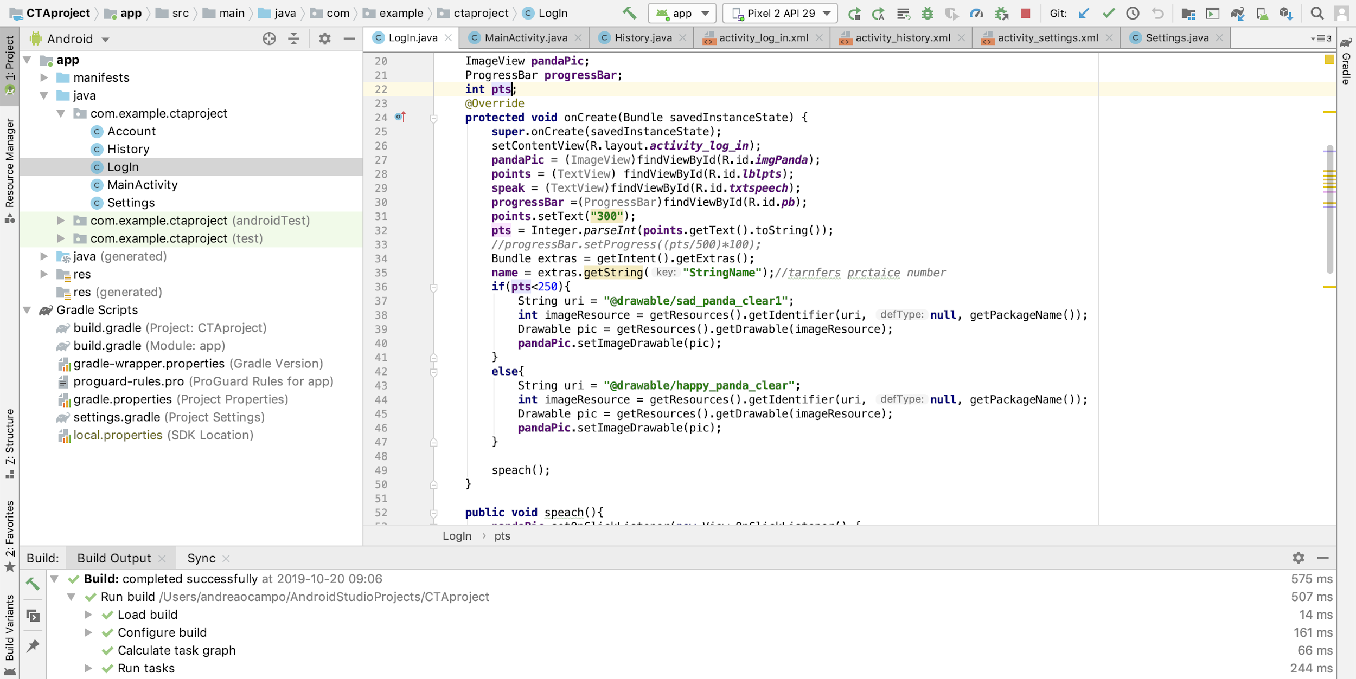
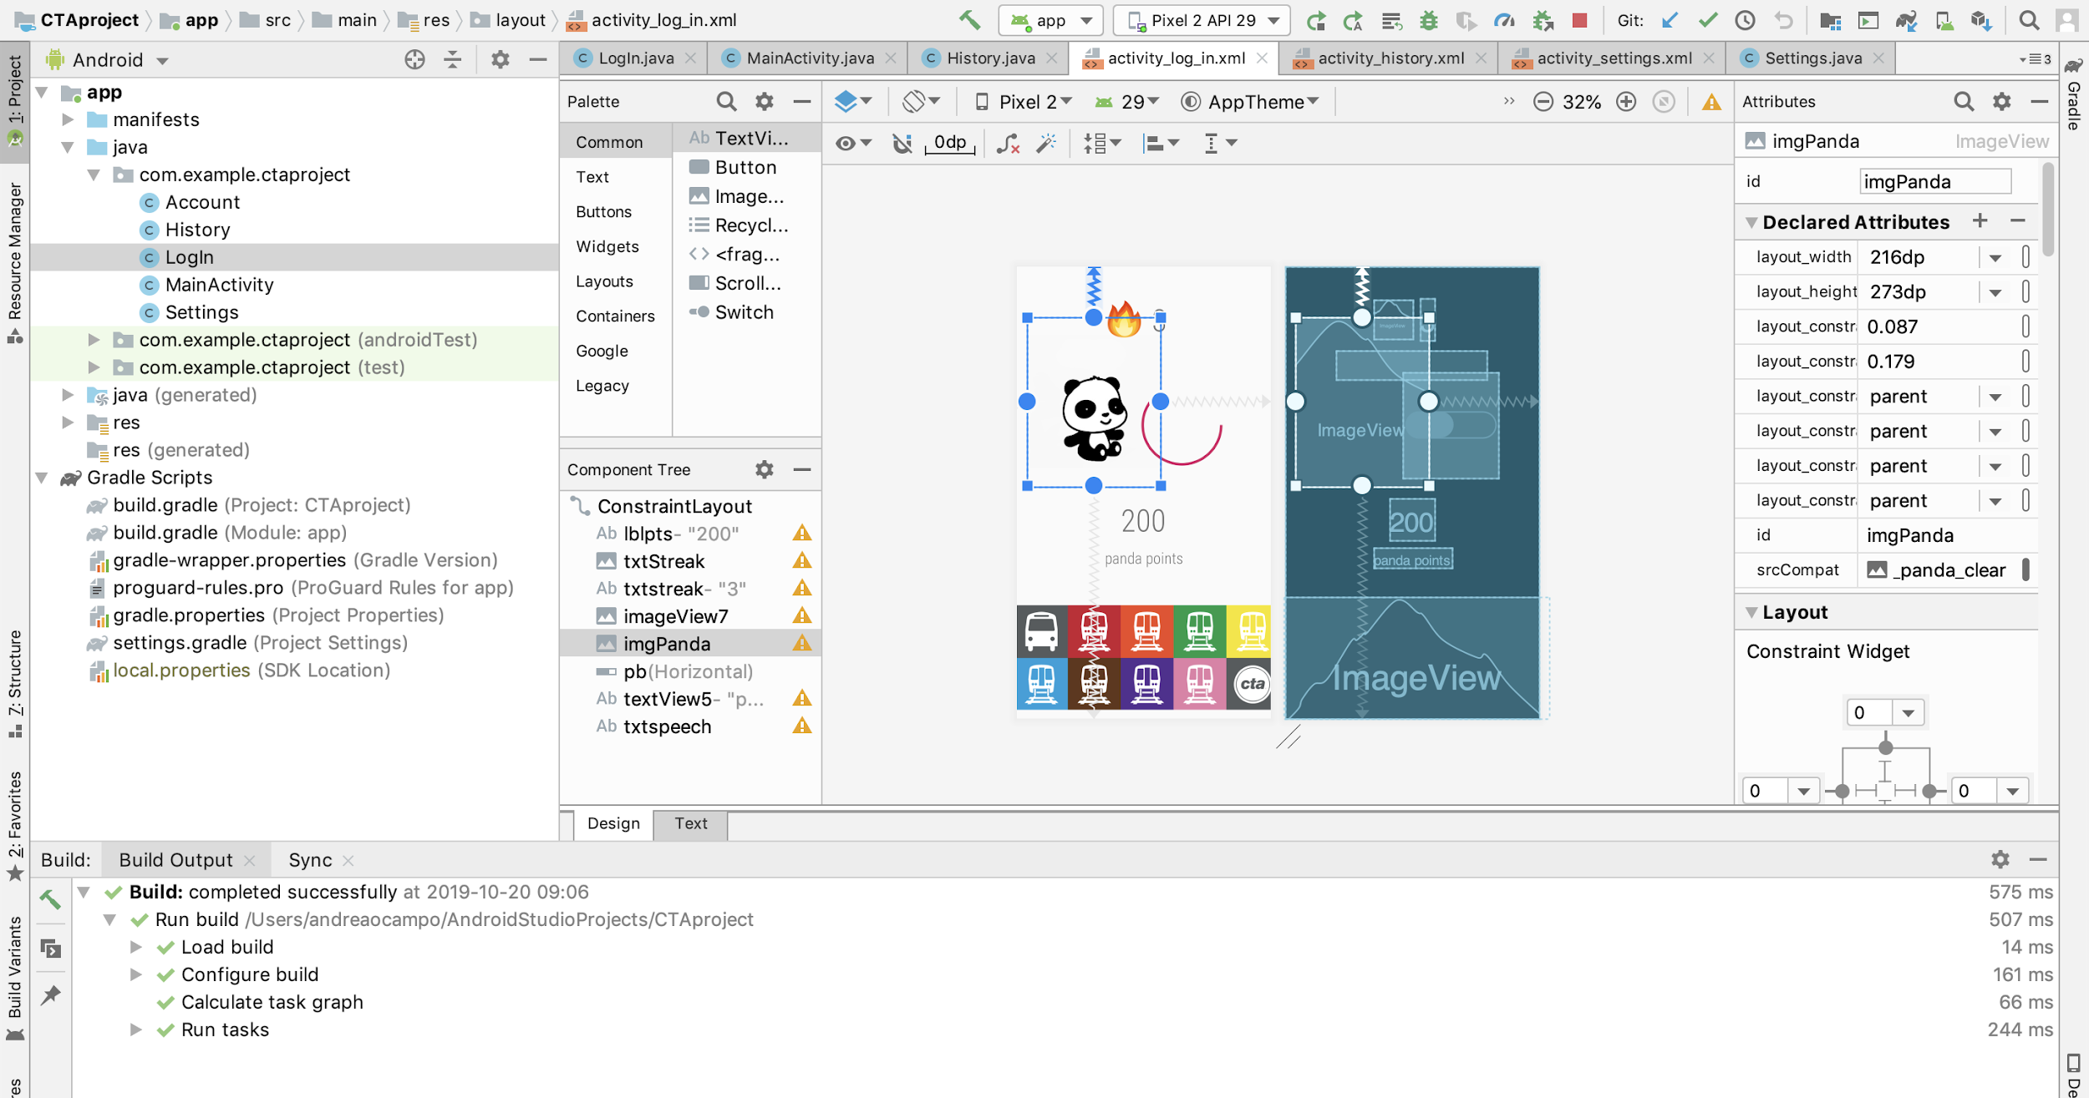
Program Structure: Front-End
Android Studio App
Java

Slide 3
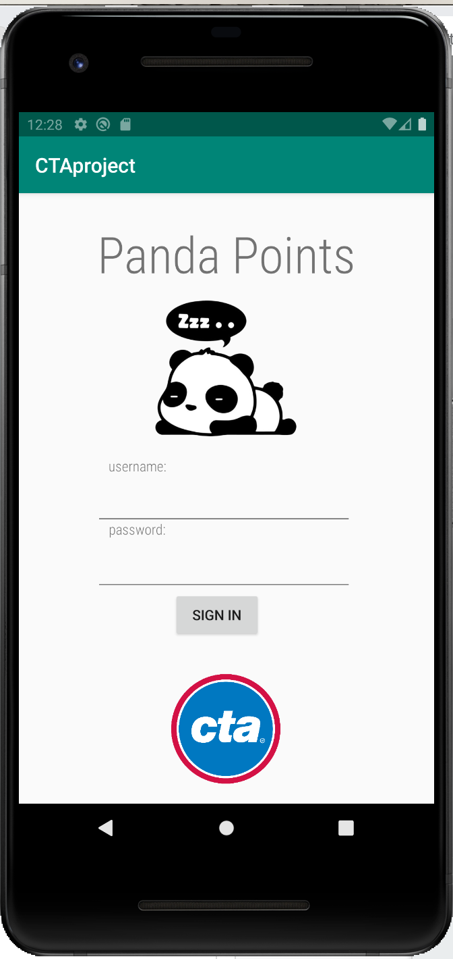
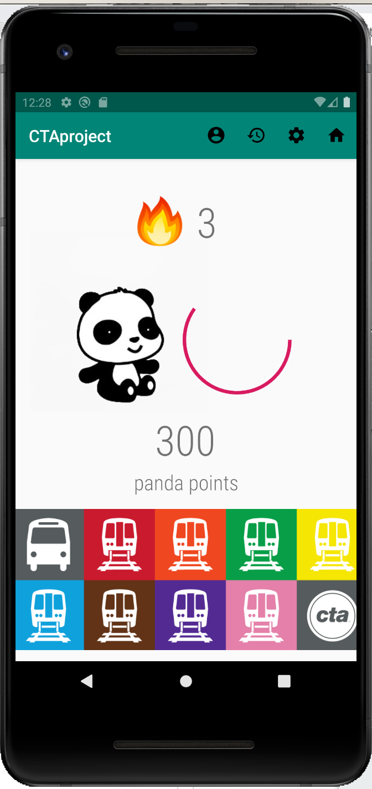
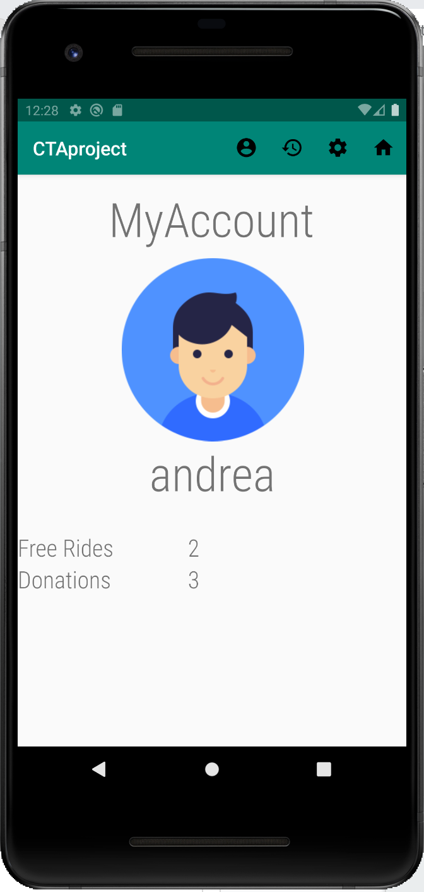

Slide 4
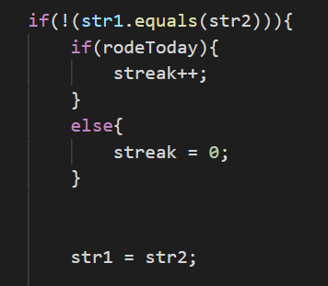


Program Structure: Back-End
Hashtable, Node, Profile, SimulatedClient, and SimulatedServer
Simulated Client initializes Simulated Server
Simulated Server connects to background processes, counts streak as user takes CTA rides daily, manages points and free ride/free ride donations
Profile holds information for users: Name, username, password, etc.

