Slide 1
COMP 206 – Introduction to Software Systems
Lecture 5 – Final Linux & Shell Ideas

Slide 2
Keeping up: An important time
Have you been able to run some Linux commands yourself?
If yes, then dive right into the assignment, use normal office hours and all will be well!
If not, it's understandable things can be tricky, but you must get help right away.

Slide 3
If you have not yet run Linux commands
Stop working on the "Install Ubuntu Locally" or "Virtual Machine" options for now.
Come back to those for long term, but they are too risky to get you started if you haven't succeeded yet.
From Windows:
Option1: Install "putty" and work remotely on the SOCS computers
Option2: Install Ubuntu via the "Windows subsystem for Linux" and work locally
From Mac:
Use your mac's terminal. Just assume it's equal to Ubuntu.
Although I told you it can have small diffs, those will lead to fewer lost marks than not being able to do the assignment at all
Once you are done everything locally, take a look at "ssh" and "scp" which allow you to remotely confirm your code works on the SOCS Ubuntu setup
If you have any trouble with these, get help right away:
Pick any office hours from myself or the TA, bring your laptop and we'll walk you through
Go to the Linux tutorials given by our TAs in Trottier 3120:
Prabhjot today at 12:30
Noah tomorrow at 1:30
Joe Wednesday at 10

Slide 4
Quiz 1
Will be posted shortly after the end of Section 001's lecture (5:30pm)
A couple of questions are easier if you know the material from today, so I wanted you to see this first.
Will be due 24 hours from the time posted (plus a bit of wiggle room since it's our first time)
To be done online on My Courses
Announcement posted when it's up (are subscribed to those yet?)

Slide 5
One follow-up from last lecture
A quicker way to learn about return codes (needed for if/while):
The $? Shell variable always holds the return code of the last command

Slide 6
Today's Plan
Last few important shell commands and tools
Take an overall look at what we know about Linux now
Start with writing our own C programs in the "Linux command" style

Slide 7
Job Control
The shell allows you to manage jobs (a.k.a. running processes)
place jobs in the background
move a job to the foreground
suspend a job
kill a job

Slide 8
Background jobs
If you follow a command line with "&", the shell will run the job in the background.
you don't need to wait for the job to complete, you can type in a new command right away.
you can have a bunch of jobs running at once.
you can do all this with a single terminal (window).
ls -lR > saved_ls &

Slide 9
Listing jobs
The command jobs will list all background jobs:
> jobs
[1] Running ls -lR > saved_ls &
>
The shell assigns a number to each job (this one is job number 1).

Slide 10
Suspending and Killing the Foreground Job
You can suspend the foreground job by pressing ^Z (Ctrl-Z).
Suspend means the job is stopped, but not dead.
The job will show up in the jobs output.
You can kill the forground job by pressing ^C (Ctrl-C).
It's gone...

Slide 11
Moving a job back to the foreground
The fg command will move a job to the foreground.
You give fg a job number (as reported by the jobs command) preceeded by a %.
> jobs
[1] Stopped ls -lR > saved_ls &
> fg %1
ls -lR > saved_ls

Slide 12
Important Linux paths (mostly review)
“/” is the root of the file system. Every other file falls below “/” in the directory tree:
E.g., $ ls /
“~” is the current users home directory
E.g., $ ls ~/
“.” is means right here when it starts a path, and nothing if it occurs within a path (2nd case just a convenience for programming):
E.g., $ ls .
E.g. $ ls /usr/./bin
“..” means the parent directory
E.g. $ cd ..

Slide 13
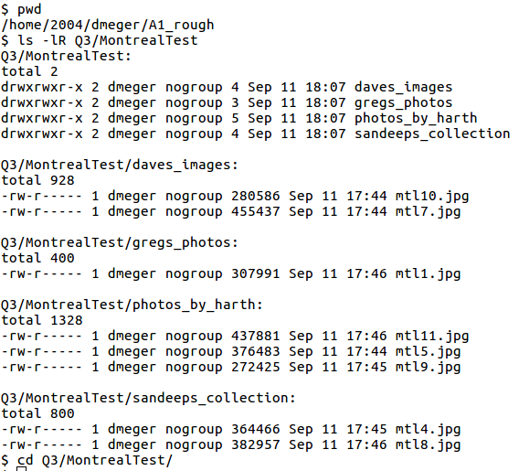
Examples to practice together:
Read and understand the directory structure on the right
What would the next command output, if it was:
"$ ls mtl10.jpg"
"$ ls "
"$ ls .."
"$ ls ~/A1_rough/Q3/MontrealTest"
"$ ls gregs_photos/../daves_images/"

Slide 14
Wildcards (metacharacters) for filename abbreviation
When you type in a command line the shell treats some characters as special.
These special characters make it easy to specify filenames.
The shell processes what you give it, using the special characters to replace your command line with one that includes a bunch of file names.

Slide 15
The special character *
* matches anything.
If you give the shell * by itself (as a command line argument) the shell will remove the * and replace it with all the filenames in the current directory.
“a*b” matches all files in the current directory that start with a and end with b.

Slide 16
Understanding *
The echo command prints out whatever you give it:
> echo hi
hi
Try this:
> echo *

Slide 17
* and ls
Things to try:
ls *
ls –al *
ls a*
ls *b

Slide 18
Other metacharacters
? Matches any single character
ls Test?.doc
[abc…] matches any of the enclosed characters
ls T[eE][sS][tT].doc
[a-z] matches any character in a range
ls [a-zA-Z]*
[!abc…] matches any character except those listed.
ls [!0-9]*
Notes:
End of class Jan 11, 2007

Slide 19
Examples to practice together:
Try to form commands that can:
Fine only the mtl jpg images starting with a 1 in their number
Find all jpgs
Find all directories that include the word "photos"

Slide 20
Quoting - the problem
We've already seen that some characters mean something special when typed on the command line: * ? []
What if we don't want the shell to treat these as special - we really mean *, not all the files in the current directory:
echo here is a star *

Slide 21
Quoting - the solution
To turn off special meaning - surround a string with double quotes:
echo here is a star "*"
echo "here is a star"

Slide 22
Careful!
You have to be a little careful. Double quotes around a string turn the string in to a single command line parameter.
> ls
fee file? foo
> ls "foo fee file?"
ls: foo fee file?: No such file or directory

Slide 23
Quoting Exceptions
Some special characters are not ignored even if inside double quotes:
$ (prefix for variable names)
" the quote character itself
\ slash is something special (\n)
you can use \$ to mean $ or \" to mean "
echo "This is a quote \" "
Math in $((..)) is still evaluated
Command-substitutions using $(…) or `..` are still evaluated

Slide 24
Single quotes
The strongest version, nothing at all is "escaped" (that means interpreted as something other than its string value):
$variables are not replaced by their value
Backslash is now no longer special
Math within $((…)) does not work
Command-substitution using $(…) does not work
For syntax, You can use single quotes just like double quotes:
> echo 'This is a quote \" '
This is a quote \"
>

Slide 25
That's it for Linux! (for now)
You have the tools to program your Linux system through the shell
These skills grow with you over time if you use them and can open a ton of doors. I encourage you to use the shell as your daily tool for as much work as possible, at least for the next while. This encourages "systems" thinking and will make you a huge asset in companies etc.
You now hold the hammer (blow torch, paint brush, chisel, no tool based discrimination...)
Next we develop the ability to read and create the floor plans!
All of the Linux kernel, the filesystem, the BASH shell, the command line tools, most text editors are written in C at their core. Let's get started building our own tools.

Slide 26
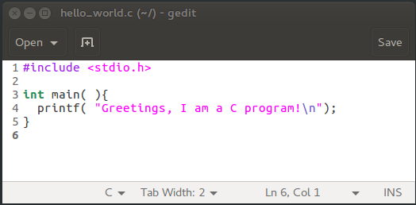
C: The very beginning
Type in our first C program. Use the same file editor you like for Bash.
Save as "hello_world.c"

Slide 27
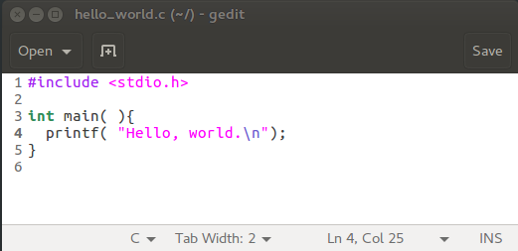
Program elements
#include is the way we ask for language functionality to be "turned on":
Same as import in Java or Python
int main() indicates this is the first function to run in a prog:
Same concept in Java/Python, just slightly different words
Printf() is our basic method to write to terminal (std out). "\n" means newline.

Slide 28
Compiling and Running Our first C program
Compiling means to create a program from the source code:
"$ gcc hello_world.c"
Running means asking the terminal to execute the program:
"$ ./a.out"
You should see "Hello, world." printed on the terminal.

Slide 29
Exercises
Try out hello world.
Read Chapter one of the K&R text (first one listed on course outline – available online if you wish to find it there)

