Slide 1
COMP 206 – Introduction to Software Systems (guest lecture by Prof. Greg Dudek)
Lecture 11 – 2D Arrays
October 5th, 2018

Slide 2
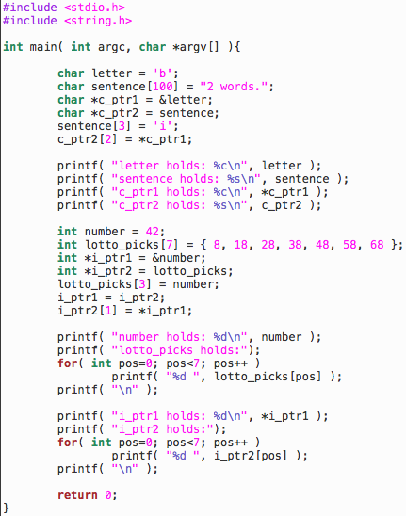
Quick Review
The code on the right should be starting to feel comfortable.
Available on Github under ExampleCode/Lecture11-2DArrays/pointer_review.c
Read through and think it over, then we’ll review to get started.

Slide 3
Box and Arrow
c_ptr1
letter
b
sentence
2
w
o
r
d
s
\0
?
?
…
?
& means “address of” or “points to” variable
* means “dereference” or “get values at” pointer
Array variables can be thought of as pointer always to the beginning
Pointers can be indexed with [i] notation just like arrays
c_ptr2

Slide 4
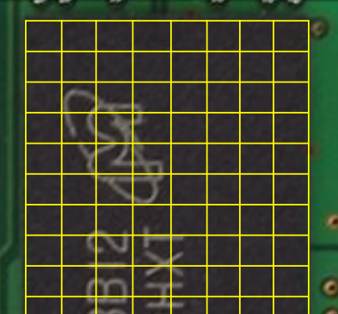
Memory and Addresses
letter
b
sentence
2
w
o
r
d
s
\0
c_ptr1
24
c_ptr2
32

Slide 5
Box and Arrows: Integers
i_ptr1
number
42
lotto_picks
8
18
28
38
48
58
68
Integers similar, but typically 4 bytes per entry and no \0
*ptr is equivalent to ptr[0]
More generally *(ptr+i) equiv ptr[i]
i_ptr2

Slide 6
Box and Arrows
i_ptr1
number
42
lotto_picks
8
18
28
38
48
58
68
“ptr1= ptr2” pattern works on addresses, changes where ptr1 points
”*ptr1 = *ptr2” pattern works on values, changes the value of memory at ptr1’s address
i_ptr2

Slide 7
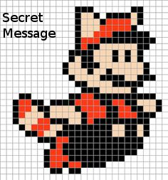
Where are we going today and next week?
Real Software Systems that work with binary (non-text) data
Specific example: how are images represented in:
Gaming
Computer Generated Imagery in movies
Satellite maps
Bunny-ear augmented selfies
Today: data that has a 2D layout

Slide 8
2D Arrays and Arrays of Pointers

Slide 9
2D Arrays
Declared by repeating the square bracket syntax:
char ttt[3][3];
Creates an array where each entry is itself an array.
The type (e.g. char) is the same for every entry of the inner array.
Outer array behaves as we expect:
Fixed size
Always represents the memory of the first entry and cannot be moved (e.g., no ++)
Elements stored directly after one another

Slide 10
Accessing 2D Array Data
For type array_name[N][M]
Syntax array_name[i][j] is used both to read and write data at entry i, j
First index can be 0 to N-1, second index can be 0 to M-1
In the image:
ttt[0][0] evaluates to ‘x’
ttt[2][2] = ‘o’; sets bottom-right value
Careful: not [i,j]

Slide 11
When to use 2D Array?
When each ”row” has the same size always:
int days_in_each_month[2][12] = {
{ 31, 28, 31, 30, 31, 30, 31, 31, 30, 31, 30, 31 },
{ 31, 29, 31, 30, 31, 30, 31, 31, 30, 31, 30, 31 } };
Often when data looks like a “table”:
float grades[number_of_assignments][class_size] = {
{ 100.0, 99.0, 83.0 },
{ 99.9, 99.9, 99.8 } };

Slide 12
What does it look like in memory?
char[2][3] greetings = { “hi”, ”yo” };
Is first off an array of length 2
We know those entries are placed directly in order
greetings

Slide 13
What does it look like in memory?
char[2][3] greetings = { “hi”, ”yo” };
Is first off an array of length 2
Each of the outer entries contains an array of length 3, following the same rules
greetings

Slide 14
What does it look like in memory?
char[2][3] greetings = { ”hi”, “yo” };
The system memory is addressed in ascending linear order (1D). This view shows the layout in address space.
greetings
h
i
\0
y
o
\0

Slide 15
What does it look like in memory?
char[2][3] greetings = { ”hi”, “yo” };
The system memory is addressed in ascending linear order (1D). This view shows the layout in address space.
NOTE: it’s often nice to draw it this way to understand working with images etc, but it is only for convenience.
Does not indicate bigger jumps in memory between ‘\0’ and ‘y’, compared to ‘y’ and ‘o’
greetings
h
i
\0
y
o
\0
greetings
h
i
\0
y
o
\0

Slide 16
Photo Challenge
Who is this?

Slide 17
When not to use 2D Arrays?
char greetings[4][8] = { “hi”, “yo”, “bonjour”, “hello” };
If the data in each entry “row” can vary in length
If the length of each entry “row” isn’t known when coding, for example it will change based on user input
Handling these cases with 2D arrays forces us to use enough space for the longest possible row… for every row!
greetings
h
i
\0
?
?
?
?
?
y
o
\0
?
?
?
?
?
b
o
n
j
o
u
r
\0
h
e
l
l
o
\0
?
?

Slide 18
Another solution: Array of pointers
char *greetings[4] =
{ “hi”, “yo”, “bonjour”, “hello” };
The type of each entry is now ”char*”, a single character pointer
This avoids wasting the space
greetings
h
i
\0
y
o
\0
b
o
n
j
o
u
r
\0
h
e
l
l
o
\0

Slide 19
Array of pointers gotcha!
Recall, where does an uninitialized pointer point?
E.g., char* single_greeting;
If we are lucky it might be NULL leading to segfault on use
We should be smart and set it to NULL ourselves
Otherwise, we will learn how to debug the hard way…
Where do I point??
single_greeting

Slide 20
Array of pointers gotcha!
Where do I point??
The same story holds for arrays of pointers:
E.g., char *greetings[4];
All of the pointers are now undefined
The declaration on it’s own does not create any memory to hold words
Must ensure to assign each pointer before its use:
To a literal like “hello”
To an existing pointer or array
single_greeting
greetings
Where do we all point?

Slide 21
What about calling functions: with 2D array
Following our example, char ttt[3][3]
Suppose we’d like a function that we can call like f(ttt)
void f( char current_board[3][3] ){ /* function code */ }
Match the types exactly: it must work!

Slide 22
What about calling functions: with 2D array
Following our example, char ttt[3][3]
Suppose we’d like a function that we can call like f(ttt)
void f( char current_board[3][3] ){ /* function code */ }
void f( char current_board[][3] ){ /* function code */ }
C needs to know the entry type to read the data correctly, so the char array of length 3 must be present
C does not need the length of the outer array: remember, it doesn’t take care of this for us anyhow!

Slide 23
What about calling functions: with 2D array
Following our example, char ttt[3][3]
Suppose we’d like a function that we can call like f(ttt)
void f( char current_board[3][3] ){ /* function code */ }
void f( char current_board[][3] ){ /* function code */ }
void f( char(*current_board)[3] ){ /* function code */ }
This says “pointer to data of type 3-length char array”
Same reasoning, as we can note the outer array with unknown size is equivalent to pointer
The brackets around (char*) are essential to distinguish this from an array of pointers (It is a good sanity check for you to be really sure you now know the difference yourself!)

Slide 24
Calling functions with arrays of pointers
Suppose we have our char* greetings[4];
And would like to be able to call f(greetings);
void f( char *greetings[4] ){ /* function code */ }
void f( char *greetings[] ) { /* function code */ }
Same reasoning as the above, we only have 1 array to track now and C can do that without the size

Slide 25
Final example for today, sort argv
Type is char* argv[], an array of pointers, each to one of the argument words
We want the user to be able to type any number of arguments, each of any length and have the result end up properly sorted
We can sort “in place” by working only on the pointer values within argv, no need to create a new variable

Slide 26
Dave’s solution on Github ExampleCode
Lecture11-2Darrays/sort_argv.c
I recommend you try this yourself as an exercise and compare
At minimum, go over and understand each component

Slide 27
