Slide 1
COMP 206 – Introduction to Software Systems
Lecture 12 – Taking control of memory dynamically!
October 10th, 2018

Slide 2
Key thoughts on memory
Your a.out is a file, it takes space on disk.
What is inside?
Each running process requires system resources.
You have likely experienced your computer running slowly when you start too many programs, when a large video plays, gaming, etc.
When we create systems programs, we have control over how the memory is used.
How-to guide today!

Slide 3

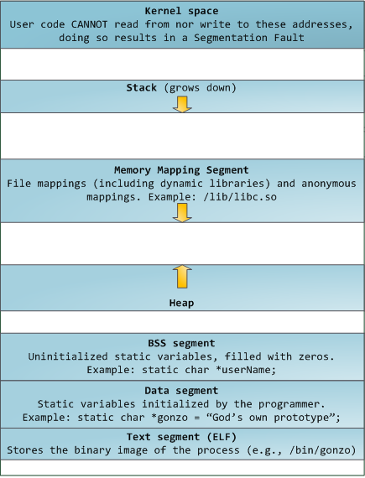
A process in memory

Slide 4
Elements of a running process:
Text space
Data segment
BSS segment
Heap
Stack
Kernel space
Memory mapping

Slide 5
Statically Sized Parts that come from gcc
Text space:
Our runnable machine code.
Stored in the a.out
The processor loads these instructions and steps through line by line
Data segment:
Elements of fixed size that are known at compile time
Stored in the a.out
E.g. string literals
Values cannot be changed (we will see an unexpected gotcha in a few slides!)
BSS (Block Started by Symbol) segment:
Space to hold “static” variables without initial values.
Filled with zeros at run time
Not actually stored in a.out, but only the size needed, since there is no initial data
Changeable

Slide 6
Elements that change in size
Stack:
Space to store the local variables within each function.
Stack “frames” are created when the function is called, and removed when the function returns.
NOTE: This means stack variables, including arrays are temporary and we should not keep pointers to them (another gotcha incoming!)
Heap:
Space for the programmer to control dynamically
Where we are allowed to request the most available resources
Grows and shrinks at our request (we will see the functions in C soon)
In object oriented languages, used for ”new” objects

Slide 7
We will leave these for later…
Kernel
Yes, we get to see a copy of a portion of the kernel in each process.
This is a ”trick” of the operating system to give us low-level functionality
To be covered in a few more weeks
Memory mapping:
Likewise, a bit more advanced than where we’re at
It’s for access to files and libraries that the Operating System connects us to

Slide 8
Static (global), stack, and heap memory
3 file in the ExampleCode folder on GitHub:
auto_array_alloc.c
static_array_alloc.c
dynamic_array_alloc.c
We’ll look through them in order

Slide 9
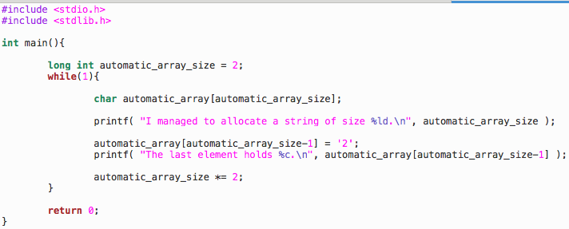
Automatically Sized Arrays
These arrays live on the stack
The size limit is typically quite small. Good for small stuff, but we need a way to ask for more memory!

Slide 10
Automatically sized arrays
Typical output:
I managed to allocate a string of size 262144.
The last element holds 2.
I managed to allocate a string of size 524288.
The last element holds 2.
I managed to allocate a string of size 1048576.
The last element holds 2.
I managed to allocate a string of size 2097152.
The last element holds 2.
I managed to allocate a string of size 4194304.
The last element holds 2.
Segmentation fault: 11

Slide 11
Stack memory limited, and there is another “gotcha” to keep in mind
When creating pointers, we must think about the stack push-pop behaviour. Similar example on Github: “stack_pointer_gotcha.c”
char* createArray( size ){
char array[size];
return array;
}
int main() {
char *new_array = createArray( 10 );
new_array[0] = ‘a’; // THIS LINE CAN SEGFAULT
}

Slide 12
What’s happening here?
The common error “returning pointer to stack memory”
new_array =
Stack 0: main
NULL

Slide 13
What’s happening here?
The common error “returning pointer to stack memory”
new_array =
Stack 0: main
&(array[0])
array =
Stack 1: createArray

Slide 14
What’s happening here?
The common error “returning pointer to stack memory”
new_array =
Stack 0: main
&(array[0])
No longer a legal part of the stack! It might exist for a while until it’s re-used, but this is super unsafe!

Slide 15
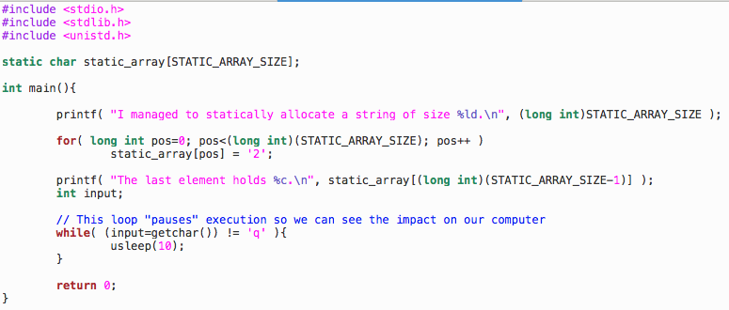
One way to fix: Statically Sized Arrays
Test with “gcc –DSTATIC_ARRAY_SIZE=number
You can typically get away with much larger sizes, even to the point where you cannot practically use the memory provided!
But what if
we didn’t know
the size in
advance?

Slide 16

The Heap: Dynamically Allocated Memory
Provides flexible, persistent memory across function calls
Example: function “char* createImageData( int width, int height )” should return a pointer to new memory that can hold pixel data.
Incorrect to point to a stack variable!
If we don’t know the size of our bunny ears in advance, cannot use static!
Our next low-level programming tool: ask for heap memory through the C dynamic memory functions
We will follow this path right to the Linux kernel today!

Slide 17
The Heap: Dynamically Allocated Memory
How does the OS decide where to locate our new memory within the heap? How does it keep things organized (or does it?) What is the most memory we can possibly use and why is it larger than what my computer’s maker reported (e.g., 4GB RAM)?
These are interesting questions that we will ignore for now
Covered in COMP 310 where you often have to code a heap allocator/de-allocator

Slide 18
Asking for Heap Memory
Request for N bytes of heap memory (not initialized):
void *malloc(size_t numberOfBytes);
Request for an array of N elements each with size bytes, and initializes the values all to 0:
void *calloc(size_t num, size_t size_of_each);

Slide 19
Allocating Useful Types
malloc and calloc return a void pointer (void *)
It must be cast before it can be de-referenced:
int *a = (int *) malloc( sizeof(int) * 40 ); // OR
int *a = (int *) calloc(40, sizeof(int));
The sizeof() function simplifies the allocation of memory by calculating the size of the provided data type.

Slide 20
Rules to follow for malloc
You have 3 TYPEs to fill in:
TYPE1 variable_name = (TYPE2)malloc( sizeof(TYPE3)*number );
int *pi = (int*)malloc( sizeof(int) * 1 );
RULE1: TYPE1 matches TYPE2, both are pointer types:
The point of casting is to tell C how we plan to interpret the heap memory allocated for us by malloc. Malloc returns void* so that it can handle any type. Since this is initially empty memory, casting is always safe.
RULE2: TYPE3 is the de-referenced version of TYPE2
“One less star”
When we de-reference the variable with “*variable_name”, C will assume the memory is of the pointer’s underlying type

Slide 21
Malloc

Slide 22
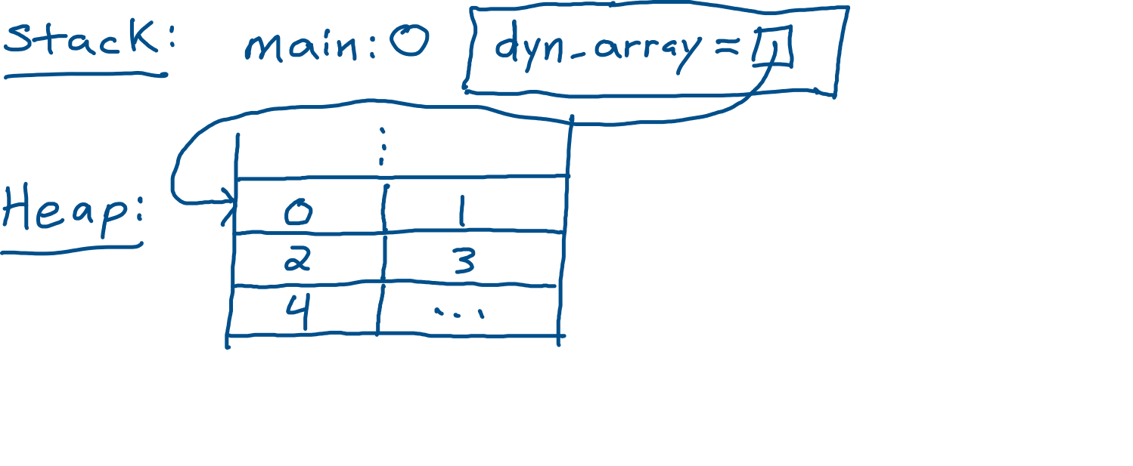
Malloc visual example
int *dyn_array = (int*)malloc(5*sizeof(int));

Slide 23
Using malloc correctly
Allocate a single integer on heap:
int *pi = (int*)malloc( sizeof(int) );
Allocate an array of 10 integers on heap:
int *my_numbers = (int*)malloc( 10*sizeof(int) );
Allocate a single integer pointer on heap:
int **ppi = (int**)malloc( sizeof(int*) );
This is our first time seeing a double pointer. It will be explained in due order, but note it’s nothing scarier than single pointers. Just follow the arrow twice!

Slide 24
Common malloc errors (these are all considered “wrong” for 206)
Mismatch between sizes:
int *pi = (int*)malloc( 10*sizeof(char) );
Not casting to pointer:
int i = (int)malloc( sizeof(int) );
Forgetting sizeof the datatype:
int *my_array = (int*)malloc( 10 );

Slide 25
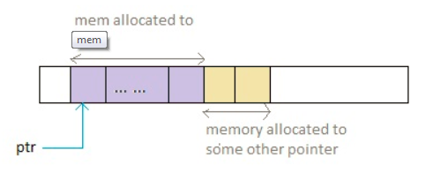
What if you change your mind?
realloc changes the size of memory (size is the new total size, not added to the old request)
void *realloc(void *ptr, size_t size);
Note that the heap might not contain enough space to simply expand at this address. So, be aware the data can be copied to a new location, changing the pointer:

Slide 26
Dangerous example
int * ptr1 = (int*) malloc(5 * sizeof(int));
int * ptr2 = ptr1;
ptr2 = (int*) realloc(ptr2, 10 * sizeof(int));
// ptr1 may become a dangling pointer
This is another thing C leaves up to you as a programmer. If you plan to keep around multiple pointers to dynamic memory, it is your job to keep them all consistent across, allocation and re-allocation. Two common approaches:
1) Never re-allocate (just plan ahead and malloc enough)
2) Be very careful and use a debugger (coming up soon!)

Slide 27
Last step: always!
For every dynamically allocated section in memory, ensure to run free when finished using:
free( void *ptr );
The pointer must be to heap memory -> that allocated by malloc, calloc or realloc
Signals the operating system this space can now be used again
Good practice, ptr =NULL; immediately after free always. Ensures you don’t forget and mess with memory of another variable.

Slide 28
Back to our original goal, fill up the whole memory with ’2’s (ultimate midterm studying procrastination!)
Recall, stack memory was very limited and global variables needed a size at compile time.
The solution is to make calls to malloc.
Let’s see how much memory we can ask for!

Slide 29
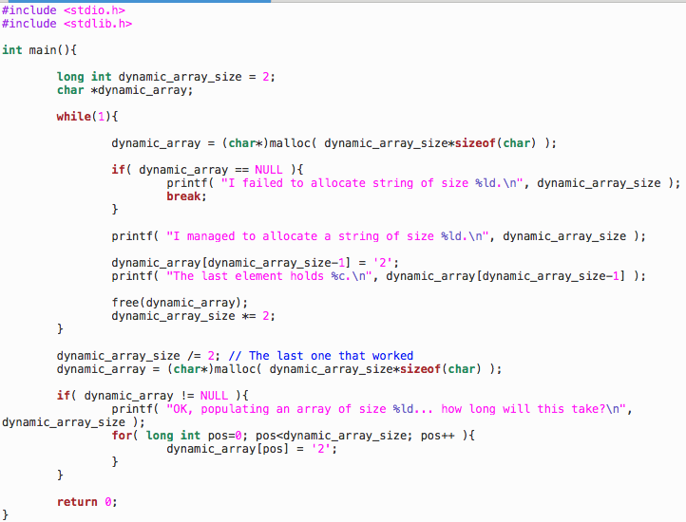
Dynamically Sized Arrays

Slide 30
Wrap-up
We have now experienced a few different ways that we can control the memory of our program. We will continue to expand this through the term!

Slide 31
Exercises and Reading
K&R text chapter 5
Practice will come with A3

