Slide 1
The PHM08 Data Set
Training set
218 engines
21 sensors and 3 operational settings
Number of cycles: between 128 and 357
Run to failure
Test set
218 engines
21 sensors and 3 operational settings
Number of cycles: between 15 and 364
Stopped before failure
Target: Predict the number of remaining cycles in the test set (RUL).

Slide 2
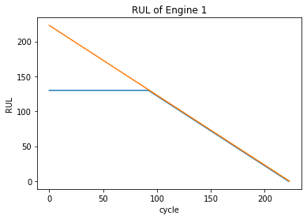
Defining RUL
Healthy engine
RUL = min(130, max cycle – current cycle)
deteriorating engine
Threshold of 130 for maximum RUL taken from F. O. Heimes, BAE systems, “Recurrent Neural Networks for Remaining Useful Life Estimation”, 2008 international conference on prognostics and health management

Slide 3
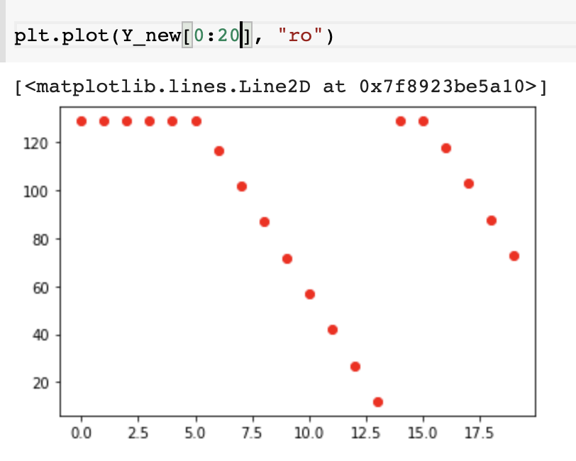
Building Training and Validation Data
Split the 218 engines into samples of 15 steps
Set the RUL of the sample to the RUL of the last step
X for training and validation:
X(samples, timesteps, features)
samples = 2962
timesteps = 15
features = 25
First 6 samples in engine 2
Y for training and validation:
Y(samples,1)
Engine 1 turned to 14 samples

Slide 4
Processing Training and Validation Data
Select 10 features with Pearson’s correlation
Split into training and validation:
1984 samples for training
978 samples for validation
Fit a MinMaxScaler on the training set and apply to training and validation

Slide 5
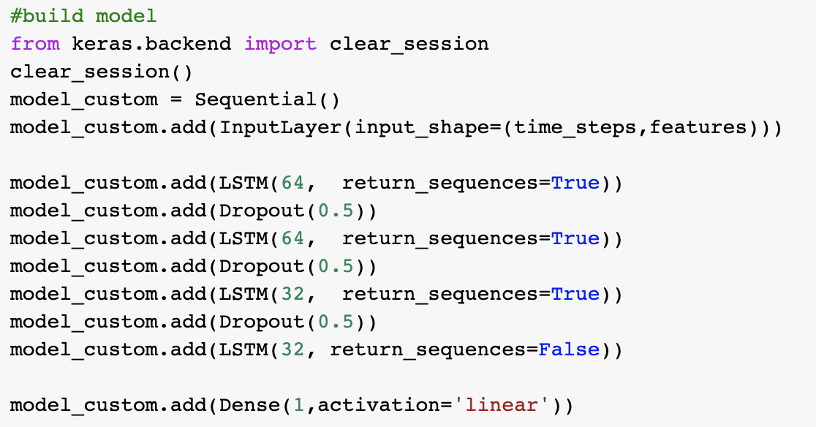
The Model: LSTM regression with Custom Loss Function

Slide 6
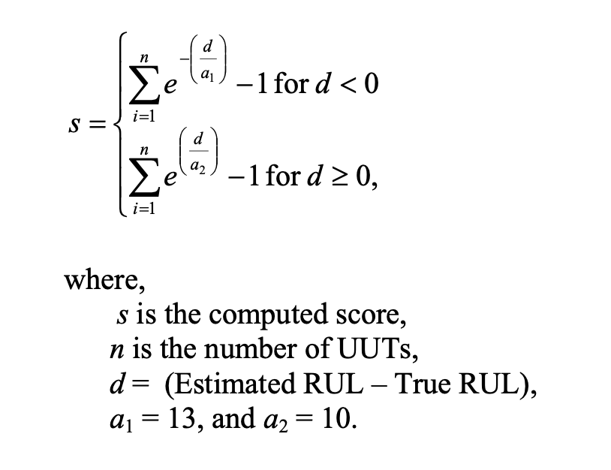
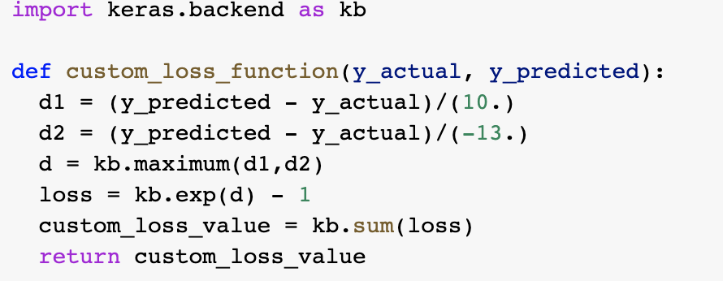
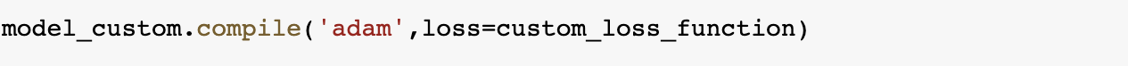
The Model: LSTM Regression with Custom Loss Function

Slide 7
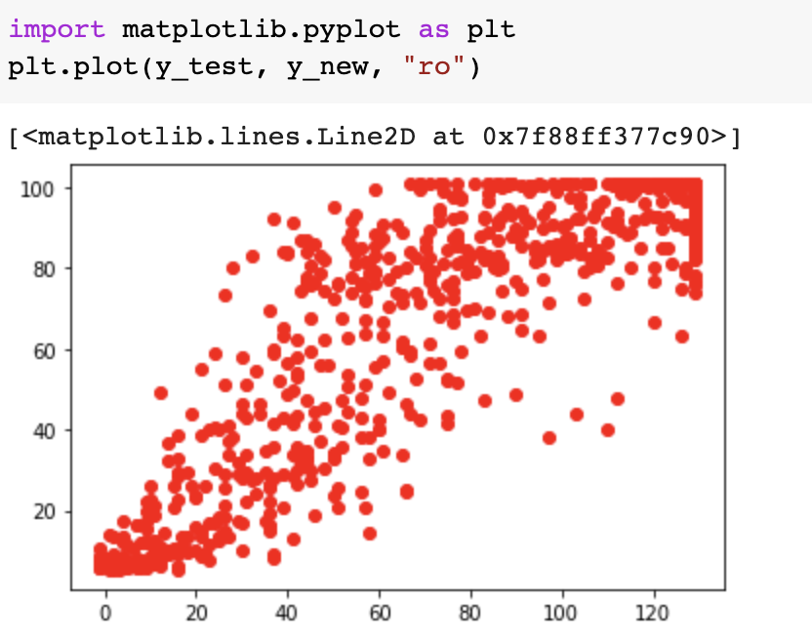
True RUL vs Predicted RUL on validation set
Learned max RUL is lower than 130 (not the case when using MSE)
Prediction is worse for the higher RUL values

Slide 8
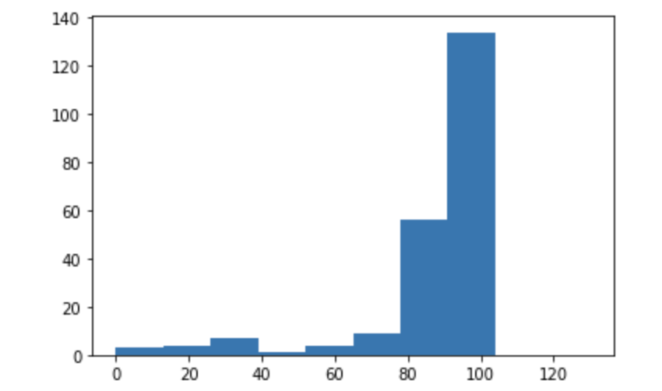
Test Set Results
Use the last 15 cycles of each engine for prediction
Apply Pearson’s selected features and MinMaxScaler fitted to training set
Score: 148,104

Slide 9
Road to improvement
Predicted RUL is clearly still overestimated/maxed out on large number of test cases
Need to reduce noise and overfitting so the model can learn more
Decrease noise:
Data smoothing: Kalman filter
Use a supervised method for feature selection like a filter or a wrapper.
Reduce dimensionality with an autoencoder.
Optimize hyperparameters:
Number of time steps.
Number and size of layers.

