Slide 1

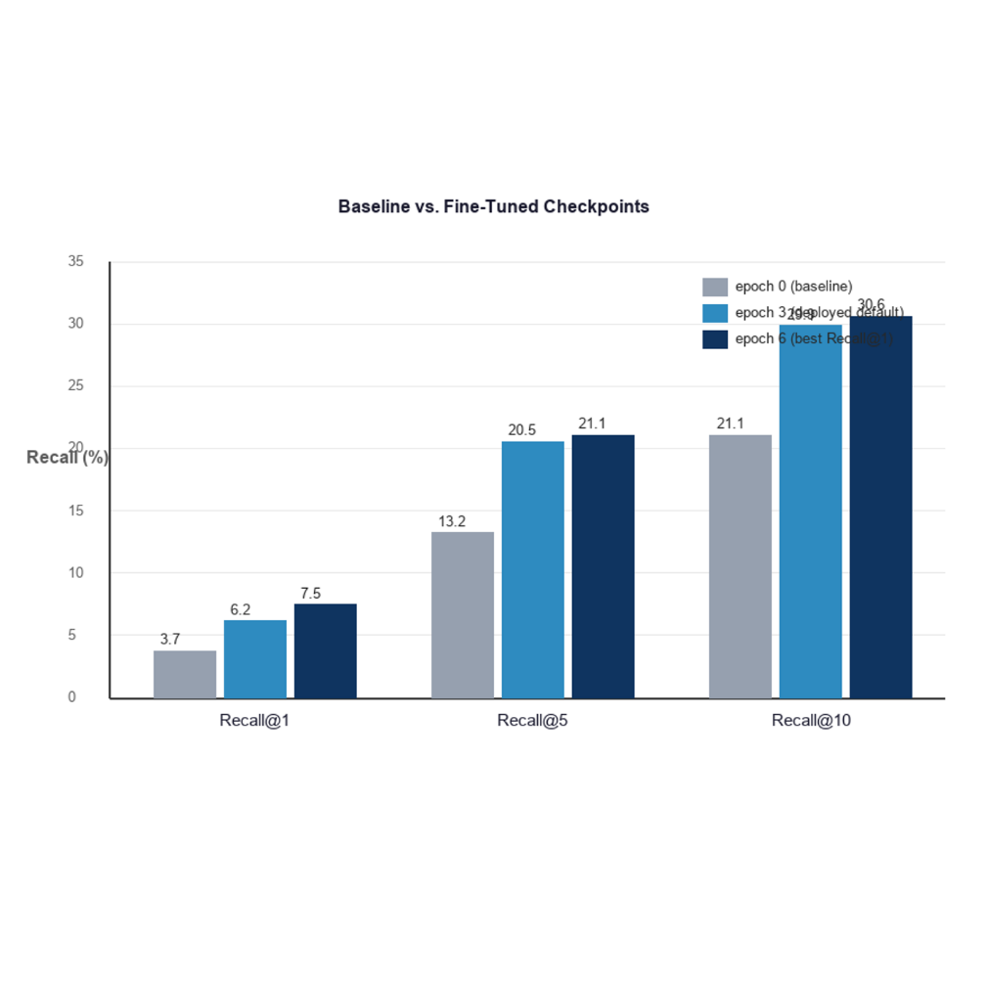
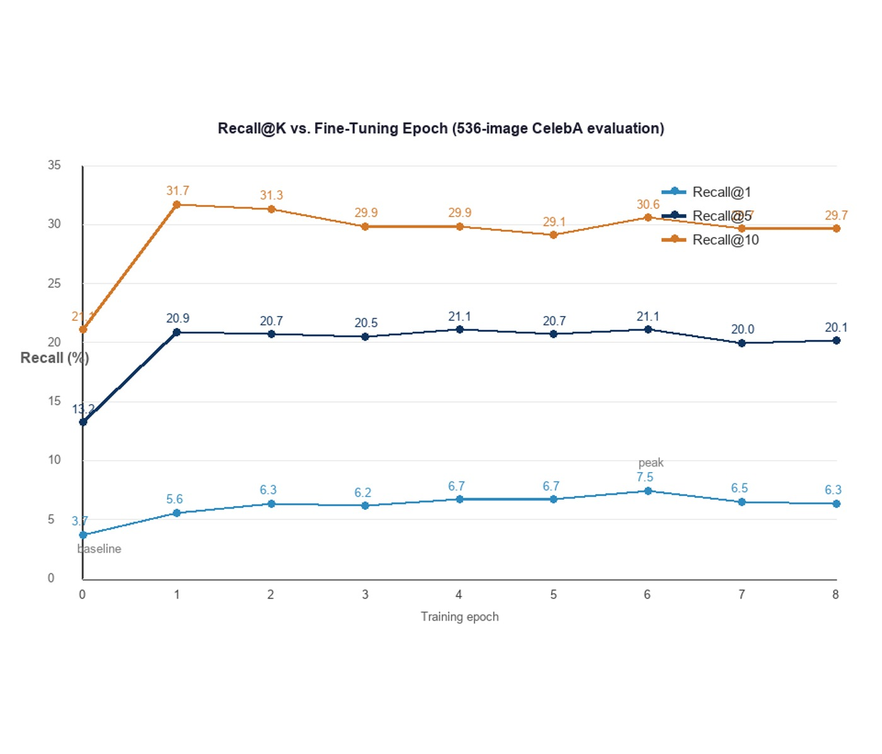
Help Culprit Recognition
By: Ali Sayed, Wasim Abdelhalem, Adel Ahmed, Mohamed Mowaffak, Ahmed Zayed
Supervised by: Dr. Fatma Mohamed · T.A.: Shamia Abdallah Ahmed
Faculty of Computer and Information Sciences - Ain Shams University
Introduction
Results
Eyewitness accounts are expressed in words, but the evidence is an unlabelled collection of photographs, and bridging the two by hand is slow, subjective, and impractical as the gallery grows.
Help Culprit Recognition closes this “semantic gap” with a fine-tuned vision-language model (CLIP), letting an investigator retrieve suspects from a gallery either by typing a natural-language description or by submitting a reference photograph.
Every photograph is ranked by how well it matches the query, and the strongest candidates are presented with interpretable percentage scores as leads for human review — a decision-support tool, not an automated identification.
Objectives:
(1) text- and image-driven retrieval;
(2) a CLIP model specialized for facial attributes;
(3) interpretable results;
(4) a secure, multi-user application;
(5) a rigorous evaluation of the fine-tuning.
Figure 1. Recall@K versus fine-tuning epoch — the learning curve peaks at epoch 6.
Fine-tuning roughly doubles top-1 accuracy: Recall@1 rises from 3.73% (baseline) to 7.46%.
Recall@1 peaks at epoch 6, then declines through epochs 7–8 — the clear onset of overfitting.
Recall@5 reaches about 21% and Recall@10 about 31%, versus a random-chance Recall@1 of only 0.19%.
Every fine-tuned checkpoint beats the pre-trained baseline on every metric.
GPU inference (RTX 3060) encodes about 400 images per second, making large-gallery indexing practical.
Checkpoint | Recall@1 | Recall@5 | Recall@10
Epoch 0 (baseline) | 3.73 % | 13.25 % | 21.08 %
Epoch 6 (best) | 7.46 % | 21.08 % | 30.60 %
Table 1. Recall@K of the best checkpoints versus the pre-trained baseline.
Methods
Conclusions
Architecture: a React single-page interface, an ASP.NET Core 8 Web API, a MySQL database, and a dedicated Python FastAPI service running CLIP (ViT-B/32) on an NVIDIA GPU.
Model: CLIP is fine-tuned on the CelebA dataset. Its 40 binary face attributes are converted into natural-language captions; transfer learning with partial layer freezing, the AdamW optimizer, and a symmetric contrastive loss then specializes the model.
Retrieval: images and text are encoded into a shared 512-dimensional space; the gallery is ranked by cosine similarity (or Euclidean distance), and the top matches are returned with percentage scores.
Evaluation: Recall@K — the fraction of queries whose correct image appears within the top K — measured identically on all nine training checkpoints over a 536-image set.
The project delivers a complete, secure, multi-user forensic retrieval system driven by both text and image queries, with a fine-tuned CLIP model at its core.
A rigorous evaluation on the project’s own checkpoints shows that fine-tuning doubles top-1 retrieval accuracy and identifies epoch 6 as the optimal stopping point before overfitting.
The outcome is both a working system and defensible evidence of when and how much fine-tuning helps — a practical investigative aid that meaningfully reduces manual effort.
Bibliography
[1] Radford et al. Learning Transferable Visual Models From Natural Language Supervision (CLIP). ICML, 2021.
[2] Dosovitskiy et al. An Image is Worth 16x16 Words (ViT). ICLR, 2021.
[3] Liu et al. Deep Learning Face Attributes in the Wild (CelebA). ICCV, 2015.
[4] Vaswani et al. Attention Is All You Need. NeurIPS, 2017.
Help Culprit Recognition · Graduation Project · Department of Information Systems · Ain Shams University · 2025 / 2026

