Slide 1
HELP CULPRIT RECOGNITION
An AI-Powered Forensic Suspect Retrieval System
Graduation Project · Department of Information Systems
Faculty of Computer and Information Sciences · Ain Shams University
Team: Ali Sayed · Wasim Abdelhalem · Adel Ahmed · Mohamed Mowaffak · Ahmed Zayed
Supervisor: Dr. Fatma Mohamed Teaching Assistant: Shamia Abdallah Ahmed
2025 / 2026
Notes:
Introduce the project: an AI tool that finds suspects in a photo database from a witness's text description or a reference image. Built as a full-stack system with a fine-tuned CLIP model.

Slide 2
Agenda
1
Problem & Motivation
7
How Search Works
2
Objectives
8
Certainty Weighting
3
Background: Vision-Language Models
9
Results & Evaluation
4
System Architecture
10
Key Findings
5
Technology Stack
11
Limitations & Future Work
6
AI Methodology
12
Conclusion
Notes:
Roadmap of the talk: motivation, objectives, the model and architecture, then the results — which is where most questions will focus.

Slide 3
Problem & Motivation
The Problem
Our Approach
A witness describes a suspect in words.
Evidence is an unlabelled pile of photographs.
Investigators bridge the two manually — slow, tiring, and inconsistent.
Beyond a few hundred images, exhaustive review is impractical.
Close the “semantic gap” between language and pixels.
Use a vision-language model to compare text directly with images.
Rank candidates by confidence and present them as leads.
Keep a human in the loop — a tool, not an identification.
Notes:
Frame the semantic gap clearly. Emphasize the system is a decision-support tool producing ranked leads, never an autonomous identification.

Slide 4
Objectives
End-to-end retrieval
Fine-tuned model
1
2
Search a gallery by text description or by a reference image.
Specialize CLIP for facial-attribute matching.
Interpretable results
Secure & multi-user
3
4
Ranked matches with clear percentage scores.
Each investigator isolated to their own cases.
Quantified benefit
Clean architecture
5
6
Measure fine-tuning with Recall@K on our own models.
Maintainable, service-oriented, extensible design.
Notes:
Six concrete objectives. The fifth — quantifying the benefit of fine-tuning — is what sets this apart from a demo and is backed by the results slides.

Slide 5
Background: Vision-Language Models (CLIP)
Both images and text become points in one shared 512-dimensional space
Two encoders
Shared space
An image encoder (ViT-B/32) and a text encoder trained together.
A photo and a sentence that describes it land close together.
Contrastive training
Direct comparison
Matching image–text pairs are pulled together; mismatches pushed apart.
Similarity is a simple cosine (dot product) of normalized vectors.
Notes:
Explain CLIP simply: it learns to map images and matching captions to nearby points. That shared space is what lets us search images with text.

Slide 6
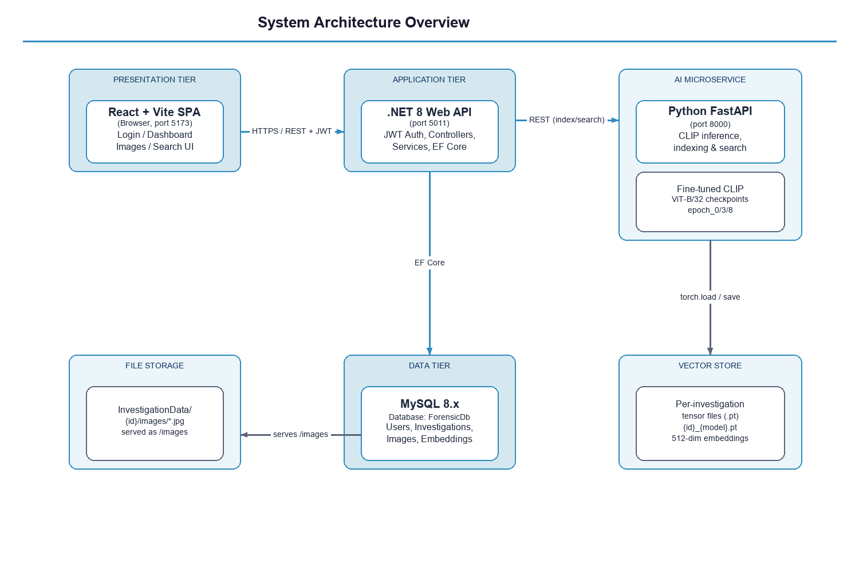
System Architecture
Three-tier web application plus a dedicated AI microservice
Notes:
Three tiers plus an AI microservice. The .NET API is the single gateway: the browser never talks to the database or the Python service directly. This centralizes security.

Slide 7
Technology Stack
Frontend
React 19 · Vite · Axios · React Router
Backend API
ASP.NET Core 8 (C#) · JWT · BCrypt
Data
MySQL 8 · Entity Framework Core 8
AI Service
Python · FastAPI · Uvicorn
ML Framework
PyTorch (CUDA) · Hugging Face Transformers
Model
Fine-tuned CLIP ViT-B/32 · 512-dim embeddings
Notes:
Heterogeneous stack chosen so each tier uses the best tool: Python for ML, C# for the transactional layer, React for the UI. The microservice split lets them evolve independently.

Slide 8
AI Methodology: Fine-Tuning Pipeline
Specializing a general CLIP model for facial-attribute retrieval
1
2
3
4
CelebA
Synthetic Captions
Transfer Learning
Contrastive Training
Face images with 40 binary attributes (glasses, beard, age…).
Rule-based: attributes → natural sentences (e.g. “a man wearing glasses”).
Start from pre-trained CLIP; partial freezing of layers.
AdamW optimizer · symmetric cross-entropy loss · checkpoints saved per epoch.
Notes:
Key point examiners ask about: CelebA gives binary labels, but CLIP needs captions — so we generate sentences from the attributes. Partial freezing avoids catastrophic forgetting and overfitting.

Slide 9
How Search Works
Text or image query → one shared space → ranked matches
Encode query
The description (or query image) becomes a 512-dim vector.
1
Load index
Pre-computed image vectors for the case are read from disk.
2
Compute similarity
One matrix operation scores every image by cosine similarity.
3
Return matches
Investigator chooses how many (5 by default), with percentage scores.
4
Notes:
Because vectors are precomputed at index time, a search is a single fast matrix operation — effectively instant. Image search is identical except the query is encoded by the image encoder.

Slide 10
Certainty Weighting
Letting the investigator express confidence in each facial attribute
How it works
Example
Sliders for glasses, beard, mustache, hat, bald, young, old.
Each expresses the witness’s confidence (0–100%).
Above 50%, the attribute phrase is appended to the query.
This steers the embedding toward the desired traits.
Base query: “a man”
+ Glasses 80% + Beard 65%
Final query: “a man, wearing glasses, with a beard”
A lightweight, transparent form of query expansion.
Notes:
Threshold-based query expansion: each slider above 50% appends its attribute phrase to the typed query, and the complete sentence is encoded as one unit. We also implemented a continuous embedding-interpolation variant, but the threshold approach gave more accurate retrieval on our fine-tuned model because encoding the full sentence preserves the contextual interaction between attributes. With no sliders raised it reduces to a plain text search.

Slide 11
Results: Recall@K Learning Curve
Measured on all 9 checkpoints over a 536-image CelebA evaluation set
Reading the curve
Big jump at epoch 1.
Recall@1 peaks at epoch 6 (7.46%).
Declines through epochs 7–8 = overfitting.
Full curve cleanly brackets the optimum.
Notes:
THE key graph. Walk each line. Recall@1 is strictest and peaks at epoch 6 (7.46%). The dip at epoch 8 is overfitting. Stress all numbers are our own measurements under one protocol.

Slide 12
Results: Baseline vs. Fine-Tuned
Fine-tuning roughly doubles top-1 retrieval accuracy
Takeaways
Every fine-tuned checkpoint beats the baseline on every metric.
Recall@1: 3.73% → 7.46% (a doubling).
Random chance ≈ 0.19% over 536 images.
Notes:
Grouped bars compare baseline, the deployed default (epoch 3), and the best (epoch 6). The doubling of Recall@1 is the headline result. Mention the random floor for context.

Slide 13
Key Findings
2×
Epoch 6
Epoch 8
top-1 accuracy vs. the pre-trained baseline
best checkpoint (Recall@1 = 7.46%)
performance dips — onset of overfitting
Why it matters
Fine-tuning on facial captions produces a substantial, measurable, and operationally meaningful gain — the correct suspect reaches the very top of the ranking about twice as often — with a clear optimal stopping point before overfitting sets in.
Notes:
Three headline numbers. The overfitting finding is a strength, not a weakness — it shows we evaluated rigorously and understand the model's behavior.

Slide 14
Limitations & Future Work
Limitations
Future Work
Evaluation on a 536-image subset with rule-based captions (indicative, not definitive).
Exhaustive search — not yet optimized for very large galleries.
Development security configuration needs hardening.
Quality degrades on occluded or non-frontal faces.
Full evaluation on the held-out split with training-aligned captions.
Approximate nearest-neighbour index for national-scale galleries.
Promote epoch 6 as default; automate checkpoint selection.
Role-based access, audit trail, and containerized deployment.
Notes:
Be candid about limitations — examiners respect honesty. The most consequential future step is replacing exhaustive search to scale up.

Slide 15
Conclusion
A complete, secure, multi-user forensic retrieval system driven by text and image queries.
A fine-tuned CLIP model specialized for facial-attribute matching.
A rigorous evaluation across all checkpoints — fine-tuning doubles top-1 accuracy and peaks at epoch 6.
Both a working system and defensible evidence about when fine-tuning helps.
Integrate early · separate concerns · measure honestly.
Notes:
Tie it together: a working system AND evidence. End on the methodological lesson — integrate early, separate concerns, measure honestly.

Slide 16
Thank You
Questions & Discussion
Help Culprit Recognition · Ain Shams University · 2025 / 2026
Notes:
Invite questions. Be ready for the graph questions: the learning curve, the doubling, the overfitting at epoch 8, and why epoch 3 is the default while epoch 6 is best.

