Slide 1
CANCER PREDICTION USING K-MEANS ALGORITHM - ELBOW AND SILHOUETTE METHODS
Presented By:
Alisha Christine

Slide 2
CONTENTS
Problem Statement
Justification of Number of clusters (K) in K-means algorithm
Elbow and Silhouette methods
1. Elbow method and its insights
2. Silhouette methods and its insights
Cluster Visualization
Insights when number of clusters is considered as 2 and 5.
Conclusion

Slide 3
PROBLEM STATEMENT
Proposed model could provide better insights to John Hughes. Here K-Means algorithm is opted in which the number of clusters, K is identified using Elbow and Silhouette methods where the leuanalysisNew.csv dataset is used that has data less than 30. Hopefully, this K-mean clustering algorithm could give better insights to predict cancer.

Slide 4
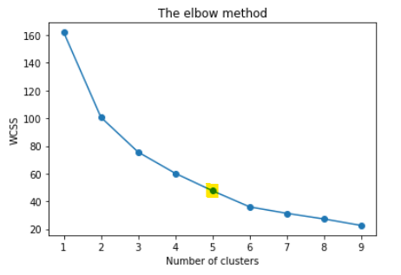
JUSTIFICATION OF NUMBER OF CLUSTERS (K) IN K-MEANS ALGORITHM: Elbow and Silhouette methods 1. ELBOW METHOD
Elbow method plot
Insights from Elbow method
Elbow method is a technique to determine the optimal value of clusters (K). It uses, average of the squared distances from the centroids.
From the graph, value of K at the elbow is chosen as 5.
Here, after the point 5 the WCSS value begins to decrease linearly, so this point could be considered as the optimal number of clusters.

Slide 5
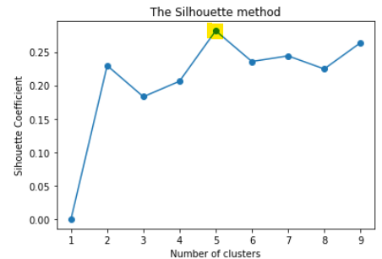
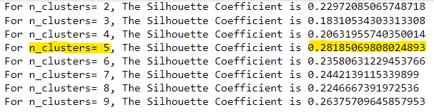
2. SILHOUETTE METHOD
Silhouette method plot
Silhouette Coefficient Values

Slide 6
Insights from Silhouette method
Silhouette method is a method to evaluate quality of clustering, which tells us how well samples are clustered with other samples that are comparable to each other.
From the graph, for the range of 1 to 9, the maximum value occurred is considered as the appropriate number of clusters (K = 5). Here the silhouette coefficient value is maximum at K=5 with a value as 0. 28185.
Silhouette score falls within the range of -1 to 1. From the graph, we could see the coefficient values ranges from 0.1831 to 0.28185 for K value ranging 2 to 9. This shows clusters are overlapping.

Slide 7
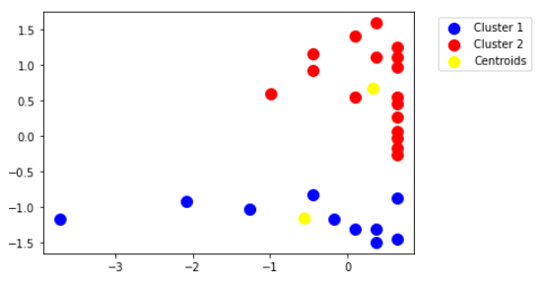
CLUSTER VISUALIZATION Insights When k= 2
Plot illustrates when number of clusters is considered as 2.
Cluster 1 is denoted in blue color with the centroid as yellow. Here, the data points are not overlapped within the cluster. However, some data points are far from the centroid.
Cluster 2 is denoted in red color with the centroid as yellow. Here the data points are overlapping within the cluster.
From the above visualization, we couldn’t optimize the given dataset.

Slide 8
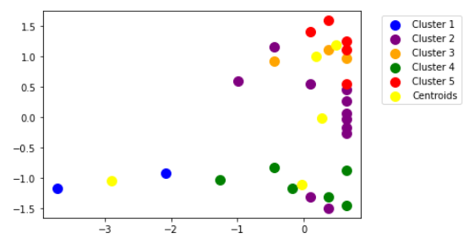
CLUSTER VISUALIZATION Insights When K = 5
Plot illustrates when number of clusters is considered as 5.
Here we could see 5 clusters with different colors as per the legend with centroids as yellow.
Among the 27 data points, Cluster 1 has only 2 number of datapoints
Maximum datapoints 11 falls under cluster 2.
Here some of clusters are overlapping each other.

Slide 9
CONCLUSION
K-means algorithm is easy to implement, that it get easily adaptable to the given dataset. This algorithm will help predicting cancer using the remission dataset.

Slide 10
THANK YOU

