Slide 1
Domain Name System (DNS) Exploration and Basic Implementation
Group Members: Alisha Rath and Omkar Yadav
Course: Computer Communication Systems-258
Instructor: Prof. Dr. Navrati Saxena

Slide 2
Table of Contents
Introduction
Related Work
Motivation
Problem Statement
Solution
Our Idea
Conclusion
References

Slide 3
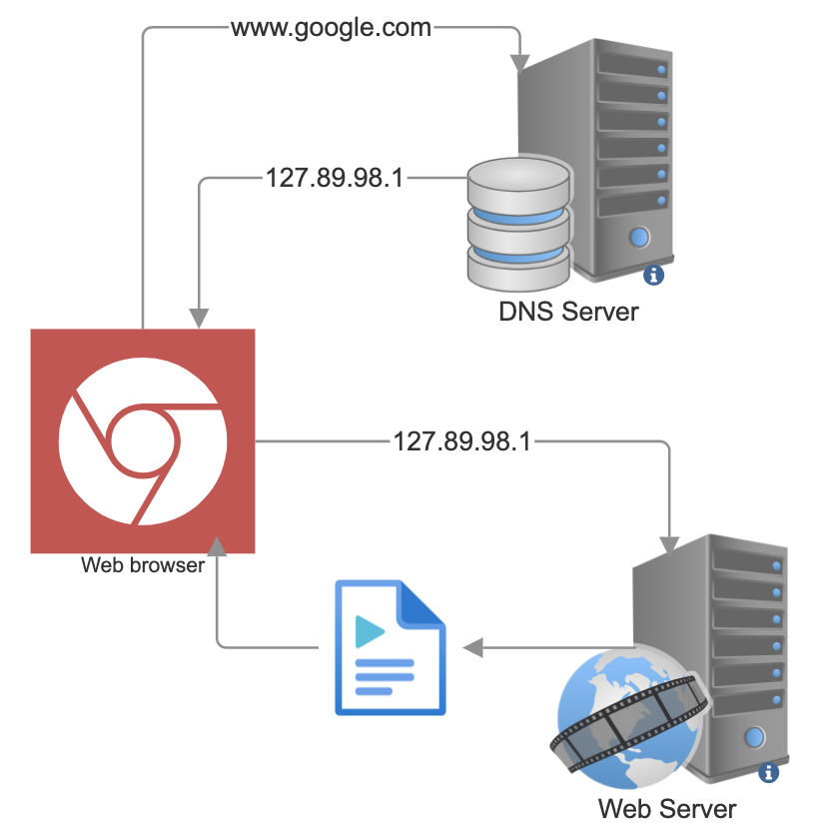
Introduction
DNS: Hierarchical naming system for internet resources.
Invented by UCI alumnus Paul Mockapetris.
Enables internet scalability and accessibility.
Associate domain names with IP addresses.
DNS working

Slide 4
Related Work
Literature Review: Petrova (2018)[1] and Mockapetris (1987)[3] offer DNS insights.
DNS Implementation: DNSimple[2] provides resources on DNS functionality.
Case Studies: Petrova (2018)[1] examines DNS attacks and best practices.
Community Forums: Online platforms offer DNS troubleshooting advice
Industry Standards: IETF and DNS-OARC set DNS protocols.

Slide 5
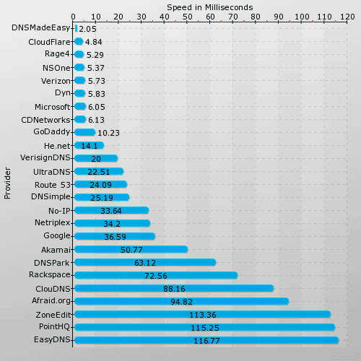
Motivation
DNS is crucial for internet architecture.
Many users don't understand DNS operations.
We aim to demystify DNS and improve internet accessibility.
Understanding DNS enhances internet security and efficiency.
DNS exploration fosters innovation in internet technology.
DNS providers
Reference: blog.cloudflare.com

Slide 6
Problem Statement
DNS is crucial for internet architecture.
Understanding DNS mechanisms for query processing and resolution.
Navigating the technical complexities involved in implementing a functional DNS.

Slide 7
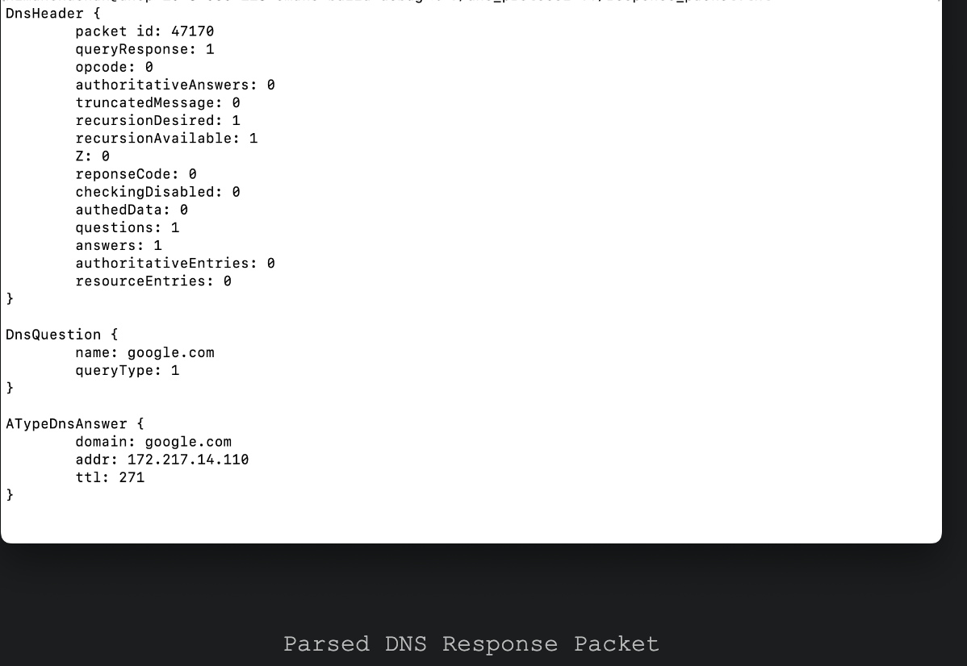
Solution: Understanding DNS Protocol
Understanding DNS Protocol: Referring to DNS RFC for format comprehension.
Inspecting DNS Packets: Using 'nc' and 'dig' for analysis.
Recording Query and Response: Capturing locally and from Google's DNS.
Inspecting Packets: Analyzing with 'hexdump’.
Parsing DNS Response: Following DNS RFC for parsing

Slide 8
Solution: Building a DNS Stub Resolver
DNS Stub Resolver Role: Intermediary between apps and recursive DNS resolvers.
Query and Response Packet Formation: Developing packet construction functionality.
UDP Client Creation: Implementing client for querying and receiving responses.

Slide 9
Solution: Implementing a DNS Proxy Server
DNS Proxy Server: Intermediary for client-DNS resolver communication.
Query Forwarding: Routes client queries to DNS resolver.
Response Delivery: Sends resolved responses to clients.
Demonstrated Functionality: Validated using 'dig' command.

Slide 10
Solution: Understanding a DNS Recursive Resolver
Recursive Resolution: Resolves domains recursively from root servers.
Recursive Lookups: Processed queries iteratively through DNS hierarchy.
Response Handling: Managed responses at each recursion stage.
Client Response: Delivered final IP address to client.

Slide 11
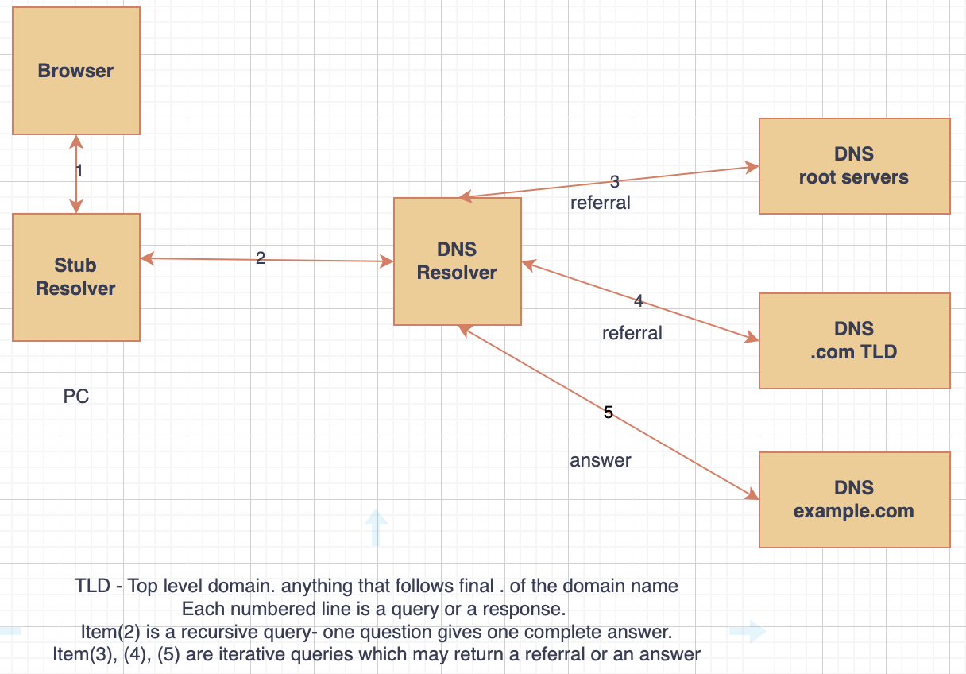

Slide 12
Our Idea
Innovative Approach: Hands-on implementation for deeper DNS understanding.
Practical Learning: Building server components for insights into DNS workings.
Enhanced Understanding: Experimentation for deeper insights into DNS mechanisms.
Comprehensive Implementation: Meticulous implementation of DNS components.
Knowledge Contribution: Adding to networking and DNS knowledge pool.

Slide 13
Conclusion
Achievements: Gained deeper DNS understanding through hands-on work.
Practical Skills: Developed networking and server implementation abilities.
Contributions: Added to DNS knowledge base for wider benefit.
Future Directions: Potential exploration of advanced DNS concepts.

Slide 14
References
[1] B. Petrova, “DNS history. When and why was DNS created?,” ClouDNS Blog, Dec. 27, 2018.https://www.cloudns.net/blog/dns-history-creation-first/
[2] DNSimple, “How DNS works,” howdns.works. https://howdns.works/
[3] P. V. Mockapetris, “Domain names - implementation and specification,” Nov. 1987, doi: https://doi.org/10.17487/rfc1035.

Slide 15

Thank You

