Slide 1


Explaining Large Language Models: Integrating Explainable AI (XAI) with LoRA
Presented by Alisha Rath

Slide 2


What is Explainable AI (XAI)?
XAI is the process of making AI decisions understandable to humans.It addresses the "black-box" nature of complex AI models, including LLMs.Key benefits:Improves trust in AI models.
Helps identify biases and errors.
Makes regulatory compliance easier in industries like healthcare and law.

Slide 3
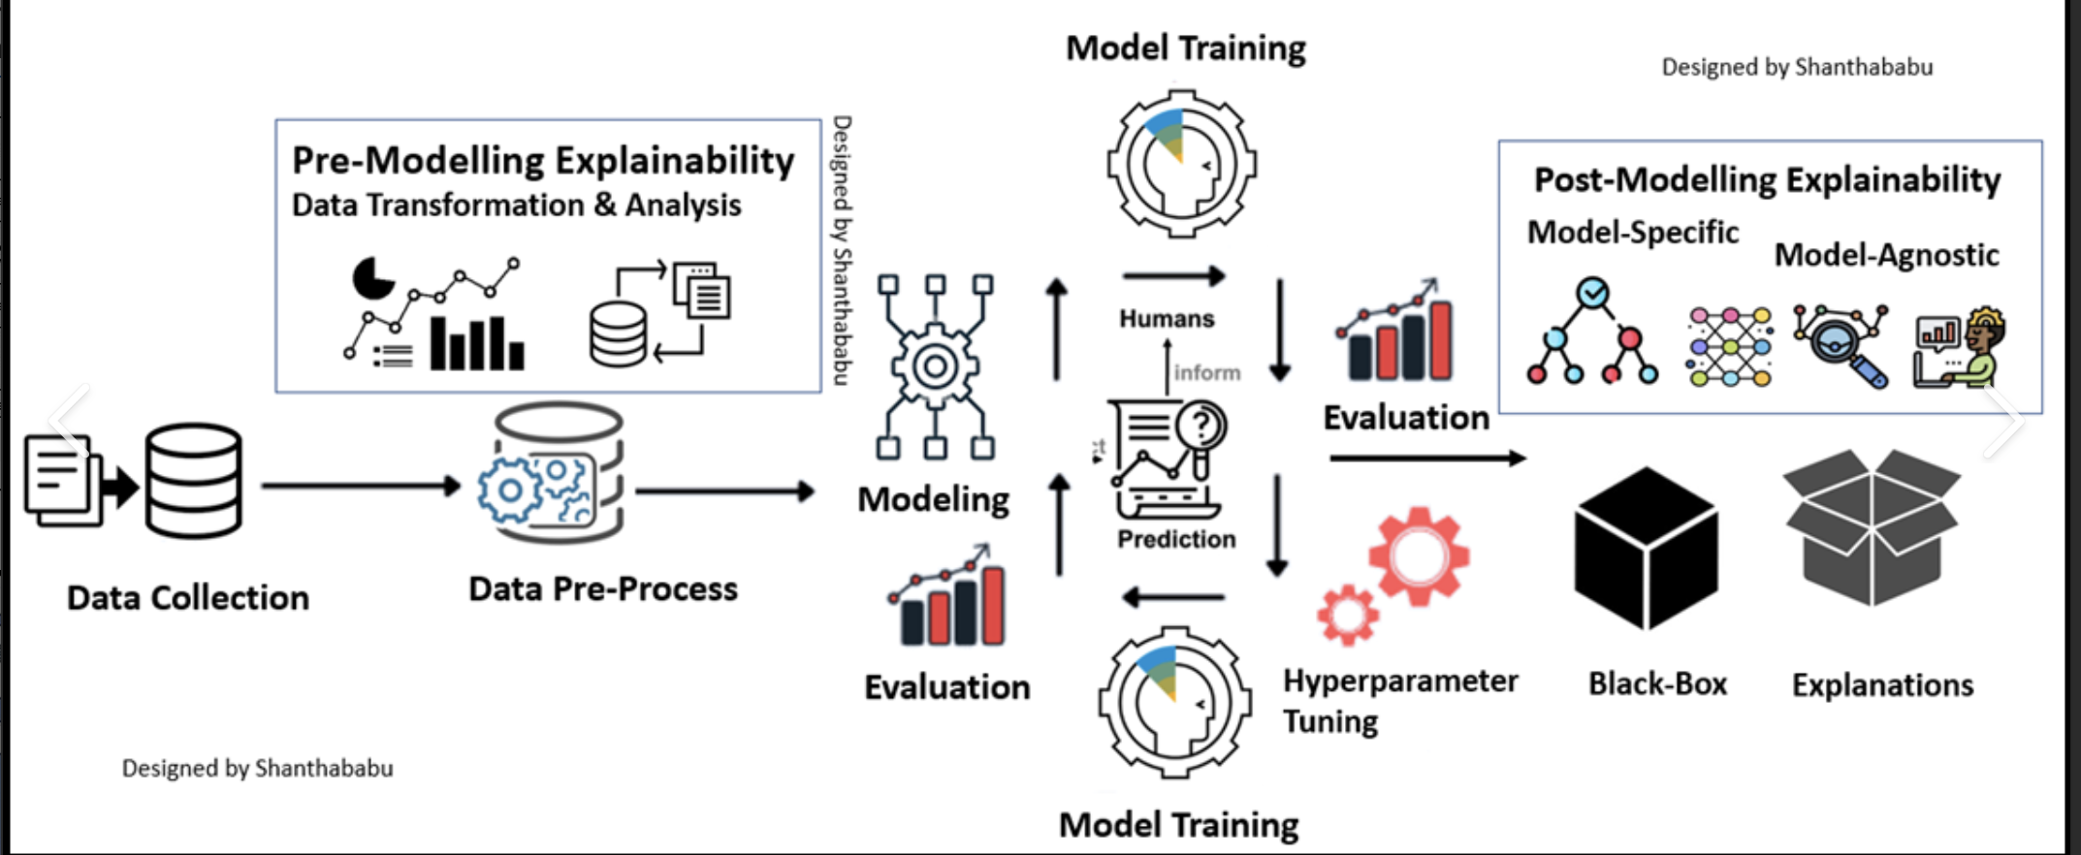

Slide 4
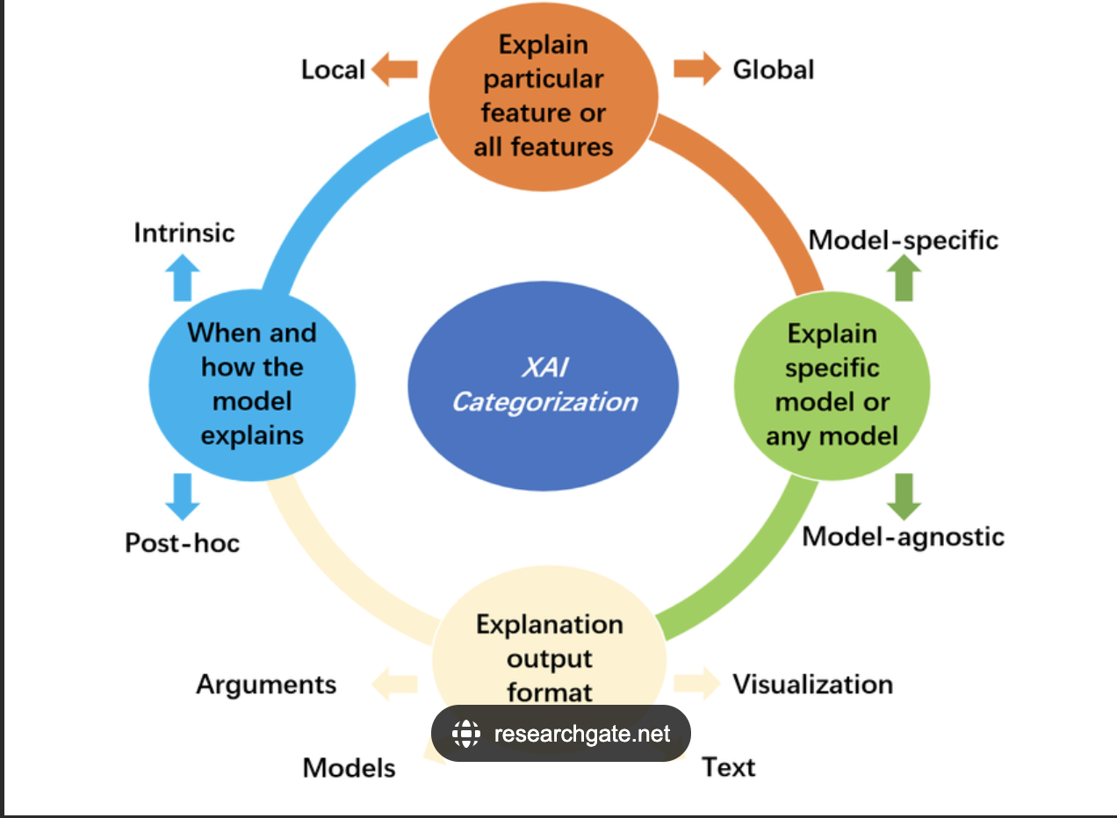

Slide 5
How XAI Works
XAI techniques provide insights into how models make decisions by:Feature Importance: Highlights which input features (tokens, words) were crucial in predictions.
Model Behavior Tracking: Provides transparency on how internal model layers (e.g., attention heads in LLMs) respond to inputs.
Counterfactual Explanations: Shows how small changes to input would alter the outcome.

Slide 6
Types of XAI Techniques
SHAP (SHapley Additive exPlanations):Explains the output by attributing importance to each input feature.
LIME (Local Interpretable Model-agnostic Explanations):Simplifies the model’s predictions locally for better understanding.
Attention Maps:Visualizes which parts of the input the model is "attending" to when making predictions.
Counterfactual Analysis:Investigates "what if" scenarios to determine how input changes affect output.

Slide 7
What is LoRA (Low-Rank Adaptation)?
LoRA is a technique used to fine-tune large pre-trained language models by applying low-rank updates.Key advantages:Reduces computational costs.
Enables fine-tuning with fewer parameters.
Helps target specific behaviors in models, making it easier to analyze and explain changes.

Slide 8
How to Integrate XAI with LoRA
Fine-Tuning with LoRA:Use LoRA to selectively fine-tune parts of the model (e.g., attention layers) to capture specific knowledge.
XAI Analysis After LoRA Fine-Tuning:Once fine-tuning is done, use XAI tools like SHAP to understand which input features (tokens, words) influenced the model’s decisions.
Attention Maps can help track the effects of LoRA fine-tuning on attention distribution.
Post-Fine-Tuning Explanation:Analyze how LoRA’s low-rank updates change the model’s behavior and make the model more interpretable.

Slide 9
Real-World Example
Content:Example: A legal decision support system using LoRA-fine-tuned LLM for predicting court case outcomes.
Process:
Fine-tune specific layers using LoRA.
Use SHAP to explain why the model predicts a certain outcome.
Use attention maps to visualize the focus of the model during its decision-making.

Slide 10
Challenges and Future Directions
Challenges:
Handling multi-modal models (text + images).
Computational costs of fine-tuning and explainability.
Future Directions:
Improved integration of XAI techniques for complex AI architectures.
More interpretable fine-tuning strategies using LoRA in different AI applications.

Slide 11

Conclusion
Integrating Explainable AI (XAI) with LoRA enhances transparency in large models like GPT.XAI helps understand why certain decisions are made, and LoRA fine-tuning ensures targeted behavior adjustments, enabling clearer explanations.

