Slide 1
Understanding XGBoost: Its Role in Legal Case Prediction
By Alisha Rath
CS 298

Slide 2
Introduction to XGBoost
XGBoost stands for Extreme Gradient Boosting.
It is an efficient and scalable machine learning algorithm based on decision tree ensembles.
Commonly used for both classification and regression tasks.
Known for its speed, accuracy, and performance.

Slide 3
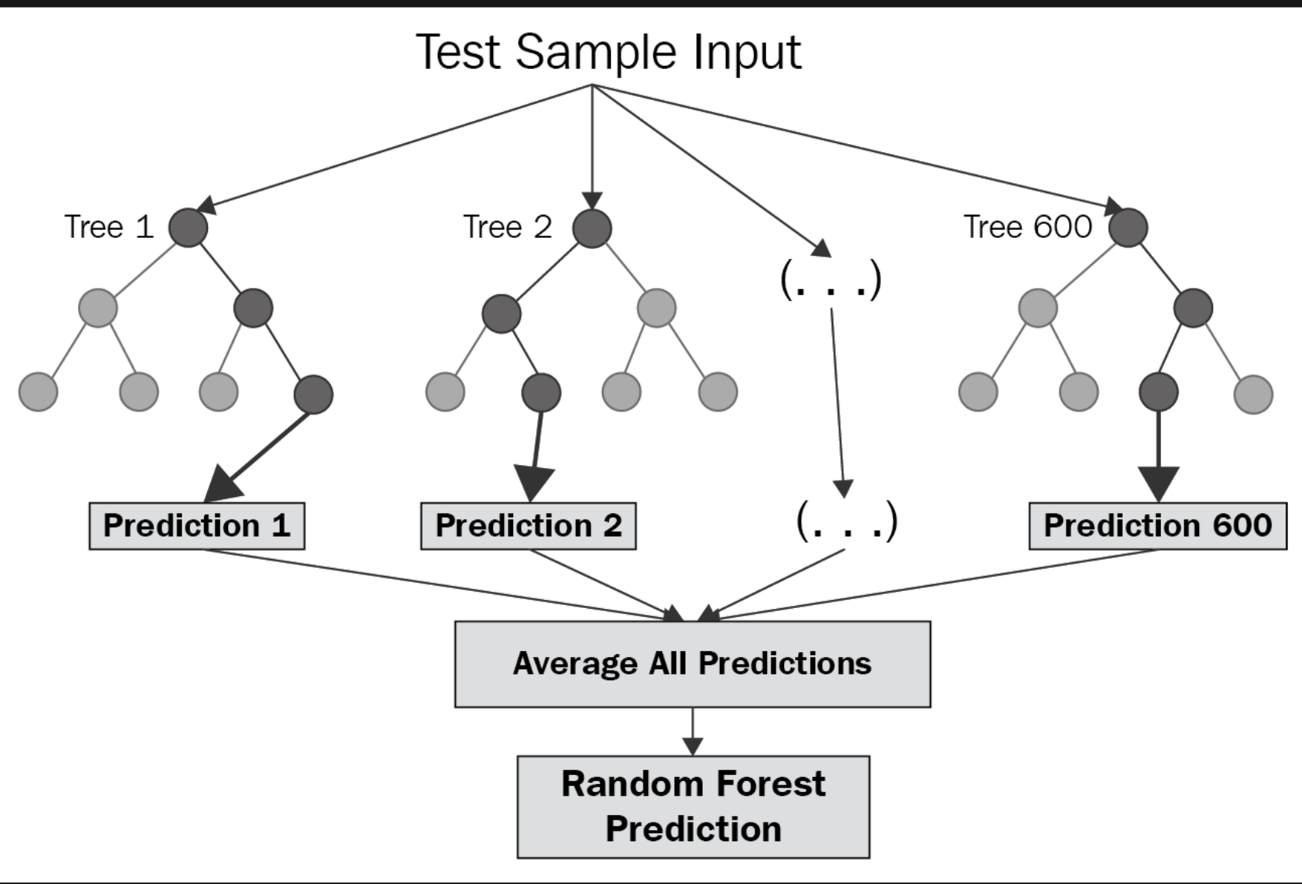

Slide 4
What Does XGBoost Do
XGBoost builds multiple decision trees sequentially, improving accuracy step-by-step.
It uses Gradient Boosting to minimize errors by focusing on misclassified data points.
It combines predictions from multiple trees to generate a final prediction.

Slide 5
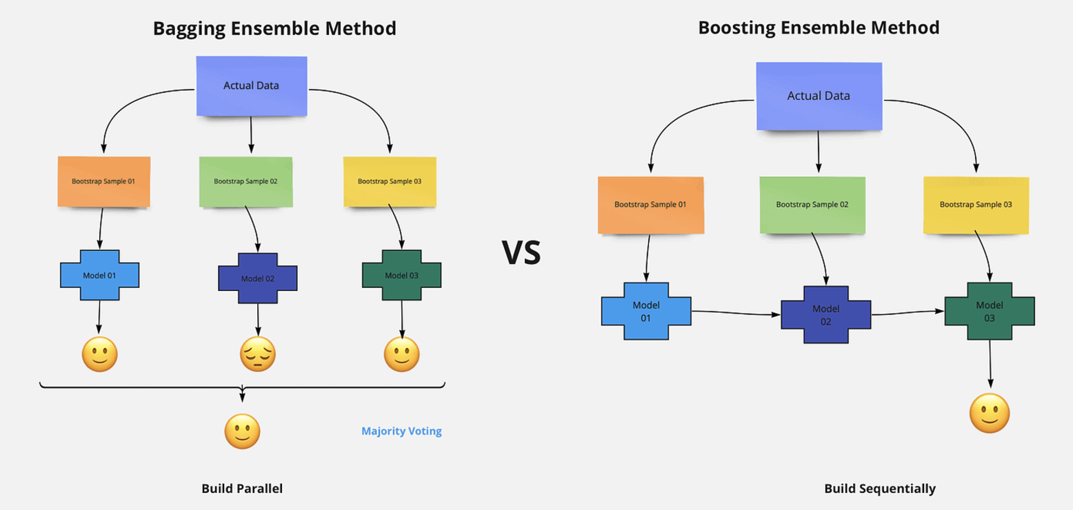

Slide 6
How XGBoost Works
Step 1: Build an initial weak model (a single decision tree).
Step 2: Calculate the residuals or errors in the first model.
Step 3: Build a second tree to correct the errors.
Step 4: Repeat this process iteratively, each time adjusting for previous mistakes.
Step 5: Combine the output of all trees to generate the final prediction.

Slide 7
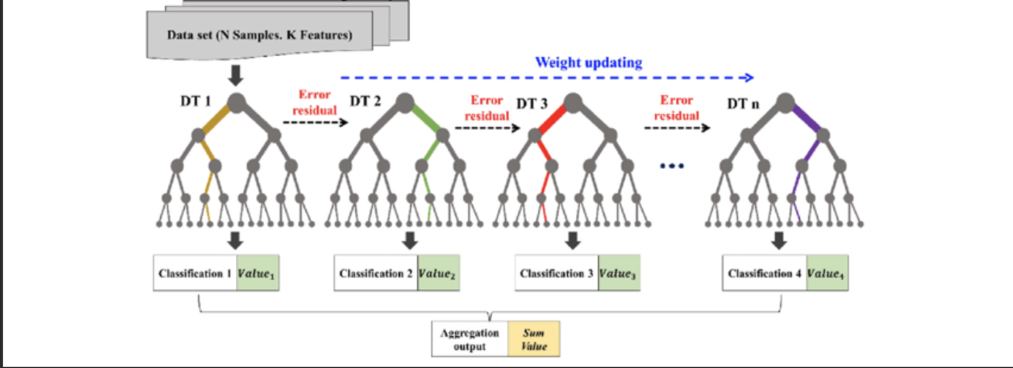

Slide 8
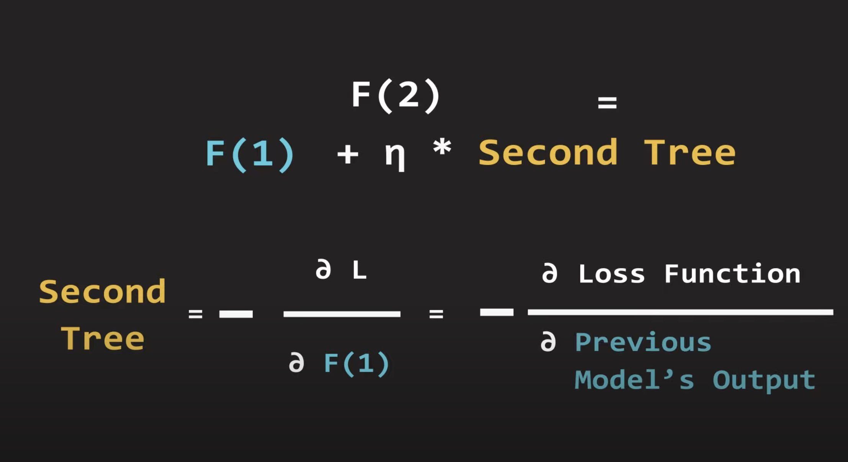

Slide 9
Features of XGBoost
Regularization: Helps prevent overfitting by adding a penalty for complex models.
Parallelization: Faster training due to parallel execution during tree construction.
Handling Missing Data: Automatically handles missing values in data without preprocessing.
Cross-validation: Built-in support for cross-validation during training.

Slide 10
Advantages of XGBoost
High performance and predictive accuracy.
Efficient handling of large datasets.
Flexibility to use for both classification and regression tasks.
Well-suited for imbalanced datasets (such as fraud detection, or legal case predictions).
Robust to overfitting due to regularization techniques.

Slide 11
Feature | XGBoost | Random Forest | Logistic Regression
Type of Algorithm | Gradient Boosting | Ensemble of Decision Trees | Linear Model
Training Speed | Faster (due to parallelization and optimization techniques) | Slower (multiple decision trees need to be trained) | Fast (simple optimization of weights)
Model Complexity | High (ensemble of trees, boosting) | Moderate (ensemble of trees) | Low (single linear model)
Handling of Overfitting | Can handle overfitting well with regularization (L1/L2) | Less prone to overfitting but can still overfit with many trees | Prone to overfitting with high-dimensional data
Performance with Large Data | Excellent (can handle large datasets efficiently) | Good (but slower with large datasets) | Good (but might underperform with non-linear data)
Interpretability | Moderate (can be interpreted with SHAP, feature importance) | High (easier to understand individual trees) | High (coefficients are interpretable)
Handling Missing Values | Built-in handling of missing values | Handles missing values during tree splitting | Requires imputation before training

Slide 12
Feature | XGBoost | Random Forest | Logistic Regression
Non-Linearity | Handles non-linear relationships well | Handles non-linear relationships with decision trees | Assumes linear relationship between variables
Tuning Complexity | High (requires tuning many hyperparameters like learning rate, depth) | Moderate (tuning number of trees and depth) | Low (tuning involves regularization, solver choice)
Use Cases | Highly effective for structured/tabular data, classification, regression | Effective for classification and regression on structured data | Effective for binary classification, particularly with linear relationships
Robustness to Noise | Robust to noisy data with appropriate regularization | Less robust to noise compared to XGBoost | Sensitive to noise, may require feature engineering

Slide 13
XGBoost in Legal Case Prediction
XGBoost can predict case outcomes based on historical data such as case type, judge rulings, and party arguments.
Feature Example: Case facts
Helps in predicting whether the plaintiff or defendant is likely to win a case.
Can assist lawyers and legal teams by providing probabilistic insights into case outcomes.

Slide 14
Why Use XGBoost for Legal Case Prediction?
XGBoost’s accuracy and speed make it ideal for processing complex legal datasets.
Ability to handle multivariate features (such as text data from court transcripts).
Supports class imbalance in cases where one outcome (e.g., defendant wins) is much more frequent than the other (plaintiff wins).
XGBoost provides feature importance, which can help identify key factors influencing case outcomes.

Slide 15
Conclusion
XGBoost is a powerful algorithm for predictive modeling, especially when dealing with large datasets and high-dimensional features.
It is widely used in various industries, including law, where accurate predictions can save time and costs.
With its ability to handle complex and unstructured data, XGBoost can significantly aid legal professionals in predicting case outcomes and making informed decisions.

