Slide 1

Consumer Buying Behavior Analysis
A Python-driven exploration of purchasing patterns using the Social Network Ads dataset.
Student Name:
Student ID:

Slide 2
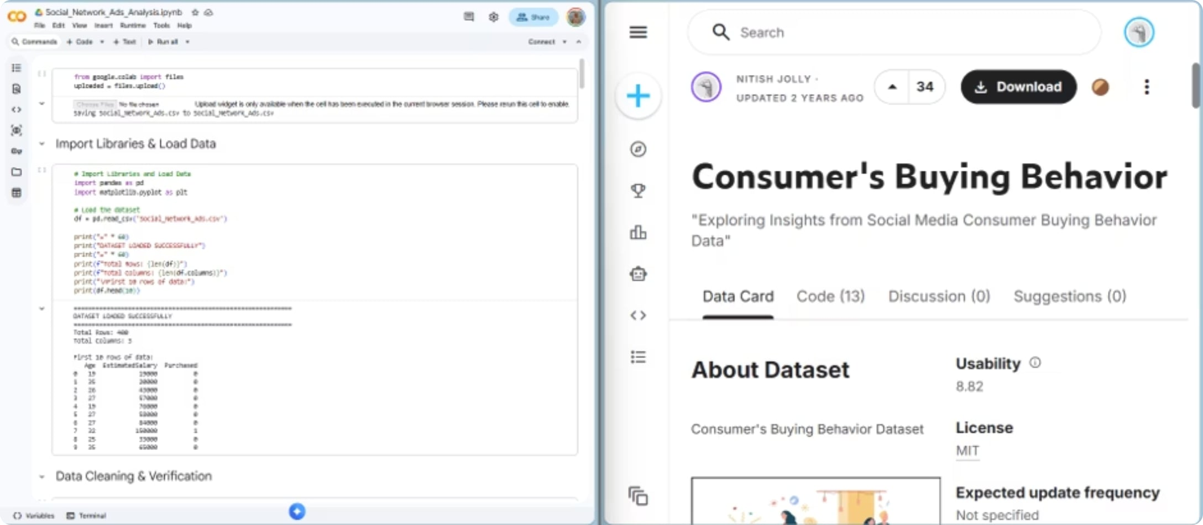
Project Overview
Dataset at a Glance
Source: Kaggle-Social Network Ads Dataset
Size: 400 consumers across 3 columns
Key Variables: Age, Estimated Salary, Purchased
Why This Dataset?
Clean, well-structured data ready for analysis
Distinct from NCHS or World Happiness datasets
Meets all project requirements for statistical and visual analysis

Slide 3
10 Analysis Questions
01
02
03
04
Average age & salary
Age 30–50, Salary >$50k, Purchased
Age 25–40, Salary <$40k, Not Purchased
Purchase rate by age group
Statistical summary
Filtering
Filtering
Grouping
05
06
07
08
Top 10 highest-paid purchasers
Age group purchase rates (high → low)
Purchasers vs non-purchasers
Bar chart - Purchase by age group
Sorting
Grouping + Sorting
Grouping + Stats
Visualization
09
10
Pie chart — Age distribution
Scatter plot - Age vs Salary by status
Visualization
Visualization

Slide 4

Data Loading & Cleaning
Check Missing
Validate Types
Handle Duplicates
Load Data
The dataset loaded successfully with 400 rows. No missing values were detected, all data types were correct (int64), and 33 duplicate records were identified but retained as they reflect realistic consumer behavior. The data is clean and ready for analysis.

Slide 5
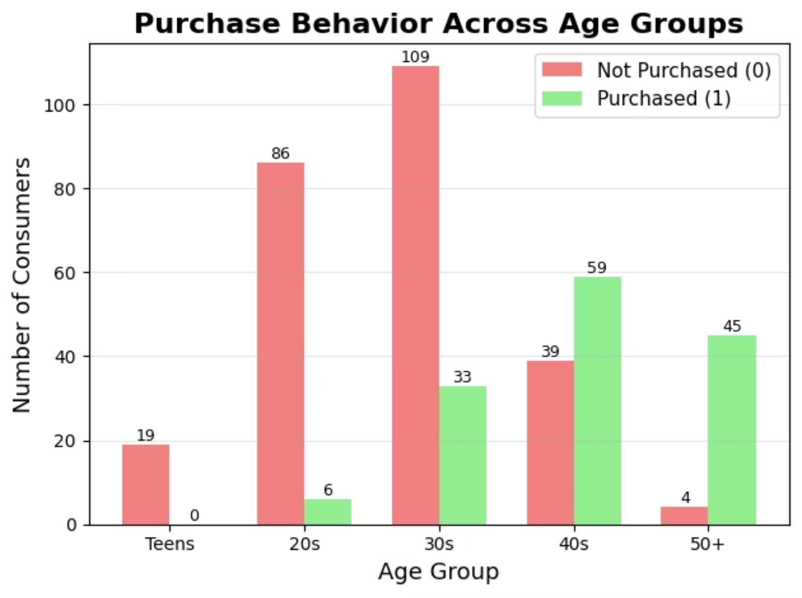

Age Group Analysis Results
Key Insight
Purchase likelihood rises sharply with age. Consumers aged 50+ have a 91.8% purchase rate nearly 14× higher than those in their 30s.
Marketing implication: Campaigns targeting the 40+ demographic are likely to deliver the highest conversion rates.

Slide 6
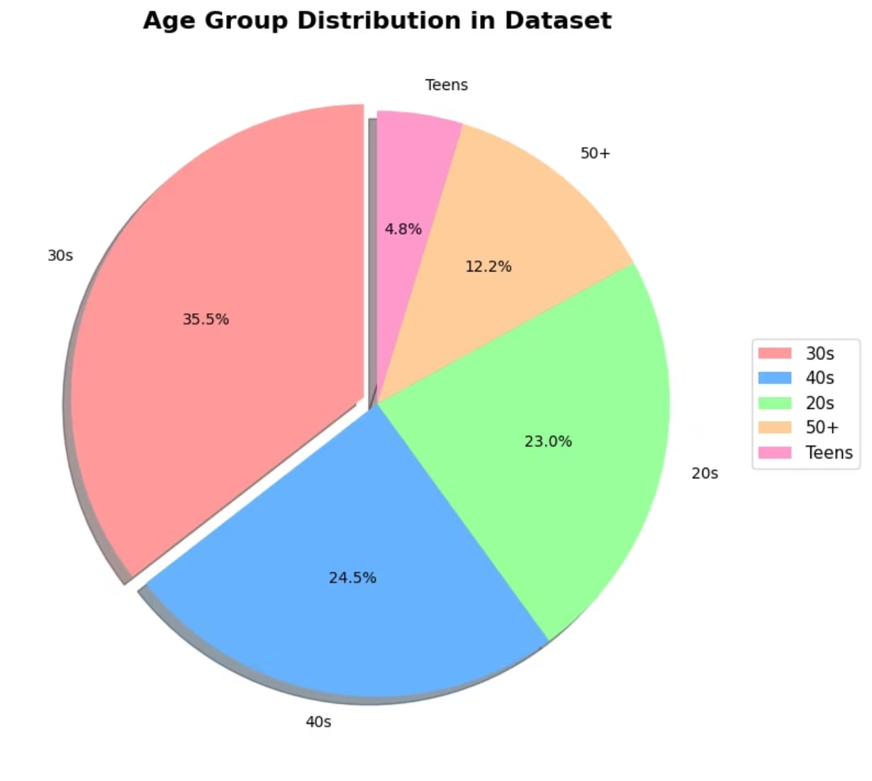
Buyer Profile Comparison
What the Data Reveals
Purchasers are consistently older and earn significantly more than non-purchasers.
Both age and salary are strong predictors of purchase behavior.
+13.6 years
Average age difference
+$25,728
Average salary difference

Slide 7
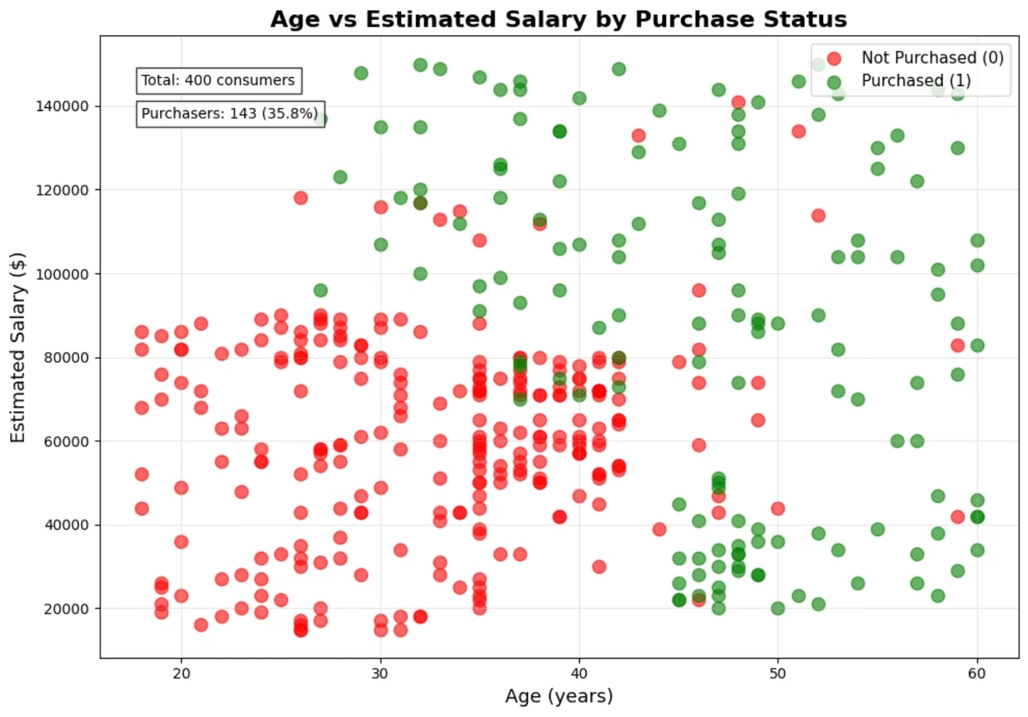

Age vs Salary: Scatter Plot Analysis
Reading the Plot
When plotted individually, green dots (purchasers) cluster toward the upper-right older and higher-earning while red dots (non-purchasers) occupy the lower-left quadrant.
This clear separation confirms that age and salary together form a reliable purchase predictor.

Slide 8
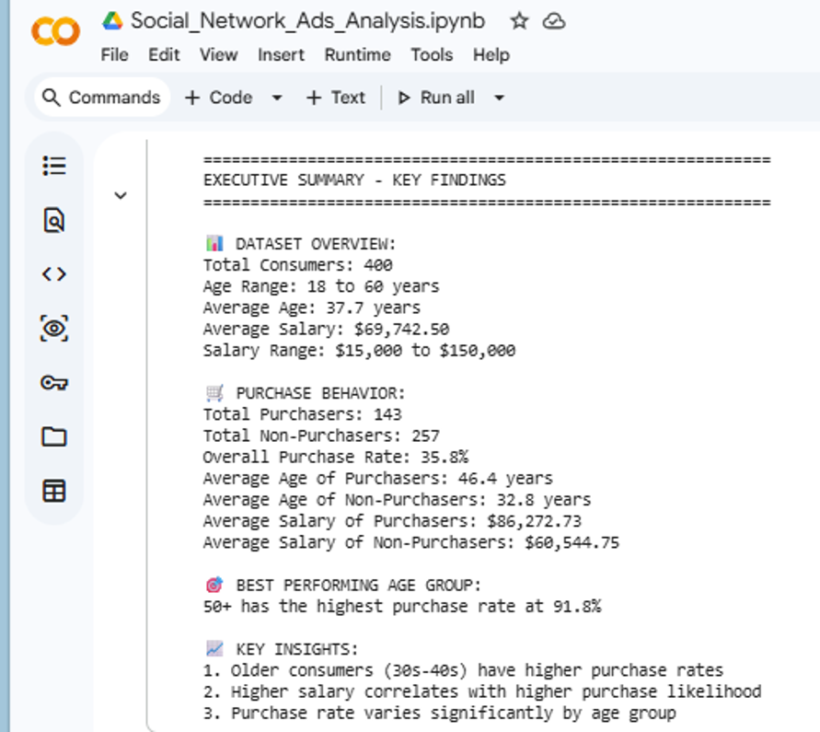
Consumer Segments Identified
66 High-Value Consumers
34 Untapped Consumers
Identified purchasers predominantly aged 40+, with above-average salaries. Prime targets for premium product offerings and loyalty programs.
Age 30–50 with salaries above $50k who have not yet purchased. Represent a clear opportunity for targeted re-engagement campaigns.
Young Professionals
Lower purchase rates in their 20s–30s, but represent future high-value customers. Affordable entry-level products can build early brand loyalty.

Slide 9
Conclusions & Recommendations
Key Findings
Strategic Recommendations
Age is the strongest purchase predictor 91.8% for 50+
Purchasers are +13.6 years older and earn +$25,728 more
66 high-value consumers identified; 34 untapped prospects remain
Target 40+ demographics
Highest conversion potential
Premium products for high earners
Match salary to offering
Affordable options for young professionals
Build long-term loyalty
Age-based segmentation
Tailor messaging by group

Slide 10

Limitations & Future Improvements
Current Limitations
The dataset includes only Age and Estimated Salary. Factors such as gender, location, browsing behavior, and product category are absent limiting the depth of segmentation possible.
Future Improvements
Enrich the dataset with additional consumer features purchase history, geographic data, and psychographic variables to build more nuanced predictive models and personalized marketing strategies.

