Slide 1
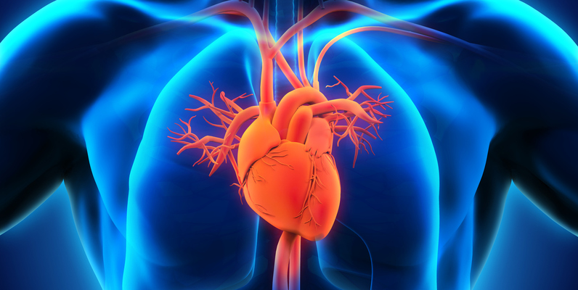
Heart Failure Prediction Dataset Analysis
PROG101 - Introduction to Programming Summer 2026 - Final Project

Slide 2
Project Overview
Project Aim:
To analyze cardiovascular health indicators and identify patterns associated with heart disease
To understand which clinical features are most strongly correlated with heart disease diagnosis
To provide data-driven insights for early detection and prevention
Dataset Selection:
Dataset: Heart Failure Prediction Dataset
Source: Kaggle (fedesoriano, September 2021)
Why Chosen: Cardiovascular disease is the #1 cause of death globally (31% of all deaths)
Size: 918 patient records with 12 clinical features
Main Columns Analyzed:
Age, Sex, ChestPainType, RestingBP, Cholesterol, FastingBS, MaxHR, ExerciseAngina, Oldpeak, ST_Slope, HeartDisease (Target Variable)

Slide 3
10 Analysis Questions
# | Question Type | Question
Q1 | Statistical | What is the average age, MaxHR, and cholesterol by heart disease status?
Q2 | Filtering | How many male patients over 50 have heart disease?
Q3 | Filtering | What is the average cholesterol of patients with ASY + ExerciseAngina?
Q4 | Grouping | What is the number of heart disease cases by chest pain type?
Q5 | Sorting | Which are the top 10 patients with the highest cholesterol?
Q6 | Combination | What is the average age for each chest pain type (sorted)?
Q7 | Combination | Which gender has higher average resting BP among heart disease patients?
Q8 | Visualization | What is the age distribution of patients with/without heart disease?
Q9 | Visualization | How many patients have heart disease by sex?
Q10 | Visualization | What is the distribution of chest pain types among heart disease patients?

Slide 4
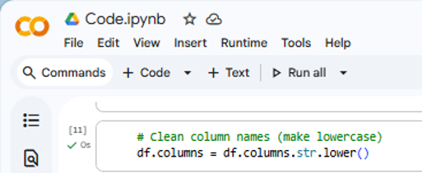
Data Loading & Cleaning
Cleaning Steps Performed:
Step | Action | Justification
1 | Checked for missing values | None found - data is complete
2 | Checked for duplicates | None found - no removal needed
3 | Standardized column names | Made all lowercase for consistency
4 | Validated data types | Confirmed correct types (int, float, object)
Why Cleaning Was Needed:
Dataset was already clean, but standardization improves code reliability
Lowercase column names prevent errors when referencing columns
Data type validation ensures proper analysis

Slide 5
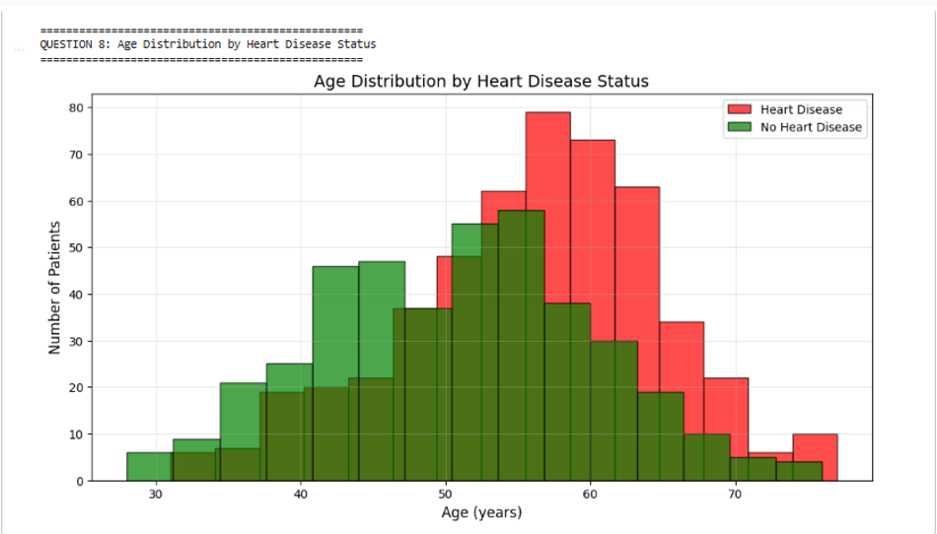
Key Findings - Statistical Analysis & Age Distribution
Finding 1: Statistical Comparison (Q1)
Key Insight: Heart disease patients are older and have lower cardiac capacity. Lower cholesterol in patients may indicate treatment effects.
Finding 2: Age Distribution by Heart Disease Status (Q8)
Measure | No Disease | Disease | Difference
Average Age | 50.55 years | 55.90 years | +5.35 years
Max Heart Rate | 148.15 | 127.66 | -20.49 lower
Cholesterol | 227.12 | 175.94 | -51.18 lower

Slide 6
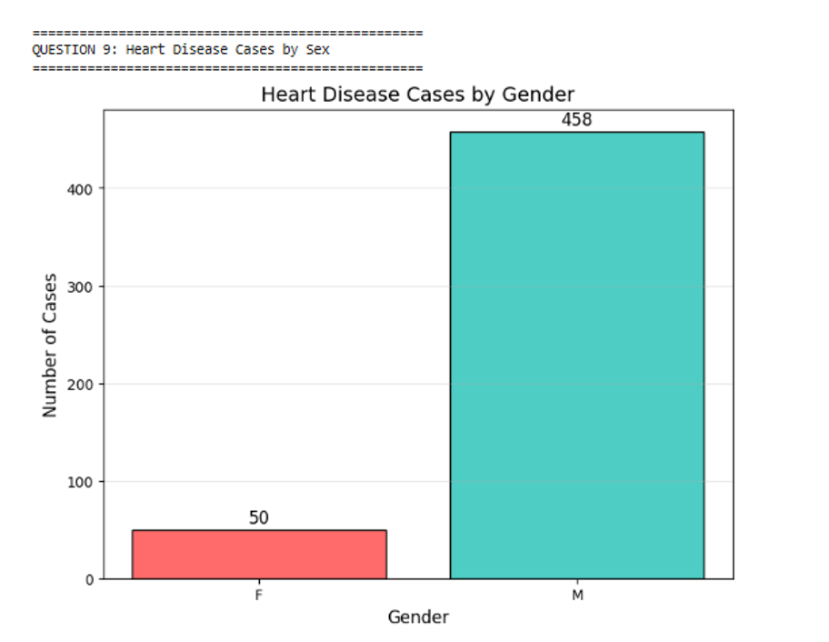
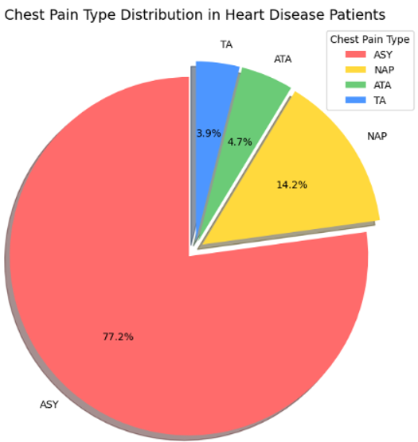
Key Findings - Gender & Chest Pain Analysis
Finding 3: Heart Disease Cases by Sex (Q9)
Key Insight: Males are significantly more affected by heart disease. Male patients over 50 represent 344 cases (67.72% of all heart disease patients).
Finding 4: Chest Pain Type Distribution (Q10)
Why This Matters:
Most heart disease patients show NO symptoms (ASY)
Reliance on chest pain for diagnosis misses the majority of cases
Highlights need for regular screening in at-risk populations
392 patients with ASY chest pain = highest risk group

Slide 7
Conclusion, Recommendations & Limitations
Key Findings Summary:
Cross-sectional data - cannot establish causality
No lifestyle factors (diet, smoking, exercise)
Geographic diversity unknown
Medication history unavailable
Possible Improvements:
Collect longitudinal data
Include lifestyle factors
Apply machine learning for prediction
Limitations:
Patients with heart disease are on average 5.35 years older
Males account for 77% of heart disease cases
67.72% of all cases are male patients over 50
Asymptomatic chest pain (ASY) occurs in 77% of heart disease patients
Both genders have elevated blood pressure (~137 mm Hg)
Recommendations:
# | Recommendation | Supporting Evidence
1 | Screen male patients over 50 regularly | Q2: 67.72% of cases in this group
2 | Don't rely on symptoms for diagnosis | Q10: 77% have no symptoms (ASY)
3 | Monitor cholesterol in ASY patients | Q3: Avg cholesterol 195.59 mm/dl
4 | Manage blood pressure for all patients | Q7: Both genders show hypertension
5 | Start prevention programs at age 50 | Q8: Disease peaks after age 50

