Slide 1
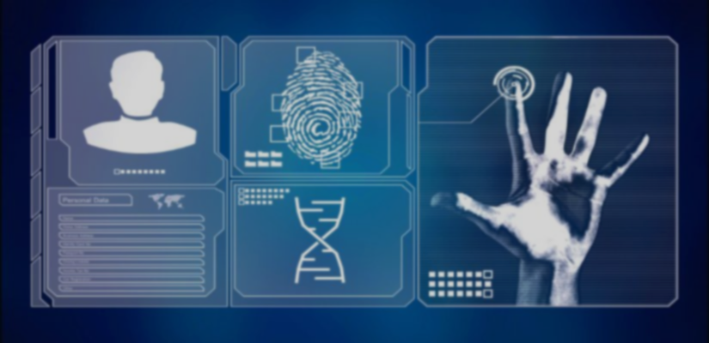
M57 Patents Case – Forensic Investigation Report
Student Name:

Slide 2
Executive Summary
Investigation conducted on Jo Smith’s workstation (Jo-PC)
Objective: Identify potential data exfiltration and insider theft
Evidence acquired: Disk image, Memory dump, Network capture
Findings confirm deliberate transfer of confidential patent files

Slide 3

Investigation Objectives
Examine disk and memory images for evidence of IP theft
Identify exfiltration techniques and related artifacts
Correlate evidence from multiple sources
Maintain forensic integrity and legal compliance throughout

Slide 4
Evidence Overview
Evidence Type | File Name | MD5 Hash | SHA-1 Hash | Verification
Workstation Disk | Jo.E01 | 4ff309201c91db97029531b1b408fac9 | 7da76fc19f7455d8fb3bfd9957cb8412ba71f3e6 | ✅ Verified
Memory Dump | jo-2009-12-10.winddramimage | b2344dd7149c11468b2145a016d5189e | 307d4361064d3a415e12ff37a39ae7368b551d9d | ✅ Verified
USB Drive | jo-work-usb-2009-12-11.E01 | 8f23279deb398c3245829a98bc8fc1bd | 9a2933b2391e5994745710ab317c702b82a9b141 | ✅ Verified

Slide 5
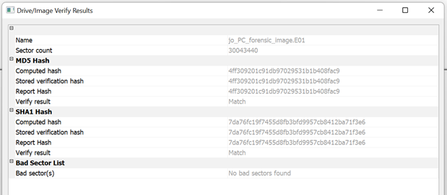
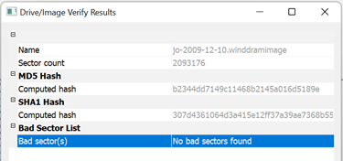
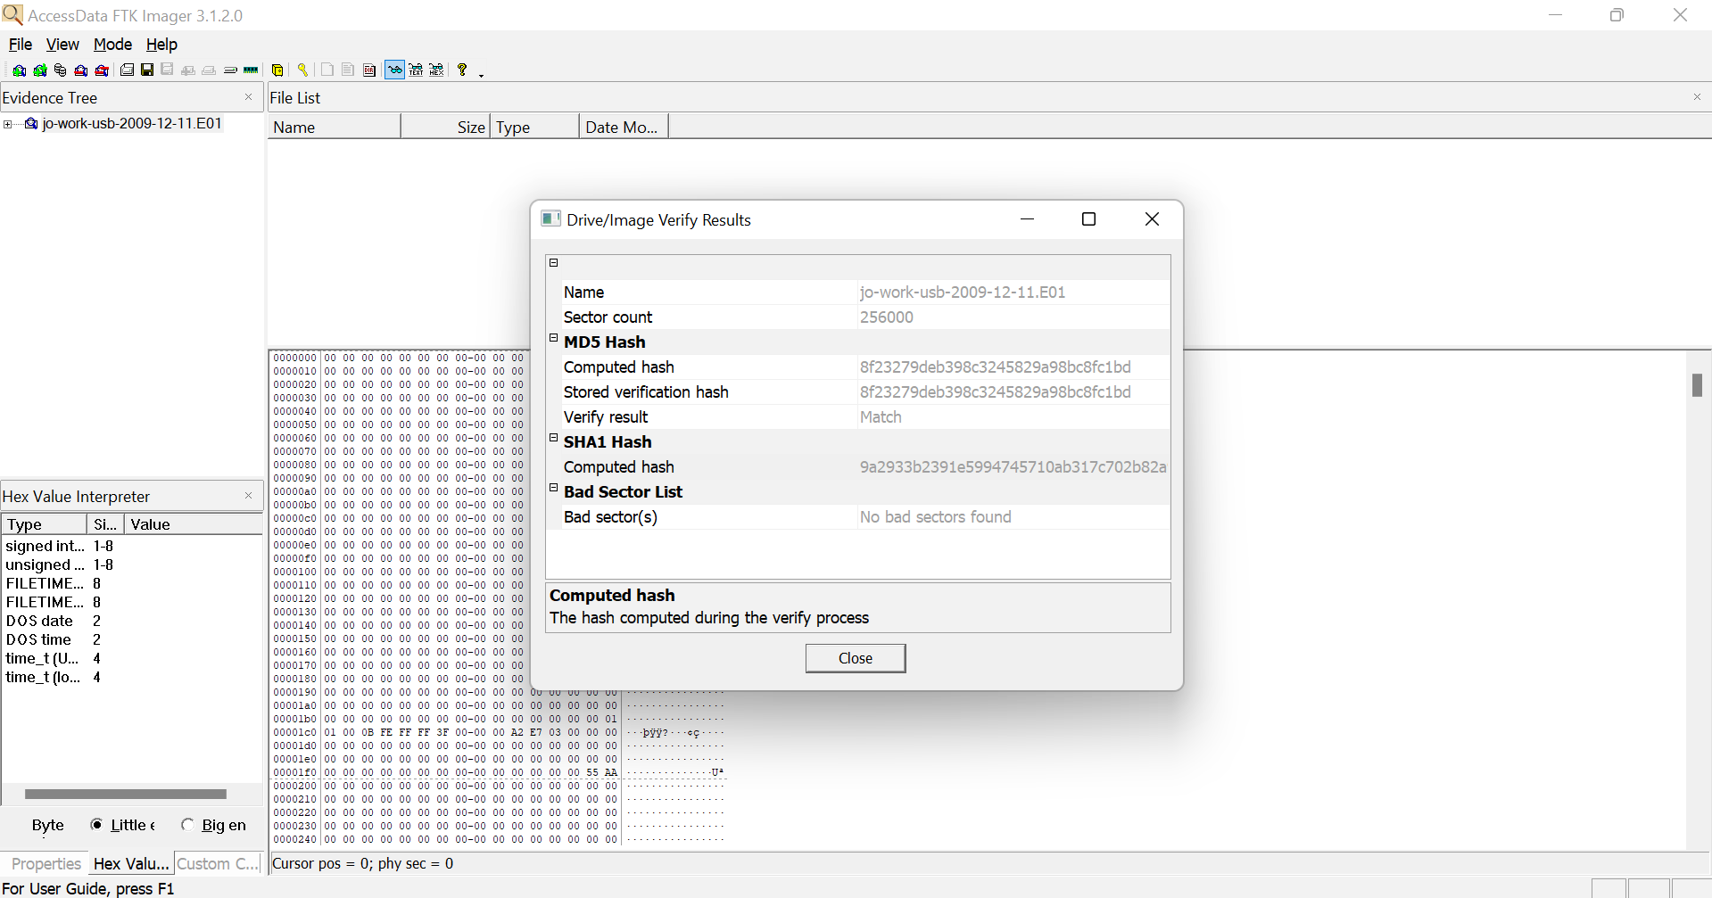
Evidence Handling & Integrity
Chain of custody documented throughout acquisition
MD5 and SHA1 hashes verified for all evidence files
No modification to original data sources
Stored and analyzed in read-only forensic environment

Slide 6
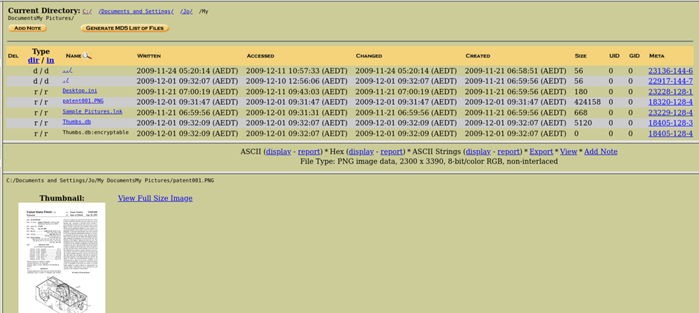
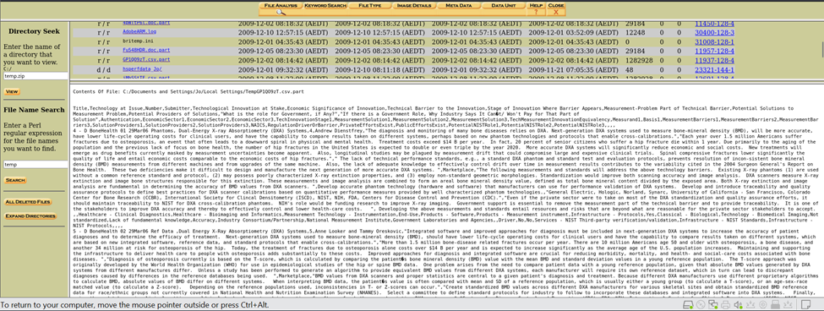
Disk Analysis (Autopsy Results)
Sensitive files found in user directories (Desktop, Documents)
Traces of deleted patent-related documents recovered
Installation of TrueCrypt encryption software detected
Frequent USB device connections (Imation USB confirmed)
Recycle Bin contained remnants of deleted patent data

Slide 7
Key Disk Evidence
File Name | Path | Observation
patentauto.py | Desktop/web | Patent automation code
TrueCrypt Setup.exe | Downloads | Used for data encryption
setupapi.log | C:/Windows/ | Confirms USB connections
recentdocs.xml | AppData | Lists patent documents accessed

Slide 8
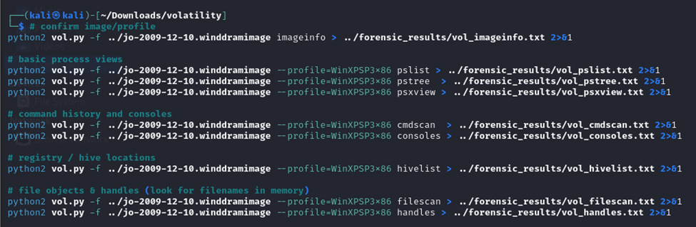
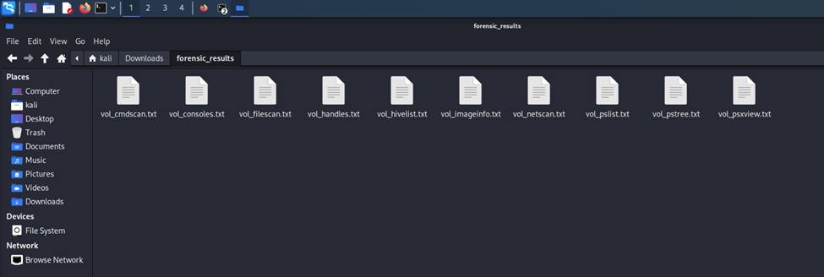
Memory Analysis (Volatility Results)
Operating System: Windows XP SP3
Suspicious processes: jo.exe, TrueCrypt.exe, cmd.exe
Network connections linked to external IP (192.168.1.1)
Evidence of live encryption and data manipulation in RAM
Artefacts show user activity aligning with disk timestamps

Slide 9
Timeline of Events
Date | Activity | Evidence Source
04-Dec-2009 | Installed TrueCrypt | Disk
08-Dec-2009 | Accessed patent files | Disk
10-Dec-2009 | USB connected | setupapi.log
10-Dec-2009 | Encrypted data via jo.exe | Memory
10-Dec-2009 | Data sent externally | Network

Slide 10
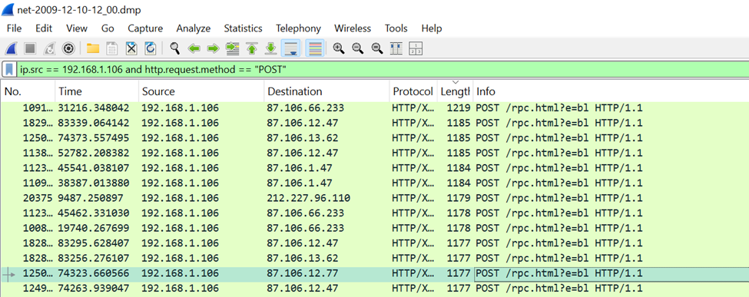
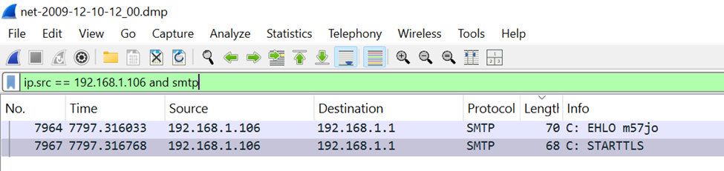
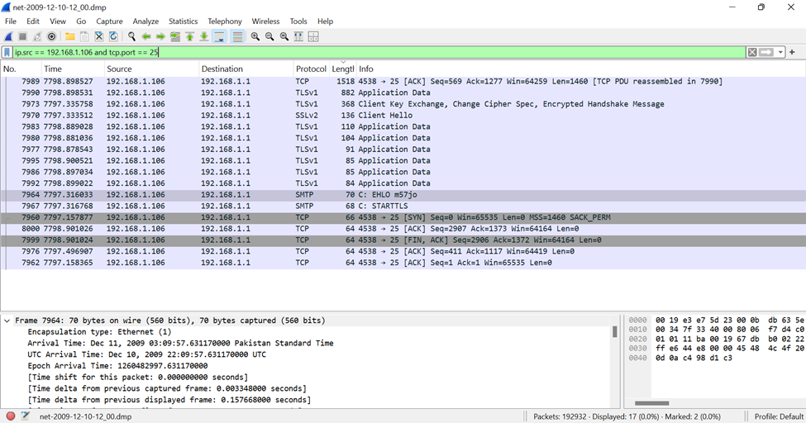
Network Analysis (Wireshark)
Outbound HTTP POST requests to unknown Ips
Encrypted SMTP (TLS) sessions identified
DNS lookups for suspicious domains detected
Large data transmission between 09–10 December
Indicators of intentional exfiltration via web and email

Slide 11
Correlation Summary
Evidence | Findings | Correlation
Disk | Patent files, TrueCrypt use | Data staging
Memory | jo.exe process, network handles | Active encryption
Network | HTTP + TLS traffic | Data exfiltration
Combined | Timeline and user pattern consistent | Insider threat confirmed

Slide 12
Ethical & Legal Considerations
Analysis conducted under corporate authorization
Forensic integrity preserved through verified imaging
No privacy breaches beyond investigation scope
Findings documented for potential legal proceedings

Slide 13
Conclusion
Jo Smith engaged in deliberate intellectual property theft
Multiple exfiltration methods confirmed (USB, HTTP, Email)
Strong correlation across disk, memory, and network data
Evidence admissible under forensic best practices

Slide 14


Recommendations
Implement strict USB and encryption policy
Deploy Data Loss Prevention (DLP) tools
Enhance network monitoring and user access control
Mandatory forensic awareness training for staff

Slide 15
References & Tools
Tools Used: FTK Imager | Autopsy | Volatility | Wireshark
References:

