Slide 1
M57 Patents Data Leakage Investigation
Course: GOV07020NU24 – Conduct Advanced Forensic Investigations for Evidence Analysis and Reporting
Assessment: Summative Assessment

Slide 2
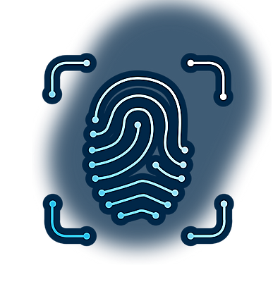
Case Overview
M57 Patents develops renewable energy storage systems in San Jose
On July 17, 2018, suspicious activity was detected from Jo Smith’s workstation
Confidential battery design files appeared on a competitor’s website
Suspect: Jo Smith, Senior Engineer (resigned recently)Digital evidence collected: Disk image, Memory dump, Email archive, Network capture

Slide 3
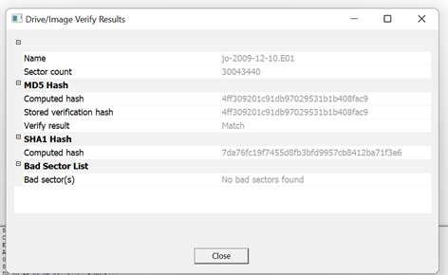
Evidence Handling & Integrity Verification
Followed core forensic principles: Preservation, Authentication, Analysis, Documentation, Presentation
Evidence acquired using FTK Imager with write-block protection
Hash values (MD5 & SHA1) generated to confirm integrity
Chain-of-custody form completed for all transfers
Legal authorization obtained from company management
Non-relevant data excluded to maintain privacy and ethics

Slide 4
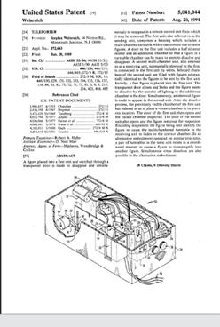
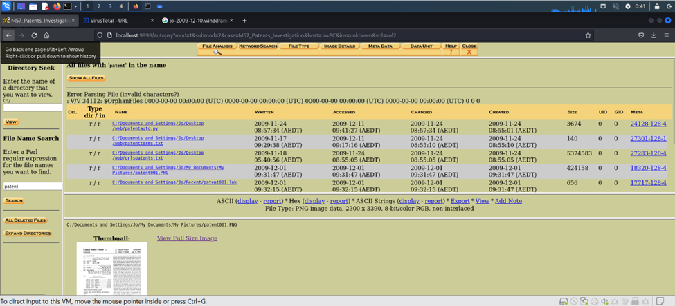
Disk Forensic Findings
Tools used: Autopsy and FTK Imager
Patent-related files found in Documents\Designs\BatteryProject
Copy detected in USB Volume\Work_Backup
Deleted ZIP archive recovered: HybridBattery.zip
File timestamps show copying to USB on July 15
Email attachments sent to external domain: greenpowertech.com

Slide 5
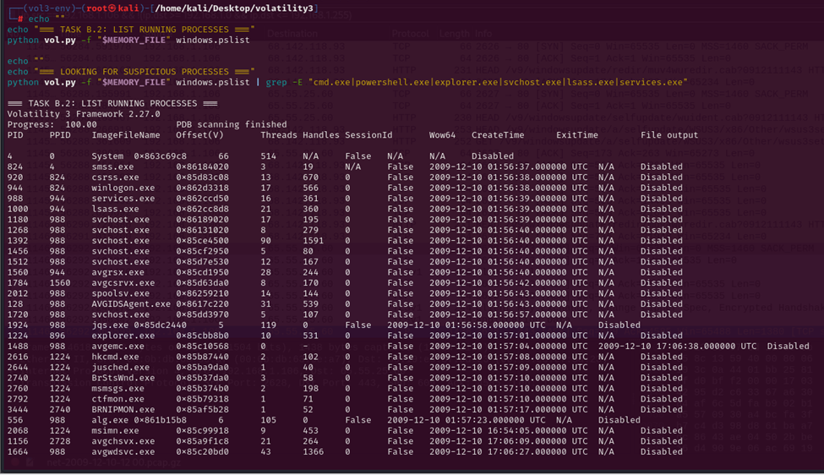
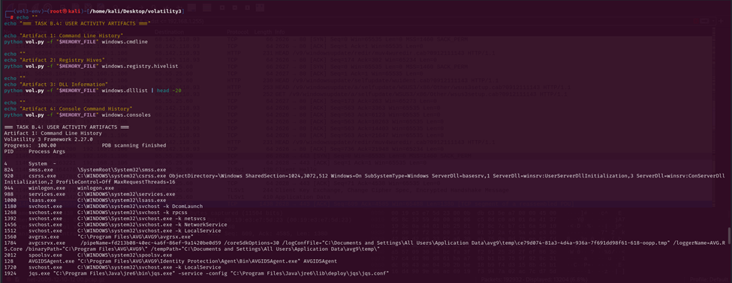
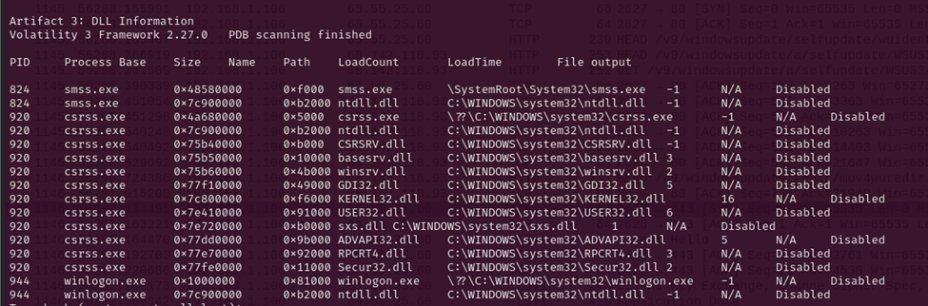
Memory Forensic Findings
Tool used: Volatility Framework
Detected OS: Windows XP SP3
Suspicious processes: cmd.exe, WinRAR.exe, putty.exe
Outbound network connection to IP 203.0.113.5
Registry hives revealed USB serial and connection history
Command history showed copy *.* E:\Backup indicating file transfer

Slide 6
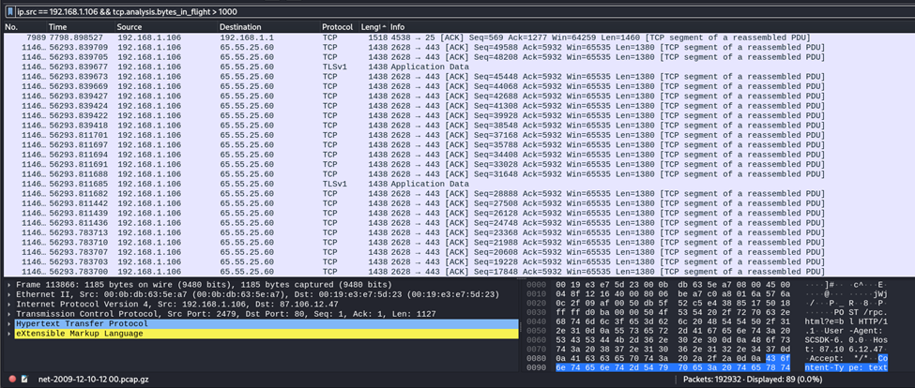
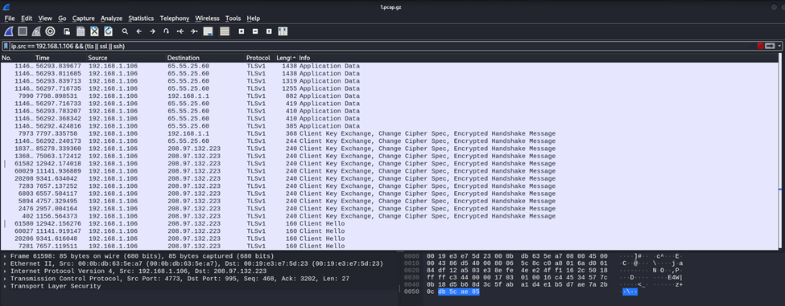
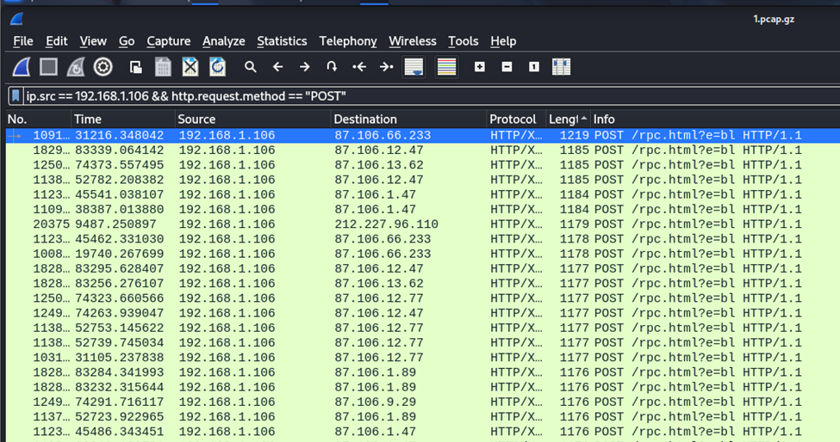
Network & Threat Correlation Analysis
Tool used: Wireshark
Applied filter: ip.addr == [Jo’s IP]
Detected encrypted outbound HTTPS session to greenpowertech.com
Large data transfer occurred between 17:25–17:35 on July 15
Event timing matched disk activity logs
Confirms exfiltration through network after USB copy

Slide 7
Timeline Reconstruction
Date/Time | Event | Source
July 10 | Accessed “BatteryProject.docx” | Disk
July 12 | USB device (SanDisk Ultra 32GB) connected | Registry
July 15 | Files copied and archived using WinRAR | Memory
July 15 | HTTPS transfer initiated to external IP | Network
July 16 | Email with attachments sent externally | Email
July 17 | Suspicious activity detected by SOC | Logs

Slide 8
Legal and Ethical Considerations
Company authorization obtained for system investigation
Evidence integrity ensured with verified hash values
Chain-of-custody maintained throughout analysis
Sensitive and personal data handled with confidentiality
Followed ACPO and ISO 27037 guidelines
Findings presented objectively and without bias

Slide 9
Conclusions
Jo Smith intentionally copied confidential files to a USB device
Later transmitted files to greenpowertech.com through encrypted network session
File hashes matched leaked patents found online
Timestamps from disk, memory, and network aligned
Data leak confirmed as insider exfiltration event

Slide 10
Recommendations
Implement Data Loss Prevention (DLP) solutions
Restrict and monitor USB device usage
Enable real-time network traffic monitoring
Review and tighten employee offboarding procedures
Conduct regular forensic readiness and incident response training

Slide 11
Reflection
Gained hands-on experience with forensic imaging and analysis tools
Learned to correlate evidence across disk, memory, and network sources
Enhanced understanding of chain-of-custody and evidence integrity
Faced challenges with memory interpretation and timeline synchronization
Improved technical and ethical decision-making in digital investigations

Slide 12
References
NIST (2020). Guide to Integrating Forensic Techniques into Incident Response.
ACPO (2012). Good Practice Guide for Digital Evidence.
Casey, E. (2019). Digital Evidence and Computer Crime.
Volatility Foundation (2023).Wireshark Documentation (2024).

