Slide 1
PYTHON -2
PRITU A PATEL

Slide 2
What is Decision Tree?
A decision tree is a supervised learning algorithm used for both classification and regression tasks.
It has a hierarchical tree structure which consists of a root node, branches, internal nodes and leaf nodes.
It works like a flowchart that helps in making step-by-step decisions, where:
Internal nodes represent attribute tests
Branches represent attribute values
Leaf nodes represent final decisions or predictions.

Slide 3
What is Decision Tree?
A decision tree splits data into smaller groups by asking a series of questions. Each question is based on a feature of the data.
Think of it like a game of “20 questions”:
Is age > 30?
Is income high?
Has the person bought before?

Slide 4
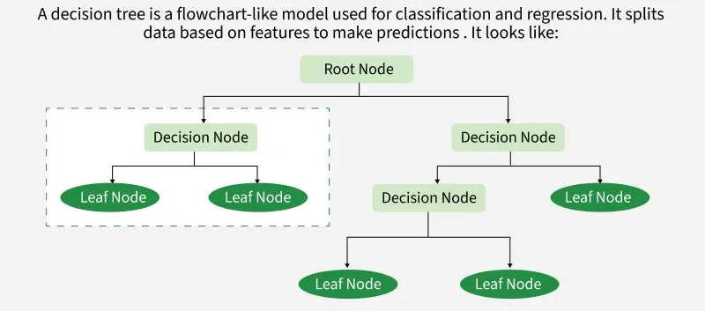
Main component Decision Tree

Slide 5
Main component Decision Tree
1. Root Node
The starting point of the tree.
Represents the entire dataset.
First decision is made here.
2. Internal Nodes
These are decision points (questions).
Each node splits data based on a condition.

Slide 6
Main component Decision Tree
3. Branches
The outcomes of decisions (Yes/No, True/False).
Connect nodes and show the flow.
4. Leaf Nodes (Terminal Nodes)
Final output or prediction.
Example: “Buy” or “Don’t Buy”.

Slide 7
Working Decision Tree
How It Works (Simple Steps)
Pick the best feature to split the data.
Divide the dataset based on that feature.
Repeat the process for each subset.
Stop when:
Data is pure (all same class), or
A stopping rule is reached.

Slide 8
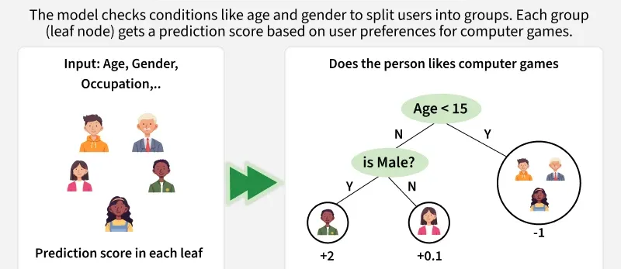
Working Decision Tree

Slide 9
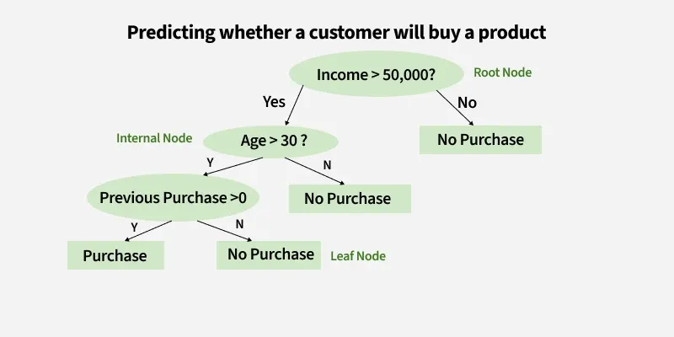
EXAMPLE

Slide 10
EXAMPLE
1. Root Node (Income)
First Question: "Is the person’s income greater than $50,000?"
If Yes, proceed to the next question.
If No, predict "No Purchase" (leaf node).
2. Internal Node (Age):
If the person’s income is greater than $50,000, ask: "Is the person’s age above 30?"

Slide 11
EXAMPLE
If Yes, proceed to the next question.
If No, predict "No Purchase" (leaf node).
3. Internal Node (Previous Purchases):
If the person is above 30 and has made previous purchases, predict "Purchase" (leaf node).
If the person is above 30 and has not made previous purchases, predict "No Purchase" (leaf node)

Slide 12

Entropy
Entropy is a measure of uncertainty or impurity in a dataset.
If all data belongs to one class → entropy = 0 (pure)
If data is evenly mixed → entropy is high (maximum uncertainty)

Slide 13
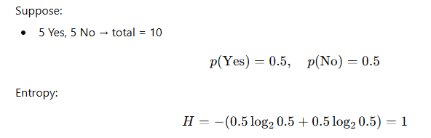
Example of Entropy

Slide 14
Implementing Decision Tree
Step 1 : Import the Required Library
from sklearn.tree import DecisionTreeClassifier
Step 2: Load the Dataset (csv file)
Step 3: Data Cleaning & EDA (if required)
Step 4: Feature Selection single x and y variable (for simple linear Regression)
multiple features selection x and single y variable(for multilinear Regression)
Step 5: Model Selection (Data Split on train and test data)
x_train,x_test,y_train,y_test = train_test_split(x,y,test_size=0.2,random_state = 10)

Slide 15
Implementing Decision Tree
Step 6 : Train the knn Model with assigning n_neighbors
DT= DecisionTreeClassifier(criterion='entropy',max_depth=3,random_state=10)
DT.fit(x_train,y_train)
Step 7: Make Prediction
y_pred = DT.predict(x_test)

