Slide 1
PYTHON -2
PRITU A PATEL

Slide 2
What is Polynomial Regression?
Polynomial Regression is a form of linear regression where the relationship between the independent variable (x) and the dependent variable (y) is modelled as an nth degree polynomial.
It is useful when the data exhibits a non-linear relationship allowing the model to fit a curve to the data.
Needs :
Non-linear Relationships
Better Fit for Curved Data:

Slide 3
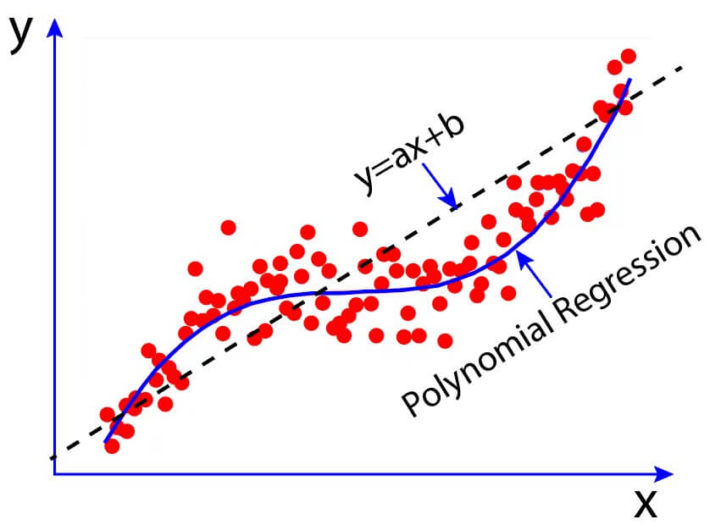
Polynomial Regression

Slide 4
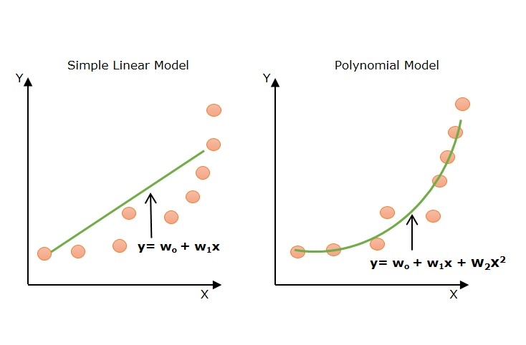
Difference Between Linear and Polynomial Regression

Slide 5
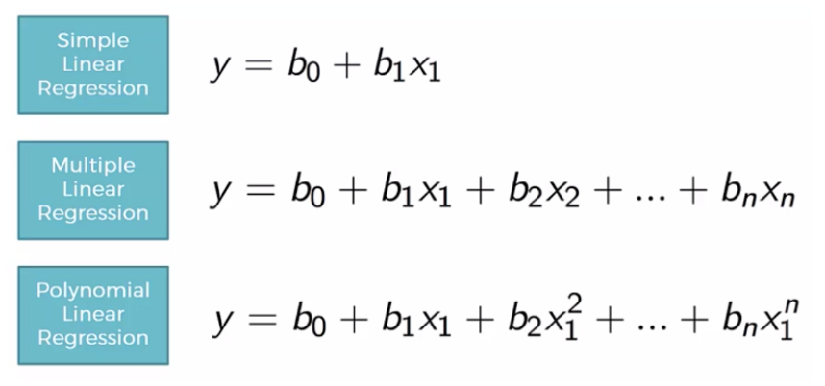
Difference Between Linear and Polynomial Regression

Slide 6

Equation of Polynomial Regression
Polynomial regression is an extension of linear regression where higher-degree terms are added to model non-linear relationships.
The general form of the equation for a polynomial regression of degree n is:
Here:
y is the dependent variable.
x is the independent variable.
Β0,β1,…,βn are the coefficients of the polynomial terms.
n is the degree of the polynomial.

Slide 7
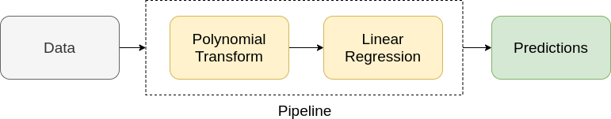
Working of Polynomial Regression
In machine learning, the polynomial regression actually works in a similar way as linear regression works. It is modeled as multiple linear regression.
The input feature is transformed into polynomial features of higher degrees (x²,x³, ..., x^{n}). These features are now treated as separate independent variables as in multiple linear regression.
Now, a multiple linear regressor is trained on these transformed polynomial features.

Slide 8
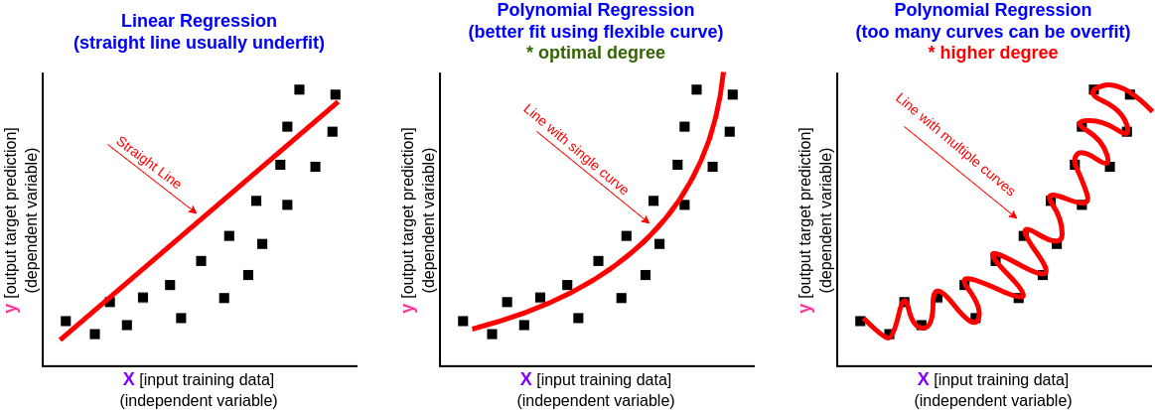
Polynomial Regression

Slide 9
Implementing Polynomial Regression
Step 1 : Import the Required Library
from sklearn.preprocessing import polynomialFeatures
Step 2: Load the Dataset (csv file)
Step 3: Data Cleaning & EDA (if required)
Step 4: Feature Selection single x and y variable (for simple linear Regression)
multiple features selection x and single y variable(for multilinear Regression)

Slide 10
Implementing Polynomial Regression
Step 6: Create a Polynomial Feature
# create a polynomial feature object with degree i (i.e, i = 1,2,..n)
poly = PolynomialFeatures(degree = i)
# transform the input data to include polynomial features
x_poly = poly.fit_transform(x)
Step 7 : Train the Linear Model
model = LinearRegression()

Slide 11
Implementing Polynomial Regression
model.fit(x_poly,y)
Step 8: Make Prediction
y_pred = model.predict(x_poly)
Step 9 : Visualize the Regression Line
# Plot the actual data points
plt.scatter(x_test, y_test, color='blue', label='Actual')
# Plot the regression line
plt.plot(x_test, y_pred, color='red', label='Regression Line')

Slide 12
Implementing Polynomial Regression
Step 10 : Model Evaluation
# Import Metrics Library for model evaluation
From sklearn.metrics import mean_squared_error,mean_absolute_error,r2_score
# Calculate Mean Squared Error (MSE)
mse = mean_squared_error(y, y_pred)
# Calculate Mean Absolute Error (MAE)
mae = mean_absolute_error(y, y_pred)
# Calculate R-squared score
r2 = r2_score(y, y_pred)

Slide 13
Implementing Polynomial Regression
Step 11: New Data Prediction
X_new = np.array([[1.9929]])
X_new_poly = poly.transform(X_new)
y_new_pred = model.predict(X_new_poly)
print(y_new_pred)

Slide 14
Implementing Polynomial Regression(With Data Splitting)
Step 1 : Import the Required Library
from sklearn.preprocessing import polynomialFeatures
Step 2: Load the Dataset (csv file)
Step 3: Data Cleaning & EDA (if required)
Step 4: Feature Selection single x and y variable (for simple linear Regression)
multiple features selection x and single y variable(for multilinear Regression)
Step 5: Model Selection (Data Split on train and test data)
x_train,x_test,y_train,y_test = train_test_split(x,y,test_size=0.2,random_state = 10)

Slide 15
Implementing Polynomial Regression(With Data Splitting)
Step 6: Create a Polynomial Feature
# create a polynomial feature object with degree i (i.e, i = 1,2,..n)
poly = PolynomialFeatures(degree = i)
# transform the input data to include polynomial features
x_poly_train = poly.fit_transform(x_train)
X_poly_test = poly.fit_transform(x_test)
Step 7 : Train the Linear Model
model = LinearRegression()

Slide 16
Implementing Polynomial Regression(With Data Splitting)
model.fit(x_poly_train,y_train)
Step 8: Make Prediction
y_pred = model.predict(x_poly_test)
Step 9 : Visualize the Regression Line
# Plot the actual data points
plt.scatter(x_test, y_test, color='blue', label='Actual')
# Plot the regression line
plt.plot(x_test, y_pred, color='red', label='Regression Line')

Slide 17
Implementing Polynomial Regression(With Data Splitting)
Step 10 : Model Evaluation
# Import Metrics Library for model evaluation
From sklearn.metrics import mean_squared_error,mean_absolute_error,r2_score
# Calculate Mean Squared Error (MSE)
mse = mean_squared_error(y_test, y_pred)
# Calculate Mean Absolute Error (MAE)
mse = mean_absolute_error(y_test, y_pred)
# Calculate R-squared score
r2 = r2_score(y_test, y_pred)

Slide 18
Implementing Polynomial Regression(With Data Splitting)
Step 11 : New Data Prediction
X_new = np.array([[1.9929]])
X_new_poly = poly.transform(X_new)
y_new_pred = model.predict(X_new_poly)
print(y_new_pred)

