Slide 1
Internship Presentation-1
ALISHA VINEETH
Software Trainee,
SayOne Technologies.

Slide 2
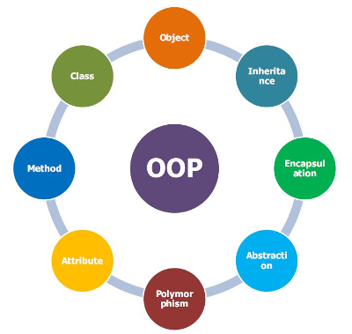
OOPs CONCEPTS
Object Oriented Programming refers to a programming methodology based on objects, instead of just functions and procedures.
Each object is independent (can be changed without affecting other blocks), can run (execute) by itself, and can be interlocked with other objects. Objects interact by passing information among each other.
It is a programming style which is associated with the concepts like
Object
Class
Inheritance
Encapsulation
Abstraction
Polymorphism.

Slide 3
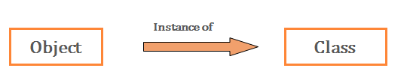
Object
“Object” refers to a particular instance of a class. It can be a combination of variables, functions, and data structures. There can be multiple instances of a class in a program.
An Object contains both the data and the function, which operates on the data. For example - chair, bike, marker, pen, table, car, etc.
In Java, object can be initialised in three ways :
By reference variable.
By method
By constructor
The syntax for creating an object of class Day is,
Day today = new Day( );

Slide 4
Class
A class is a collection of method and variables. It is a blueprint from which you can create objects. It defines the variables and the methods (functions) common to all objects of a certain kind.
It’s a logical entity.
We can define a class using the class keyword and the class body enclosed by a pair of curly braces.
Syntax :
class <class_name>
{
fields;
methods;
}

Slide 5
Inheritance
Inheritance can be defined as the process where one class acquires the properties (methods and fields) of another.
The class which inherits the properties of other is known as subclass (derived class, child class) and the class whose properties are inherited is known as superclass (base class, parent class).
extends is the keyword used to inherit the properties of a class.
Syntax :
Class Super{
……
}
Class Sub extends Super{
……
}

Slide 6
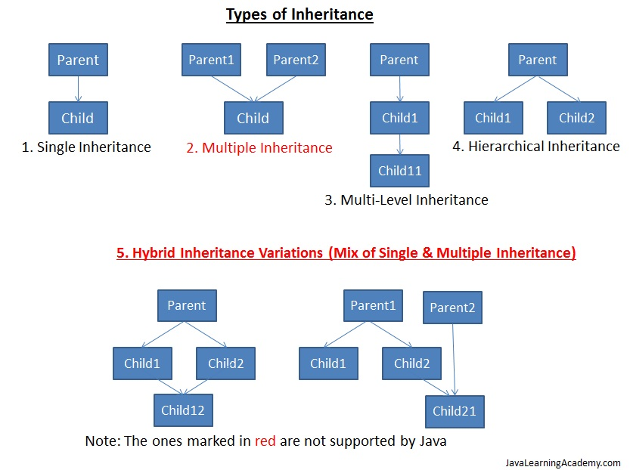

Slide 7
Encapsulation
Encapsulation is an OOP technique of wrapping the data and code.
In this concept, the variables of a class are always hidden from other classes. It can only be accessed using the methods of their current class.
For example, when we call from our mobile phone, we select the number and press call button. But the entire process of calling or what happens from the moment we press or touch the call button to the moment we start having a phone conversation is hidden from us.

Slide 8
Abstraction
Abstraction is an act of representing essential features without including background details.
The concept of abstraction focuses on what an object does, instead of how an object is represented or “how it works.”
For example, Human Being’s can talk, walk, hear, eat, but the details of the muscles mechanism and their connections to the brain are hidden from the outside world.

Slide 9
Polymorphism
Polymorphism is one of the OOPs feature that allows us to perform a single action in different ways.
It allows us to redefine the way something works, by either changing how it is done or by changing the parts used to get it done. This can be done in two ways, overloading and overriding.
Polymorphism is the capability of a method to do different things based on the object that it is acting upon.
In other words, polymorphism allows you define one interface and have multiple implementations.

Slide 10
PROGRAMMING METHODOLOGIES
The approach to analysing complex problems, planning for software development and controlling the development process is called programming methodology.
The most popular Programming Methodologies include:
Agile
Waterfall
Scrum
Extreme Programming
Rapid Application Development Methodology
Spiral

Slide 11
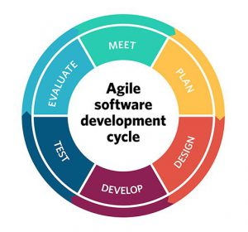
Agile
Agile software development is a conceptual framework for undertaking software engineering projects.
Main goal is minimizing the risk by developing software in short timeboxes, called iterations, which typically last one to four weeks.
Each timebox is like a mini software project that includes all the tasks necessary to release the mini-increment of new functionality.
Main principles:
face-to-face meetings
constant cooperation
early and continuous delivery of the working software
transparency.

Slide 12
Agile
Pros
Adaptive approach that responds to changes favourably
Allows for direct communication to maintain transparency
Improved quality by finding and fixing defects quickly and identifying expectation mismatches early
Cons
Focuses on working with software and lacks documentation efficiency
Chances of getting off-track as outcome are not clear

Slide 13
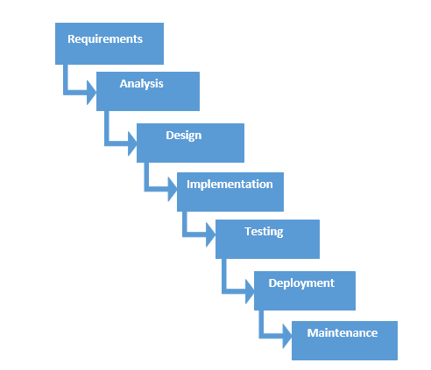
Waterfall
The Waterfall model is a sequential development approach, in which development is seen as flowing steadily downwards (like a waterfall) through several phases, typically:
Analysis
Software Requirements Specification
Software Design
Testing
Integration (if there are multiple subsystems)
Deployment (or Installation)
Maintenance

Slide 14
Waterfall
Pros
Easy to understand and functional
Simple enough to handle as model is rigid
Saves significant amount of time
Allows for easy testing and analysis
It allows for departmentalization and managerial control.
Cons
Only matches precise needs
Not applicable for maintenance projects
Does not allow editing in the testing phase
No option to know possible outcome of a project
Not excellent for long and ongoing projects

Slide 15
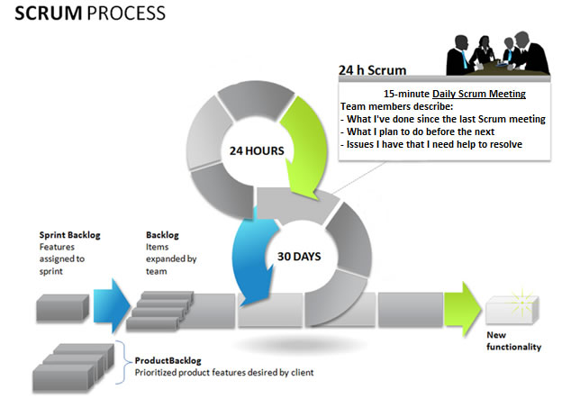
Scrum
Scrum is an iterative and incremental agile software development framework for managing product development.
The entire project is split up into timeboxes called Sprints.
Scrum adopts an evidence-based empirical approach .
Teamwork, inspection, and transparency are key factors in the Scrum method.
Notes:
evidence-based empirical approach
— accepting that the problem cannot be fully understood and instead focusing on how to maximize the team’s ability to deliver quickly, to respond to emerging requirements, and to adapt to evolving technologies and changes in market conditions.

Slide 16
Scrum
Main features of Scrum:
a living backlog of prioritized work to be done
completion of a fixed set of backlog items in a series of short iterations or sprints
a brief daily meeting (“a scrum”) for explaining the progress, describing an upcoming work and possible obstacles
a brief planning session in which the backlog items for the sprint will be defined
a brief heartbeat retrospective when all team members reflect about the past sprint.
Pros
Decision making lies in the hands of the team
Lightly controlled method empathizing with constant updating
Cons
Not suitable for big sized projects.
Requires highly expert team, which has no place for novices.

Slide 17
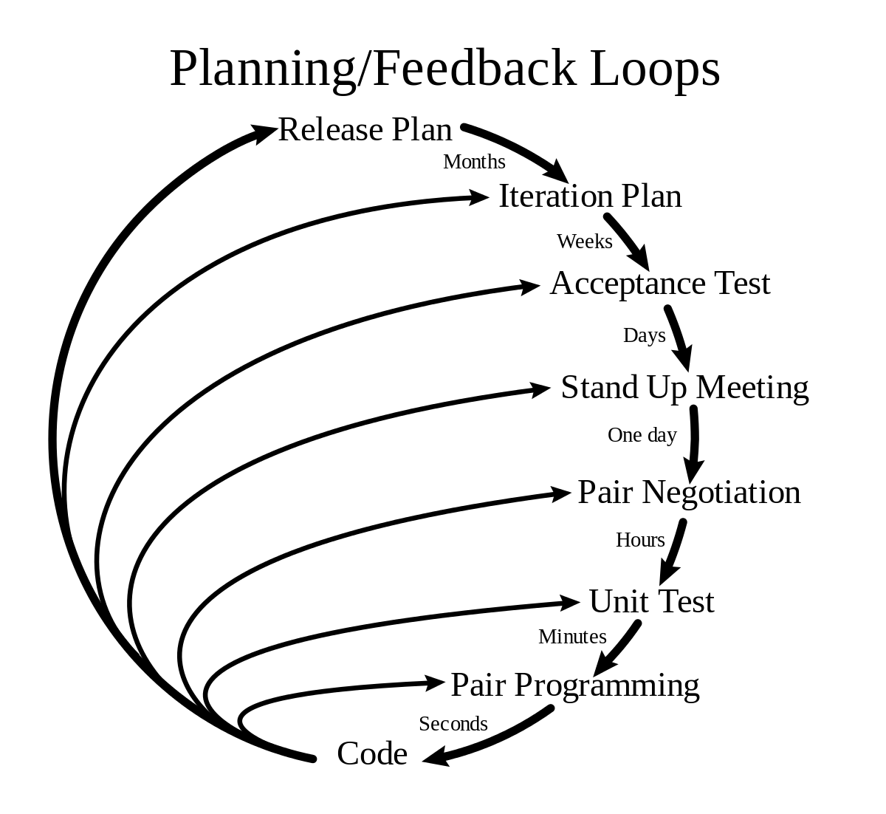
Extreme Programming
Extreme Programming approach (XP) refers to an agile software engineering methodology.
It was created to avoid the development of functions that are not currently needed.
Aims :
Creation of a top-notch final product with no regard for frequent changes in requirements.
Reducing the costs of software essentials.
In comparison with the other approaches, XP takes more time and human resources.
Notes:
reduce the costs of software essentials-To achieve that, continuous testing and planning are applied.

Slide 18
Extreme Programming
Pros
It lays focus on customer involvement
Establishes rational plans and schedules
Developers are exceptionally committed to the project
Equipped with modernistic methods for quality software
Cons
Effectiveness depends on the people involved
Requires frequent meeting for development raising total costs
Necessitates for excessive development changes
Exact possibilities and future outcomes are really unknown

Slide 19
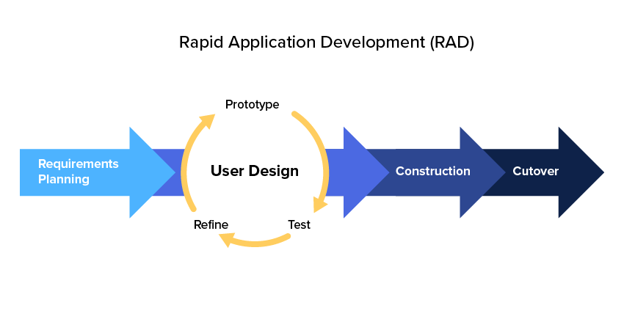
Rapid Application Development Methodology
Rapid Application Development (RAD) Methodology is created to take the maximum advantage of the development software.
Aimed to reduce the amount of construction needed to build a product.
Produces a high-quality system with low investment costs.
The Rapid Application Development method is divided into four phases:
Requirements Planning
User Design
Construction
Cutover

Slide 20
Rapid Application Development Methodology
The user design and construction phases are repeated until the user approves that all of the requirements are met.
RAD usually embraces object-oriented programming methodology, which inherently fosters software re-use.
Pros
Makes the entire development process effortless
Assists client in taking quick reviews
Encourages feedback from customers for improvement
Cons
Dependant on the team for performance
Works on modularized system confined on this methodology
Requires extremely skilled personnel to handle complexities
Not applicable for the small budgeted projects

Slide 21
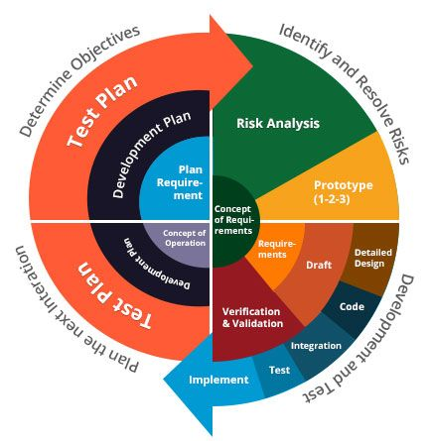
Spiral
The Spiral methodology extends the Waterfall model by adding rapid prototyping in an effort to combine advantages of top-down and bottom-up concepts.
It is a sophisticated lifecycle model that focuses on early identification and reduction of project risks.
A spiral project starts on a small scale, explores risks, makes a plan to handle the risks, and then decides whether to take the next step of the project (to do the next iteration of the spiral).

Slide 22
Spiral - Steps
New system requirements are defined in details.
A preliminary design is created.
A first prototype of the new system is constructed from the preliminary design.
A second prototype is evolved using four steps:
--evaluation of the first prototype;
--defining the requirements for the second prototype;
--planning and designing;
--constructing and testing.
If the risk is great the project could be aborted.
The existing prototype is evaluated in the same manner(as previous), and, if necessary, another prototype is developed.
The preceding steps are iterated until the customer is satisfied.
The final system is constructed (based on the refined prototype)
The final system is thoroughly evaluated and tested
Routine maintenance is carried out on a continuing basis to prevent large-scale failures and to minimize downtime

Slide 23
Spiral
Pros
Risk factors are considerably reduced
Excellent for large and complex projects
Allows for additional functionality later
Suitable for highly risky projects with varied business needs
Cons
Costly model in software development
Failure in risk analysis phase may damage the whole project
Not appropriate for low-risk projects
Might get continued and never finish

Slide 24
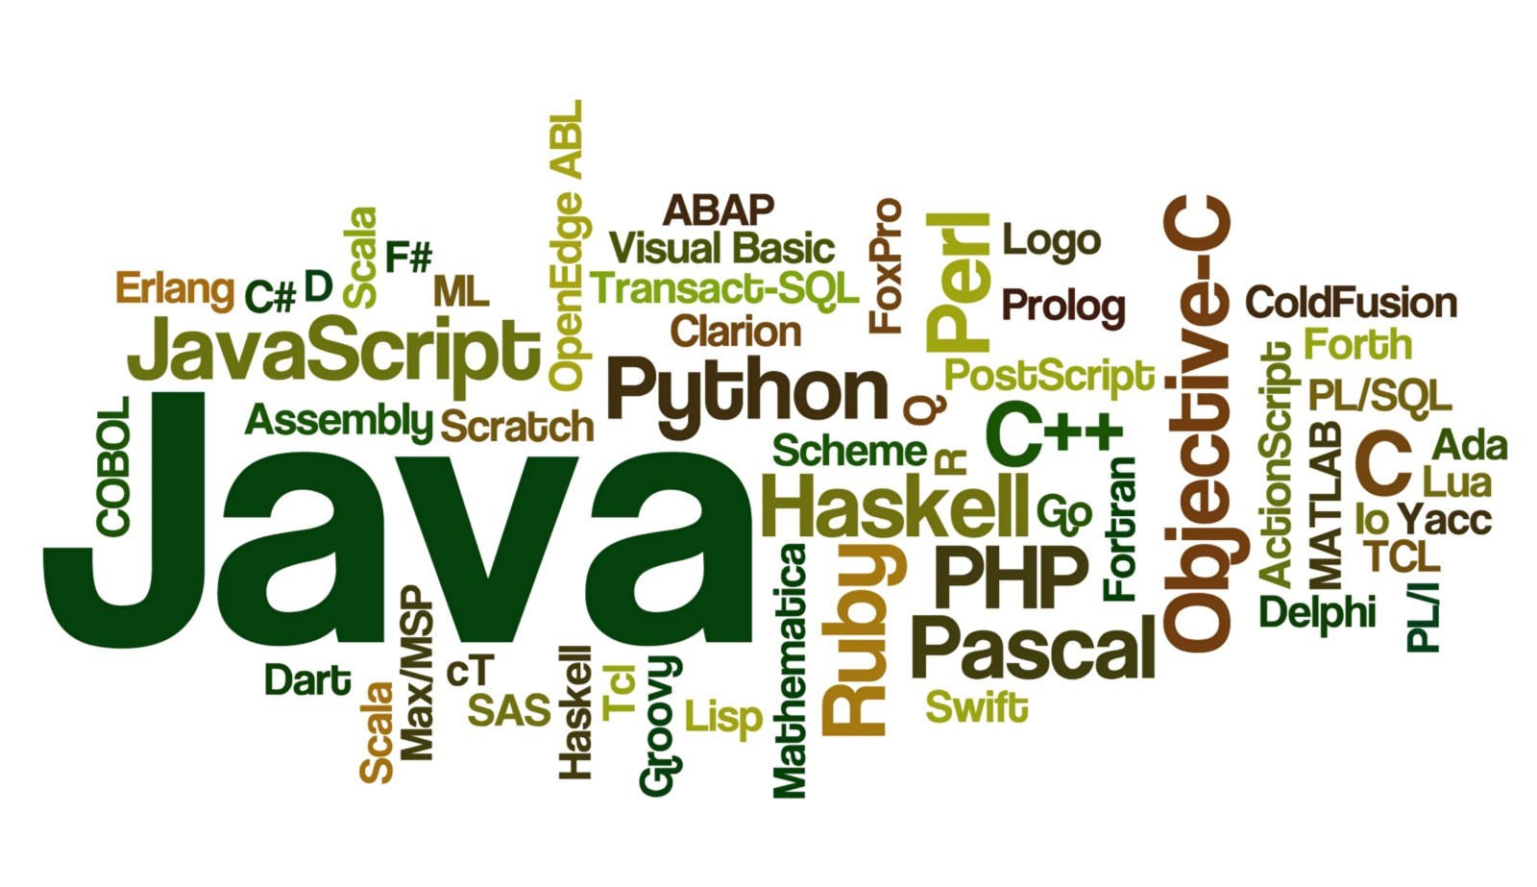
PROGRAMMING LANGUAGES
A programming language is a set of commands, instructions, and other syntax use to create a software program.
Two Types:
High Level Languages
Low Level Languages
Some of the languages on demand includes,
Java
Objective - C
Swift
JavaScript
Python

Slide 25

Java
Java is a general-purpose computer-programming language that is class-based and object-oriented.
Java applications are typically compiled to bytecode that can run on any Java virtual machine (JVM) regardless of computer architecture.
Java was originally developed by James Gosling at Sun Microsystems (which has since been acquired by Oracle Corporation) and released in 1995.
Java platforms
Java SE - Simple, stand-alone applications are developed using Java Standard Edition.
Java EE - provides the ability to create server-side components.
Java ME - a lightweight platform for mobile development known as Java Micro Edition,

Slide 26
Java
Example Program :
class Simple{
public static void main(String args[]){
System.out.println("Hello Java");
}
}
Output : Hello Java

Slide 27
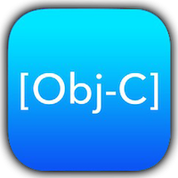
Objective-C
Objective-C (ObjC) is defined as a small but powerful set of extensions to the standard ANSI C language.
It is used in the OS X and iOS operating systems and their application programming interfaces (APIs).
It was originally developed in the early 1980s.
Objective-C source code 'implementation' program files have .m filename extensions, while header files have .h extensions.

Slide 28
Objective-C
Example Program :
#import <Foundation/Foundation.h>
int main()
main() function
{
NSLog(@“Hello World!");
return 0;
}
Output : Hello World!

Slide 29

Swift
Swift is a general-purpose, multi-paradigm, compiled programming language developed by Apple Inc. for iOS, macOS, watchOS, tvOS and Linux.
Swift was introduced at Apple's 2014 Worldwide Developers Conference (WWDC).
It has modern programming features and makes use of safe programming patterns.
In Swift Playgrounds you create small programs called “playgrounds” that instantly show the results of the code that you write.
Example Code:
import UIKit
var str = "Hello, World!“
println(str)
Output : Hello, World!

Slide 30
Swift
Some additional features of Swift include:
Closures unified with function pointers.
Tuples and multiple return values.
Generics.
Fast and concise iteration over a range or collection.
Structs that support methods, extensions, and protocols.
Functional programming patterns, e.g., map and filter.
Powerful error handling built-in
Advanced control flow with do, guard and repeat keywords.

Slide 31

JavaScript
JavaScript, often abbreviated as JS, is a high-level, interpreted programming language that conforms to the ECMAScript specification.
JS is a prototype-based, multi-paradigm, dynamic scripting language, supporting object-oriented, imperative, and declarative (e.g. functional programming) styles.
Alongside HTML and CSS, JavaScript is one of the three core technologies of the World Wide Web. JavaScript enables interactive web pages and thus is an essential part of web applications.

Slide 32
JavaScript
Example code:
<script type="text/javascript">
document.write("Hello JavaScript");
</script>
Output : Hello JavaScript
Three Places to put JavaScript code:
Between the body tag of html
Between the head tag of html
In .js file (external javaScript)

Slide 33

Python
Python is an interpreted, high-level, general-purpose programming language.
It has a design philosophy that emphasizes code readability, notably using significant whitespace.
Python features a dynamic type system and automatic memory management.
It supports multiple programming paradigms, including object-oriented, imperative, functional and procedural, and has a large and comprehensive standard library.

Slide 34
Python
Example Program :
num1 = 1.5
num2 = 6.3
# Add two numbers
sum = float(num1) + float(num2)
# Display the sum
print('The sum of {0} and {1} is {2}'.format(num1, num2, sum))
Output :
The sum of 1.5 and 6.3 is 7.8

Slide 35
Compiler
A compiler is a special program that processes statements written in a particular programming language and turns them into machine language or "code" that a computer's processor uses.
Structure of a compiler :
The front end checks whether the program is written correctly in terms of programming language syntax and semantics.
Back end is responsible for translating source into assembly code.
Front End –
Lexical Analysis
Pre-processing
Syntax Analysis
Semantic Analysis
Back End –
Analysis
Optimization
Code Generation

Slide 36
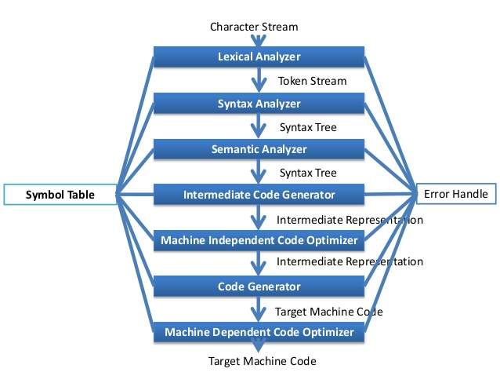
Compiler
Compiler Phases :
Lexical Analysis
Syntax Analysis
Semantic Analysis
Intermediate Code Generation
Code Optimisation
Code Generation.

Slide 37
Server-Side
Programming Languages :
There are several languages that can be used for server-side programming:
PHP.
ASP.NET (C# OR Visual Basic)
C++
Java and JSP.
Python.
Ruby on Rails and so on.

Slide 38
Server-Side
Frameworks :
A web framework or web application framework is a software framework that is designed to support the development of web applications including web services, web resources and web APIs.
Web frameworks aim to reduce the overhead associated with common activities performed in web development.
Examples :
Django(Python), Flask(Python), Laravel(PHP) etc
REST APIs :
A RESTful API is an application program interface (API) that uses HTTP requests to GET, PUT, POST and DELETE data.
Also referred to as a RESTful web service, it is based on representational state transfer (REST) technology, an architectural style and approach to communications often used in web services development.

Slide 39
Web Pages
Web pages are what make up the World Wide Web.
A Web page is a representation of a document that is actually located at a remote site. Every Web page is identified by a unique URL(Uniform Resource Locator).
The data found in a Web page is usually in HTML or XHTML format.
Web pages can either be static or dynamic.
Static pages show the same content that is stored in the server, each time they are viewed.
Dynamic pages have content that can change each time they are accessed, based on user input.
These pages are typically written in scripting languages such as PHP, Perl, ASP, or JSP.

Slide 40
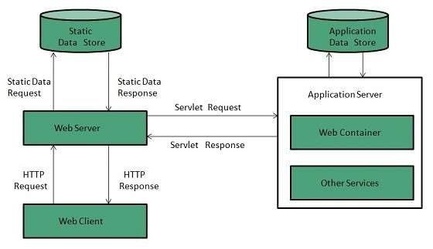
Web Server
A Web server is a program that uses HTTP (Hypertext Transfer Protocol) to serve the files that form Web pages to users, in response to their requests, which are forwarded by their computers' HTTP clients.
All computers that host Web sites must have Web server programs.
Leading Web servers include Apache, Microsoft’s IIS etc
Web server responds to the client request in either of the following two ways:
Sending the file to the client associated with the requested URL.
Generating response by invoking a script and communicating with database.

Slide 41
Web Applications
A Web Application is a computer program that utilizes web browsers and web technology to perform tasks over the internet.
Usually coded in browser-supported languages such as JavaScript and HTML.
The web application requires
a web server to manage requests from the client,
an application server to perform the tasks requested,
sometimes a database to store information.
Working of a Web Application:
User triggers a request to the web server over the internet.
Web Server forwards the request to appropriate web application server.
Web Application server performs the requested task and generates the result.
Web Application server sends result to the web server with the processed data.
Web Server responds back to the client with the requested information that then appears on the user’s display

Slide 42
Mobile Applications
Mobile App : is a type of application software designed to run on a mobile device, such as a smartphone or tablet computer.
History :
The first smart phone was announced for the general use by IBM in 1993 that was equipped with the features like calculator, world clock, calendar and contact book.
The BlackBerry Smartphone released in 2002 was the next major achievement in the field of mobile application development and it was marked by BlackBerry Limited, formerly known as Research In Motion Limited (RIM) and integrated with the innovative concept of wireless email.
One of the first “apps” created to entertain, the game snake, introduced in 1998 as a standard pre-loaded game on Nokia phones, this became a global sensation.

Slide 43
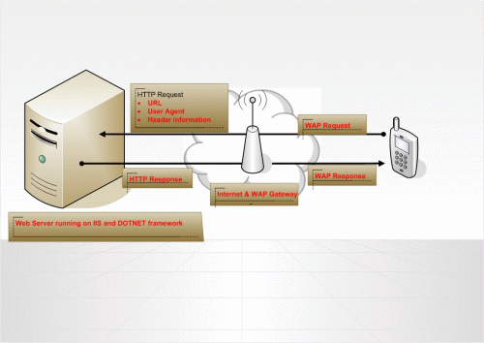
When you request a page from a cell phone, the mobile browser sends the WAP request to a WAP gateway.
The gateway translates this into an HTTP request and passes it to the web server over the internet.
The HTTP request contains the URL, the User Agent and Header Information.
It generates a WML output because cell phone mobile browsers can understand only WML.
Once the WML output has been generated, the web server sends the output as HTTP response to the WAP gateway and it translates it to a WAP response and passes it to the cell phone.
This is how mobile web applications work across different mobile devices.

Slide 44
Types of Mobile App
Native apps:
Built for a specific operating system.
Softwares used to develop native apps generally would be Objective-C or Swift for iOS, Java and ADT for Android operating system and .NET(C#) for Windows operating system.
Hybrid apps:
Mixture of both native and mobile web apps.
Has cross-platform compatibility but can still access phone’s hardware.
Softwares used to develop these apps are generally HTML, CSS, Javascript, JQuery, Mobile Javascript frameworks, Cordova/PhoneGap etc.
Cross Platform Apps:
Mobile apps that can be deployed or published on multiple platforms using a single codebase, instead of having to develop the app multiple times using the respective native technologies for each platform
Languages : React Native, Flutter etc,

Slide 45


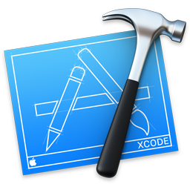
Tools used for mobile apps
Development Tools for Android
Android Studio
Eclipse
IntelliJ IDEA
Corono Labs
Emulator
Development Tools for iOS
Xcode
Simulator
AppCode
Code Runner
XSwift

Slide 46
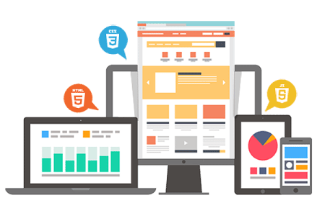
Design Standards
A useful and natural flow of mobile app makes the users comfortable to understand. The designers must accompany mobile user interface design principles to create a user-centric mobile app.
Few such principles are,
Design according to the platform
Maintain the design flow as per the theme
Less typing using autocomplete data
Make interface elements clearly visible
Content must be readable to user
Product must highlight while representing a portfolio
Define UI brand signatures
Use a performance dashboard
Optimize UI flows and elements
Make navigation self apparent

Slide 47
THANK YOU

