Slide 1

ASTROSAGE
Analytics​
​
By​​
​​
Alisha Pawar
25/10/2024​​

Slide 2

ABOUT ASTROSAGE
Investment Overview: AstroSage has received a 1 crore investment aimed at enhancing call center operations.​

Slide 3
Core Challenge:
Determine the most effective way to allocate this investment to achieve three key outcomes:
Maximize Operational Efficiency
Enhance Customer Satisfaction
Increase Profitability
Approach:
Conduct a comprehensive analysis of:
Historical call data
Performance metrics
Market trends
Objective:
Make informed decisions that drive improvement across all aspects of call center operations.

Slide 4
AstroSage is committing a 1 crore investment to optimize its call center operations with the following goals:
Enhance Operational Efficiency:
Streamline processes to reduce wait times and improve call handling, ensuring that agents can serve customers effectively.
Increase Customer Satisfaction:
Utilize data analysis to better understand customer needs and preferences, enabling personalized and timely support.
Boost Profitability:
Leverage insights from historical call data and performance metrics to identify opportunities for cost savings and revenue generation.

Slide 5

40+ Million
10344+
1+ Cr
Downloads
Active Users
Market Share
Verified by AstroSage, world’s number 1 astrology portal​
40+ Million Downloads​
10344+ Active Users​
1+ Cr Investment
Consultations: Anytime, Anywhere​
Connect Globally​
Unlimited Benefits​
Quick Payments & Reports​
Expand Your Knowledge By Connecting With Astrologers On Board

Slide 6
User Registration And Login
New Users register on Astrosage platform for creating new IDs providing basic details like name, birthdate and preferred astrology services
1
Select desired service from Astrosage
Users must choose the desired services provided by Astrosage and choose according to the ratings and experience
2
Booking a consultation
After choosing an astrologer/guru users can book a consultation via call / chat at their desired time.
3
Expert Recommendations
During the consultation users have personalized experience with the astrologer and provided with recommendations to improve the quality of life
4
User Feedback and Detailed report
Post consultation users could provide a feedback regarding the consultation and could collect a detailed report of their consultation and could organize further consultations.
5
HOW ASTROSAGE works ?

Slide 7

Data Cleaning
• Data Cleaning: Addressed missing values and standardized data formats.
• Data Enrichment: Integrated additional metrics and categorized data.
• Analysis Techniques: Used pivot tables, correlation analysis, and trend analysis.
• Tools Used: Excel for data manipulation, charts, and pivot tables.

Slide 8
Platform activity uses Breakdown:
Consultation Revenue Insights
Total revenue generated is approximately Rs. 213,987.31.
Revenue Breakdown
Call Consultations:
Generated Rs. 168,442.04 from 8,508 users.
This shows a strong preference for call consultations among users.
Chat Consultations:
Earned Rs. 45,494.68 from 19,514 users.
There is high user engagement despite lower revenue compared to calls.
ConsultationType | Revenue | User Count
Call | 168442.035 | 8508
Chat | 45494.68333 | 19514
Complementary | 0 | 2
public_live_Call | 50.597 | 3
Grand Total | 213987.3153 | 28027

Slide 9
User Interest
Complementary Consultations:
Only 2 users participated, indicating minimal interest.
Public Live Calls:
Contributed a modest Rs. 50.60 from just 3 users.
ConsultationType | Revenue | User Count
Call | 168442.035 | 8508
Chat | 45494.68333 | 19514
Complementary | 0 | 2
public_live_Call | 50.597 | 3
Grand Total | 213987.3153 | 28027
Key Takeaways​
Call consultations perform strongly in terms of revenue.​
Chat consultations are popular and engage many users.​
There are opportunities for improvement in complementary and public live offering

Slide 10
User Distribution by each category
The user distribution across our platforms provides important insights into user engagement. The total number of users is 28,027, with 7,800 users utilizing the app. In contrast, the dashboard has only 2 users, indicating very limited engagement. The majority of users, 20,225, are on Gurucool, making up approximately 72% of the total user base.
This data suggests that while Gurucool is significantly popular, the app also maintains a solid user presence. However, the minimal activity on the dashboard points to a potential area for improvement. Strategies to enhance the dashboard’s appeal and functionality could help increase user engagement across all platforms.

Slide 11
Revenue generated by each category
The revenue distribution across our platforms highlights key financial insights. The total revenue generated is approximately Rs. 213,987.31. The app is the standout performer, generating Rs. 125,267.38, which reflects its significant impact on overall revenue.
Gurucool contributes Rs. 88,719.93, showing its value but indicating room for growth. Notably, the dashboard has recorded no revenue, suggesting a need for reevaluation of its features and potential to drive income. This distribution emphasizes the strong performance of the app and the necessity to explore strategies to enhance revenue from Gurucool and the dashboard.

Slide 12
Average daily cAlls Average Daily Calls 138.9
Average Daily Call Volume Insights
Average daily call volume: 139 calls per day (Dec 1, 2023 - Jan 3, 2024).
Call Volume Fluctuations
Call volume showed notable peaks and valleys.
Highest Call Volume:
232 calls on December 10, 2023.
Lowest Call Volume:
Only 31 calls on January 3, 2024.

Slide 13
Demand Patterns
Variation suggests changing demand patterns.
Possible influences include:
Seasonal factors
Specific events affecting call volumes.
Key Takeaways​
Stable baseline with occasional spikes in call traffic.​
Reflects the dynamic nature of call demand during the period.

Slide 14
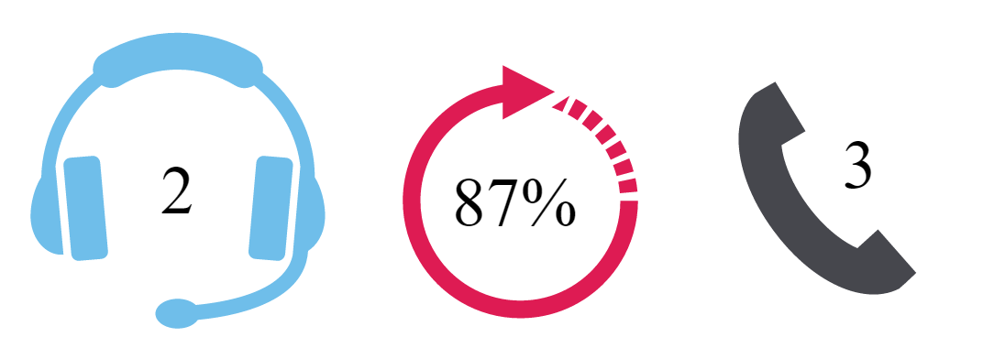
Data Analysis
131
57%
8365
Total Guru
Repeat Call %
Total calls

Slide 15
Call Interaction Summary
Total Calls: A total of 8,363 calls were recorded, with a success rate of 41.25% (3,450 successful calls).
Peak Time: The peak call period occurs between 6 AM and 10 AM, accounting for approximately 40.3% of all calls. This indicates that a significant portion of call activity happens during these early morning hours.

Slide 16

Customer Satisfaction
• Correlation Coefficient: --0.00020245
Indicates a negligible relationship between call duration and customer satisfaction.
• Visual: Scatter plot showing the relationship between call duration with Guru and satisfaction.

Slide 17
Guru Ratings Analysis
Ratings reveal a broad spectrum of user satisfaction.
Top Performers
Astro Pujaa Rai and Tarot Mystical:
Both have an average rating of 7.5
Indicates exceptional performance and high user approval.
Overall Performance
Average rating across all gurus is approximately 2.93.
Lower-rated gurus, like Tarot Rittika, show ratings close to zero.
This highlights significant areas for improvement.
Key Takeaways
Focused support and development are needed for lower-rated gurus.
Enhancing consultation quality can improve overall user experience.

Slide 18
Average Customer Satisfaction Score by Month
The analysis of customer satisfaction scores by month provides valuable insights into user experiences. In December 2023, the average rating was approximately 2.95, indicating a moderate level of satisfaction among users during that period. However, in January 2024, the average rating decreased to about 2.68, suggesting a decline in customer satisfaction.
Overall, the grand total average rating across the months is approximately 2.93. This trend highlights a need for closer examination of factors affecting customer satisfaction, particularly the drop in January, and suggests that strategies to improve user experiences should be prioritized to enhance overall ratings moving forward.

Slide 19
Call Status:
In terms of calls, 4,723 were logged, with 73.1% completed successfully. However, 26.9% were marked as busy, pointing to issues with call availability.
Chat Status:
A total of 19,515 chats were recorded. Among these, 28.3% were completed successfully, while 37.1% failed, indicating challenges in achieving successful outcomes. Additionally, 34% of chats were marked as incomplete, with 0.2% pending and 0.2% started. These figures suggest areas for improvement in user engagement and support.
Overall, these figures highlight the need for targeted strategies to reduce failed and incomplete chats and to enhance call availability, ultimately aiming to improve user satisfaction and engagement across both platforms.

Slide 20
Consultation Types Analysis
Total consultations recorded: 28,027.
Call Consultations
App: 7,797 calls
Gurucool: 711 calls
Total Calls: 8,508 calls
Chat Consultations
Gurucool: Primary platform with 19,514 chats.
Other Consultation Types
Complementary Consultations: Only 2 logged on the dashboard.
Public Live Calls: 3 from the app, indicating minimal activity.
Key Insights
Most Popular Interaction: Chat consultations, especially on Gurucool.
Call Consultations: Primarily utilized through the app.
Low Engagement Areas: Opportunities for growth in complementary and public live consultations.

Slide 21
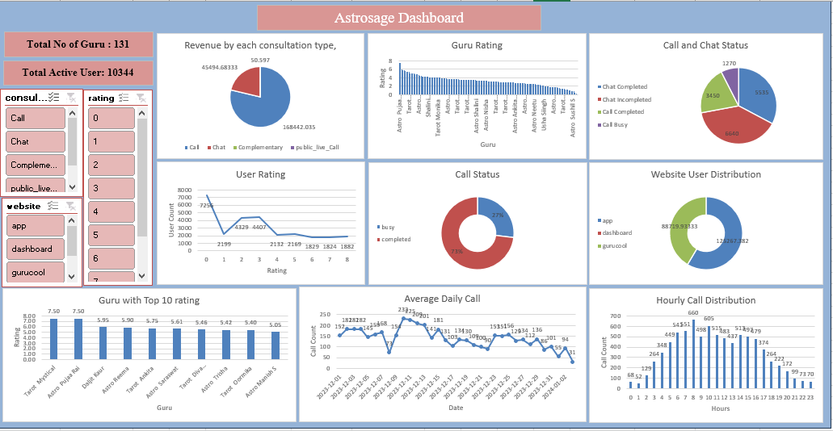
Astrosage Dashboard
Astrosage Dashboard

Slide 22

Summary of Findings
Key Findings
High Engagement in Chat Consultations:
19,514 chats recorded on Gurucool.
Significant user interaction, but challenges include a high percentage of failed and incomplete chats.
Call Availability Issues:
Total calls on the app: 8,508.
Success rate: 41.25%.
26.9% of calls marked as busy, indicating availability concerns during peak hours.
Implications
Need for Enhanced User Support:
High volume of chat consultations necessitates improved support mechanisms.
Consider implementing AI chatbots and providing additional training for gurus.
Resource Optimization During Peak Times:
Call availability issues highlight the need for better resource allocation.
Optimizing staffing during high-demand periods could improve call success rates and enhance user satisfaction.

Slide 23


