Slide 1



Bank Account Management System
A web-based banking solution built with Java, HTML, CSS, and JavaScript— designed to digitize and streamline core banking operations for academic and practical use.
ALISHA KUMARI
B.TECH FIRST YEAR PROJECT
Notes:
1

Slide 2

Problem Statement & Objectives
The Challenge
Project Objectives
Manual record-keeping is error-prone and slow
No real-time balance visibility for customers
Transaction tracking is fragmented and unreliable
Lack of a structured, secure account management workflow
Automate account creation, deposits, and withdrawals
Provide instant balance inquiry and transaction history
Ensure data persistence using file-based storage
Deliver a clean, menu-driven user interface
Notes:
2

Slide 3





Project Overview
The Bank Account Management System is a Java-based web application that replicates core banking functions — from account creation to transaction tracking — all within a secure, file-backed environment.
Account Creation
Register new customers with unique account IDs and credentials
Deposit & Withdraw
Process cash transactions with validation and balance updates
Balance Inquiry
Instant access to current account balance at any time
Transaction History
Maintain and retrieve a complete log of all account activity
Notes:
3

Slide 4




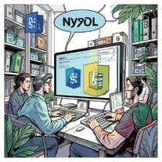
Technology Stack
Built with modern, widely used technologies chosen for scalability, maintainability, and a responsive user experience.
Java
JSON
HTML / CSS
JavaScript
Backend language for building robust server-side application logic and business services
Lightweight data format for exchanging structured information between application layers
Frontend markup and styling for creating structured, accessible, and responsive interfaces
Adds interactivity, dynamic behavior, and client-side enhancements to the user interface
MySQL / PostgreSQL
Relational database systems for reliable data storage, querying, and application persistence
Notes:
4

Slide 5
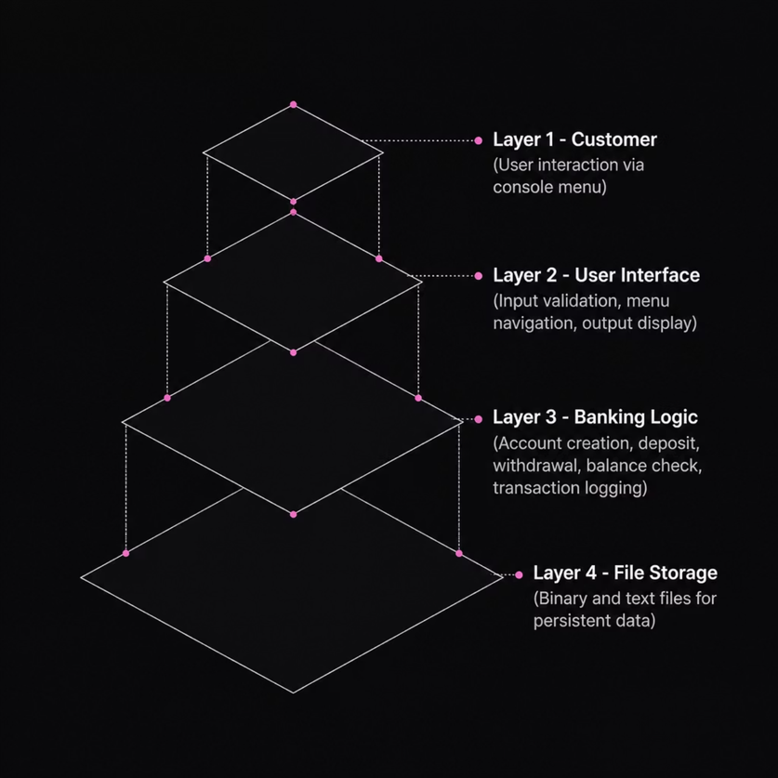
System Architecture
A clean layered architecture separates concerns across four distinct levels — from user interaction to persistent storage — ensuring modularity and maintainability.
Design Principles
Separation of Concerns: UI, logic, and storage are independently modular
Data Persistence: Account records survive program restarts via file I/O
Input Validation: Every user input is sanitized before processing
Error Handling: Graceful failure messages for invalid operations
Notes:
5

Slide 6
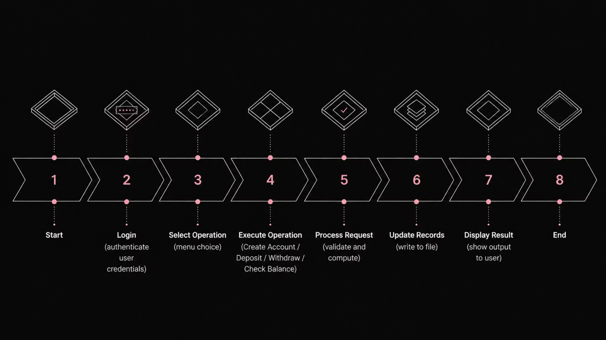
System Flowchart
The end-to-end user journey — from authentication through operation selection to record updates and result display.
All operations are atomic — if a step fails, the system rolls back and notifies the user without corrupting stored data.
Notes:
6

Slide 7
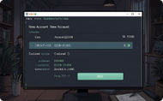


Key Features in Action
Each feature is designed for clarity, speed, and data integrity — demonstrated through a clean console interface.
Account Creation
Deposit & Withdraw
Balance & Transactions
Customers register with a unique account ID, name, and initial deposit — records are saved instantly to file.
Validated cash operations update balances in real time and append entries to the transaction log.
Users can query their current balance or review a full, timestamped history of all account activity.
Notes:
7

Slide 8
Results & Future Enhancements
What We Achieved
Roadmap Ahead
✅ Fully functional account lifecycle management
✅ Zero data loss across sessions via file persistence
01
Mobile App — React Native frontend for on-the-go banking
02
✅ Input validation prevents invalid transactions
✅ Clean, navigable menu-driven interface
OTP Verification — Two-factor authentication for security
03
Cloud Database — Migrate from files to MySQL/PostgreSQL
04
AI Fraud Detection — Anomaly monitoring on transaction patterns
Notes:
8

Slide 9
Conclusion & Key Takeaways
This project demonstrates practical application of Java web development, JSON data handling, and system design — delivering a fully operational banking simulator.
Learning Outcomes
Java fundamentals: classes, inheritance, and object-oriented design
Web development for building responsive, interactive interfaces
JSON data handling for structured data exchange and storage
Database design and integration for persistent application data
Thank you for your attention. Questions are welcome.
Notes:
9

