Slide 1
PRESENTED BY;
ALISHBA.M.FAISAL
TOPIC;
SELF PRESENTATION

Slide 2


Slide 3
INTRODUCTION;
Hello everyone
My Name is ALISHBA.M.FAISAL.I am from Karachi and currently study in 12th grade in medical field. Today I am discuss my Self Introduction.

Slide 4
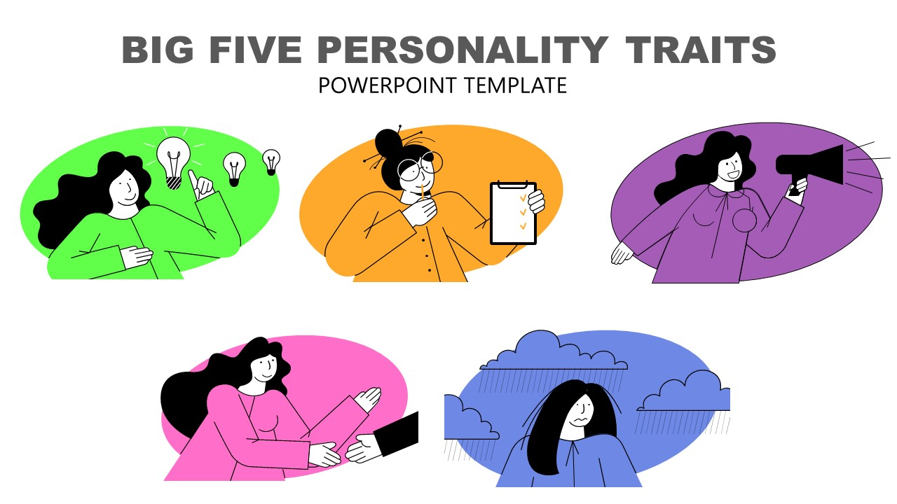
PERSONALITY TRAITS;
CURIOUS
FRIENDLY
HARDWORKER
CONFIDENT AND INDEPENDENCE
PATIENCE

Slide 5

HOBBIES AND INTERESTS;
In my free time, I like to watch mobile phone and listening music and apply henna. learning and exploring new things and ideas.

Slide 6

PERSONALITY ACHIEVEMENTS;
My personal achievements is that I have improved my English speaking and also got 1st position in English speech. I improved my confidence by speaking in front of people and also stayed positive even in difficult time.

Slide 7
SKILLS LEARNED IN THIS COURSE;
IN THIS COURSE I HAVE LEARNED IMPORTANT COMPUTER SKILL;
I learned basic use of computer.
I can use MS WORD for typing and making documents.
I can use MS EXCEL for simple calculations and tables.
I can make presentations in MS POWERPOINT.

Slide 8
FAVORITE TOPIC;
My Favorite topic is MS POWERPOINT.
I like it because I can make slides and show ideas in creative way.
I adding pictures designs and animation to my slides.
PowerPoint improve my confidence when I speak in front of people.
In the future, I want to learn more advanced designs and tools in Power Point.

Slide 9

STRENGTH ;
My Strength is I am hardworking. I like to learns new things and I have patience and don’t give up easily.

Slide 10

WEAKNESS;
My Weakness is that I feel nervous in public speaking and overthink small mistakes and i feel shy when meeting new people.

Slide 11

FUTURE GOALS;
My future goal is to become a doctor because doctors have lives and give hopes to patients and I will work hard I my studies to achieve my dreams and In future I want to serve society with honesty and care.

Slide 12

INSPIRATION;
My inspiration is my mother because she always work hard and take care of our family and I learn patience and strength from her and she motivates me to study well achieve my goals.

Slide 13

CLOSING;
THAT WAS A SHORT INTRODUCTION ABOUT ME. I HOPE YOU GOT TO KNOW ME BETTER.THANKYOU FOR TIME AND ATTENTION.

Slide 14


