Slide 1
Effects of Stress on Adult Development
Name
Notes:
The purpose of this presentation is on the basis that I have been selected as a consultant for a community service agency that conducts seminars to aid the general public on issues detrimental to their health. The particular seminar is being conducted to educate both individuals and professionals on the issue of stress, and its effects on productivity and human life. The general assumption made has been in respect to the fact that the audience is adult oriented and fast heading towards the later stages of health. At the same time , it has been assumed that the audience is at an age where work stress, family stress and other forms of stress are constantly bombarding their everyday life, making it harder for them to cope. They are here in search of an answer and want to educate themselves about stress and its effects on their daily adult lives.

Slide 2
Stress Facts
Though often considered to be psychological, stress affects the hormonal structure of the body. Not only does it affect the female reproductive system, but also decreases male sperm count (Quick, 2003).
Stress is linked to the leading causes of death ; Heart attacks, lung problems, road accidents, and suicide.
1/3 of Americans make resolutions each year to enroll in stress management workshops.
You can look 32 years older than your chronological age due to stress. It can work the other way around as well! (Regal, 2010)
40% of Employee Turnover is due to stress related issues.
Neurotic reaction (Depression) is 4th on the list of worker disabling injuries in the United States!
1/4th of all prescription drugs sold in the United States are for depression related problems. (Regel 2010)
Notes:
The reason for the induction of this slide is to educate the general public about stress. The basics of stress are mentioned above so that those are inflicted by this disease can better relate to them. The rationale behind including this slide was to educate the audience about stress. The facts and figures will create a better reception level amongst the audience so that they listen with curiosity. All facts mentioned above are pertinent to different classes and age groups of society, and one or the other will definitely strike the audience.

Slide 3
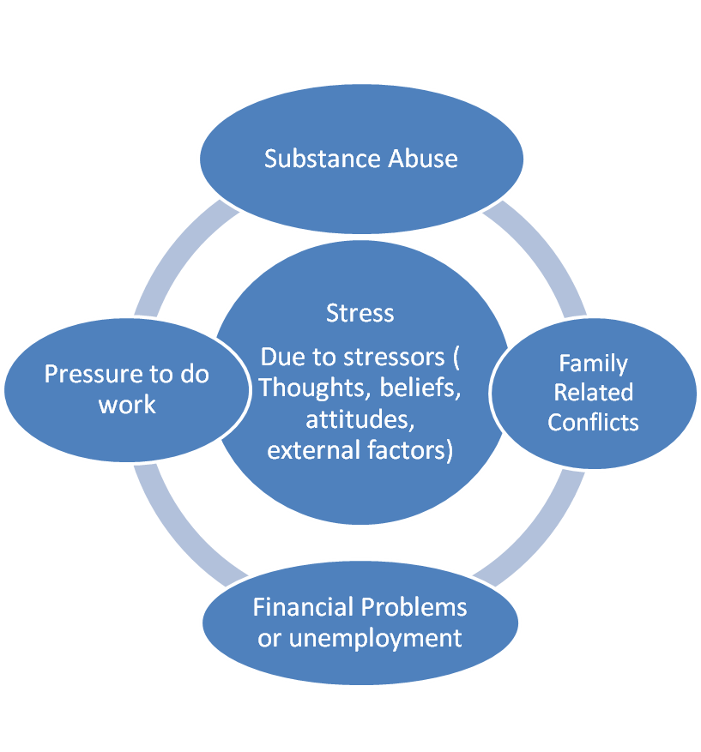
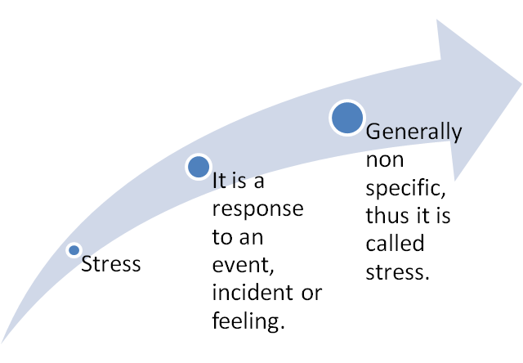
Introduction to stress
(Wilson, 2002).
Notes:
Defining stress is important to build a base for the theory that is to follow. This slide meets the objective. The different reasons for stress are mentioned in the bubbles above to highlight to the audience that they are not alone. The key point to mention here is that people should identify their stressors. These stressors can be unique for anybody. Though the general ones have been mentioned, stressors can be as simple as going to college, or having had a death in the family. These are stressors that lead the body towards an unconditioned response. Stress.

Slide 4
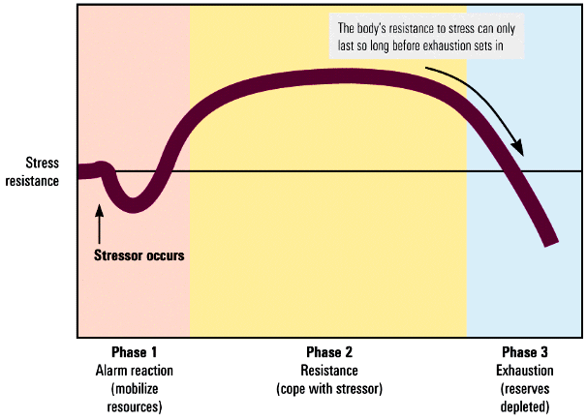
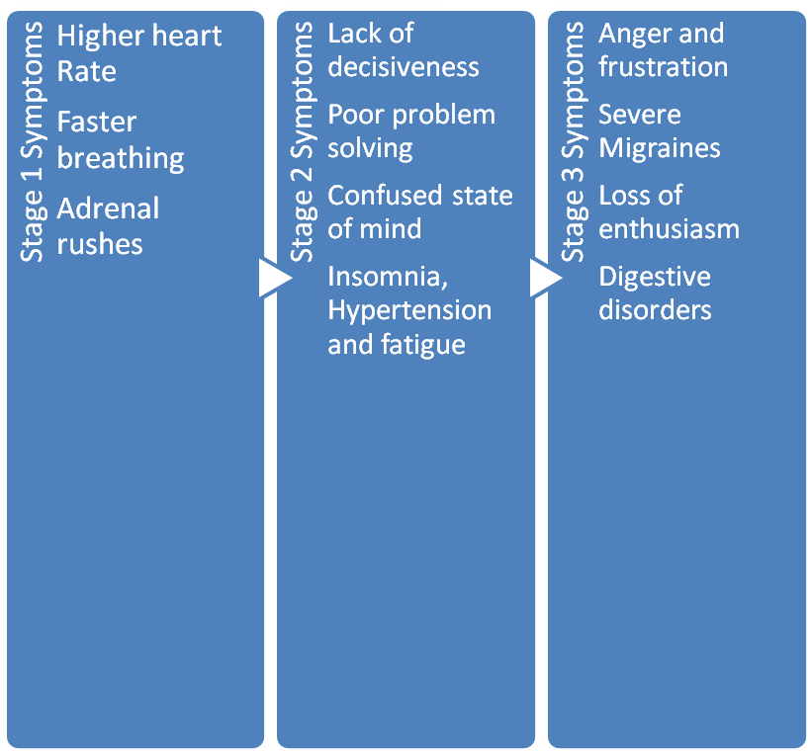
Stages of Stress
The body’s resistance to stress can only
Last so long before exhaustion sets in
Stress
resistance
Stressor
occurs
Phase 1
Alarm
reaction
(mobilize
resources)
Phase 2
Resistance
(cope with
stressor)
Phase 3
Exhaustion
(reserves
depleted)
(Bernstein, 2010)
(Wilson, 2002).
Notes:
To help people understand stress, the stages of stress have been mentioned. One or two will be relatable to the audience, and therefore, the more relatable the content is , the more prone they will be to listen. The idea behind the slide is to educate on the different symptoms that people may face while undergoing stress. During the first stage, an individual feels alarmed, as mentioned in the diagram. They begin to fight the stressor and show resistance. And finally, those who cannot fight it become exhausted. The core idea behind this information is that people should know when they are in which stage to better react to them. If they notice that they are in the resistance phase, they should try to develop processes (mentioned ahead) which help them cope with stress without necessarily moving towards exhaustion. Understanding how stress management works helps in dealing with stress, and thus the rationale for the slide is exactly that. TO aid understanding.

Slide 5
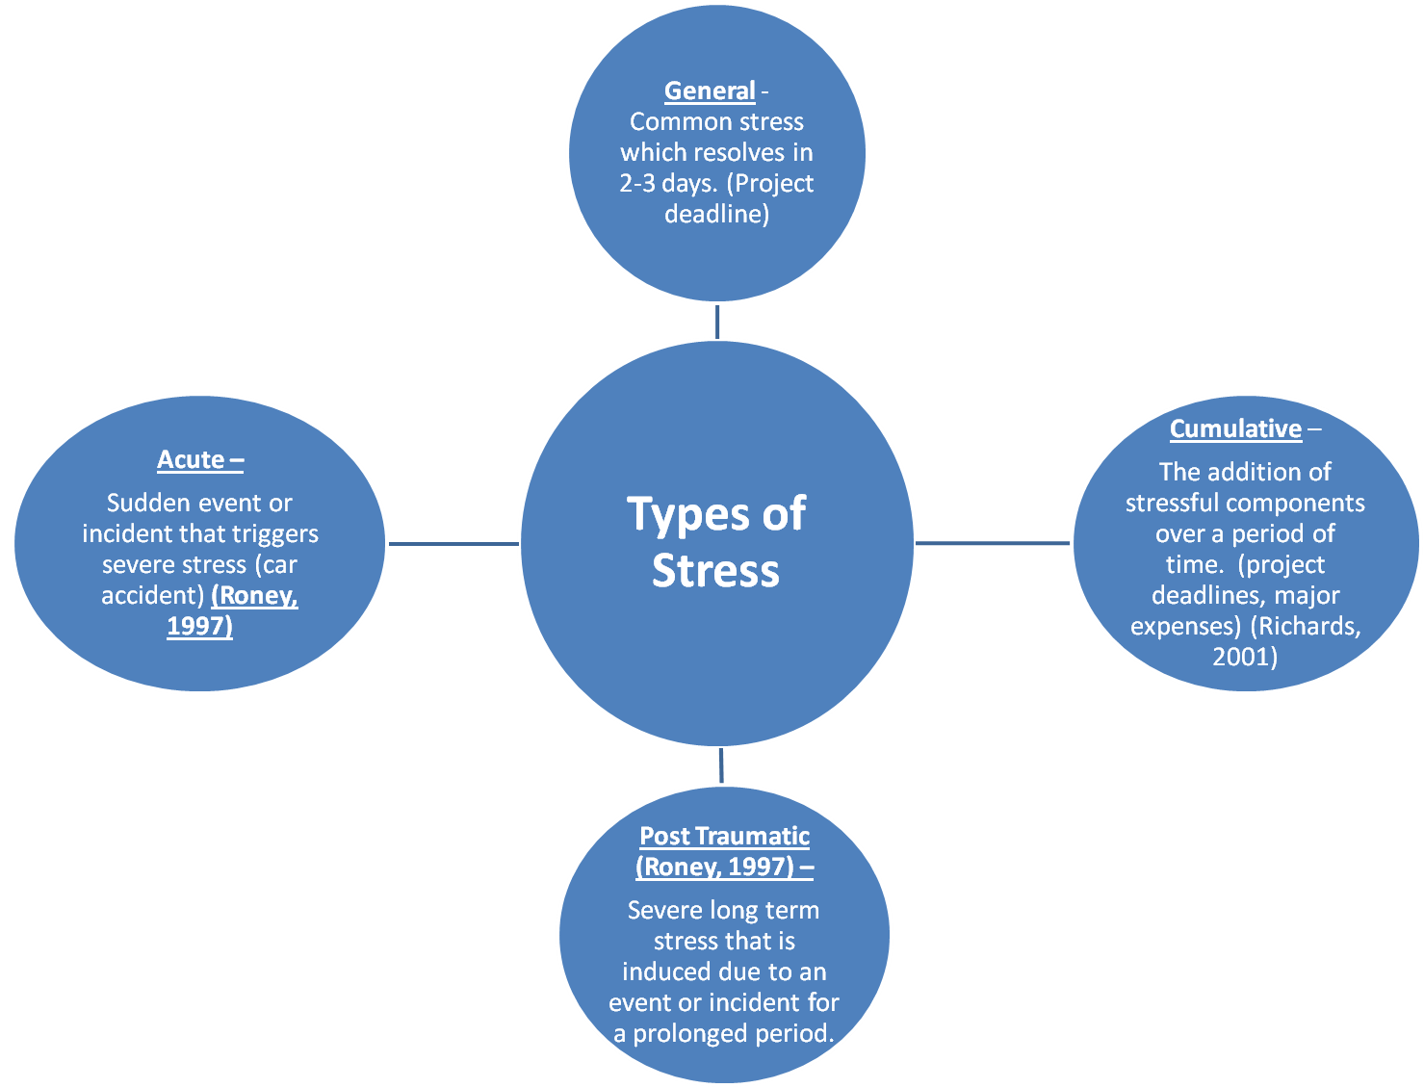
Notes:
Different people face different forms of stress. Above, the most basic kinds of stress types have been identified. The rationale behind the inclusion of this slide was to let people know how stress types can affect them. Daily stress is not something to fret about. This is general stress that comes and goes with events. however, acute stress can be due to a shocking incident such as a death in the family. If the individual fails to get over it fast enough, it can become worse and turn into post traumatic stress. The idea behind explaining the different types of stress is that individuals should seek to relieve their burdens as soon as possible. As the diagram shows, stress cumulates. And when it cumulates, it becomes a source of serious health problems for individuals (Roney, 1997)
.

Slide 6
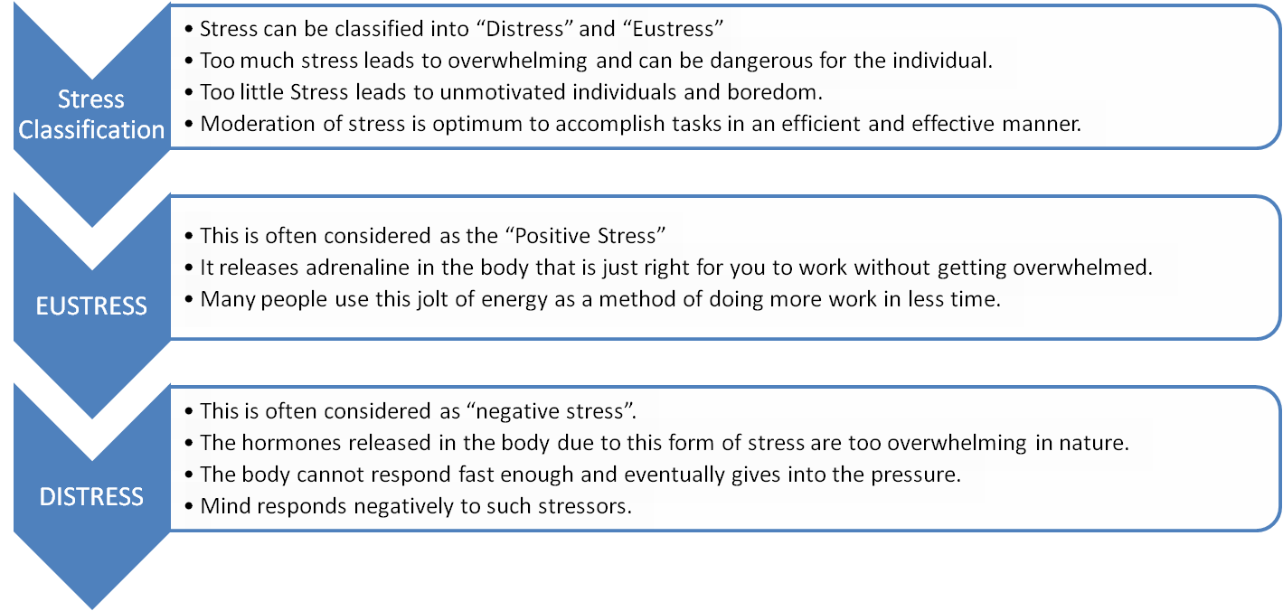
Diversification of stress
(Sapolsky, 2004)
Notes:
Since the purpose of the seminar is to educate, it is important to let individuals know that no stress is not a good thing. There are three levels of stress as mentioned above in the slide. The rationale for including this slide was that individuals should not seek to be entirely stress free. A little level of stress aids work, motivates and orients the body towards faster and effective working. The careful distinction has to be made between what is good for the body and what is not good for the body. The diversification has been mentioned above.

Slide 7
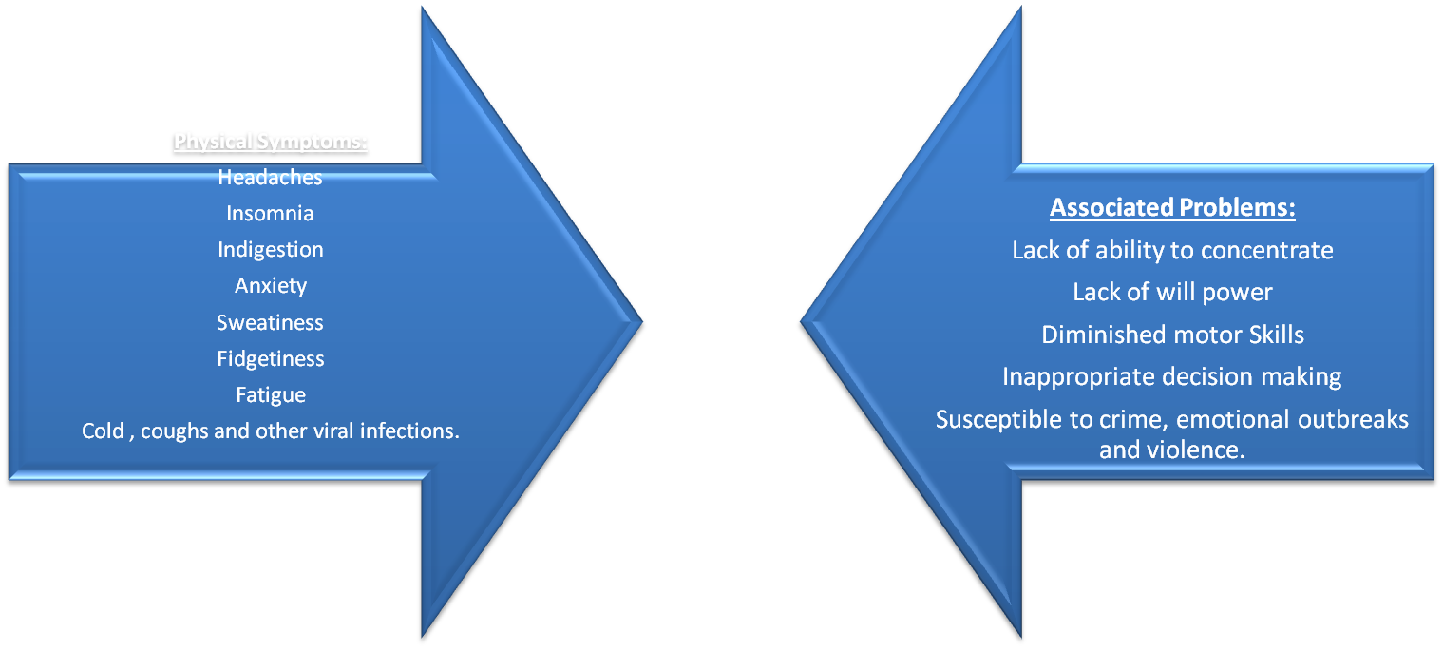
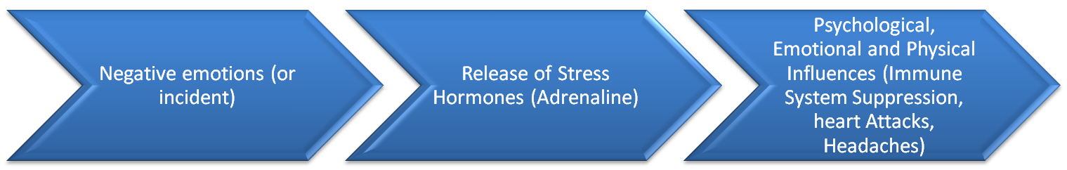
Physical Symptoms
(Chiang, 1995)
Notes:
Often, depressed people do not know if they are depressed. They need help. The concept behind adding this slide was to let individuals know what the process of being depressed looks like. Towards the bottom, the biological symptoms are mentioned, whereas towards the top, physical symptoms are mentioned. The rationale behind this was that individuals should be able to identify when they are feeling stressed. This might not be a perfect exercise but it can definitely put things into perspective. The associated problems are added to help individuals relate how stress can be harmful to their daily lives. By putting things in reference to daily activities, the rationale is that individuals listening to the seminar will be able to relate more effectively.

Slide 8
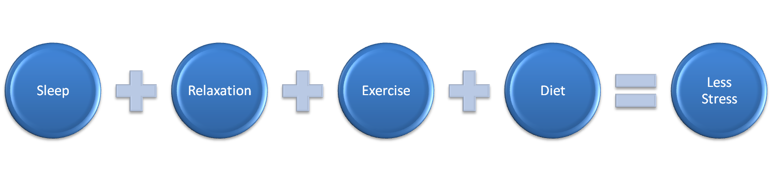
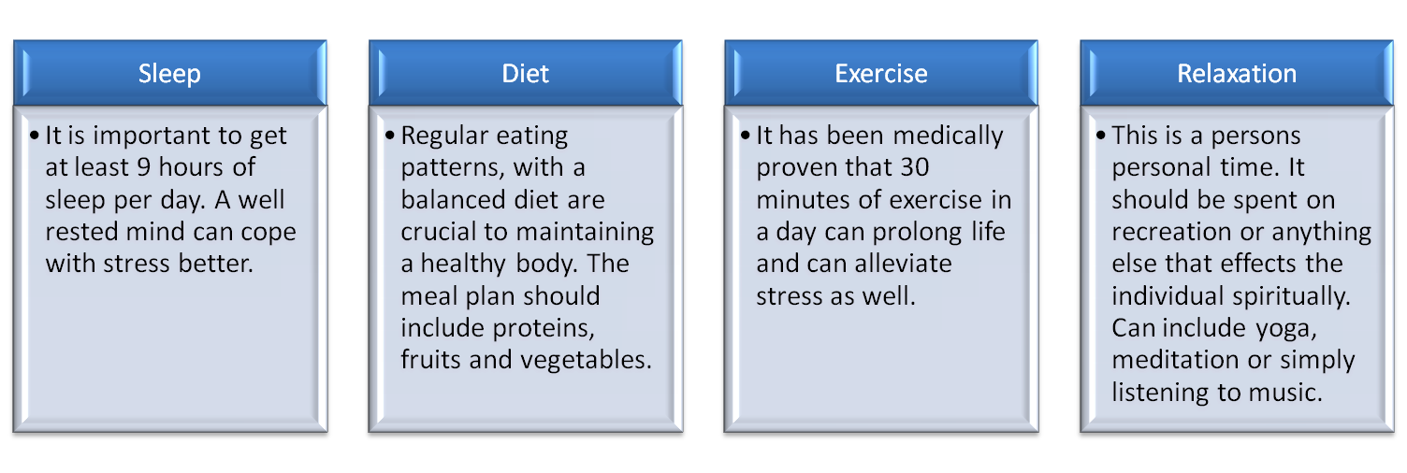
Coping Strategies
(Mitchell,1983)
(Rubenstein, 1999).
Notes:
A step by step process on how to effectively deal with stress has been listed above. The idea behind that is to provide information to individuals on how they can make their lifestyles less stress prone. The above mentioned plan has been developed using a consensus formula. The items most likely to drop stress have been listed above.

Slide 9
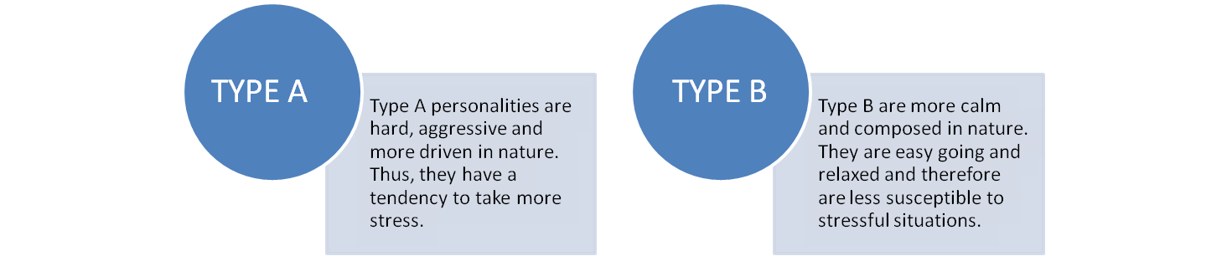
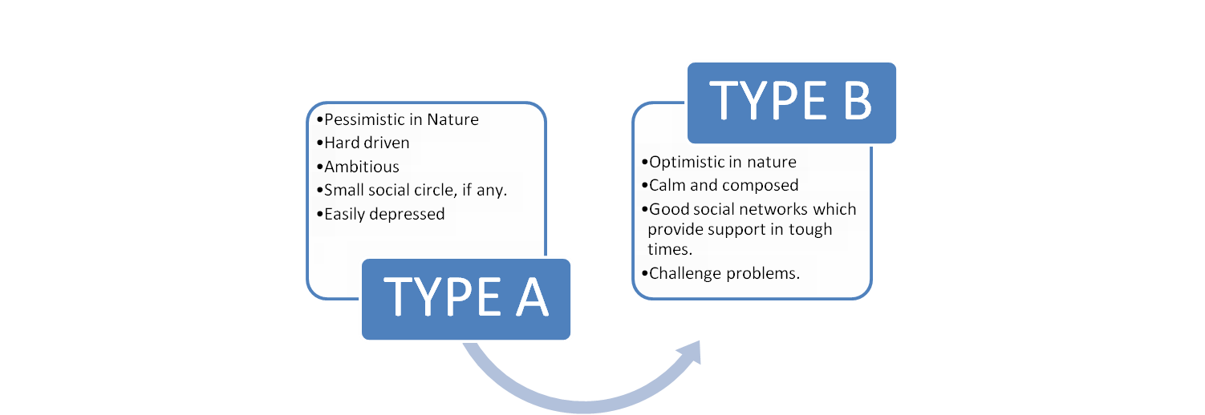
Counseling Techniques
Notes:
This particular slide was oriented towards professionals who can understand personality types. However, it is equally applicable to the general public. The core reasoning behind this side is to promote TYPE B personality types. Their characteristics have been mentioned above and the rationale is ; head towards TYPE B if you are TYPE A. TYPE B personalities are less prone to stress and live calm lives in comparison to TYPE A personalities (Mimura C & Griffiths, 2003). Also, it helps in determining the application of modern stress management techniques in a practical and doable manner.

Slide 10
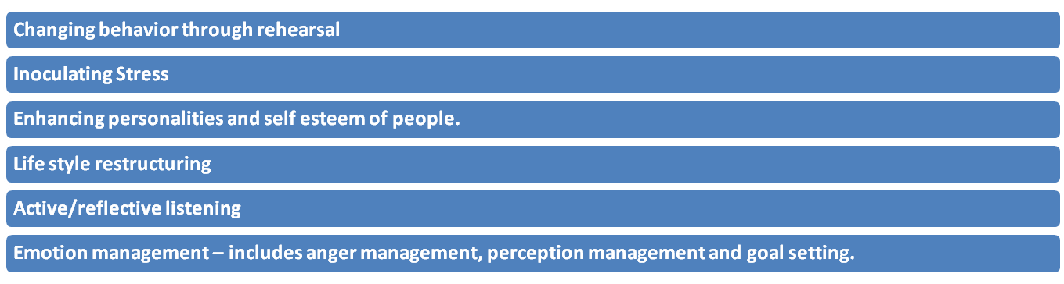
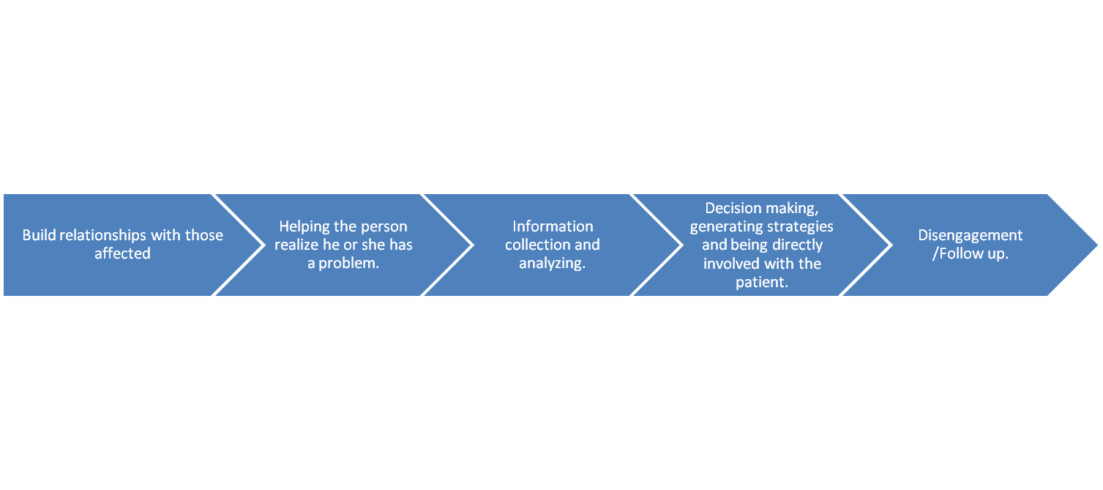
The human link (Intervention strategies)
Notes:
The rationale behind this side is to give a human intervention strategy to help those afflicted with stress in coping. The top list shows the basic requirements in a broad sense to help patients recover from stress (Parad, 1971). However, the bottom process list shows the stages in which such patients should be approached. First of, trust has to be established with the patient. Then he or she must come to terms with the problem (Greenberg, 2008). Slowly, information has to be gained regarding the stress of the patient and then strategies have to be devised to help them cope. Finally, the person helping the patient must either disengage or continue to follow up on the patient (Nathan, 2004) .

Slide 11
Resources
Greenberg, J. (2008). Comprehensive stress management. McGraw-Hill Humanities.
Weiss, B. (2003). Eliminating stress, finding inner peace. Hay House.
Bernstein, A. (2010). The Myth of stress: where stress really comes from and how to live a happier and healthier life. Free Press.
Rubenstein, L. (1999). The Stress management handbook: strategies for health and inner peace. : Keats Publishing.
Wilson, J. (2002). Adrenal fatigue: the 21st century stress syndrome. Smart Publications.
Sapolsky, R. (2004). Why Zebras don't get ulcers. Holt Paperbacks.
Chiang, C. X. (1995). A Study of Stress Reactions among Adolescents. Chinese Journal of School Health, 26, 33-37.
Nathan, R. (2004). Stress management: a comprehensive guide to wellness. Ballantine Books.
Quick , J. (2003). Stress and strain (fast facts). : Health Press.
Roney, A. (1997). Professionals on workplace stress - the essential facts. John Wiley and Sons.
Mitchell, J. T. (1983). Effects of Stress Management Training on Paramedic Coping Styles and Perceived Stress Levels Doctoral Dissertation). Ann Arbor, MI: University Microfilms International.
Regel, S. (2010). Post-traumatic stress (the facts) . Oxford University Press.
Parad, H. J. (1971). Crisis Intervention. In R. Morris (Ed.) Encyclopedia of Social Work, vol. 1, 196-202). 4
Mimura C & Griffiths P (2003) The effectiveness of current approaches to workplace stress management in the nursing profession: an evidence based literature review, Occupational and Environmental Medicine, Jan (60)1.
Richards, D. (2001). A field study of critical incident stress debriefing versus critical incident stress management. Journal of Mental Health, 10, 351-362.
Cohen, Kamarack , Mermelstein .(1983) A global measure of perceived stress. J Health Soc Behav.: 24:385–396.

