Slide 1
Ethnocentrism
By: Alexandria Short

Slide 2
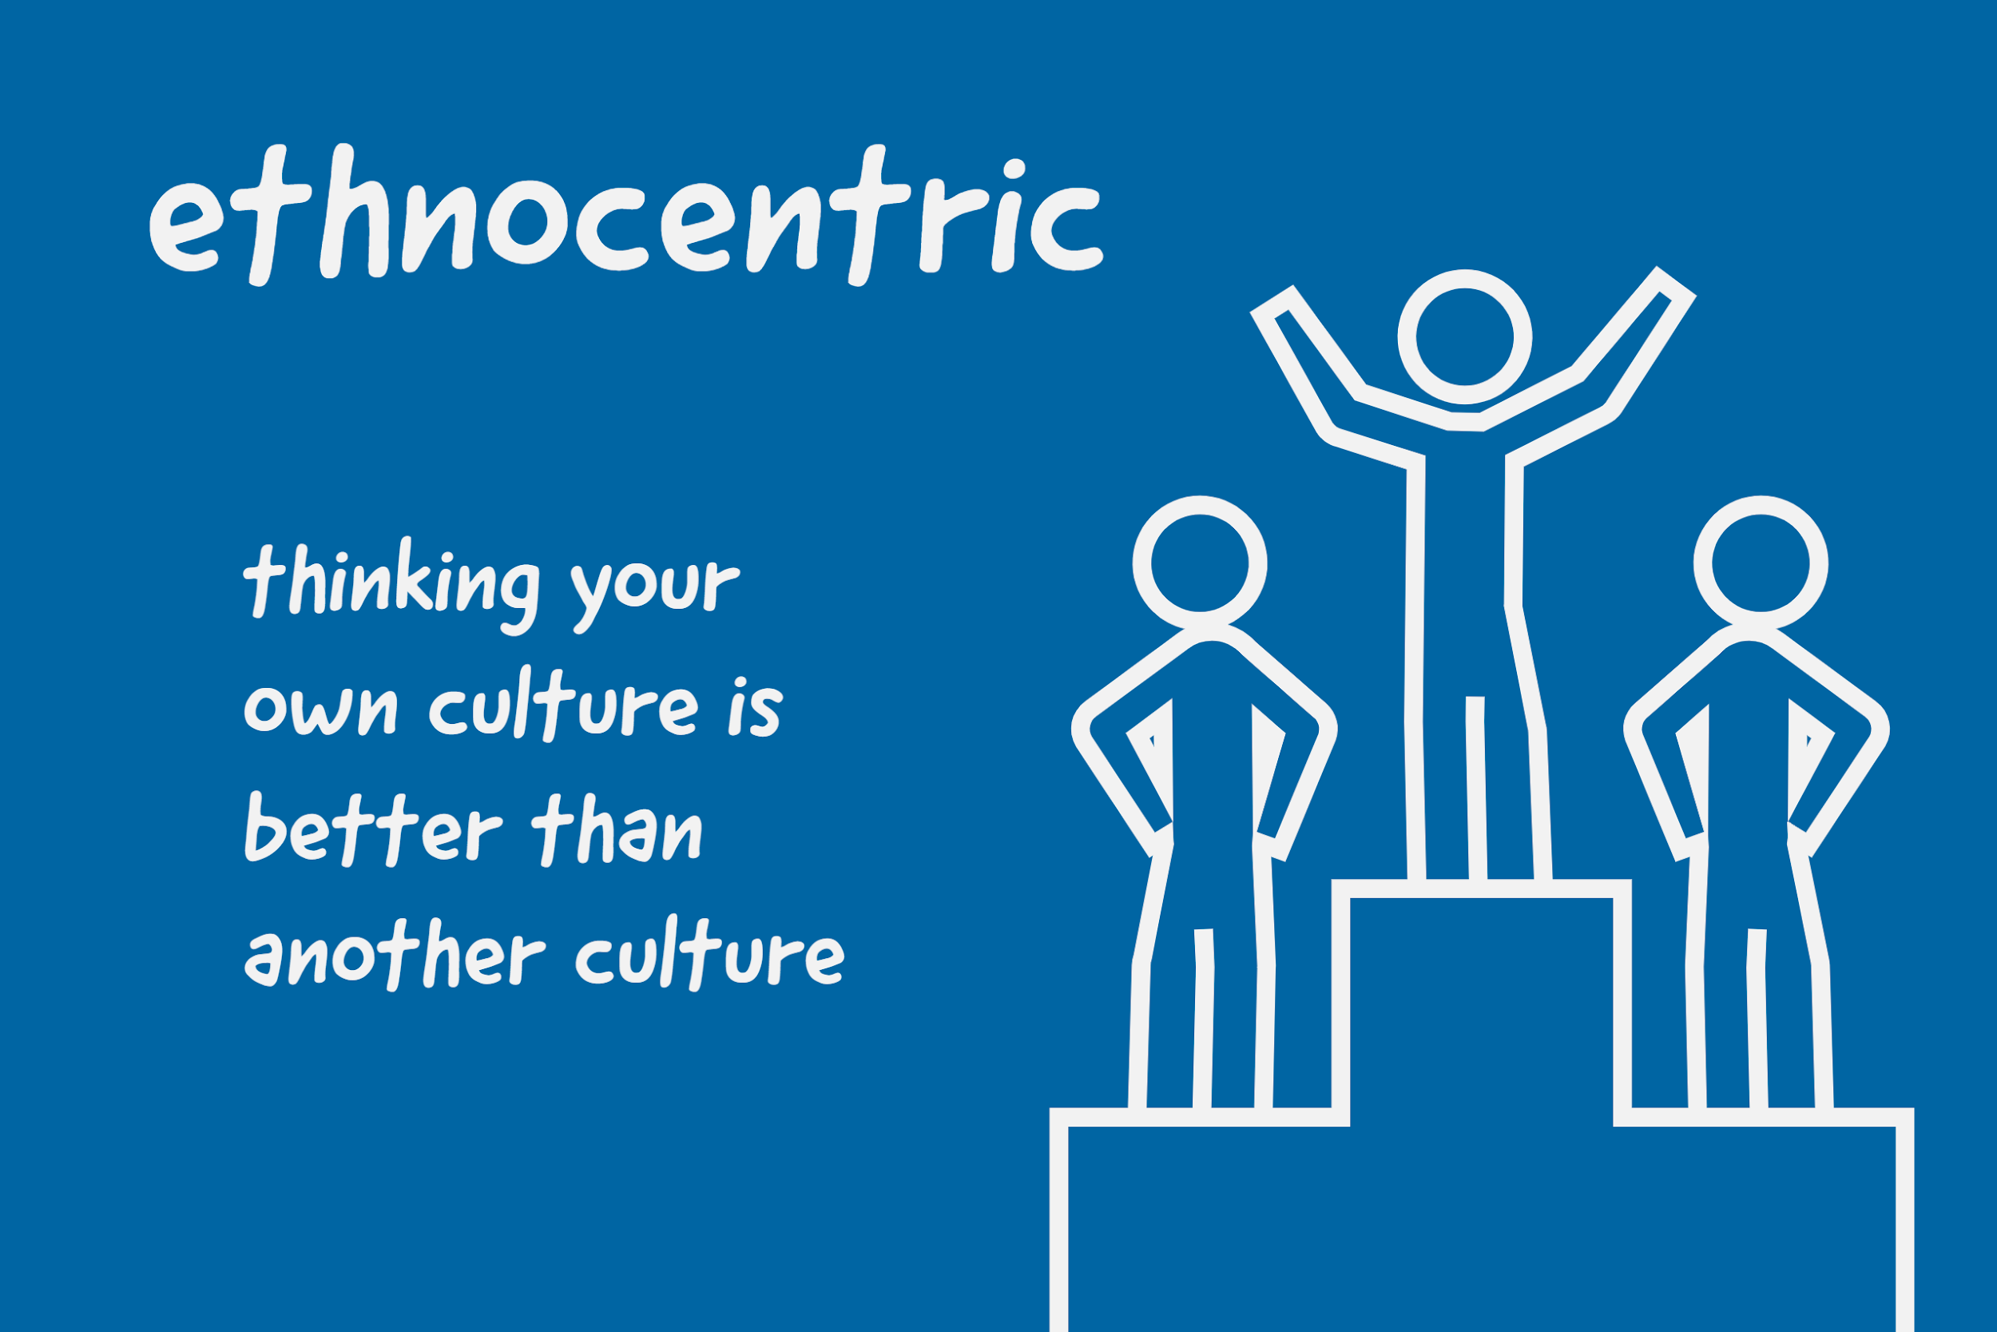
Image source: https://www.quora.com/What-is-ethnocentrism

Slide 3
What is Ethnocentrism?
According to the European Journal of Theology, Ethnocentrism“ describes ‘a tendency to view alien groups or cultures from the perspective of one’s own, and evaluates ‘other cultures according to preconceptions originating in the standards and customs of one’s own culture’. “Ethnocentric individuals view their own culture as normative and judge other groups in relation to their own ethnic group”(reimer,26).
Notes:
Reimer, J. (2017). Dealing with Ethnocentrism in this Generation. European Journal of Theology, 26(2), 154–161

Slide 4
Effects of ethnocentrism
Foundation for racism
Foundation for nationalism
Self centered ideology

Slide 5
Examples of ethnocentrism
American food is better than any other type of food.
American ideology is the blueprint for the rest of the world.

Slide 6
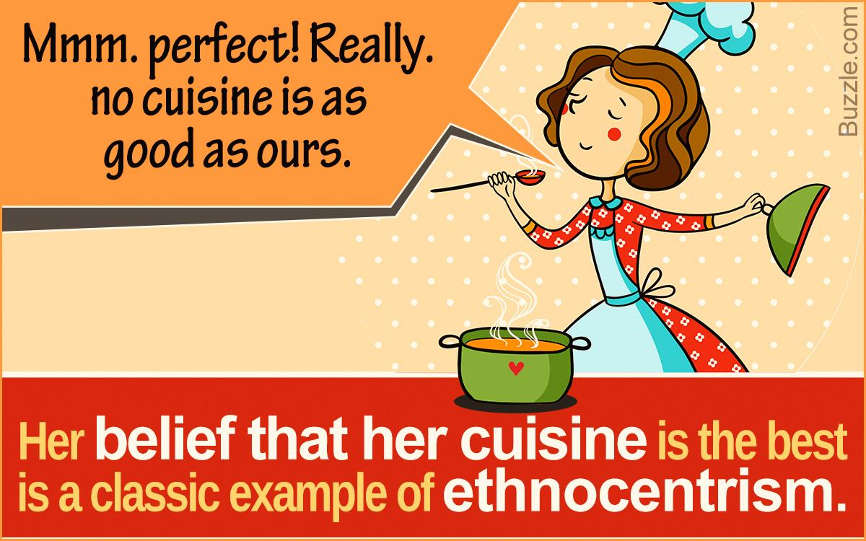
Image source: https://opinionfront.com/examples-of-ethnocentrism-to-help-you-understand-it-better

Slide 7
According to the Journal of Politics,
”Public opinion research correlates ethnocentrism with opposition to immigration, trade, and foreign outsourcing”
“ethnocentrism directly undermines economic integration. Ethnocentrism erodes the trust necessary to form and sustain cross-border contractual relationships, creates an aversion to the consumption of foreign products, and weakens the information exchange necessary for efficient markets”(andrews,2018).
Notes:
Andrews, S., Leblang, D., & Pandya, S. S. (2018). Ethnocentrism Reduces Foreign Direct Investment. Journal of Politics, 80(2), 697–700. https://doi-org.ezproxy.library.skagit.edu/10.1086/694916

Slide 8
According to Philosphy East and West,
“ethnocentrism is pragmatically less productive than cultural diversity, and yet homogeneous groups may have a false sense of confidence in their productivity.”(Bruya,2017).
Notes:
Bruya, B. (2017). Ethnocentrism and Multiculturalism in Contemporary Philosophy. Philosophy East and West, 67(4), 991+.

Slide 9
Context
ethnocentrism:
Negatively impacts economics
Makes forming interpersonal relationships difficult
Creates a false sense of superiority
Negates diversity

Slide 10
Thesis
Ethnocentrism causes conflict in interpersonal communication.

Slide 11
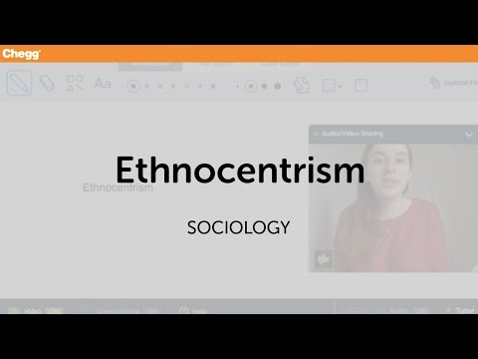
https://www.youtube.com/watch?v=B_Y8LuQRamE

Slide 12
Modern day examples of Ethnocentrism
The following is a tweet by President Trump source: https://www.theatlantic.com/magazine/archive/2020/09/the-end-of-denial/614194/
“So interesting to see ‘Progressive’ Democrat Congresswomen, who originally came from countries whose governments are a complete and total catastrophe, the worst, most corrupt and inept anywhere in the world (if they even have a functioning government at all), now loudly and viciously telling the people of the United States, the greatest and most powerful Nation on earth, how our government is to be run,” Trump tweeted on Sunday, July 14, 2019. “Why don’t they go back and help fix the totally broken and crime infested places from which they came. Then come back and show us how it is done. These places need your help badly, you can’t leave fast enough.”

Slide 13
The last quote illustrates ethnocentrism due to the fact that Trump states that the United States is the greatest country on earth and, uses racist rhetoric to compare it to other countries.

Slide 14
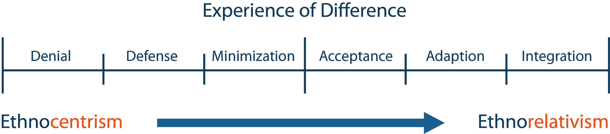
Source: https://www.theatlantic.com/magazine/archive/2020/09/the-end-of-denial/614194/

Slide 15
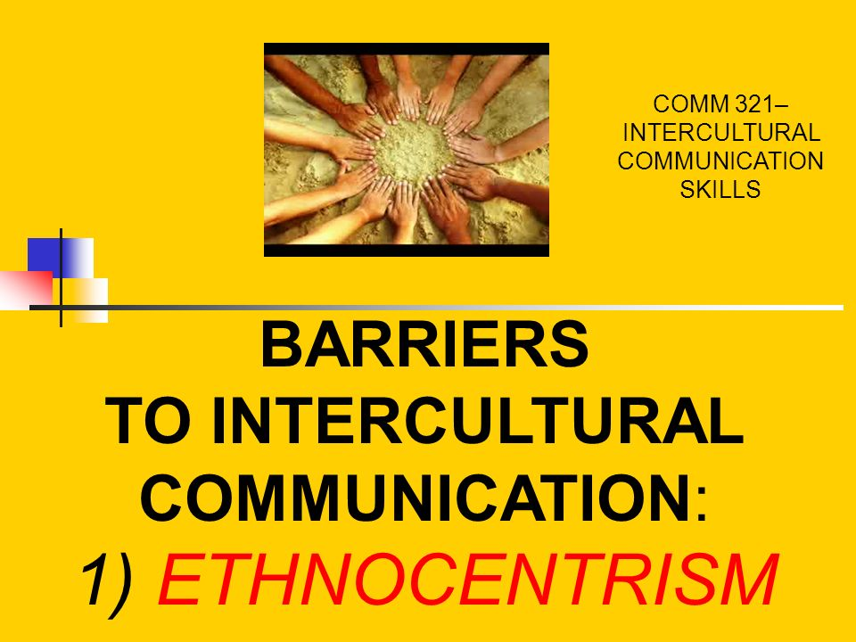
Image source: https://slideplayer.com/slide/8870361/

Slide 16
Ethnocentrism causes conflict in interpersonal communication.
Why?
Racism
Sexism
Nationalism
Negative interactions between cultural groups

Slide 17
Why does ethnocentrism act as a barrier?
“Ethnocentricism is perceiving one's own cultural beliefs and customs as superior to those of others. In communication, an attitude of ethnocentrism makes people from other cultures feel that you do not value them. When a person feels devalued or invalidated, they tend to shut down. Thus, communication is unproductive and/or even counterproductive.”
https://study.com/academy/lesson/ethnocentricity-stereotypes-in-communications.html

Slide 18
“When ethnocentrism grows to a certain level, it will become a barrier for communication among people from different cultures (Neuliep & McCroskey, 1997a). Ethnocentrism leads persons to use their own group as the center of viewing things, which tends to develop prejudice by judging other groups as inferior to their own.” https://web.uri.edu/iaics/files/01Guo-MingChen.pdf

Slide 19
Why it is a barrier?
Ethnocentrism in interpersonal communication creates
Anxiey
Frustration
Unproductive communication
Makes others feel invalidated

Slide 20
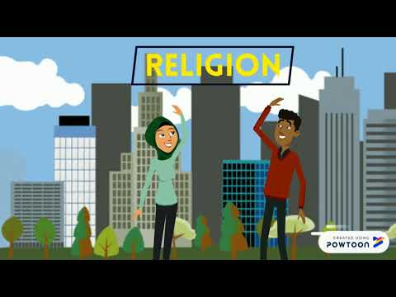
https://www.youtube.com/watch?v=mZI3CRtJumw

Slide 21
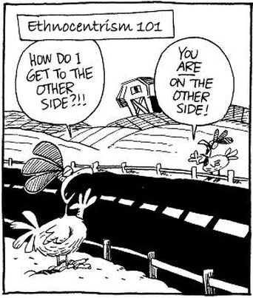
Image source https://www.ic-english.com/ethnocentrism.html

Slide 22
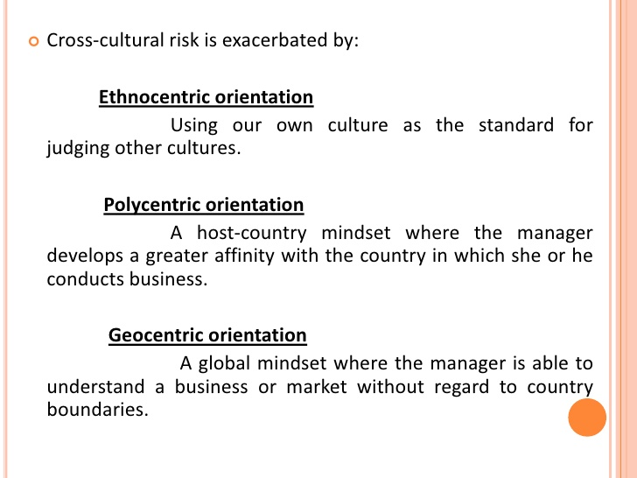
How do we stop ethnocentrism?
https://www.slideshare.net/onlyvvek/cross-cultural-communication-in-business-world

Slide 23
https://eccointernational.com/embracing-cultural-identity/#:~:text=Instead%20of%20immersing%20yourself%20immediately,place%20you%20plan%20to%20visit.
According to ecco international,
How do we move toward geocentrism?
Be aware: Think back to when you were just learning and, thus, where might you have gotten your ethnocentric behaviors
Learn, learn, learn: Be willing to open up and learn about other people and cultures different from your own
Sort old and new information: Decide what views, either from your early learnings or recent ones, you want to keep and which are out-of-date or no longer fit
Take risks: Put yourself in new, difference and uncomfortable situations. This will narrow your ethnocentric boundaries and broaden your geocentric view. Get involved and put all the theory to practice!

Slide 24
Solution Geocentrism
Geocentrism: The ability to find a variety of choices when seeing the world and situations.
https://eccointernational.com/embracing-cultural-identity/#:~:text=Instead%20of%20immersing%20yourself%20immediately,place%20you%20plan%20to%20visit.

Slide 25

Thank you!

Slide 26
Literary Sources Works Cited
Reimer, J. (2017). Dealing with Ethnocentrism in this Generation. European Journal of Theology, 26(2), 154–161
http://web.b.ebscohost.com.ezproxy.library.skagit.edu/ehost/pdfviewer/pdfviewer?vid=6&sid=21c9a8d6-af4e-426f-a9d2-4ce5ec6557a7%40pdc-v-sessmgr01
Andrews, S., Leblang, D., & Pandya, S. S. (2018). Ethnocentrism Reduces Foreign Direct Investment. Journal of Politics, 80(2), 697–700. https://doi-org.ezproxy.library.skagit.edu/10.1086/694916
Bruya, B. (2017). Ethnocentrism and Multiculturalism in Contemporary Philosophy. Philosophy East and West, 67(4), 991+. https://go-gale-com.ezproxy.library.skagit.edu/ps/retrieve.do?tabID=T001&resultListType=RESULT_LIST&searchResultsType=SingleTab&hitCount=42&searchType=AdvancedSearchForm&currentPosition=4&docId=GALE%7CA509321042&docType=Essay&sort=Relevance&contentSegment=ZLRC-MOD1&prodId=LitRC&pageNum=1&contentSet=GALE%7CA509321042&searchId=R1&userGroupName=moun28208&inPS=true

Slide 27
Non literary Sources Cited
Image and video sources are included on each slide
https://www.theatlantic.com/magazine/archive/2020/09/the-end-of-denial/614194/
https://study.com/academy/lesson/ethnocentricity-stereotypes-in-communications.html
https://web.uri.edu/iaics/files/01Guo-MingChen.pdf
https://eccointernational.com/embracing-cultural-identity/#:~:text=Instead%20of%20immersing%20yourself%20immediately,place%20you%20plan%20to%20visit.

