Slide 1
Skagit
By: Alexandria Short

Slide 2
Skagit River Presentation Overview
Today I will be discussing the Skagit River and its tributaries. There is a satellite map and a map of the river itself. Then, a graph of the river’s water temperature, discharge, and gage height. Lastly, I discuss the dam and its impacts on the area around it. Thank you for your time and enjoy the presentation!

Slide 3
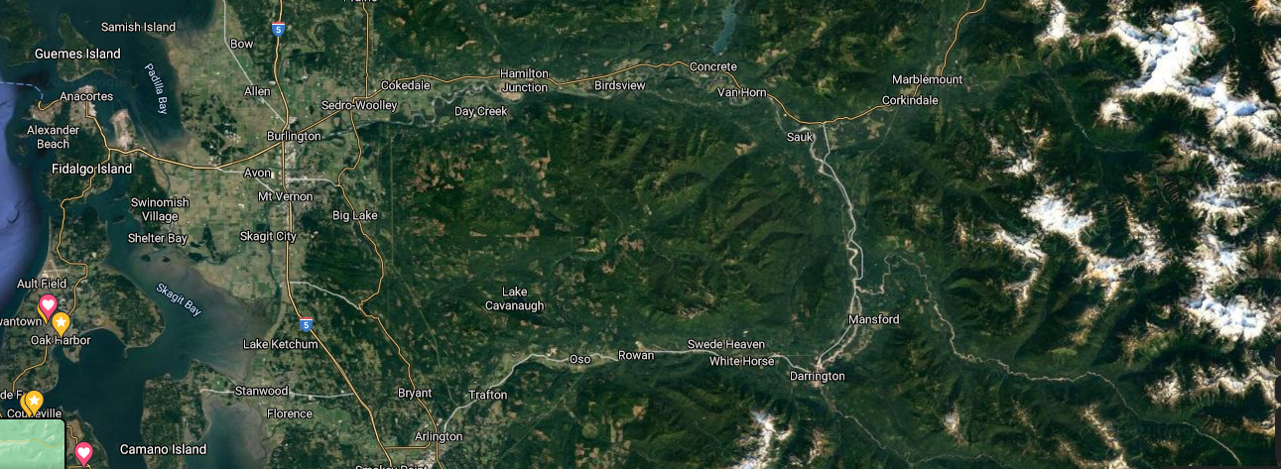

Slide 4
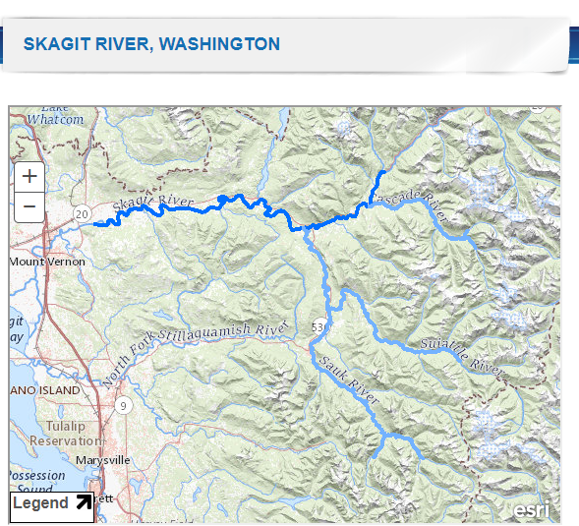
Skagit and its Tributataries
The map shows the Skagit and its tributaries. The Skagit river Is 158.5 miles.
Image source: https://www.rivers.gov/rivers/skagit.php
Notes:
https://www.rivers.gov/rivers/skagit.php

Slide 5
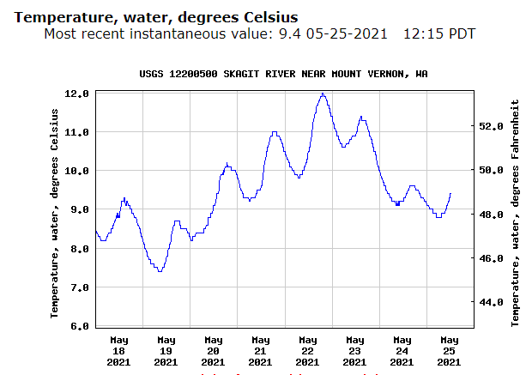
Readings of the Skagit- Water temperature

Slide 6
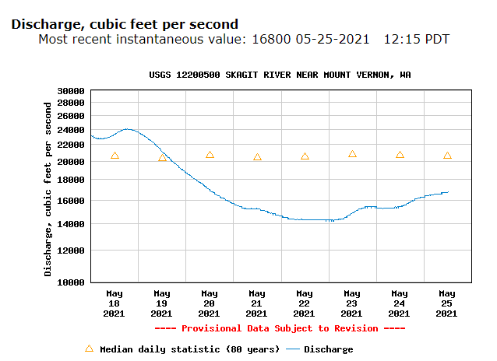
Discharge

Slide 7
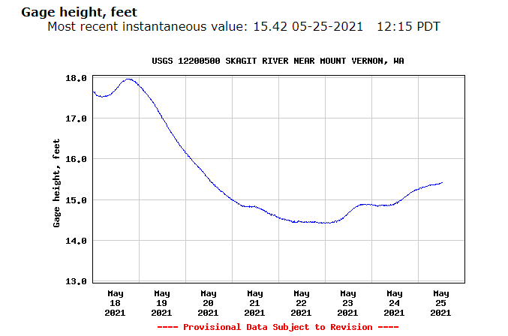
Gage Height

Slide 8
Problems with the Dam
North Cascades National park contains the three dams that were built on the Skagit river. The dams were used to provide cheap power, and the dam created more recreational areas.
The dam negatively impacts the fish populations of the Skagit. This also is harmful to the Native American’s that rely on the river and salmon populations.
A fish ladder may be able to help support fish populations moving through the dam, but the fish populations are currently in danger and there are demands for a comprehensive fish passage study.

Slide 9
Notable Sources
Dam Article Source: https://www.king5.com/article/news/investigations/seattles-skagit-river-dams-hurt-salmon-orcas-and-native-american-culture-agencies-say/281-d4e483c2-1178-4af1-b8db-634e3b4009f7
Graph and biological resources:
https://waterdata.usgs.gov/usa/nwis/uv?site_no=12200500
Thank you!

