Slide 1
Game using Javafx
Done by:
N. Mompi Devi
BT/IT/13-36
General Proficiency III
Mentor: Dr. Md. Iftekhar Hussain

Slide 2
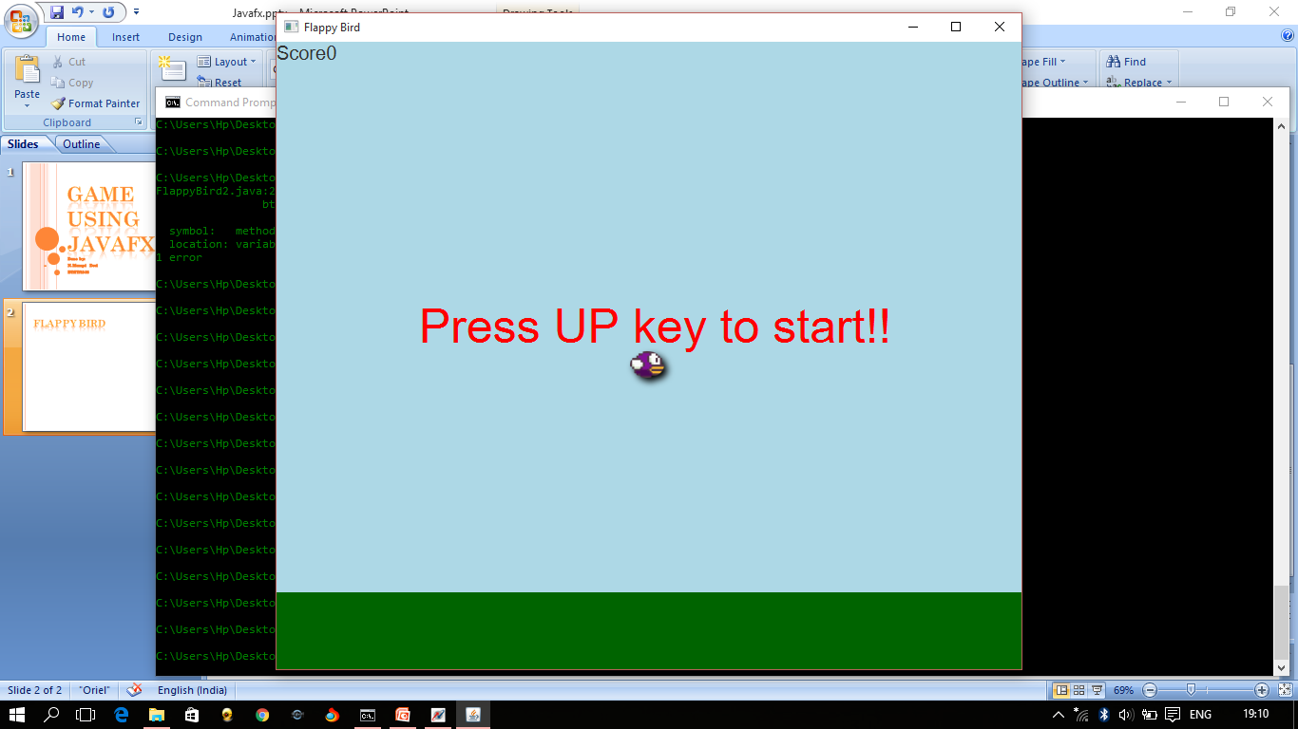
Flappy Bird
Flappy Bird is a 2013 mobile game, developed by Vietnam-based developer Nguyễn Hà Đông (Dong Nguyen) and published by .GEARS Studios. In this game the player controls a bird, attempting to fly between rows of pipes/pillars without hitting them.

Slide 3
Adding rectangles
Initializing height with a random value between 50 and 300 and space=300
Add two Rectangles
1st rectangle of coordinates X= W+width+(columns.size()*200), Y=H-height-120 and width=100 and height=height
2nd rectangle of coordinates X=W+width+(columns.size()-1)*200,Y=0 and width=100,height=H-height-space

Slide 4
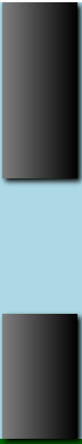
H
Space=300
height
Width=100
W

Slide 5
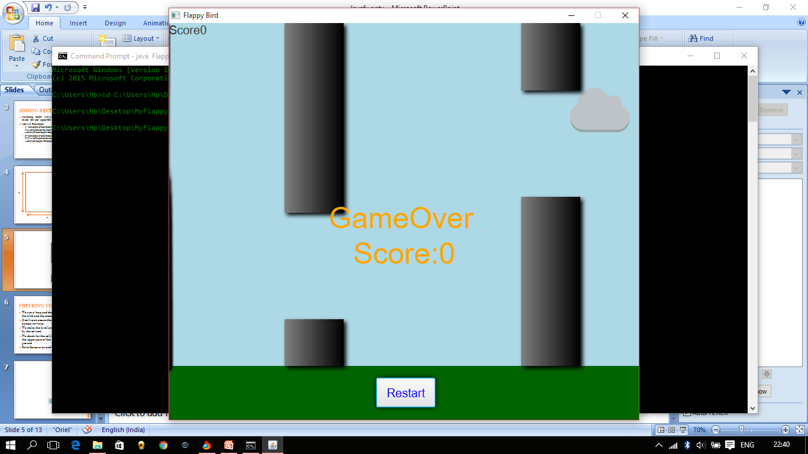
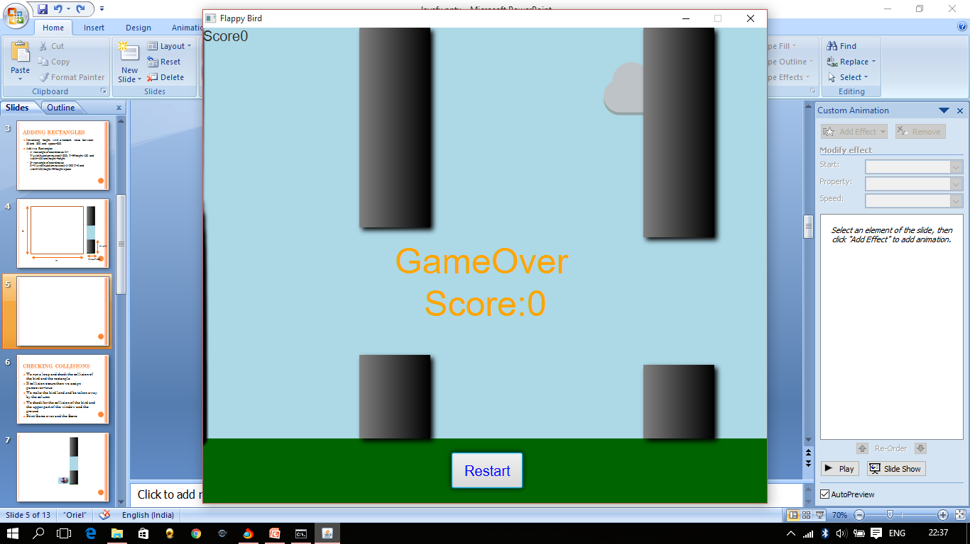

Slide 6
Checking Collisions
We run a loop and check the collision of the bird and the rectangle
If collision occurs then we assign gameover=true
We make the bird land and be taken away by the column
We check for the collision of the bird and the upper part of the window and the ground
Print Game over and the Score

Slide 7
Game Over
Score:0

Slide 8
To make the bird jump
void Jump(){
if(!gameOver){
if(ymotion>0){ //if the bird’s position is assigned for going down
ymotion=0; //then the bird’s position will be assigned 0
}
ymotion=ymotion-10; //this makes the bird jump
}
}

Slide 9
Start()
We set the bird’s position to the center of the screen
We assign gameover=false
We assign the motion of the bird to zero
Initialize score=0
Clear the columns
Print Press UP key to start
Pause the timeline
Until the UP key is pressed, the screen will be in a pause mode
Once the UP key is pressed, we play the timeline
Press the UP key

Slide 10
Start(Stage window)
It is the main entry point
Set the keyframe for the bird and the duration will be 20 milli seconds
Ticks counts the frames
The movement of the bird downwards is written below:
if(ticks%2==0&&ymotion<15)
{
ymotion=ymotion+2;
}
We check if the UP key is pressed then we will call the jump function

Slide 11

Start(Stage window)
Set the cloud’s position as X=W+(int)cloud.getWidth() and Y=10+(int)(Math.random()*100);
In every frame, X is decremented by 2
We then check if the cloud has passed by the screen and if it has passed then set the coordinates of the cloud to its initial position

Slide 12
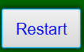
Start(Stage window)
We check for collisions
If gameover=true then we wait for the Restart button to be clicked
Once clicked we will go to the start() function
Set the keyframe for the columns and the duration will be 20 milli seconds
We decrement the X coordinate with 5
We check whether the bird passes the columns. If it passes then we increment the score.
In the timeline we add both the keyframes
We call the start() function to play the timeline

Slide 13
Score=1
Score=0

Slide 14
Conclusion
From this project I learnt the basics of javafx. This has really helped me in gaining more interest in gaming and I intend to make more games in future because javafx is a good platform for making games.
References
www.youtube.com
www.github.com

