Slide 1
Reconstruct C dynamics of CABLE in CMIP6 Preliminary tests
Yuanyuan Huang
27/07/2021

Slide 2
Number of plant functional types: 13
What disturbances are simulated (e.g., land use or fire etc.)? No land use, no fire
9 carbon pools
CMIP6: 1%ptbgc
Pools: cLeaf; cRoot; cWood; cLitter; cSoil
Fluxes: NPP, rh

Slide 3
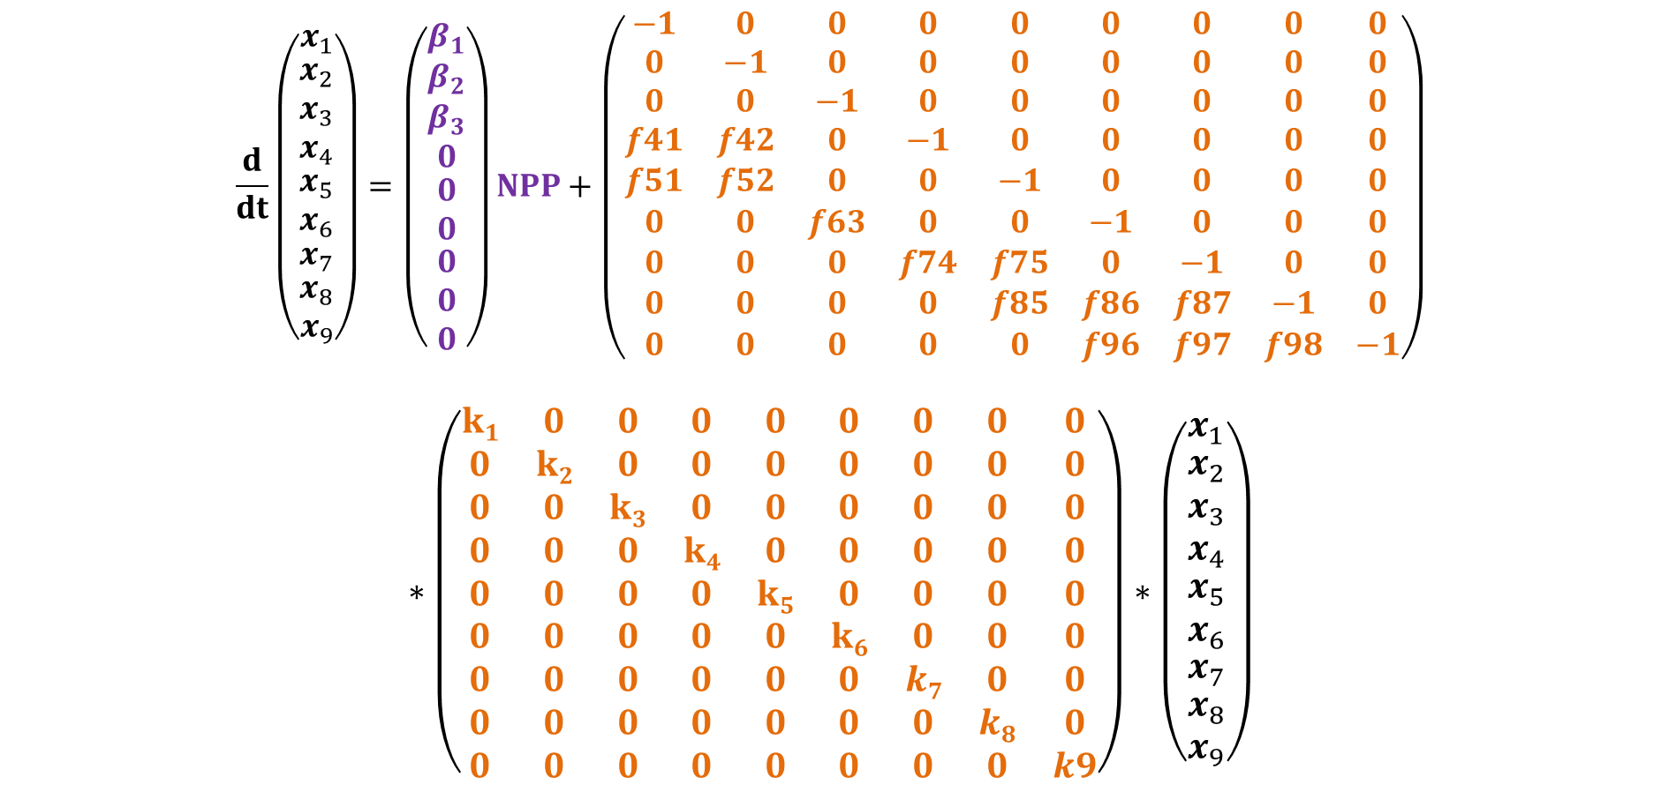
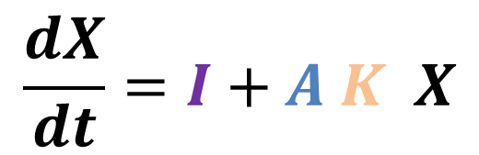
$$\frac{dX}{dt}=I+A K X$$
$$\frac{d}{dt}\left(\begin{aligned}\begin{matrix}x_{1} \\ \begin{matrix}\begin{matrix}\begin{matrix}x_{2} \\ x_{3} \\ x_{4}\end{matrix} \\ x_{5} \\ x_{6}\end{matrix} \\ x_{7}\end{matrix}\end{matrix} \\ x_{8} \\ x_{9}\end{aligned}\right)=\left(\begin{matrix}β_{1} \\ \begin{matrix}\begin{matrix}\begin{matrix}β_{2} \\ β_{3} \\ 0\end{matrix} \\ 0 \\ 0\end{matrix} \\ \begin{aligned}0 \\ 0 \\ 0\end{aligned}\end{matrix}\end{matrix}\right)NPP+\left(\begin{matrix}−1 & 0 & 0 & 0 & 0 & 0 & 0 & 0 & 0 \\ 0 & −1 & 0 & 0 & 0 & 0 & 0 & 0 & 0 \\ 0 & 0 & −1 & 0 & 0 & 0 & 0 & 0 & 0 \\ f41 & f42 & 0 & −1 & 0 & 0 & 0 & 0 & 0 \\ f51 & f52 & 0 & 0 & −1 & 0 & 0 & 0 & 0 \\ 0 & 0 & f63 & 0 & 0 & −1 & 0 & 0 & 0 \\ 0 & 0 & 0 & f74 & f75 & 0 & −1 & 0 & 0 \\ 0 & 0 & 0 & 0 & f85 & f86 & f87 & −1 & 0 \\ 0 & 0 & 0 & 0 & 0 & f96 & f97 & f98 & −1\end{matrix}\right)$$
$$∗\left(\begin{matrix}k1 & 0 & 0 & 0 & 0 & 0 & 0 & 0 & 0 \\ 0 & k2 & 0 & 0 & 0 & 0 & 0 & 0 & 0 \\ 0 & 0 & k3 & 0 & 0 & 0 & 0 & 0 & 0 \\ 0 & 0 & 0 & k4 & 0 & 0 & 0 & 0 & 0 \\ 0 & 0 & 0 & 0 & k5 & 0 & 0 & 0 & 0 \\ 0 & 0 & 0 & 0 & 0 & k6 & 0 & 0 & 0 \\ 0 & 0 & 0 & 0 & 0 & 0 & k7 & 0 & 0 \\ 0 & 0 & 0 & 0 & 0 & 0 & 0 & k8 & 0 \\ 0 & 0 & 0 & 0 & 0 & 0 & 0 & 0 & k9\end{matrix}\right)∗\left(\begin{matrix}x_{1} \\ \begin{matrix}\begin{matrix}\begin{matrix}x_{2} \\ x_{3} \\ x_{4}\end{matrix} \\ x_{5} \\ x_{6}\end{matrix} \\ \begin{aligned}x_{7} \\ \begin{aligned}x_{8} \\ x_{9}\end{aligned}\end{aligned}\end{matrix}\end{matrix}\right)$$

Slide 4
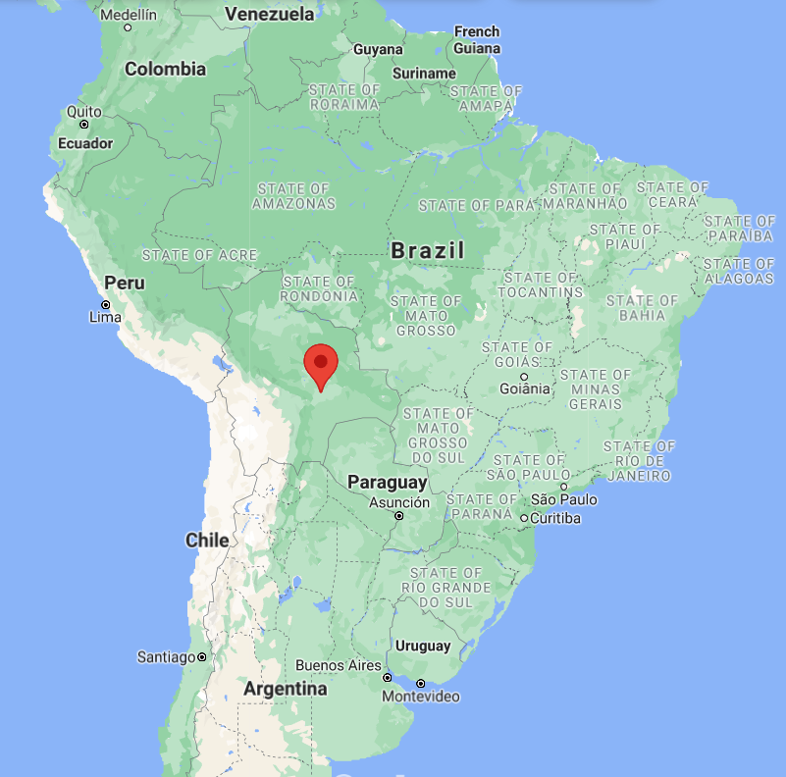
Site Information
Evergreen Broadleaf Forest 53%
C3 crop 26%
Deciduous Broadleaf Forest 13%
C4 grass 7%
Clay: 0.2028
Silt: 0.2808

Slide 5
Frame the target
Model structure: see the matrix equation
Known output: cLeaf; cRoot; cWood; cLitter; cSoil; rh; NPP
Unknowns: beta1, beta2, fs, initial conditions

Slide 6
Start simple
In real model, betas, fs, ks change with environment and time. Here we start assuming these parameters are constant and do not change with time
The first step is trying to find “average” betas, fs and ks.
Not all betas, fs and ks need to be optimized; some values could be found from model descriptions; e.g., in CABLE, some transfers (fs) are known, some are a function of clay; ks for litter use the same temperature and moisture functions

Slide 7
Final parameters to be optimized
16
Matrix equation:
"beta1","beta2", "lig_leaf","lig_wood", "f41","f42", "kleaf","kroot","kwood","kmet","kmic", "kslow","kpass",
Initial conditions:
"cmet_init", "cstr_init", "cmic_init", "cslow_init"

Slide 8
Objective function
Mismatches between matrix simulation vs. CMIP6 output
Mean square error across time (1680 months, 140 years)
I gave more weight to rh
(J_obj1 + J_obj2 + J_obj3 + J_obj4 + J_obj5 )/200+ J_obj6/4

Slide 9
Initial parameter value to start
Need information from the model
Pa= [0.15, 0.2,0.15,0.28, 0.6, 1/365, 1/(365*5), 1/(365*40), 0.5/(365*0.1), 0.3/(365*0.137), 0.3/(365*5), 0.3/(222.22*365), 0.05, 0.1, 1, 5]

Slide 10
MCMC
Number of simulations: 20000
Number of chains: 4
Burn-in period: 500
Acceptation rate: 16%

Slide 11
Distribution of accepted parameters

Slide 12
Matrix simulation vs. CMIP6 output
Grey: Matrix
Blue: CMIP6
Rh
Cpool
Time
Time

Slide 13
How to improve
Adjust objective function for optimization
Bring in time variant ks, fs. e.g., plugin temperature, moisture dependent functions

